Slide 1
Chapter 20-22 Israel, Italy, Belgium, Nigeria
Group 7
Sherel Barcenas
Garret Brooks
Jamie Duke
Katy King
Amanda Knapp
Sarah Olson
Ryan Patterson
Luke Ryan

Slide 2
Israel

Slide 3
Israel’s History
Christian and Muslim rulers
Opposed polytheistic tribes surrounding Israelites
Judaism, Islam, Christianity all connected through Jerusalem, a sacred city
Judaism: searching the meaning in all aspects of life

Slide 4
Israel’s History
State of Israel declared on May 14, 1948
After UN partitioned for the land to be split
54.5% to Israel, 45.5% to Palestinians
Large number of immigrants accepted as result of Zionist dream
Population doubled
Economy grew dramatically
Largest recipient of U.S. grants and charity by 1991

Slide 5
Zionism
Zion: Jerusalem and the land of Israel
A modern and ideological movement born in the last half of the 19th century
Movement for redemption of Jews in the land of Israel

Slide 6
Constant Fighting
The 1967 War: Israel gains possession of Sinai Peninsula, Gaza Strip, the West Bank, the Golan Heights, East Jerusalem
Yom Kippur War: 1973; war was won, but many lives were lost
Intifadas

Slide 7
Religion
Secular and agnostic Israelis
Reformed Jews
Looser practice of Judaism
Ultra-Orthodox Jews
Females
Diet
Religious law

Slide 8
Options to define oneself as a Jew
Secular Zionists
Modern society and army
Religious Zionists
Support secular Zionist state
Religious, messianic Zionists
Follow a process that ends when the Messiah comes
Ultra-Orthodox, non-Zionist Jews
Total Jewish rule, only after return of the Messiah
Secular Russians
Atheists

Slide 9
Kibbutz
First founded in 1909; totaled 271 in 2008
30% are moshav
Communal settlement based on agriculture
Community ownership
Absolute equality
Democratic decision making
Value of work
Communal responsibility
Group over individual

Slide 10
Values
Egalitarianism, socialism, group-oriented socialism and individualism, connection to land
Democracy-parliamentary democracy with 3 branches
Executive, legislative (Knesset), judiciary
Overlap with government and Judaism

Slide 11
The Israeli Army
Not a military society
Required military service
Much more casual than other countries
Power distance score is second lowest
Scored in middle of 61 societies for valuing lower power distance
Has turned into one of the most unequal societies

Slide 12
Role of Power
Attempting to gain power frowned upon
Caused the disrespect for authority
Anarchist thoughts in Israel came from Marxist and socialist ideas, unsuccessful
Voluntarism: highly regarded in Israeli society and kibbutzm
Socialism in kibbutz and society

Slide 13
Group vs. Individual
Early pioneers with Zionist movement focused on groups
Sacrifice individuality to meet demands
Security threats
Bureaucracy with little respect to individuals
Long lines
Kibbutz: high collectivism; participative management
Private sector: individualistic; directive leadership
Public sector: delegative management

Slide 14
Size and Family life
Over 80% live in triangle between Haifa, Jerusalem, and Tel Aviv
318 people/sq. kilometer
Close-knit families
Responsibility of parents to children
Obsessive consumers of mass media

Slide 15
Traumas, Worldview, Personality
2 main traumas- Holocaust, and struggle with Arab neighbors.
Younger Israelis focus on making it into a modern country
No common markets, religion, language, or open borders
Self reliance at all cost

Slide 16
Fatalistic Attitude
Ein Brera- there is no choice
Fatalistic attitude as a result of never-ending state of war
Claustrophobia as a major issue
Drives Israelis and kibbutz members to many trips outside the country
Ashkenazim Jews vs. Sephardim Jews
By 1960’s “Second Israel” emerges

Slide 17
Church and State
Major conflicts between religions and secular Israelis.
No agreement on “Who is a Jew?”
Common perception that Israelis are impolite, arrogant, and brash
Do not keep proper driving distance
Cut corners in their business and personal dealings
Spillover from the anxiety and internal frictions

Slide 18
Personal Style
Quick to react, scold, but also quick to calm down.
Sabra
Dugry- Arab term meaning don’t take offense as I am going to speak frankly
Deemphasize status
Rarely wear a suit and tie
Introduce with first name
Classic “doing”, and intellectual society

Slide 19
A Changing Culture
The Moshavim- popular alternative to kibbutzim
Less rigid lifestyle
Lower degree of ideological fervor
Ownership of private property
Kibbutzim
Has started to become less rigid ideologically
Industrialization
Emphasis on group effort and collective well-being

Slide 20
Italy
About the size of Florida, but less fertile and less endowed with natural resources
1861- emerged as a nation-state as a result of national unification known as “risorgimento” or revival
Italians have been influenced by foreign rule, they have managed a create a culture that is distinctly their own

Slide 21
Get with the program Italy
Laggard economically, compared to other nations in the EU
High taxes
Low rate of labor force participation
Low productivity
Criminal groups (mafia)
Unpaid taxes=27% of Italy's GDP
Low number of large firms compared to other nations
In danger of extinction
Italy’s fertility rate= 1.28 CPW
Far below the replacement= 2.2

Slide 22
Country Divided
Northern range of Apennine mountains almost completely cuts off the north from the south
Geographical division has led to extreme regionalism
Italians view Italy as two separate nations
North- wealthier & industrialized (pop 37 million)
South- poorer & agrarian (pop 20 million)

Slide 23
North vs South
South- 11th century King Frederico established autocratic form of gov. (politically and economically successful)
North- centuries of long legacy of civic involvement through guilds and democratic elections that held corruption in check
Today north is successful while south is in poverty
Northern League-seeks to separate Italy

Slide 24
Victim of Mother Nature
Natural disasters have struck Italy for centuries, and recently Italians nicknamed their nation “landslide country”
Volcanos
Floods
Famines
Earthquakes
Mudslides

Slide 25
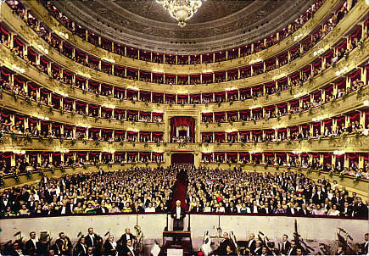
Opera Metaphor
Only art form for theatrical theater where words are almost all sung rather than spoken
Opera represents almost all features of Italian culture
Metaphor for Italy itself:
Music
Dramatic action
Public spectacle
Pageantry
Sense of fate

Slide 26
Overture
Typically five minutes long
Includes passages that are emotionally somber, cheerful, reflective and so forth
Various points during it can be quick, moderate, or slow in tempo
Low-Context ←-----------------→ High-Context
U.S. Americans Italian Asian

Slide 27
Regional Differences for Overture
Milan (north)-tendency to shorten overture
You can see the overture even in the smallest café
Sandwiches are presented in colorful and appetizing manner and various forms of espresso or coffee are displayed
May be few moments of conversation with the owner, but they are pleasant, like the display of food
In the south it can be much more involved

Slide 28
Pageantry & Spectacle
Italians are more animated and expressive than most other nationalities
Noise level in Italy is high in public places
People tend to congregate rather than isolate
Curtain goes up and audience is greeted by a set so visually stunning it elicits applause
P&S play such a big role in Italian life that people and things tend to be judged first on their appearances

Slide 29
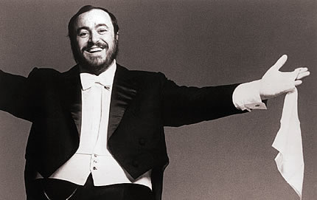
Pageantry (cont)
First purpose of the show is to make life acceptable and pleasant.
Italians try to make dull moments exciting & significant by decorating and ritualizing them

Slide 30
Garbo
Turns Italian life into a work of art
la bella figura- projection of “confident, knowing, capable face to the world”
Many Italians join clubs that let them temporary portray themselves as wealthy
Rent prestigious car
Collection of paintings on their walls for a party
1938 Hitler visited Rome

Slide 31
Pageantry of Italian life
View church much like the opera, as a source of drama and ritual but not authority
Italians do not let decisions be influenced by taste, hazards, or hopes
They prefer to look each other in the face so they can gauge the others position
Middle class people work when they have a profession, not while in school

Slide 32
Voice
bel canto
Loud Speech
Speech and Gesture
Hand Motions
Contentious Spirits
Flattery
Arguements

Slide 33
Externalization
Emotions
The View From the Piazza
La Bella Figura

Slide 34
Externalization (Cont.)
Family Ties
Gender Issues
Personal Style
Problematic Attitudes

Slide 35
Chorus and Soloists
A Culture of Death
Different Ways of Doing Business
Chorus and Culture

Slide 36
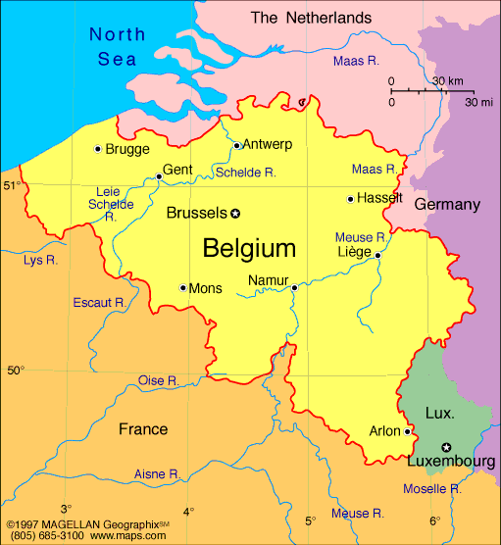
Belgium
Slightly larger than Maryland
Two major ethnic groups; Wallonians and Flemings

Slide 37
Wallonian Versus Flemish
Conflicts between Wallonians and Flemish
Systematic problem solving
Small federal government, lots of states
Protests are civil, and even humorous.

Slide 38
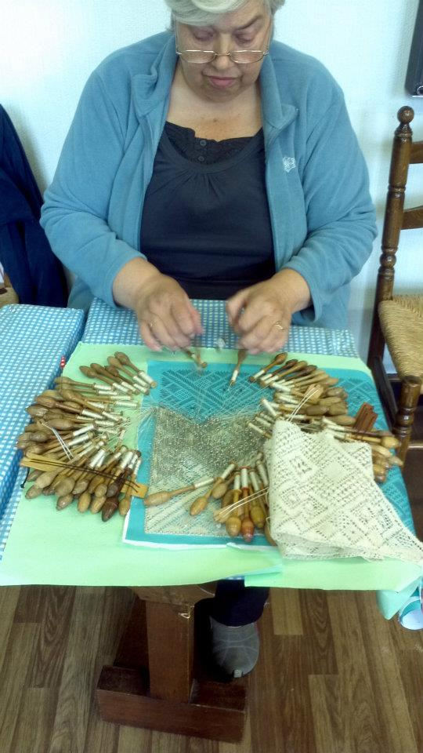
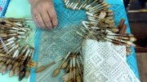
History of Lace
Lace is a metaphor for Belgium

Slide 39
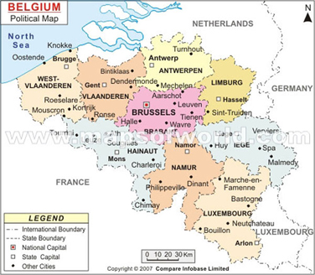
Land of Contrasts

Slide 40
Land of Three Languages
The Belgian government recognizes three languages
Flanders
Wallonia
Limburg
In Brussels business is conducted in Dutch, English, or French

Slide 41
Land of Three Languages cont.
5% of population is foreigners
In school
Native region language for 8 years
Second language for 4 years
Headstrong Belgians will communicate in English

Slide 42
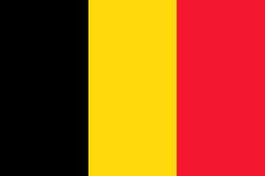
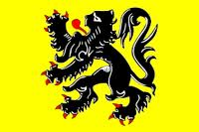
Region Versus Nation
Three flags
Belgium Flag
Wallonian Flag
Flanders Flag

Slide 43
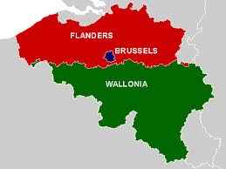

Slide 44
Individual Versus Group
Tend to be very Individualistic
Considered a major accomplishment to be established on their own
Aesthetic taste
Cleanliness
Ecological

Slide 45
Family Life
Very family oriented
Meals and activities
Sunday lunch
Vacations
Gender Roles
1.9 million of 4.4 million workers are women
Women in “non-male” occupations
Contradictions
The Catholic church

Slide 46
Industry and Business
Coal and steel subsidies
Salvageable?
Cultural differences
In 1830, Wallonians were the social elite, so French was considered the cultured language
Flanders economy surpassed that of Wallonia

Slide 47
Immigration Issues
Belgians prefer unemployment to menial labor
Immigrants are considered necessary, but temporary
Increasing amounts of immigrants

Slide 48
Urban Vs Rural Areas
Urban areas in Belgium
Rolling green hills with little white farmhouses
Does not seem like it has entered the 20th century
The cities in Belgian
Look like medieval fortresses with a wall surrounding them
Inside the cities, there is a further contrast between the modern industrial facilities and the grandeur of the older architecture.

Slide 49
Beauty Vs Practicality
The artistic history of the country is evidenced by the prominence of museums, theaters, and artistic venues.
Bokrijk is the largest museum in Belgium
Flemish art
Art in the churches
The study of artistic history is strongly supported by the school system
Battle of the Bulge

Slide 50
Control
Lace production requires strict and complex controls to avoid needless flaws, similar to the Belgian preference
According to Hofstede’s cross cultural study, Belgium ranked 6th in terms of avoiding uncertainty.
3x8 time schedule

Slide 51
Transportation
Political and linguistic borders are well defined and mapped
Belgium has designed the most immense transportation system in the world for its size because it has several ports
Hub-and-spoke fashion roads
Cobblestones roads

Slide 52
Social Rules
Belgians are formal in their interactions with others and employ a number of explicit rules
Formal titles
Gifts are given at any social visit
Require certainty and privacy in social settings and everyday life

Slide 53
Public Gatherings
Beer is cherished and a source of pride for Belgians
Frituur or french-fry maker’s shop
The complex government

Slide 54
Stress
Hofstede demonstrated a strong correlation between high uncertainty avoidance and high anxiety and stress
Doing society
Frequently have minor breakdowns

Slide 55
The middle road
Weather
Managers
Cooperative to a greater extent than they are competitive
Tax rates are the one of the highest in Western Europe

Slide 56
Negotiators
Peter Paul Rubens
International corporations

Slide 57
http://youtu.be/HebVrYwh6H4

Slide 58
Nigeria
http://upload.wikimedia.org/wikipedia/commons/3/30/Nigeria-Pos.png

Slide 59
Nigeria
Federal Republic of Nigeria
36 States
Capital- Abuja
7th most populous country in the world with majority black population
http://www.communicaid.com/access/pdf/library/culture/doing-business-in/Doing%20Business%20in%20Nigeria.pdf
http://www.state.gov/cms_images/nigeria_map_2007-worldfactbook.jpg

Slide 60
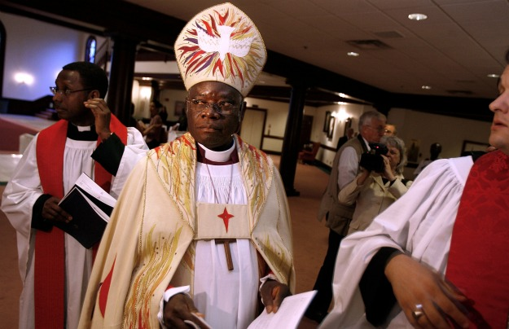
Demographics
Largest ethnic groups:
Hausa-Fulani
Igbo
Yoruba
Main Religions
Muslim
Christian
Tribal (traditional)
Languages
Official- English
Over 521 estimated spoken in Nigeria
http://www.foreignpolicy.com/files/fp_uploaded_images/101220_Nigeria.jpg
http://www.communicaid.com/access/pdf/library/culture/doing-business-in/Doing%20Business%20in%20Nigeria.pdf

Slide 61
Demographics
Population (2011 est)
About 20% African population lives in Nigeria
155,215,573
51.7% rural, 48.3% urban
Life expectancy- 47.56 years
Poor health care and general living conditions
http://www.indexmundi.com/nigeria/demographics_profile.html

Slide 62
Economy
Mixed economy
Middle income status (according to World Bank)
Second largest GDP in Africa
Oil is largest export
Supplies US with 8% total oil imports
5th largest exporter of goods to the U.S.
Member of OPEC since 1971
http://upload.wikimedia.org/wikipedia/commons/thumb/3/32/Naira_notes.jpg/252px-Naira_notes.jpg
http://en.wikipedia.org/wiki/Nigeria

Slide 63
Government
Democracy as of 1999
Modeled after US
Independence from Britain in 1960
Focus on liberation of African dignity
Leading role in fight against Apartheid regime in South Africa
http://www.mapsofworld.com/images/world-countries-flags/nigeria-flag.gif
http://en.wikipedia.org/wiki/Nigeria

Slide 64
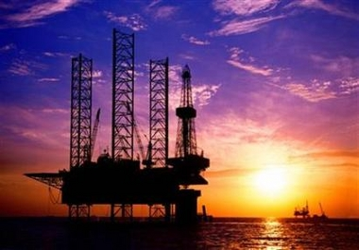
Business in Nigeria
Pros:
Most populous country in Africa
Rich in oil
Many natural resources
Good port facilities
Cons:
Political instability
Regional strife
Massive corruption
Poor infrastructure
http://www.usafricaonline.com/wp-content/uploads/2010/11/oil-rig-nigeria-reuters-file-pix12.jpg
http://www.worldbusinessculture.com/Business-in-Nigeria.html

Slide 65
Business Structures
Native Nigerian Companies:
Hierarchical tendencies
Culture rich in tribal tradition
Age is highly valued
Middle managers don’t have much power
Decisions made at the top
Relationship-oriented culture
http://www.worldbusinessculture.com/Business-in-Nigeria.html
http://drupal.in-cdn.net/cdn/article/public/working_in_nigeria_0.jpg

Slide 66
Management Style
Strong leaders
Executive decisions expected to be carried out exactly
Polite directions and instructions
Micro-managing
Managers take interest in employees’ personal lives
People ask for personal advice from boss
http://www.worldbusinessculture.com/Business-in-Nigeria.html

Slide 67
Meetings
Personal safety important
Phone meetings difficult
Include a lot of social interaction
Don’t usually start on time
http://www.worldbusinessculture.com/Business-in-Nigeria.html

Slide 68
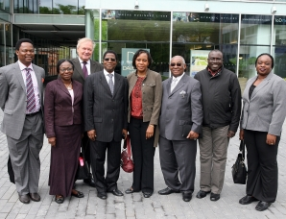
Teamwork
Team members need to feel comfortable with each other
Tensions close to the surface
Team usually stay together for other projects
Leaders need to clearly define each member’s roles and responsibilities
http://m.gmgrd.co.uk/sbres/704.$plit/C_67_article_2051834_body_articleblock_0_bodyimage.jpg?03%2F06%2F2009%2012%3A58%3A40%3A719
http://www.worldbusinessculture.com/Business-in-Nigeria.html

Slide 69
Communication Styles
300+ ethic groups with different languages
Respect shown through language and address
Personal life in business conversation is important
Long lingering handshakes is good
http://www.napmantronix.com/images/handshake.jpg
http://www.worldbusinessculture.com/Business-in-Nigeria.html

Slide 70
Women in Business
Debated issue
Many government initiatives to place women in management positions
Foreign female leaders treated with respect but not usually taken seriously by male colleagues
http://www.worldbusinessculture.com/Business-in-Nigeria.html
http://blogs.state.gov/images/Dipnote/behind_the_scenes/2010_0728_women_business_m.jpg

Slide 71
Education
6-3-3-4 Education policy
Adopted in 1982
Education is managed by the state
First 6 years of primary education are mandatory
31 Universities in Nigeria

Slide 72
Sports
Soccer is the Dominant Sport
Super Eagles
National soccer team
Adjudged best in Africa and top 10 in the world
U-20 Team won the bronze medal in the Junior World cup
Gold medal in the 1996 Olympics

Slide 73
Hakeem Olajuwan
http://www.youtube.com/watch?v=0GCyU0sKxqI

Slide 74
Hakeem Olajuwon
Born in Lagos, Nigeria
Jan 21, 1963
Yoruba
Soccer player in high school
Played basketball for the Houston Rockets
Won 2 back to back championships
“Dream Shake”

Slide 75
Chamillionare
Hakeem Seriki
Born November 28, 1979
Houston, Texas
Yoruba
Well known rapper

Slide 76
Tinie Tempah
Patrick Chukwuemeka Okogwu
Born in Plumstead, London, England
November 7, 1988
Ibo
Rapper from London

Slide 77
Nigerian Names
Rooted in religious traditions
Middle names will always have a special meaning
The entire family will name you
Naming ceremony
“Ayoola”-joy

Slide 78
Yoruba Names
Yoruba have high twin rates
“Taiwo” and “Kehinde” most common twin names
“Idowu”- means born after twins
Common prefixes
“Ade” typical royal family name
“Oba”- means King
“wu” is usually found in a last name

Slide 79
References
"Doing Business in Nigeria." - Nigerian Business Culture. Web. 28 Feb. 2012. <http://www.worldbusinessculture.com/Business-in-Nigeria.html>.
Nigeria: Africa's Emerging Business Opportunity. Worldbanknigeria, 19 Sept. 2011. Web. 27 Feb. 2012. <http://youtu.be/HebVrYwh6H4>.
"Nigeria." Wikipedia. Wikimedia Foundation, 27 Feb. 2012. Web. 28 Feb. 2012. <http://en.wikipedia.org/wiki/Nigeria>.
11EDmanLV. "Hakeem Olajuwon Top 10 Career Plays." YouTube. YouTube, 19 Mar. 2009. Web. 05 Mar. 2012. <http://www.youtube.com/watch?v=0GCyU0sKxqI>.

