Slide 1
General Motors
Phillip Dalen, Kent Ingram, Tyler McGinnis, John Minnot, Brittany Sanford, Brittany Self, Lauren Tarpley, and Cole Taylor

Slide 2
Introduction
History and Heritage of GM
GM’s Involvement in Mexico
Expatriate Interview
Repatriate Interview
Innovation
Design and Technology
Environment
Community and Education
Quality and Design
Future of GM
Notes:
**Paradox 4 communicating across cultures (quoted in intro)** Being fluent in the language and understanding the nuances of a new culture are both important, generally takes much more time to become fluent than to understand a culture’s history, norms, customs, and so forth.
**add to expat slide** paradox 5 crossing cultures,(quoted in conclusion) expats confront many paradoxes when working in the host culture, including feeling powerless and powerful, giving up some values and strengthening core values, and being at home everywhere but fitting in nowhere

Slide 3
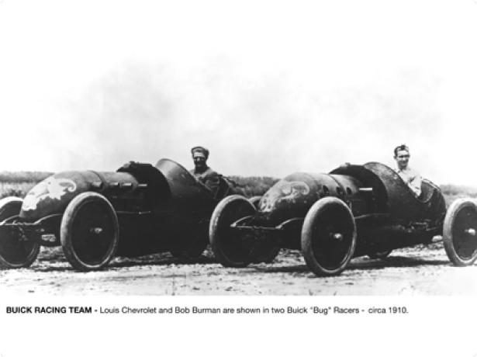
GM History: Creation: 1897-1909
GM History: Acceleration: 1910-1929
Early 20th century
Fewer than 8,000 automobiles in America
First New York Auto Show in 1900
General Motors was founded by William “Billy” Durant on September 16, 1908
As demand for automobiles grew to unexpected heights in the 1920s, General Motors set the pace of production, design, and marketing innovation for others to follow.
1927 Cadillac LaSalle
Designed by Harley Earl
World apart from the high and boxy Ford Model T
Notes:
GM History Creation: At the beginning of the twentieth century, there were only 8,000 automobiles on the roads in the United States. In 1900 at the New York Auto Show, Americans unexpectedly became more drawn to the idea of owning their own automobile. On September 16, 1908, William “Billy” Durant founded General Motors Durant in Flint, Michigan, becoming an instant leader in the manufacturing industry.
GM History Acceleration: GM led the automobile industry in innovation with a milestone in 1927 by creating the Cadillac LaSalle, with curves rather than sharp corners and a long, low stance. The Cadillac LaSalle, designed by Harley Earl, went beyond transportation by making a statement within the automobile industry.

Slide 4
GM History: Emotion: 1930-1959
GM History: Revolution: 1960-1979
During the war GM supplied the Allies with more goods than any other company.
GM delivered more than $12 billion worth of materials including airplanes, trucks and tanks.
In 1971, GM created engines that could run on low-lead or unleaded gasoline
Two years later, air bags invented
Notes:
GM History Emotion: During the war, President Roosevelt chose GM President, William Knudsen, as Chairman of the new Wartime Office of Production Management because General Motors supplied the Allies with an abundance of supplies. GM provided one hundred percent support of the Allies by 1942, by donating more than $12 billion worth of war materials.
GM History Revolution: Environmental issues arose in the 1960’s and 1970’s forcing GM to increase prices. Soon General Motors introduced automobiles that were able to operate on unleaded gasoline. Two years later in 1973, GM invented the air. Air bags are now a standard safety feature in every automobile.

Slide 5
GM History: Globalization 1980-1999
GM History: Innovation & Challenges 2000-Present
New complex in Zaragoza, Spain
Annual vehicle sales outside North America exceeded three million units
Five million vehicles were sold in the United States
GM is smaller, leaner company than its predecessor
More than 70 percent of its sales now come from outside the U.S.
In 2010, GM Mexico celebrated 75 years as the nation’s largest auto industry investor, producer and exporter in the nation’s history.
Notes:
GM History Globalization: In 1982, General Motors expanded outside of North America and into Zaragonza, Spain. Immediately, the Spain facility began producing he fuel-efficient Opel Corsa. The 1980’s and 1990’s marked joint ventures in China and India, as well as the additions of Saab and HUMMER to GM. General Motors now is being sold worldwide. In 1995, GM sold a record breaking three million units outside of North America, and five million units were sold in the United States that year.
GM History Innovation: The new General Motors is smaller with four major brands, Chevrolet, Buick, GMC, and Cadillac. GM continues to grow outside of the United States with more than 70 percent of its sales outside of North America. In 2010, GM in Mexico celebrated 75 years as the nation’s largest auto industry investor, producer and exporter in the nation’s history. General Motors in Mexico has produced 7 million vehicles, 20 million engines, 4 million transmissions and 1.5 million tons of foundry materials since the beginning of operations.

Slide 6
Expatriate Interview Questions
Interview of Bob Sanford
Director of After Sales
Mexico, Caribbean, Central America
September 2011 to Present

Slide 7
Business in Mexico
Surprised about work ethic
Staying until 8:00pm to finish work
“Aha” Moment
Careful on sharing opinions/thoughts
Supervise 12 Managers
Language difficulties at first
Experience has changed him
More patient and understanding to delays
Not confrontational, laid back, slower paced
Notes:
Work ethic-
Bob always goes in early and leaves on time
Mexican co-workers go in late and leave as late as 8pm to finish work
Don’t find that in US
Aha moment
Bob would share opinion or thoughts: “we should look into this” and found his mangers were already looking at it
They didn’t take it as his thoughts, took it as directive
Has to be careful about sharing ideas
Supervising
All employees are bilingual
At first couldn’t tell if managers were speaking English or Spanish because English was broken with thick accent
Some things still get lost in translation but his ear is getting better for the language
Experience
The culture is non confrontational, laid back and slower paced causing him to be patient and understanding to delays

Slide 8
Preparation/Support
Go-See
10 day visit
Language lessons
Employee and spouse
GM security department
Network of support
Expatriates
ADMIN
Managers
Advisors
Financial
Paperwork
Notes:
Go-see
Prior to accepting job, GM sent Bob and his wife on a look-see which is a 10 day paid visit to see if it is something they are comfortable with.
Meet the management, manager who previously had the position, look at housing options
Language lessons
Rosetta Stone as well as tutoring offered to both the manager and his/her spouse
GM security department
Spent time with Bob to ensure he know what was important and what precautions they take to ensure maximum security
This was important to him since all the negative associations with security and Mexico
Network of support
Expatriates- personal side- told him how to fit in, how to adjust, best practices, and what they learned when they came
ADMIN- Administrative assistant- handled his schedule, acted as gatekeeper preventing him from being “lost”
Manager- traveled with them and learned how the business was done. He watched actions and learned from them
Advisors
Financial advisors helping with transition
People to help process/fill-out/translate the paperwork

Slide 9
Reflection
Suggestions to future expatriates
Patience
Learn the culture
Suggestions for HR department
Continue support
Quick responses
Notes:
Future expats
Patience because it is going to be difficult and frustrating at first
Need the support of the culture, need to respect and learn it so that it is a smooth transition
HR department
Continue the language, go-see, financial/paperwork advisors, security support
Be better at quick responses
Have lots of questions that require fast responses so decision can be made

Slide 10
GM’s Involvement in Mexico
GM factory in Mexico opened in 1935
GM built three engine and vehicle plants in 60’s and 70’s
11,500 Direct and 90,000 Indirect Employees
Invested $4.1 billion in Mexico
Three factories producing vehilces
Near 50 just producing parts
Notes:
After 1962 Mexican law required foreign automakers to increase the local content of their vehicles, GM built three engine and vehicle plants in 60’s and 70’s
GM Mexico operations include 11,500 Direct and 90,000 Indirect Employees
As of 2010 GM Invested $4.1 billion in Mexico over previous 4 years.

Slide 11
The Experience of a Repatriate

Slide 12
Background Information
Name: Ann Ihde
Title: Strategic Planning Manager
Location: Mexico City
Duration: 4 years
Time Frame: March 1998 to March 2002

Slide 13
Before Ann Left for Mexico
Chosen because of her background in market research, planning, and long term sales forecasting.
GM needed people in Mexico who had knowledge of U.S. processes.
Underwent a cultural awareness class
Was inadequate and out-of-date

Slide 14
Her Time in Mexico
Was able to take on new responsibilities in Mexico.
Was responsible for bringing the Saab brand to the Mexican market
During that project, Ann learned “learned a lot about the culture and how decisions are made in Mexico and being a female executive in a predominately male Latin culture.”
Notes:
At first her decisions were not taken seriously, and her Mexican subordinates often looked for male supervision.

Slide 15
Her Time in Mexico
Involved in a car accident that shaped her view of Mexican culture.
Began to focus on the familial nature of Mexican workers.
Led to an increase in respect and trust.
Became attached to her subordinates
Her group relied on each other in difficult times.
Notes:
Difficult times: A worker in her group died of cancer while Ann was in Mexico.

Slide 16
The Return
Ann had trouble readjusting to life in America.
Had difficulty with the post 9/11 patriotism
GM did not capitalize on her experience and knowledge
Transferred to a position where her experience was largely irrelevant

Slide 17
Her Insights
Believes repatriates fail to transfer knowledge because of groupthink.
Employees who did not work abroad rely on stereotypes and misconceptions.
Believes GM failed in her repatriation process.

Slide 18
Recommendations
Return should be to a position in which knowledge of another country/market can be readily used.
Follow-up should be done with the expat after 3 months, 6 months and a year to ask about how knowledge transfer is going and how their knowledge could be better utilized.

Slide 19
Recommendations
Upon initial return, there should be 1-on-1 meetings between the expat and their new manager
GM should provide a class that helps repatriates learn how to effectively share their experiences, and also helps them to assimilate back into America.

Slide 20
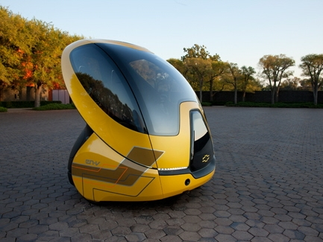
Design and Technology
New Advances
Electric Vehicles
Autonomous Driving
Mobile Applications
The Chevrolet EN-V concept, which stands for electric networked vehicle, can avoid crashes, doesn't use gasoline and can drive and park

Slide 21
Environment
More Fuel Efficient Vehicles
Preserving Resources
Water Conservation
Saving Habitats

Slide 22
Education
GM Educational Website
Divided by grade and age.
Interactive games and activities that are age appropriate.
All geared toward careers in Science, Technology, Engineering and Math.

Slide 23
Community
Buick Achievers Scholarship program
Awarded $4.5 million in 2011 to 1100 students.
Easy to apply.
FIRST
Robotics competition divided by grade and age.
LEGOs to start, real robots to finish.
Notes:
Anyone can apply for the scholarship, but special consideration is given to first generation college goers, minorities, female students and military veterans.
FIRST—For Inspiration and Recognition of Science and Technology.
The robotics competition starts with grades K-3 and goes all the way to high school seniors. The K-3 students begin with LEGO building while the high school students may compete in actual robot buildin.

Slide 24
Safety
GM and OnStar
In car diagnostics checks.
Advanced alert to authorities in case of a crash.
Working on Accident Avoidance
GM and StabiliTrak
Helps the driver in hazardous conditions: Ice, Snow, Rain, etc.
Notes:
. OnStar and GM have the ability to alert authorities that you’ve been in a wreck just milliseconds after it happens. GM is also working with OnStar on crash avoidance. This begins with OnStar diagnostics. The OnStar program has the ability to tell you if anything is wrong with your vehicle while you’re in the vehicle.
StabiliTrak, a system that has proven to decrease the amount of single vehicle crashes in low traction conditions such as ice, snow, rain and slick pavement.

Slide 25
Quality
2012 Acadia—Best Value among SUV’s $30,000-$45,000.
Chevrolet Express 4500—Head to head victory against Ford E-450.
Cadillac most improved in luxury category.

Slide 26
Future – Past Financials
Restructuring in 2009-10
Filed for Chapter 11 reorganization
$13.8 Billion from Bush Administration
$34 Billion from Obama Administration
Nov. 18, 2010 Initial Public Offering (IPO)
Top 5 largest in U.S.
$20.1 Billion

Slide 27
Future – Strategic Change
GM shut down Daewoo in South Korea
Introduced Chevrolet brand for increased brand awareness in international market
GM ventures into hybrid and zero-gasoline vehicles; ex. Chevrolet Volt platform
GM appeals to European market and carries trends into North America with clean diesel cars
Notes:
With the restructuring, GM had to change a lot of things. GM shut down several brands prior to the restructuring, which many believe was the precursor for shutting Daewoo down in South Korea.

Slide 28
Future – Current Financials
GM made $7.6 billion in 2011, a 62% gain over the prior year (2010)
IPO stock price: $33.00
Current Price: $23.01 (April 30, 2012)
GM investor confidence still on a declining trend
GM strives to build major brands in foreign markets and phase out smaller, less productive makes and models

