Slide 1
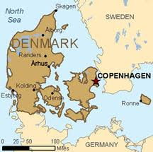
Denmark

Slide 2
Misconception about Denmark
Interesting Facts on Denmark

Slide 3
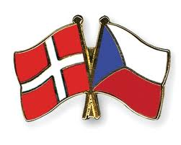
Comparisons
Denmark
Area: 46,094 Sq. Km
Population: 5,543,453
Government: Constitutional Monarchy
Helle Thorning-Schmidt, from the Social Democrats is the Prime Minister
GDP: $208.8 billion
Czech Republic
Area: About 25,000 less km than Czech republic
Population: 10,177,300
Government: Parliamentary Democracy
GDP: $272.2 Billion
Notes:
The monarch is the head of state. The prime minister, who is the head of government, is appointed by the monarch with the approval of the People's Assembly.
Their government is is based on consensus politics. Since 1909, no single party has had the majority in Parliament.

Slide 4
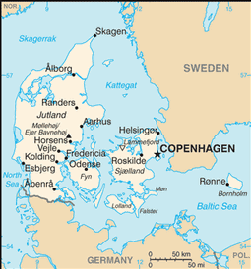
Geography and Climate
46,094 Sq. Km.
Composed of 406 several islands
Smallest of the Scandinavian countries
Rainy, humid, overcast,
windy winters and
cool summers
Notes:
slightly less than twice the size of Massachusetts
Situated just north of Germany and nearby Sweden and Norway.
Rains about a 1/3rd of the days throughout the year. Known for having dreary days

Slide 5
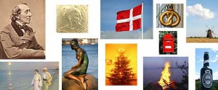
A Little Bit of History
Unification of the country in d. 987 by Harold I Bluetooth.
Viking Age, c. 800-1100
Queen Margrethe I of Denmark united Denmark, Norway, and Sweden in 1397
During WW2 Germany invaded both Norway and Denmark
Became part of the United Nations in 1945, NATO in 1949 and the European Community (now the EU) in 1972
History of Scandinavia (Sweden,Norway,Denmark)
Notes:
Transformation from brutal Vikings to a much more tame and relatively quiet country.
Unification was after hundreds of years of invasions from the south.
Viking Age was characterized by the frequent Viking expeditions which led to the conquest of England for a short period in the 11th century and took the pillaging Vikings as far away as Ireland, Northern France and Russia. Danish Viking kings never managed to turn their conquests into a lasting empire. The murder of Canute IV the Holy in 1086 ended the strong royal power, which had been one of the secrets behind the victorious Viking expeditions.
The Kalmar Union
-The Black Death, around 1350, wiped out a large part of the Danish population, which resulted in major economic and social changes. This led to the Kalmar Union.
Norway belonged to Denmark until 1814 as did most of southernmost Sweden until 1658. . Between the 13th and 17th centuries, Denmark was a superpower whose influence was as powerful as that of the largest European countries.
During WW2 Germany invaded both Norway and Denmark. The German military demanded that all Jews in the nation wear armbands identifying themselves as Jewish. The Danes attempted to secretly transport all Jews out of the country to the safety of Sweden. They saved about 95% of the Jewish residents. Denmark has never won a war.

Slide 6
Economy
Member of the EU
Kroner
Free health care, and subsidized child and elder care
Modern market economy
High-tech agricultural sector
World-leading firms in pharmaceuticals, maritime shipping and renewable energy
High dependence on foreign trade
Notes:
The Kroner is about 5 per US dollar. Although they are a member of the EU, they refused to replace the Krone with the Euro.
Danish economy is characterized by extensive government welfare measures and an equitable distribution of income. Denmark is a net exporter of food and energy but very dependent on imports of raw materials for the manufacturing sector. Extremely strong supporter of trade liberalization.
GDP per capita is ranked 22nd in the world. Comparison the czech republic is 52nd.

Slide 7
Involvement in the EU
“Footnote” member
Within the EU, Denmark is among the strongest supporters of trade liberalization
Denmark will occupy the EU presidency during the first half of 2012
Notes:
Known as a footnote member because of all the items to which it would not give full approval, thus requiring footnotes noting Danish disapproval.
Promoting priorities involving a responsible, dynamic, green, and safe Europe. In addition, one of Denmark's most important objectives will be to help steer Europe out of its euro zone economic crisis

Slide 8
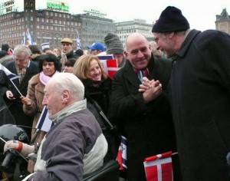
People
Population: 5.4 Million
Language:
Danish, Faroese, Greenlandic (an Inuit dialect), German (small minority)
Religion:
Evangelical Lutheran (official) 95%, other Christian (includes Protestant and Roman Catholic) 3%, Muslim 2%
Attend church on a regular basis
Notes:
Half the size of the czech repulic. Comparison, us has about 330 million. Its major city is copenhagen which has about 1 million people
English is the predominant second language. Closely resemble Swedish and Norwegian, Danish is very different.

Slide 9
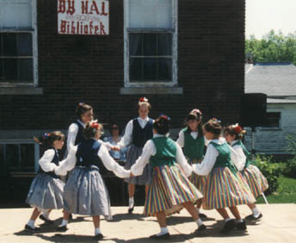
Culture
Interdependent Individualistic Nation
Equality
Happiest place on earth
Relaxed approach to life
Emotional expressiveness and outlandish behavior
“Italians” of Scandinavia
Notes:
Hofstede ranks then 9th of 53 nations fir being individualistic. However, due to its size, geography and historical experiences, more often referred to as a Interdependent Individualistic nation. They were ranked low on in-group collectivism but high on societal institutional collectivism.
While surveying international happiness, Denmark was proven to be the happiest. Very modest with expectations. Known for the simplicity and practicality of their furniture.
Even if Danes are wealthy, they play down this aspect of their lives, thus deemphasizing power distance. Part of this comes from the Lutheranism culture.
Very satisied and don’t have high expectations. Ex. Garbage man
Controlled in terms of emotional expressiveness and outlandish behavior compared to many other cultures, although the Danes are more expressive than other Scandinavians.

Slide 10
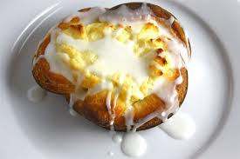
Danish Food
Breakfast(morgenmad): Coffee, bread
Lunch(frokost): Open-faced sandwiches
Dinner(aftensmad): American influence, soup, seafood and variations of meat
Dessert: Danish, cookies and layered cake
Notes:
Breakfast: Variety of bread slices and rolls with
Lunch: Variety of cold cut meats with spread made from a pigs liver. Fast lunch
Dinner: BBQs, pizza, and frozen dinners. Soup for dinner, seafood is prominent in most of their dishes. Meatballs, grilled lamb, steak, roasted goose and duck. Varies sides such as salads, vegetables and bread.
Danish: Originated from Vienna. There was a strike among the bakeries in 1850. This caused the bakeries to hire many foreign workers, and several of these were Austrian bakers. They started making pastries from there hometown, the Danes modified the recipe by adding more fat and its what is now know as the Danish.

Slide 11
Conducting Business
High tax
Janteloven
Hierarchy of Business
Labor Market
Flexicurity
Still having troubles with unemployment due to the recession
Notes:
Low-skilled immigrants consume a dispropotionate share of the public services and although the Danes get a lot back for their taxes, there is not much margin for complications like unemployment.
Danish businesses tend to have flat hierarchies. Employees rely less on personal power
and authority and managers are seen more as team leader or coach. Social barriers between managers and their employees are regarded as unnatural and
undesirable.
This concept of janteloven states: Don’t think you are better than us or that you are special. The primary consensus believes it is meant promote social equality and fairness, two qualities for which Scandinavian societies are well known for. Perhaps hearing about these concepts over and over again really has engrained the idea into Scandinavian society. Some say Janteloven is a serious obstacle that inhibits Norwegians from high achievements and seeking to stand out. This concept states that companies may be open to innovative ideas from their users; in business this provides a fertile ground for citizen-driven product design.
Unemployment levels were historically low until the recession and now they are staying at 6%.
Denmark has the most flexible labour market in Europe; the policy is called flexicurity. Flexicurity essentially provides substantial unemployment and welfare benefits but imposes very few restirctions on hiring and firing by employers. Some of the elements of flexicurity include full employment, equal wages among different sectors and wage and unemployment subsides. Denmark has the world's lowest level of income inequality, according to the UN, and the world's highest minimum wage, according to the IMF. Faces an increasing high shortage of labor. Bc they take advantage of the great education in Denmark and move to other countriess where the taxes are much lower. Also, parents are only required to work 80% of a full timetable if they wish.

Slide 12
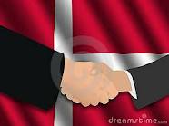
Need to Know Business Facts
Communication
Direct
Interrupt
Humor
Consensus
Punctuality is very important
Notes:
Direct when dealing with business. They very much prefer openness and honesty. This may be offensive to foreigners. Leave small talk to a later time and get straight to business. Don’t interrupt, appreicate dry humor (make gifts for embarrassment) but don’t use irony and sarcasm.
All relationships are valued and they value equality. As a result, Danish people prefer to resolve conflicts by comparison and negotiation so you will often find your Danish counterparts will strive for a win-win solution. Decision-making tends to involve a lot of people, but consensus is not always necessary. Danish do expect to be able to share their ideas and opinions. DON’T be too aggressive in your negotiation and communication style. Danes will be suspicious of this approach and you may lose their trust and confidence in you.
Important to be on time and ready to work

Slide 13
Danish Quiz
1. It’s okay to make jokes about the Royal Family
2. There is no word for ’please’ in Danish.
3. Danes are very competitive workers.
4. Danish business life is marked by a guild system.
5. Danish have a laidback business style.

Slide 14
Answers
1. False. One should not criticize the Royal Family as Danes are very proud of their monarchy
and look up to Queen Margrethe II.
2. True. Instead, the listener has to rely on context and intonation to understand what is meant.
3. False. Although Danes are very efficient workers, they would rather co-operate than take a very competitive stance. Despite working hard, the business style is rather laidback. This also underlines the importance of the family life in Denmark.
4. True. The guild system is an association of skilled workers in special fields. Unemployment pay is provided so the labor market is rather inflexible and jobs are quite stable.
5. True. Danes also have a lot of patience and will spend as much time as necessary finding solutions.

Slide 15
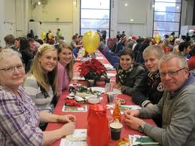
Christmas Luncheon
Julefrokost
Business family
Notes:
Book uses this as an example to provide a unique insight into the Danish culture
The company provides the alcohol while the employees provide the food. Start around noon and end at 2 or 3 am.
Engage in inappropriate and possibly hostile expression of feelings toward the organization, its management and other employees. Not uncommon to have overt sexual overtures and extramarital affairs at the party.
Most Denmark employees reside in the same city and work for the same organization all of their lives. This provides a sense of continuity and history that is lacking in many American organizations. This also reinforces Denmark’s culture of workplace collaboration, which produces win-win outcomes for both corporations and their employees

Slide 16
References
https://www.cia.gov/library/publications/the-world-factbook/geos/da.html
http://www.communicaid.com/access/pdf/library/culture/doing-business-in/Doing%20Business%20in%20Denmark.pdf
http://www.denmark.dk/en/menu/About-Denmark/History/
http://www.denmark.dk/NR/rdonlyres/E0AE5FAD-227C-4C99-8999-59E160377338/0/History.pdf
http://www.infoplease.com/ce6/world/A0857732.html

Slide 17
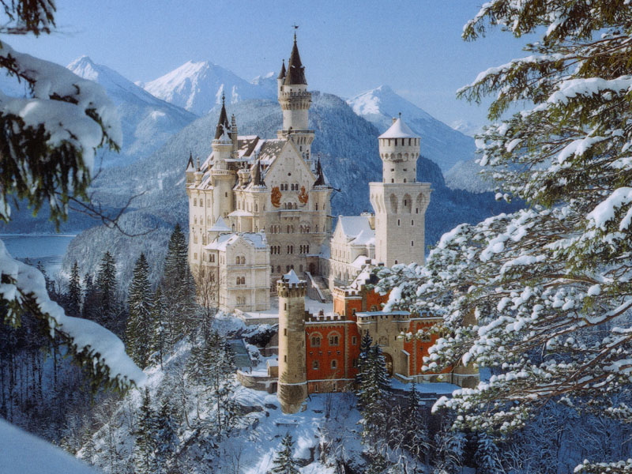
Germany

Slide 19
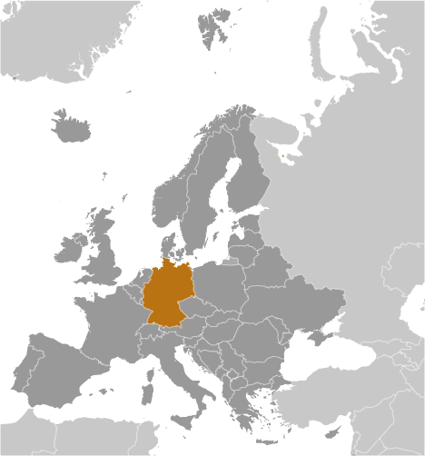
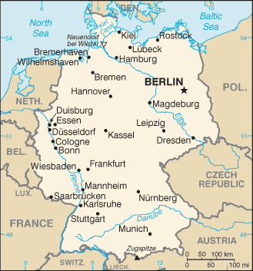
Area: 357,022 sq km

Slide 20
People and Society
Population: 81,305,856
Ethnic Groups:
German: 91.5%, Turkish: 2.4%, other (Greek, Italian, Polish, Serb, Spanish): 6.1%
Religions:
Protestant: 34%, Roman Catholic: 34%, Muslim 3.4%, unaffiliated or other: 28.3%
Notes:
Europe’s second largest populous country

Slide 21
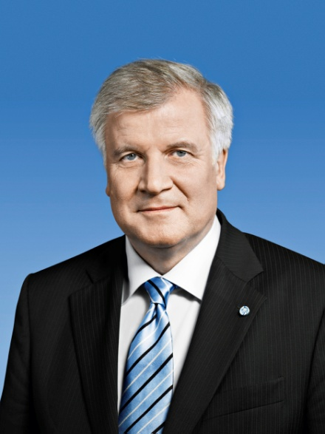
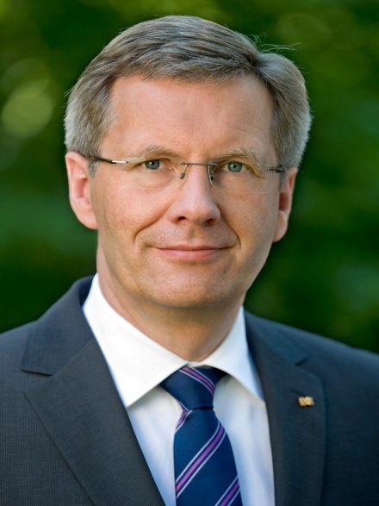
Government
Capital: Berlin
Government type: Federal Confederation
16 states: act independently of one another
Current President: Horst Seehofer
Previous President: Christian Wulff

Slide 22
Economy
5th largest economy in the world
Europe’s largest economy
Europe’s largest exporter economy
machinery, vehicles, chemicals, and household equipment
GDP: $3.085 trillion

Slide 23
History
Defeated by Hermann the Great- 109 BC
Detested these “uncouth” people
German- derogatory term
Frederick the Great- 1740-1780
Strong Prussia emerged
Integration of small kingdoms - 1871

Slide 24
History
First Reich
8th Century rule of Charlemagne
Leader of the Holy Roman Empire
Second Reich
Becomes nation for the first time- 1871
Marked by militarism and economic growth
Emphasis on education and culture

Slide 25
History
Third Reich
Hitler
World War II
Hitler's speech
Postwar Evolution
1945- Allies take over
Marshall Plan of 1947
1980s- antimilitaristic

Slide 26
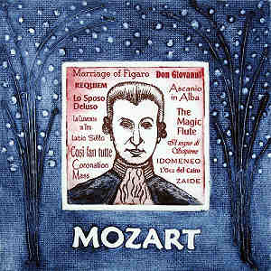
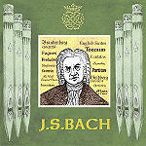
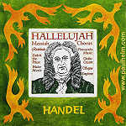
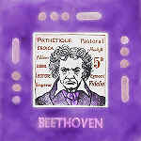
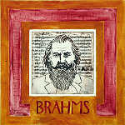
German Symphony
Created in German territories in the 16th century
Famous Composers:
Haydn, Mozart, Bach, Handel, Beethoven, Brahms
Beethoven

Slide 27
German Symphony
Orchestra- single instruments united
society
Conductor- brings instruments together
leader

Slide 28
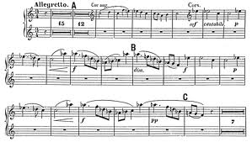
How is Germany like a symphony?
Diversity of musical instruments
Positional arrangements of musicians
Conductor or leader
Precision and synchronicity
Unified sound
Unfinished nature of genre

Slide 29
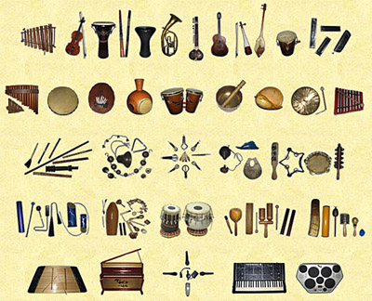
Diversity of Musical Instruments

Slide 30
Diversity of Musical Instruments
Divided into variety of ethnic and religious groups
Each group has evolved separately
Number of foreigners:
Before WWII- 500,000
After WWII- 6.7 million

Slide 31
Diversity of Musical Instruments
Germany not a “melting pot”
Families stay in same geographic region and even same house
Don’t interact with strangers
Treat foreigners with wariness

Slide 32
Diversity of Musical Instruments
Geography
South (Bavaria): sunny and warm
Heavily Catholic
North: cold
Protestant
City
Frankfurt: like American City
Most diverse city
Dorfen: small village
Notes:
Pg 184

Slide 33
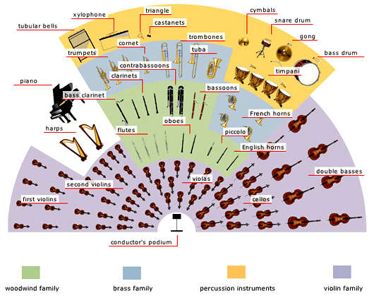
Positional Arrangement of Musicians

Slide 34
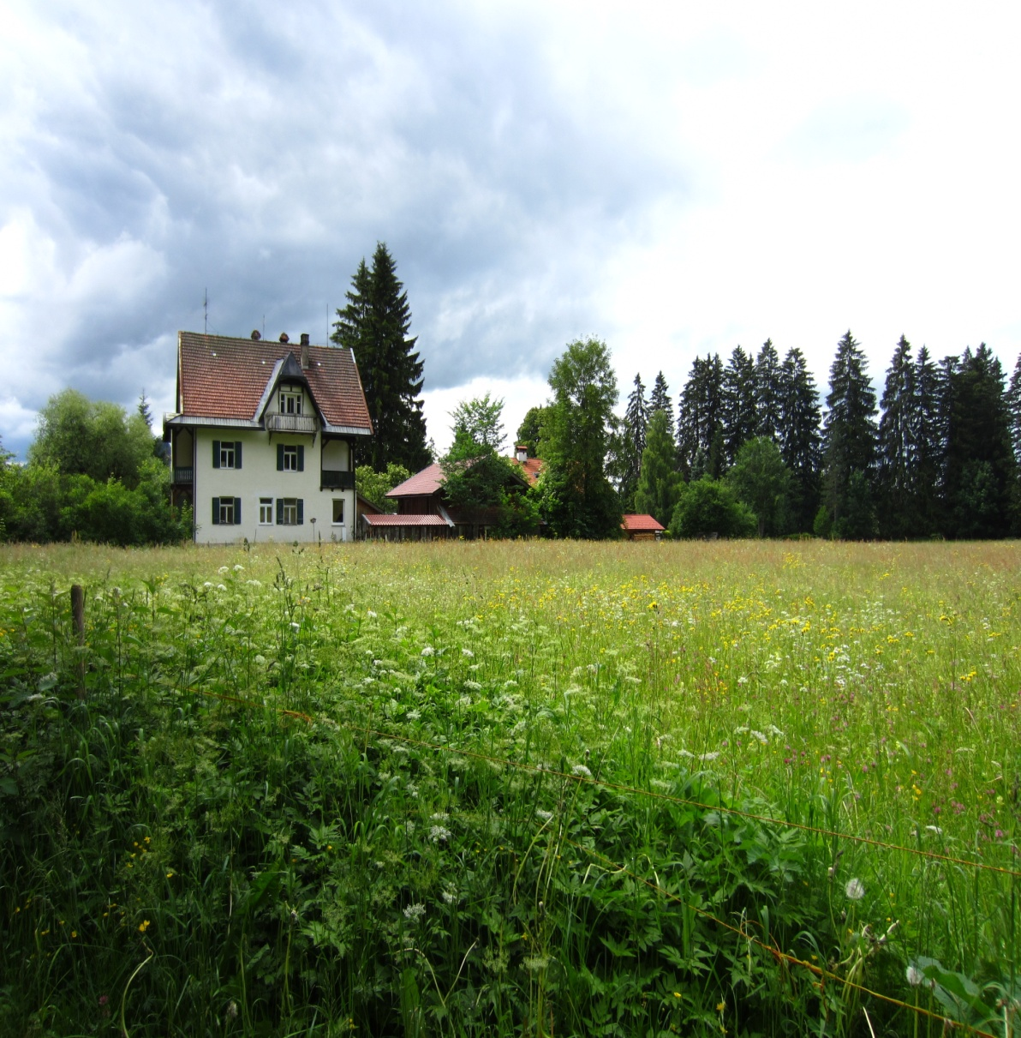
Positional Arrangement of Musicians
Crowded
Germany: 230.5 residents per sq kilometer
US: 31.7 residents per sq kilometer
Home (das Heim) as a haven
Notes:
Much like the stage of the orchestra is crowded- so is germany
P186
Protected from outsiders -Barriers: fences, walls, hedges, solid doors, blinds, shutters,
Prideful in their homes- keep spotless

Slide 35
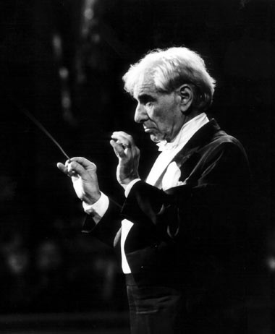
Conductors and Leaders

Slide 36
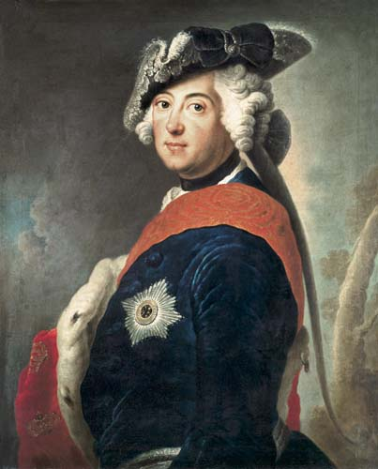
Conductors and Leaders
Frederick the Great
created basis of German nation
Well-rounded:
studied art, music, and literature
Wrote poetry, played the flute, and composed sonatas
Epitome of great German leader
Notes:
Like conductors- german leaders have provided direction and guidance to an often fragmented state p 189

Slide 37
Conductors and Leaders
Like Frederick, German CEOs are well-rounded and independent
75% of German Industrial CEOs hold doctorates
Manage by pushing subordinates to perform but do not hover
Notes:
p190

Slide 38
Precision and Synchronicity

Slide 39
Precision and Synchronicity
Conscious of time and efficient allocation
Tardiness unacceptable
Preferably show up 5 minutes before
Meetings and negotiations
long and have well-marked stages
Notes:
Pg 192

Slide 40
Precision and Synchronicity
Communication:
Directly express ideas both in written or oral form
Very literal
Problem Solving:
Use deductive thinking: relies on past history and theory
Notes:
Pg 193- let’s do dinner- actually showed up

Slide 41
Precision and Synchronicity
Festivals and Celebrations
Typical festivals: beer drinking, abundant food, brass bands, dancing, and colorful parades
Sporting Events
Tennis
Soccer
Notes:
Just like the orchestra unites individual instruments- festivals unite the german population

Slide 42
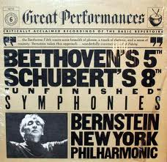
Unfinished Symphony

Slide 43
Unfinished Symphony
Continuation of population diversity
Generational clashes
Leadership roles
EU and NATO
Notes:
Like many of the famous unfinished symphonies composed by beethoven and brahms… Germany too is a work in progress

Slide 44
Doing Business in Germany Take-aways
Show up 5 minutes early
Start with history
Be prepared for a long meeting
Get to the point

Slide 45
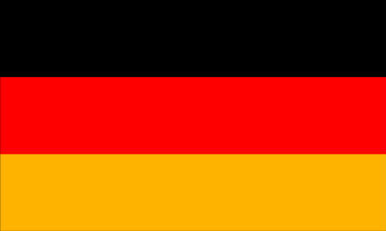
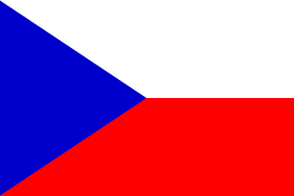
Comparison
Germany
Area: 257,022 sq km
Population: 81,305,856
Government: Federal Confederation
GDP: $3.085 trillion
Czech Republic
Area: 78,867 sq km
Population: 10,177,300
Government: Parliamentary Democracy
GDP: $272.2 billion

Slide 46
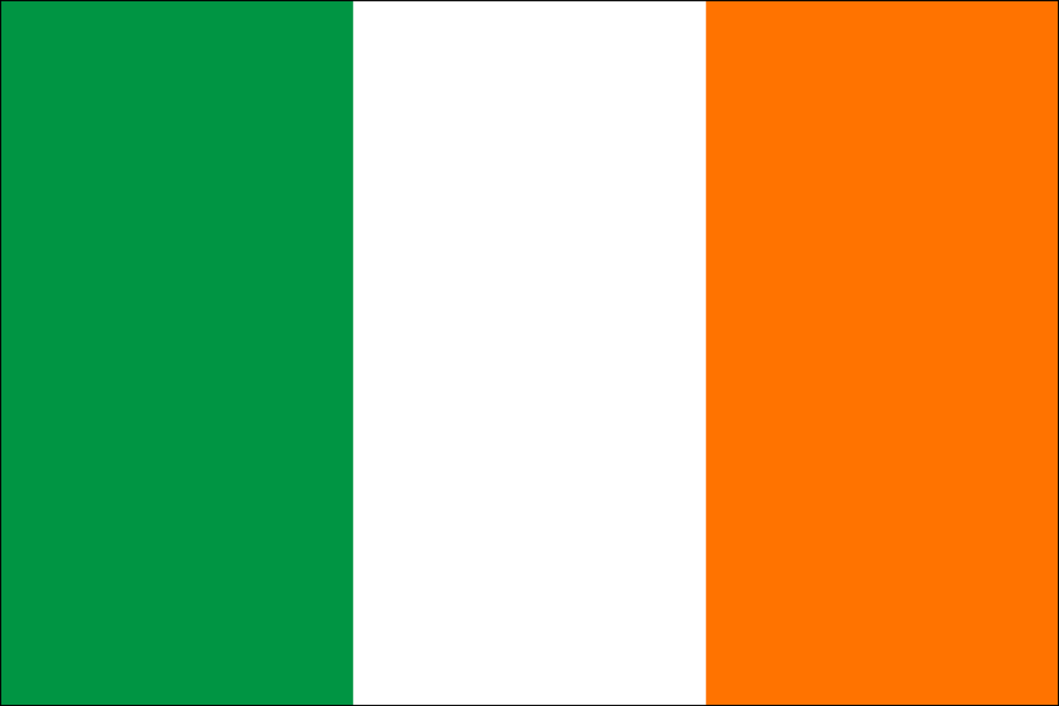
Ireland

Slide 47
General
Republic of Ireland
Northern Ireland is considered part of the United Kingdom
Constitutional Parliamentary Republic
Population of 4,581,269 according to the 2011 census
Part of the European Union as well as the Euro Zone

Slide 48
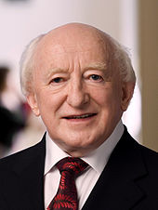
General
Capital City is Dublin
44% claim they attend Sunday Mass regularly and 90% claim they are Catholic
Religious aspects could play into some types of business
Current president is Michael D. Higgins. Took office in November 2011.

Slide 49
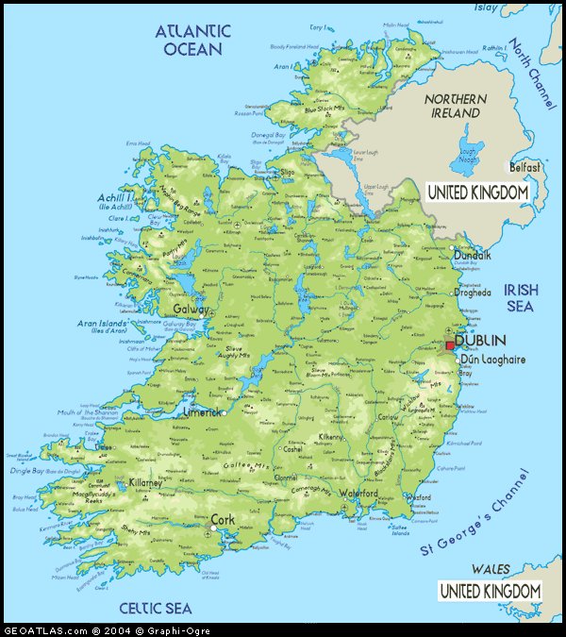
Geography and Climate
Covers approximately 5/6 of the island of Ireland
Western part is cliffs and mountains
Central part is lowlands
Emerald Isle

Slide 50
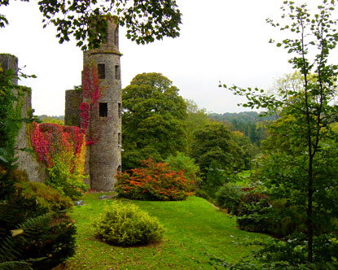
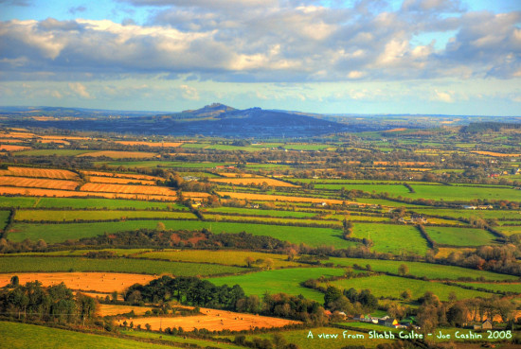
Scenery
http://www.youtube.com/watch?v=qZ_HfH60-c0

Slide 51
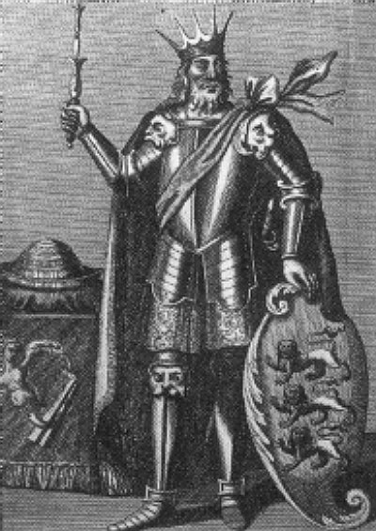
Early History
The Celts conquered Ireland around 700 B.C.
Ireland was split into various kingdoms.
Had a Golden Age of learning and scholarship
Viking started raiding the coast of Ireland around 800 AD.
Brian Boru
English Involvement
Potato Famine

Slide 52
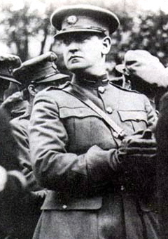
History
Easter Revolution of 1916
War for Independence from 1919-1922
Anglo-Irish Treaty established Republic of Ireland
Formation of IRA
Michael Collins
Partition of Ireland in 1920
Civil War from 1922-1923
Officially withdrew from Commonwealth in 1949
Became a member of UN in 1955
Did poorly economically until the 1980’s

Slide 53
Culture
Folk Music
Literature
James Joyce
St. Patrick’s Day
Stepdance
http://www.youtube.com/watch?v=W22gpBv00gg
Mythology
Leprechauns

Slide 54
Religion
The role of the Catholic Church has been diminished, but still quite prevalent.
The national school system is still under the control of the Church. (Catholic or Protestant)
Costs are lower, but religion is thoroughly woven into education.

Slide 55
Religion
The Church is able to instill their beliefs starting at a young age.
44% of Irish say that they attend Sunday Mass regularly and 90% claim Catholicism.
Divorce was only legalized in 1997 and abortion is illegal.

Slide 56
Irish Conversation
Oppression by English
As a result conversation has a place of great importance in Irish culture.
Vivid imagery is to be expected.
Gaelic is the official language of Ireland, English is more widespread.
When gathering to eat, conversation can be more important than food that is being eaten.

Slide 57
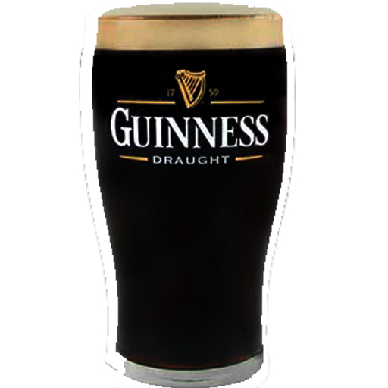
Irish Conversation
Family meals are considered to be a very important component of family life.
Family members talk about their days
Superficial conversations are not appreciated
Weddings and Wakes
The Pub
Music is very important
Irish Folk, Chieftains

Slide 58
Economy
Strong GDP per capita.
Has fallen over the past couple years due to the economic crisis
One of the wealthiest nations per capita in the European Union.
5th out of 27
Highly developed nation
Part of the EU and the Eurozone
However, banking crisis of 2008 hit Ireland hard

Slide 59
Banking Crisis
Ireland had expanded rapidly from 1997-2007, known as the Celtic Tiger years.
Hit hard by the financial crisis of 2008, still in uncertain economic times.
Included in the infamous P.I.I.G.S. after 2008. The term is banned by some organizations.
Bank bailouts were more than the economy of Ireland could sustain.

Slide 60
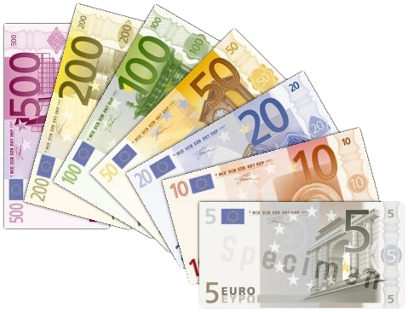
Banking Crisis
As of April 2011, Ireland’s debt has been reduced to junk status.
Uncertainty for the future, there is a chance that a second bailout will be necessary.
Having such a large amount of debt has cause emigration.

Slide 61
Conducting Business
Personal Relationships
A company that already has an existing relationship with suppliers would help things go smoother.
Humor is used in business
Punctuality is essential

Slide 62
Conducting Business
Decisions can take a long time
Horizontal hierarchy
Some division
Board of Directors make decisions
Don’t call them British or English

Slide 63
Comparison
Ireland
Area: 70,273 sq km
Population: 4,581,269
Government: Constitutional Parliamentary Republic
GDP: $212.8 billion
Czech Republic
Area: 78,867 sq km
Population: 10,177,300
Government: Parliamentary Democracy
GDP: $272.2 billion

Slide 64
Sources
http://www.communicaid.com/access/pdf/library/culture/doing-business-in/Doing_Business_in_Ireland.pdf
http://www.irishtimes.com/newspaper/finance/2011/0711/1224300497041.html
http://www.rte.ie/news/2011/0418/rating-business.html
http://en.wikipedia.org/wiki/Republic_of_Ireland
http://en.wikipedia.org/wiki/Irish_culture

Slide 65
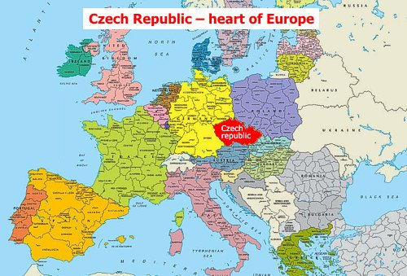
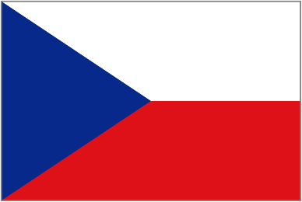
Czech Republic
---heart of Europe
http://www.youtube.com/watch?v=1mLBqgmmVQI&feature=endscreen&NR=1

Slide 66
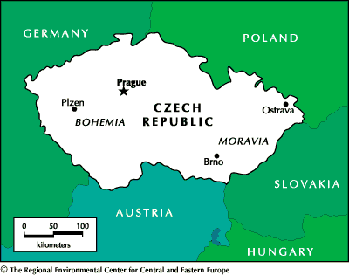
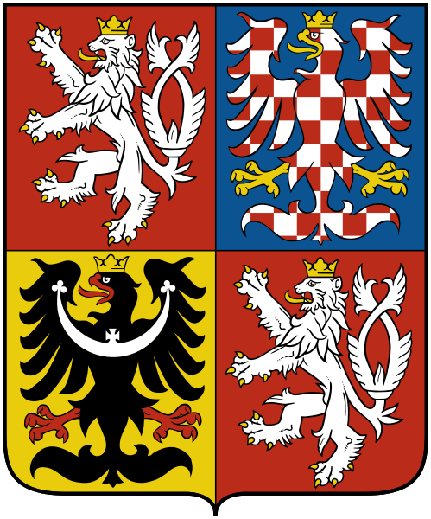
Basic information
Population: 10,562,214 (2011)
Area: 78,866km²
Neighbors: Germany, Poland,
Austria, Slovakia
Time zone: UTC+1
Capital: Prague
Official language: Czech
Government: Parliamentary republic
Currency: Czech koruna (CZK)
Coat of arms

Slide 67
Economy
GDP: $218.363 billion (2011)
Main industries: machinery manufactory, chemical industry, metallurgy, glass-making, beer brewing
Developed, high-income economy : GDP per capita of 80% of the European average
Free trade: EU member, WTO member, joined Schengen Area
Plan to adopt euro by 2013
Main export partners: EU, esp. Germany
Tourism contribution

Slide 68
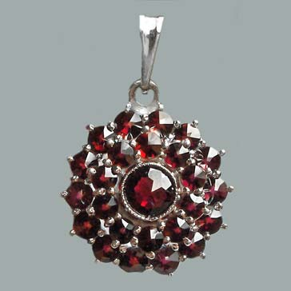
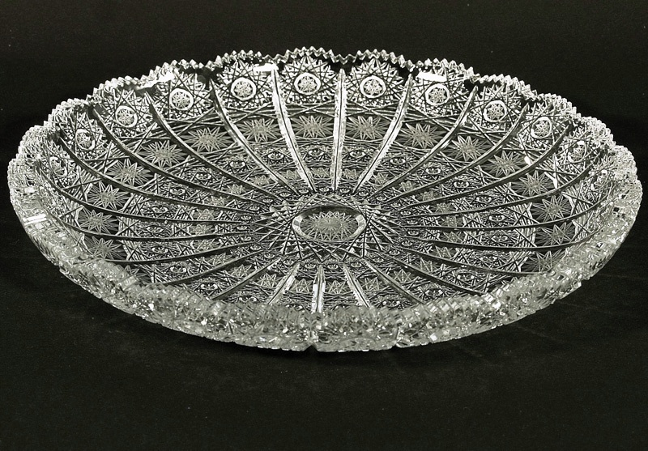
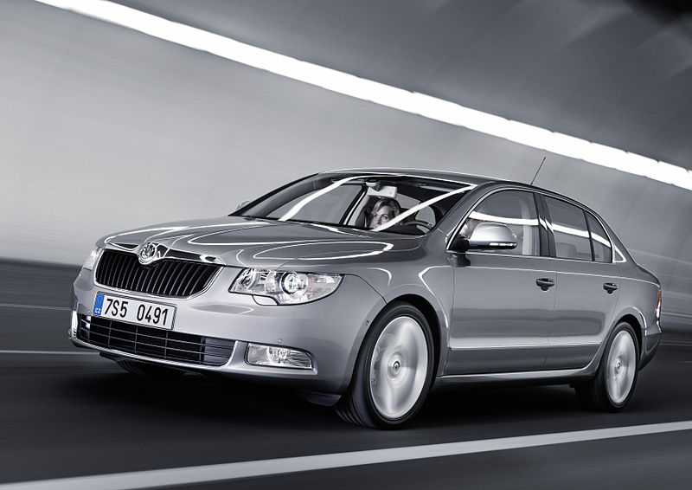
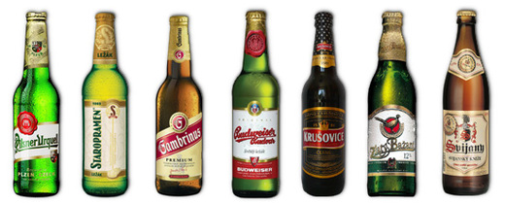
Czech Products
Bohemian garnet
Skoda auto
Bohemian glass
Pilsner, Budweiser

Slide 69
International Expansion for

Slide 70
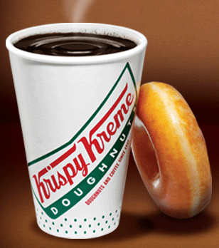
Krispy Kreme
Doughnuts & Coffee since July 1937
From a secret yeast-raised doughnut recipe of a New Orleans French chef
Products: doughnuts, coffee & beverages, iced drinks & Kool Kreme®
Around the world: USA, Canada, Mexico, Australia, China, Japan, Korea, Indonesia, Malaysia, Middle East, Philippines, Thailand, Turkey, UK, Puerto Rico

Slide 71
Krispy Kreme for Czech
Dessert-lovers
Open to diversity
Tourism attraction brings international customers: 6.3 million foreign tourists 2010
Expansion of European market

Slide 72
Resources:
http://www.czech.cz/en/Discover-CZ/Lifestyle-in-the-Czech-Republic/Tradition
http://krispykreme.com/home
http://www.youtube.com/watch?v=1mLBqgmmVQI&feature=endscreen&NR=1

Slide 73
Total Global Strategy Chapter 4
---Designing Global Products and Service

Slide 74
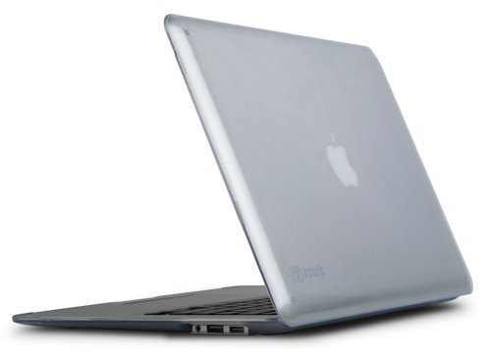
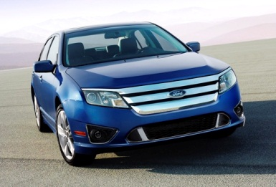
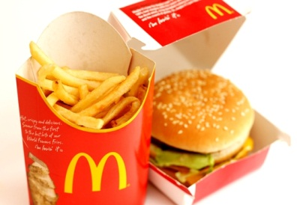
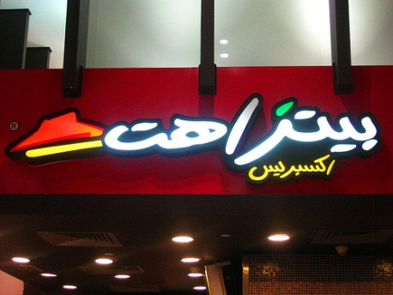
Designing Globalized products and services
Which?
How?
Where?

Slide 75
Designing Global Products and Service
4.1 Benefits of Global Products and Services
4.2 Drawbacks of Global Products and Services
4.3 Global Standardization in Service Business
4.4 When to Use Global Products and Services
4.5 Developing Global Products and Services
Notes:
Developing and maintaining global products and services constitutes the second global strategy level.

Slide 76
Global products
“The idea of fully standardized global product that is identical all over the world is a near myth that has caused great confusion.”
Better approach: standardizing the core product or larger part of it while customizing peripheral or other parts.
McDonald's Burger

Slide 77
4.1 Benefits of Global Products and Services
Cost reduction
development, sourcing, production, inventory
division and concentration→ economies of scale
Improved quality
financial and management resources being focused
Enhanced customer preference
frequently consumed products at home and abroad
travel-related consumer services
Competitive leverage
Notes:
1.Soft drinks, fast food, cigarettes, candy—Coca-Cola, McD, Nestle;
Seldom purchased—detergent, floor wax
2. Credit cards, airlines, automobile rental

Slide 78
’s benefits
Enhanced customer preference—frequently repurchased
Recognition by customers over the world
Standardized products with locally tailored doughnut series

Slide 79
4.3 Global Standardization in Service Business
4.2 Drawbacks of Global Products and Services
Partially sacrificed national needs
Key: satisfy the most important common needs of the most important markets
Easy to globalize and localize
eg. McDonald in India-Veggie Burgers; in Britain-tea and coffee; in France and Germany-beer
Notes:
American appliance for Japanese kitchen; Japanese small calculator pads for American fingers;
Nature of service—manufacturing and consumption at the same point of time—makes standardization and customization feasible

Slide 80
4.4 When to Use Global Products and Services
4.4.1 Market Globalization Drivers
Common customer needs
Global customer
4.4.2 Cost Globalization Drivers
Global scale economies
High product development cost/fast changing technology
Notes:
Customers in different countries share the same needs and tastes in given product or service. Eg. Medicines, computers

Slide 81
4.4 When to Use Global Products and Services (continued)
4.4.3 Government Globalization Drivers
Favorable trade policies
Compatible technical standards
4.4.4 Competitive Globalization Drivers for Global products

Slide 82
4.5 Developing Global Products and Services
Two ways:
1st: developing products and services with the global market in mind (preferred)
2nd: adapting existing products or services (more common)

Slide 83
Czech food
Lunch is very important—soup, main course, and dessert.
Big meat & potato people—pork, beef, chicken are popular; goose, duck, rabbit and wild game are served; fish and seafood are rare
Strong and salty taste
Beer for every meal
Desserts are not particularly sweet,
frequently contain poppy seeds

Slide 84
Hints for
Adjust the sweetness
Add local elements—poppy seeds doughnuts

Slide 85
Review
4.1 Benefits of Global Products and Services
4.2 Drawbacks of Global Products and Services
4.3 Global Standardization in Service Business
4.4 When to Use Global Products and Services
4.5 Developing Global Products and Services
Notes:
Developing and maintaining global products and services constitutes the second global strategy level.

