Slide 1
Good To Great Level 5 Leadership
Katelyn Reed
Venessa Rodriguez
Kristen Hodge
Monica Longer

Slide 2
“You can accomplish anything in life, provided that you do not mind who gets the credit.”
Harry S. Truman

Slide 3
Level 5 Hierarchy

Slide 4
Kimberly Clark
Darwin E. Smith was the CEO for 20 years
Transformed the business into the leading paper-based consumer products company
In retirement, Darwin stated “I never stopped trying to become qualified for the job.”

Slide 5
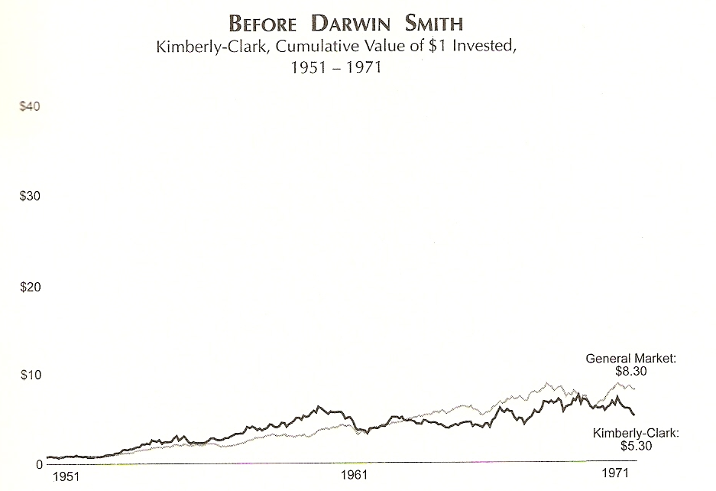

Slide 6
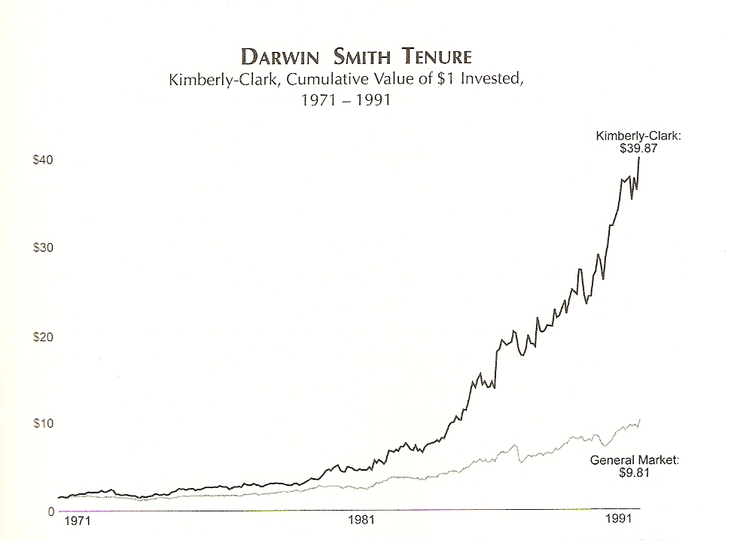

Slide 7
Humility + Will = Level 5
Modest
Willful
Do what must be done
Humble
Window and Mirror
Fearless
Abbot Laboratories

Slide 8
Coleman Mockler- Gillette
Hostile takeover from Revlon
Proxy battle from Coniston Partners
Risks
Made shareholders 3 times better off
Modest– Forbes magazine
He did what was best for the company

Slide 9
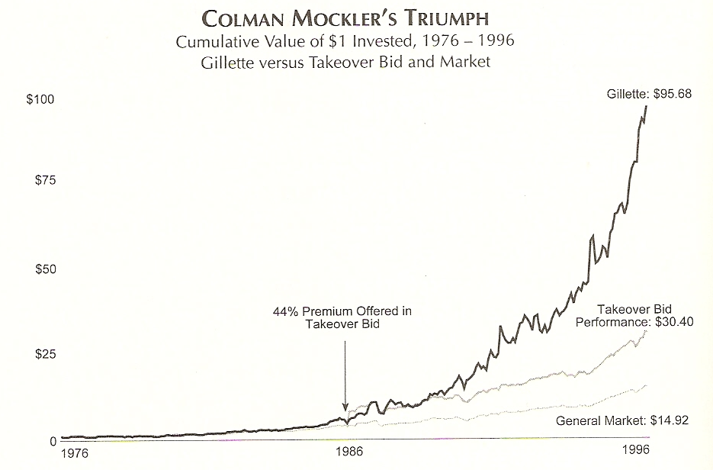

Slide 10
Set up Successors for Success
Level 5 leaders want to see the company succeed in the next generations.
Non Level 5 leaders often chose weak successors, setting the companies up for failure.
Rubbermaid and Stanley Gault
Steve Jobs temporarily left Apple twice.

Slide 11
Compelling Modesty
Don’t talk about themselves
Don’t take credit for the success of the company
In 2/3 of comparison companies, the presence of a “gargantuan personal ego” contributed to the demise of the company.
Scott Paper’s Al Dunlap
Chrysler and Lee Iacocca

Slide 12
Unwavering Resolve
Fanatically Driven
Ex. Abbot Laboratories vs. Upjohn
Come from inside the company
10 out of 11

Slide 13
Walgreens
Charles R. “Cork” Walgreen 3rd
From milkshakes to Medicine
Becoming the BEST IN THE WORLD!
Blue Ocean
Value innovation

Slide 14
The Window and the Mirror
Level 5 Leaders
Window = Credit, Mirror = blame
Level 4 and below
Window = blame, Mirror = Credit

Slide 15
The Window and the Mirror Cont.
Joseph F. Cullman 3rd
Emphasized luck
Ken Iverson
View on imports
The window and the mirror do not reflect objective reality.

Slide 16
Sub-par Leaders
Appointed weak successors
Ex. Rubbermaid & Stanley Gault
“Great to Irrelevant”
Al Dunlap & Scott Paper
“Rambo in Pinstripes”

Slide 17
Egotistical
Concerned with self significance
Ex. Lee Iacocca & Chrysler
“I Am Chairman Of Chrysler Corporation America”
Commercials, Special Appearances, & Autobiography
Company turnaround in 1980s could not endure.

Slide 18
Is it Possible?
Can I become a level 5 leader?
Jim Collins Hypothesis
Two categories of people
Without potential
Fame, fortune, power, etc…
With potential
Are capable, abilities need aid in developing

Slide 19
Is it Possible? Cont.
“ The problem is not, in my estimation, a dearth of potential level 5 leaders. They exist all around us, if we just know what to look for.”

Slide 20
Summary: The Two Sides of Level 5 Leadership
Personal Will
Personal Humility
Superb results
Unwavering resolve
Won’t settle for less than greatness
Looks in the mirror to apportion responsibility for poor results
Modest, never boastful
Quietly determined, relies on standards not charisma
Sets up successors for greatness
Looks out the window to apportion credit for the success of the company

Slide 21
Jim Collins Video
http://www.jimcollins.com/media_topics/level-5.html#audio=81

