Slide 1
BLUE OCEAN STRATEGY
Chapter 2
James Blanton, Lauren DeFrancisco, Aaron Phillips

Slide 2
What is a Blue Ocean?
Characteristics:
New and uncontested market space
Competition is irrelevant
Creates consumer value
Decreasing cost
Increasing revenue
An effective Blue Ocean Strategy focuses on risk minimization and not on risk taking

Slide 3
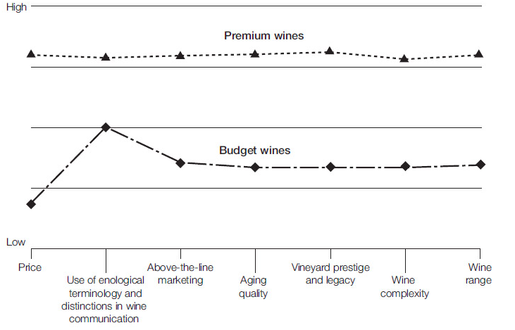
The Strategy Canvas
A diagnostic and an action framework for building a compelling blue ocean strategy
A key component for value innovation and beneficial in the creation of blue oceans
Purpose:
Captures current state of play in the known market space (Horizontal axis)
Captures the offering level that buyers receive across all these key competing factors (Vertical axis)
Notes:
purpose 1: allows you to understand where the competition is currently investing, the factors the industry currently competes in: products, services and what customers receive from existing competitive offerings in the market
purpose 2: help on this one

Slide 4
Value Curve
Blue Ocean Strategy
Red Ocean
Overdelivery without payback:
Ex. Premium Wines and Rolex
Strategic contradictions:
Ex. Company website looks great but runs super slow
An internally driven company
Companies using to much Jargon

Slide 5
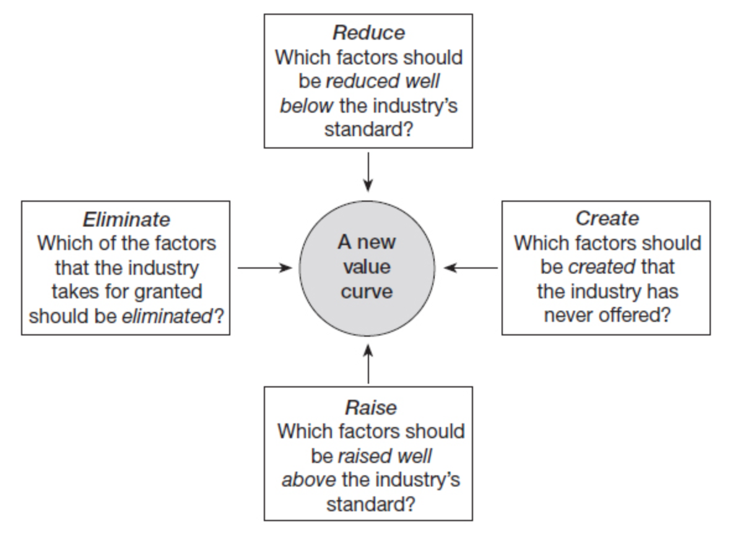
Four Actions Framework
To break the trade-off between differentiation and low cost and to create a new value curve
Eliminate
Reduce
Raise
Create
Notes:
Eliminated: this may occur if some factor is seen as no longer having value or even detracting from value
Reduce:this occurs when when a company tends to overproduce or overdesign in an attempt to match or beat our their competition in the market
Raise:

Slide 6
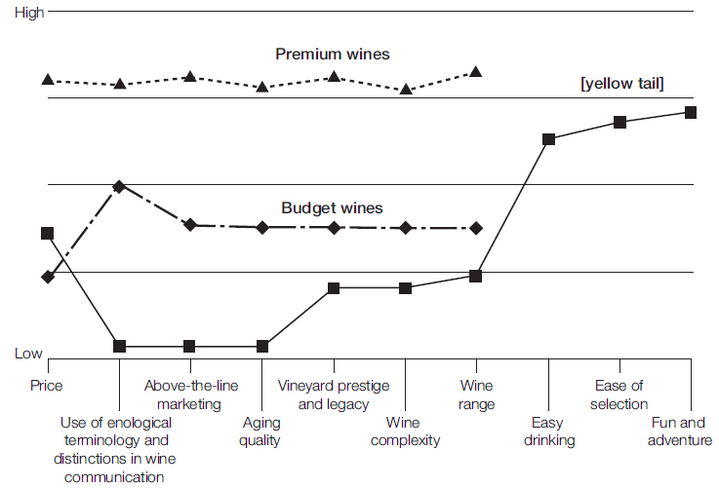
Value Curve - yellow tail

Slide 7
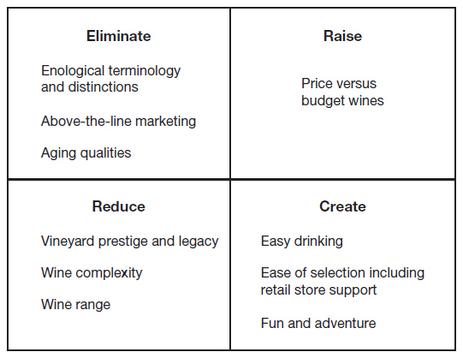
Eliminate → Reduce → Raise → Create Grid

Slide 8
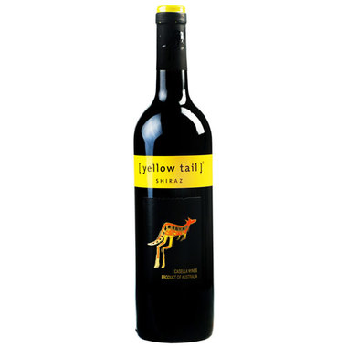
yellow tail
Fastest-growing brand in the wine-industry in Australia and the U.S.
Converted many beer, cocktail, and traditional wine drinkers
Attributes
Inexpensive
Simple fruity sweetness
Eliminated traditional factors (tannins, oaks, complexity, aging)
Simplistic (label, boxes, technical jargon)

Slide 9
Cirque du Soleil
Eliminates
Use of animals, and star performers.
Reduces
Animal costs, and transportation costs.
Raises
Price, unique venue, profits
Creates
Themes, artisan music and dances

Slide 10
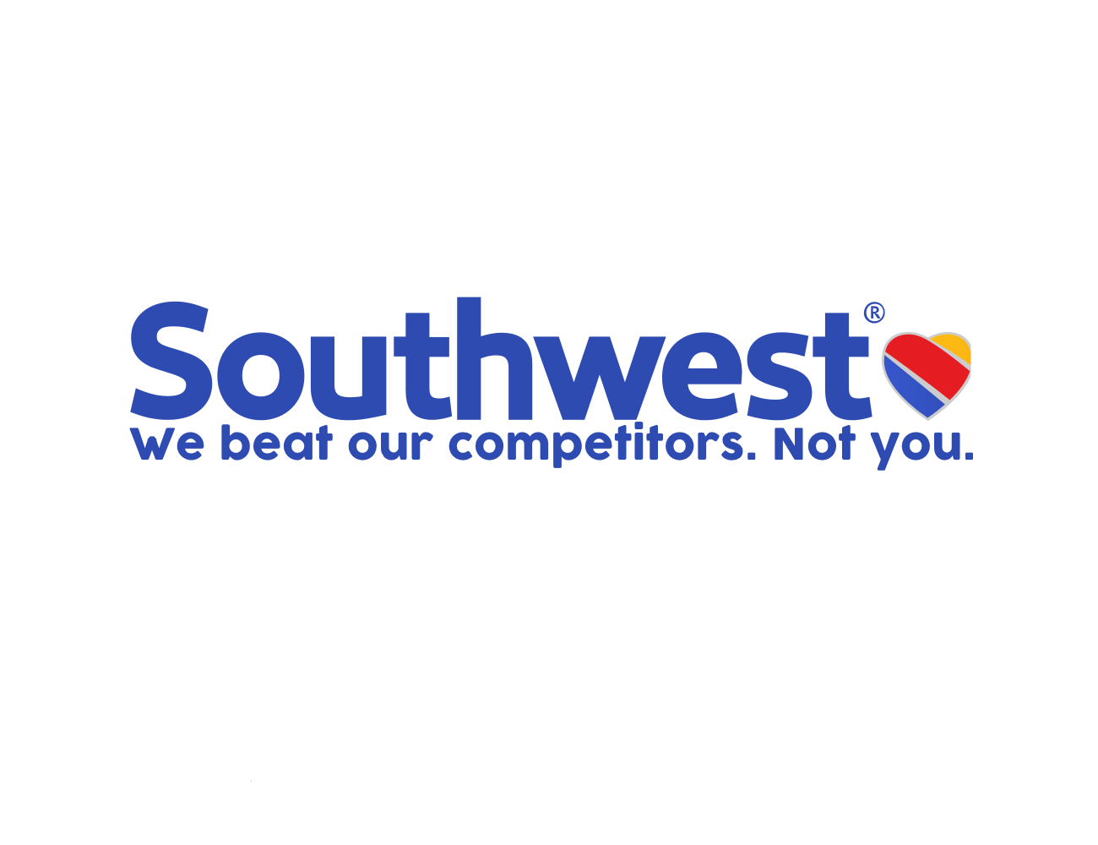
Southwest Airlines
Eliminates
First class, picking seats, long-duration flights, and meals.
Reduces
Time between take-off and departure.
Raises
Customer service, and overall experience.
Creates
Customer loyalty.

Slide 11
Characteristics of a Good Strategy
Focus
Divergence
Compelling Tagline
In order to have a good strategy these three characteristics serve as an decisely indicative test of the commercial viability of blue ocean ideas

Slide 12
Focus
yellow tail:
Customers, and products
Cirque du Soleil:
Higher value performances, quality acrobatics, and various themes
Southwest Airlines:
Friendly Service, speed, and frequent point-to-point departures

Slide 13
Divergence
“The best way to beat the competition, is to stop trying to beat it.”
yellow tail:
Made the wine more convenient for everyday customers
Cirque du Soleil:
Adapted their shows to have themes
Southwest Airlines:
Pioneered point-to-point travel

Slide 14
Compelling Tagline
A good tagline must not only deliver a clear message but also advertise an offering truthfully, or else customers will lose trust and interest
yellow tail
“We are passionate about creating great tasting, quality wines for everyone to enjoy.”
Cirque du Soleil
“Do not miss this show if it comes to an arena near you”
Southwest Airlines
“The speed of a plane at the price of a car-whenever you need it.”

Slide 15
In Conclusion
Through the use of various techniques, Cirque du Soleil, yellow tail, and Southwest Airlines were able to produce an original and exciting market space to grow their companies.

