Slide 1
American Apparel Company and Industry Analysis
Team 1 – Patrick Morales, Will Turner, Chris Mathis, Jared Stowe, Becky Alvarado

Slide 2
Introduction
American Apparel is a vertically integrated manufacturer
Founded in 1989
After success as a wholesale brand, the company moved into the retail market
Became a publicly traded company in 2007

Slide 3
Industry Snapshot
Industry Sales (2010): $213.735 Billion
Lifecycle Stage: Mature
Degree of Vertical Integration: None*
Technological Innovation: Somewhat
Scales of Economy: Purchasing; Manufacturing
Highly Fragmented

Slide 4
Industry Driving Forces
Changes in consumer preferences
Increasing globalization
Changing societal views/attitudes/lifestyles

Slide 5
Competitive Comparisons
Competition’s Strengths
Gap- reaches larger demographics and lower prices
Urban Outfitters-more product variety
Abercrombie-better brand loyalty and younger demographics
H & M- International and bigger presence in department stores
Banana Republic-more sophisticated brand culture
Competition’s Weaknesses
Gap-better labor standards
Urban Outfitters-superior vertical integration
Abercrombie-not as fad orientated
H & M-more focused brand culture and loyalty
Banana Republic-more contemporary style of clothing

Slide 6
Competitive Analysis
Market Share Data
American Apparel, Inc. |  | 1%
GAP |  | 8%
Urban Outfitters |  | 4%
Abercrombie & Fitch |  | 3%
H & M |  | 9%
Banana Republic |  | 1%
Others |  | 74%
 |  | 100%

Slide 7
Competitive Analysis
Factor | American Apparel, Inc. | GAP | Urban Outfitters | Abercrombie & Fitch | H & M | Banana Republic
Brand loyalty | 240 | 270 | 240 | 270 | 270 | 180
Customer service | 90 | 90 | 75 | 60 | 75 | 90
Reliable distribution and wholesale network | 250 | 200 | 175 | 150 | 225 | 200
Brand culture | 100 | 140 | 80 | 80 | 140 | 80
Responsive to changing fashion trends | 60 | 40 | 50 | 30 | 60 | 40
TOTAL WEIGHTED SCORE | 740 | 740 | 620 | 590 | 770 | 590

Slide 8
Porter’s 5 Forces Model
 |  |  | POTENTIAL NEW ENTRANTS
 | Intensity of Rivalry: Medium level of rivalry due to high number of retailers |  | Typically include small companies that |  | Bargaining Power of Buyers: The industry has high bargaining power compared to suppliers. With many suppliers in Asia and S. America, competitors in the industry can dictate prices from the suppliers
 |  |  | gain brand buzz and a loyal following
 |  |  | RIVALS
 | SUPPLIERS OF KEY INPUTS |  | American Apparel, Inc. |  | BUYERS
 |  |  | GAP
 | Most supply comes from low cost |  | Urban Outfitters |  | The industry caters to all males and
 | manufacturers located in Asia and |  | Abercrombie & Fitch |  | females typically in the 18-35 year old
 | South America |  | H & M |  | age demographic
 |  |  | Banana Republic
 |  |  | SUBSTITUTE PRODUCTS
 | Threat of Substitutes: There is very low threat of substitutes because clothing and apparel are necessities for everyone the industry caters to |  |  |  | Barriers to Entry: Barriers to entry are relatively low, but creating brand loyalty is sometimes difficult. New entrants also struggle to compete with the economies of scale achieved by large companies
 |  |  | No substitutes - Clothing and apparel
 |  |  | are necessities for every consumer
 |  |  | within the industry

Slide 9
Strategic Group Map
Low cost off-shore manufacturing
 | Vertical Integration
 |  | User Defined Criteria for X & Y Axes |  | Relative Indication of Size
 | Strategic Group Map Data | Vertical Integration | Low cost off-shore manufacturing | Group Size
 | User Defined Titles of Groups | (X) | (Y) | (Diameter)
 | American Apparel | 90 | 10 | 20
 | Urban Outfitters, GAP, Abercrombie & Fitch | 10 | 75 | 68
 | H&M, Ralph Lauren, etc. | 20 | 90 | 12

Slide 10
Market Analysis
Target Market: 20-35 year olds
Market Size: 32.1 million people
Market Growth: 3.3% per year
Market Penetration: 12.5%
Distribution Channels: Retail/Online, Wholesale

Slide 11
American Apparel: 4 Year Financial Analysis
Fiscal year is January-December. All values USD millions. | 2008 | 2009 | 2010 | 2011
Sales/Revenue | 545.05M | 558.78M | 532.99M | 547.34M
Sales Growth | 40.82% | 2.52% | -4.61% | 2.69%
Net Income | 14.11M | 1.11M | (86.32M) | (39.31M)

Slide 12
SWOT Analysis
STRENGTHS |  |  |  | WEAKNESSES
Vertically integrated business model |  |  |  | Erratic CEO Dov Charney
Fair wages and working conditions in L.A. factory |  |  |  | Controversial and sexual advertising
Stability in demand for product design-very basic |  |  |  | Stereotyping when hiring at retail level
Made in the U.S.A or domestic production |  |  |  | Limited product designs
Effective utilization of RFID tag inventory system |  |  |  | Recent Hurricane Sandy marketing tactics
OPPORTUNITIES |  |  |  | THREATS
Add factories in U.S. to increase domestic production |  |  |  | Negative public perception of corporate culture
Expand on high level of vertical integration |  |  |  | Loss of portion of workforce to immigration reform
Produce and offer expanded product line and designs |  |  |  | Recent loss of a large U.S. Army uniform contract
Increase retail expansion in U.S. and internationally |  |  |  | Unstable sales growth over last 5 years

Slide 13
TOWS Matrix
 | 1. Vertically integrated business model | 1. Erratic CEO Dov Charney
 | 2. Fair wages and working conditions in L.A. factory | 2. Controversial and sexual advertising
 | 3. Stability in demand for product design-very basic | 3. Stereotyping when hiring at retail level
 | 4. Made in the U.S.A or domestic production | 4. Limited product designs
 | 5. Effective utilization of RFID tag inventory system | 5. Recent Hurricane Sandy marketing tactics
 | SO Strategies | WO Strategies
1. Add factories in U.S. to increase domestic production | 1. Adding another major factory to mirror the L.A. factory will double the size and capability of the vertically integrated business model by offering more opportunites to improve internal efficiences | 1. Reduce controversial advertising both online and at the retail store level. Revamped image will bode well for expansion in retail operations worldwide
2. Expand on high level of vertical integration
3. Produce and offer expanded product line and designs | 2. Fair wages and happy employees mean factory workers will be more inclined to buy into any new expanded designs/prints/fabrics that can be offered | 2. A positive public image overall of CEO Dov Charney will help the efficiency and effectiveness of current vertical integration strategy
4. Increase retail expansion in U.S. and internationally
 | 3. Effective use of RFID tags in select stores should be expanded into all stores and new retail operations in the U.S. and internationally | 3. Expanded product line can be offered at higher prices while maintaining current prices and margins of limited basic designs.
 | ST Strategies | WT Strategies
1. Negative public perception of corporate culture | 1. Vertically integrated strategy can be utilized to improve efficiencies within a newly reduced workforce. Concentrated and better focused efforts from the top down will help American Apparel be successful despite labor losses | 1. A serious public image campaign could be undertaken to improve negative perceptions of CEO Dov Charney and the corporate culture as a whole. This would be positive for the company to fix the current perceived negatives
2. Loss of portion of workforce to immigration reform
3. Recent loss of a large U.S. Army uniform contract | 2. Although a large U.S. Army contract was recently lost, the made in the U.S.A. allure that American Apparel brings can be used to secure uniform contracts with other large U.S. based firms or organizations | 2. Examination of the current marketing and advertising strategy needs to occur. Less sexual and insensitive advertising will help erase the stigma associated with American Apparel's culture.
4. Unstable sales growth over last 5 years
 | 3. A better understanding and utilization of RFID tag system will help the company maximize sales and help combat previous unstable sales growth heading into the future | 3. Expanding on current limited product line will offer customers with more options and increase impulse buying, which will help over come unstable sales growth
Strengths (S)
Weaknesses (W)
INTERNAL
FACTORS
EXTERNAL
FACTORS
Opportunities (O)
Threats (T)

Slide 14
American Apparel: Internal Analysis
Current Strategy: International Expansion
No constraints have been identified
Corporate Culture
Relaxed atmosphere
Increased collaboration due to vertical integration
Younger employees
Politically active in community
Planned Change Program
Instituted former Blockbuster CFO Tom Casey as standing president
Lion Capital has begun overhaul of top executives

Slide 15
Core Competencies
Local Production (U.S. Domestic)
Wholesale Manufacturing
Single Location (L.A. “campus”)

Slide 16
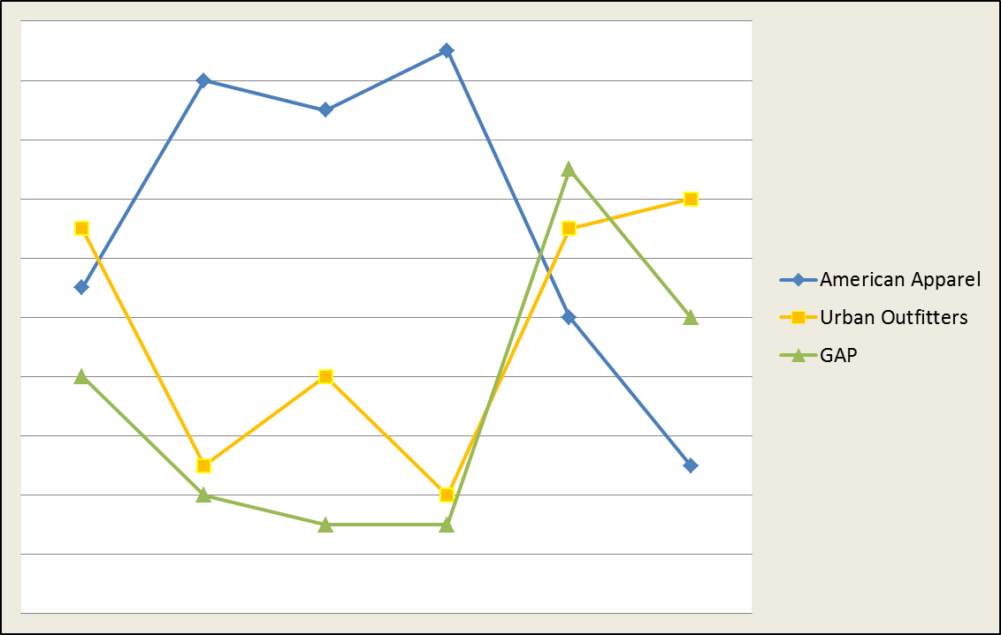
Strategy Canvas
 | Factors
Company | Price | Labor Standards | Domestic Production | Vertical Integration | Merchandising | Product Variety
American Apparel | 55 | 90 | 85 | 95 | 50 | 25
Urban Outfitters | 65 | 25 | 40 | 20 | 65 | 70
GAP | 40 | 20 | 15 | 15 | 75 | 50

Slide 17
Four Action Strategy
New Value Curve
REDUCE
Product variation
Outsourcing
International operations
CREATE
More efficient vertical integration strategy
A second major U.S. production facility
Widespread use of RFID tag system in retail stores
RAISE
Domestic production
Vertical Integration
Labor standards
Wholesale operations
ELIMINATE
Advertising that creates negative attention
Instability in upper management

Slide 18
Alternative Strategic Suggestions
 | Bundle 1 | Bundle 2 | Bundle 3
 | The New American Image | Double Trouble | Made in the U.S.A Pride
Fit with corporate culture | 3 | 9 | 9
Adverse effect on competitors | 6 | 8 | 5
Growth in profits | 8 | 8 | 7
Strength of value proposition | 9 | 5 | 8
Extent to which culture must change | 0 | -2 | 0
Capital investment required | -6 | -8 | -2
Likelihood of competitive retaliation | -3 | -4 | -3
Time to breakeven point | -7 | -4 | 0
Overall riskiness | -1 | -2 | -4
OVERALL SCORE | 9 | 10 | 20

Slide 19
Alternative Strategic Suggestions
Bundle 3
Made in the U.S.A Pride
Made in the U.S.A. Pride aims outfit some of America's largest and most powerful businesses and organizations in clothing or uniforms produced by American Apparel. Although American Apparel recently lost out on a large uniform contract with the U.S. Army, the company should not let such a set back get in the way of what could become a much larger vision. American Apparel is synonymous with made in the U.S.A., so why shouldn't it market its uniform producing capabilities companies that place a large emphasis on made in America(Ford, GM, etc.) Large quantity contracts will help to improve the bottom line of the company and improve sub-par financial conditions that have existed over the past 4-5 years.
Bundle 3 - “Made in the U.S.A Pride” chosen based on comprehensive analysis

