Slide 1
Industry and Competitive Analysis: Under Armour
Courtney Ellis, Travis Tempel, Casey Harvey, Roberto Padilla, Mason Stone, Miguel Medrano, Julio Garcia, Glen Lesley

Slide 2
Mission Statement
Under Armour's mission is to make all athletes better through passion, design, and the relentless pursuit of innovation. Every Under Armour product is doing something for you; it's making you better.

Slide 3
Performance Apparel and the Performance Apparel Industry
Clothing made from moisture wicking material to enhance athletic performance
Kevin Flank, Under Armour founder, 1996
Under Armour's implementation founded the Performance Apparel Industry

Slide 4
Under Armour's Public Image
Positive due to being first to the market
Produce an innovative and quality product
Partner with high schools and universities all across the country
Legacy Partners

Slide 5
Legacy Partners
Habitat for Humanity
Ronald McDonald House
V Foundation
Boomer Esiason Foundation
Living Classrooms Foundation

Slide 6
Under Armour's Programs
Under Armour Green
Under Armour Freedom
Under Armour Power in Pink
Under Armour Youth Movement
Under Armour Combines

Slide 7
SWOT Analysis
•Strengths: •-Sponsoring Schools •-UA Legacy Partner •-UA Green •-UA Freedom •-UA Power in Pink •-UA Youth Movement •-UA Combine •-UA Innovation Challenges •-Shipping Internationally •-Quality products | •Weaknesses: •-Stuggles attracting more international market share •-They do not have a patent for any of the materials used in their products •-Many of the materials used in their products are petroleum based, and therefore subject to fluctuation •-UA is a much smaller company compared to competitors, and therefore not as strong •-Fairly expensive
•Opportunities: •-Rash guards for MMA training •-Endless amount of possibilities in performance apparel ideas for sports | •Threats: •-Bigger and stronger companies taking over the market due to a larger economies of scale •-Without patents, imitators could easily copy ideas and steal spot in market by producing less expensive alternatives

Slide 8
UA Corporate Strategy
Industry summary
Competitive strategy
Industry competition

Slide 9
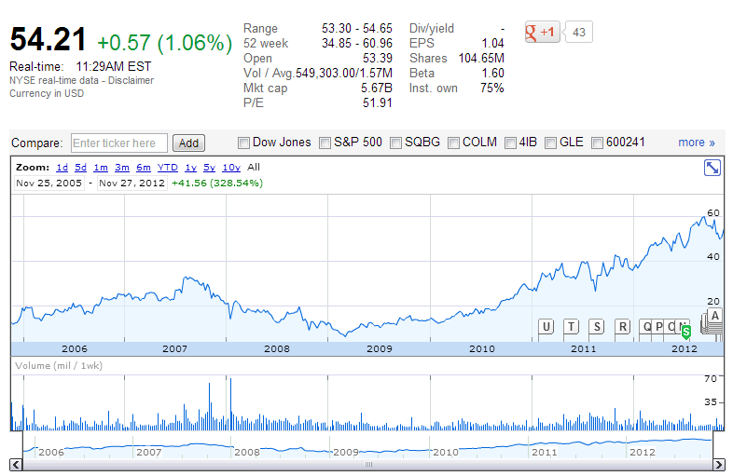

Slide 10
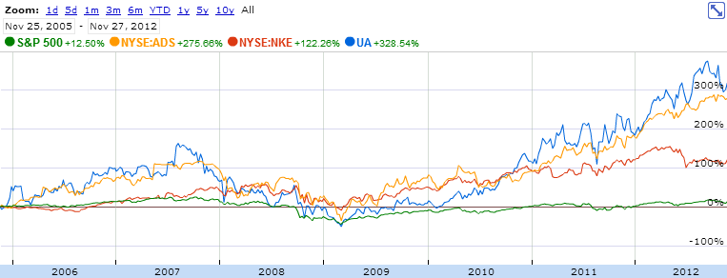

Slide 11
Rate of Growth
Large opportunity for growth
Outlet Stores
“My 39 Submit-an-Idea”
Specifically tell Under Armour what product they want to see

Slide 12
Rate of Growth
Large opportunity for growth
Outlet Stores
“My 39 Submit-an-Idea”
Specifically tell Under Armour what product they want to see

Slide 13
Ease of entry and competition
Very hard for new companies to enter into this industry
Highly competitive industry
NIKE, Adidas, Columbia

Slide 14
Technology and Innovation
Emphasis on R&D
Come out with new products for the customers
Microfiber clothing that is light and repels sweat

Slide 15
Management Capability
Employees know exactly how to act and work
“The Code” is available to the public on their website
Customers can trust the company because they can see how Under Armour operates.

Slide 16
Economic Factors
Adapting to different market conditions
Employees
Hire appropriate people that fit culture and success.
Not easy, competitors work to recruit the best as well.
In UA’s Forward-Looking Statements – “changes in general economic or market conditions that could affect consumer spending and the financial health of our retail.”

Slide 17
Economic Factors
Federal Trade Commission and other agencies make sure product is appropriate.
Labor
Strikes and lockouts cause slow downs that hurt production.
Policies in other countries can change.
Can lead to risks that can affect the consumer in the end.

Slide 18
Social Factors
Age distribution
Geographical Boundaries
HeatGear, ColdGear, AllSeasonGear
Sports Marketing
Differentiated brand image
International Exposure

Slide 19
Social Factors
Seasonality

Slide 20
Financial Factors
Access to capital when required is strong
Degree of Capital Utilization is strong
Ease of Exit from the market is weak
Profitability, Return on investment is strong
Liquidity, Available Internal Funds is strong
Degree of leverage, Financial Stability is strong
Ability to compete on prices is strong
Capital Investment, Capacity to meet demand is strong
Stability of Costs is strong

Slide 21
Technical Factors
Technical and Manufacturing Skills are strong
Resource and Personnel Utilization are strong
Level of Technology Used in products is strong
Strength of patents is weak
Production effectiveness and delivery schedules is strong
Value added to Product is strong
Intensity of Labor to produce the product is strong
Newness of Plant and equipment is strong
Application of computer technology is strong

Slide 22
Technical Factors Ctd.
Third-party Manufacturing
Processes and fibers are not unique.
Threat of imitators
Innovation
UA and their competitors constantly compete on innovation
Brand Mission
Submit an Idea

Slide 23
Environmental Threat and Opportunity Profile
Impact of Factors Importance of Factors Environmental Threat
Economic 7 8 15
Political 5 2 7
Social 4 6 10
Technological 8 8 16
Competitive 8 9 17
Geographic 5 1 16
TOTAL 81
•Helps to identify, consolidate, and provides a strategy for a corporation(s), identifIes opportunities and threats, consolidate and strengthen organization(s) position, provides the strategists of which sectors have a favorable impact on the organization, and organization(s) knows where it stands with respect to its environment.

Slide 24
Key Success Factor / Strength Measure Weight UA Nike Adidas Columbia
Quality / product performance 0.15 8/0.60 10/0.70 8/0.60 5/0.60
Reputation / image 0.10 8/0.50 9/0.70 8/0.65 4/0.10
Raw material access / cost 0.15 5/0.30 10/0.95 5/0.80 5/0.50
Technological skills 0.20 10/1.70 10/0.25 8/0.50 7/0.15
Manufacturing capability 0.05 8/0.30 9/0.20 8/0.10 6/0.75
Marketing / distribution 0.05 7/0.30 9/0.20 8/0.10 7/0.20 Financial strength 0.10 5/0.70 10/1.00 7/0.90 8/0.90
Relative cost position 0.25 4/0.45 10/3.50 7/1.05 3/0.15
•Reveals strength of a/your firm’s position in its industry. It shows how firm stacks up against rivals, measure-by-measure—pinpoints the company’s competitive strengths and competitive weakness.

Slide 25
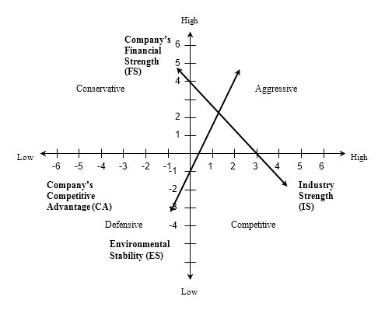

Slide 26
Phase 1
Entrepreneurial Structure
Plank saw the need for a new product
Made designs and prototype for friends in NFL to test
Mostly concerned with shorter term goals to get the company on its feet
Need for direction Crisis
They need a way of planning for the future
Need to start marketing and expanding the business

Slide 27
Phase 2
•Formalization
Here is where they build a business model/strategy for the company
Start looking towards longer term goals for the future
Start promoting the product with TV commercials
“Protect this House”
Lack of Autonomy Crisis
Employees need to have the authority over how they do work and with whom they do work with
Let employees do work that is most enjoyable

Slide 28
Phase 3
Expansion
This is where the company starts to expand on a larger scale
They expand internally with new and bigger departments
They start to show their competitive side both in the market and with their competitors
This is where they are right now

Slide 29
Kip Fulks-Founding Partner and Chief Operating Officer
Byron K. Adams, Jr.- Chief Performance Officer
Charlie Maurath-President International Sales
Diane Pelkey-VP Global Brand Communications
John Rogers-VP/GM of Global E-Commerce
Kevin Eskridge-VP of China
Matt Shearer-VP of EMEA
Steve Sommers-VP of Global Brand Marketing
Adam Peak- Senior VP of US Sales
Brian Cummings- VP of Sales
Fred Knowles-SVP of Human Resources
Edith Matthews-VP of HR Business Partners
Gene McCarthy-SVP of Footwear
Keith Dunlap-VP of Footwear Sourcing
Henry Stafford-SVP of Apparel, Accessories and Outdoors
Edward Giard-VP of Licensing and Accessories
Glenn Silbert-VP of Men's, Youth, and Accessories
Gwyn Wiadro-VP of Women's Apparel
Lisa Struble-VP President of Technical Design
Matt Mirchin-SVP of Brand and Sports Marketing
Jamie Bragg-VP of Team Sports
Steve Battista-SVP of Brand
Amy Larkin-VP of Culture
Joseph Giles-Chief Information Officer
Dave Demsky-VP PMO
David Berman-VP Corporate Controller
John Stanton-VP of Corporate Governance and Compliance
Shawn Herrin-VP of Business Intelligence
Scott Plank-Executive VP Business Development
Cynthia Raposo-VP Legal
Kevin M. Haley- SVP of Innovation
Rich Rapuano-SVP of Planning
Scott Salkeld- VP of Strategy
Todd Montesano-VP of Strategy Alliances
Jim Hardy-Chief Supply Chain Officer
Keith Hoover-VP of Sourcing Resources
Mike Fafaul-SVP of Global Logistics
Kevin Plank-CEO (Founder)

Slide 30
Importance of Culture on Different Factors
Founder’s Beliefs
Team Oriented
Hard Work
Employees and Customer Involvement
Effective Communication over all levels
Innovation – From changing a cotton shirt to also changing shorts, sweats, socks, etc.

