Slide 1
NIKE Industry and Company Analysis
Presented by: Paige Adams, Haley Smith, Laura Freeman, Dan Lawson, Hayley Jacobs, Gage Mitchell
Notes:
Paige

Slide 2
History of Nike
Bill Bowerman and Phil Knight
Desired greater performance shoes
Founded Blue Ribbon Sports in 1964
Created the “Swoosh” and changed name to Nike in 1971
Based in Beaverton, Oregon
Notes:
Paige

Slide 3
Nike Today
Nike is now the world’s leading supplier of athletic shoes and apparel and major manufactures of sports equipment.
We are continuously working to expand, improve, and remain competitive within the industry.
Notes:
Paige

Slide 4
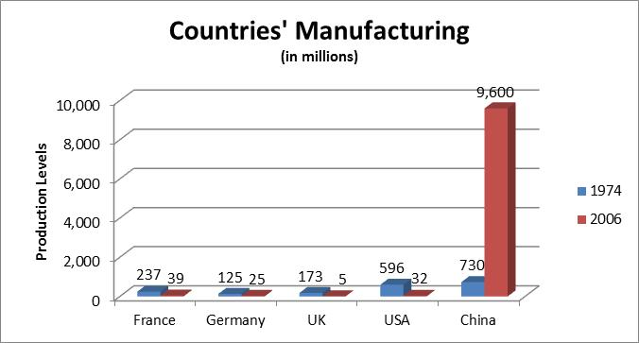
Industry Analysis: Outsourcing
Notes:
Haley

Slide 5
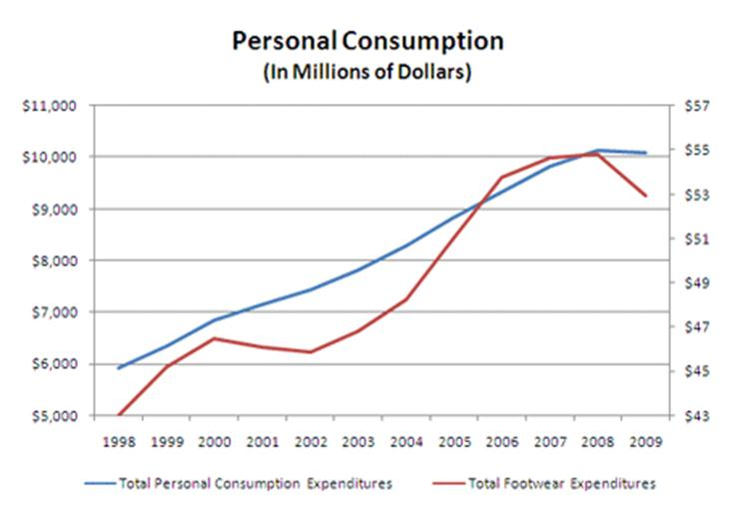
Industry Analysis: Personal Consumption
Notes:
Haley The graph below compares consumer spending before the recession and total footwear sales. The decrease in 2008 is caused by a high unemployment which caused a 3.5% decrease on the amount spent on normal goods, such as footwear.

Slide 6
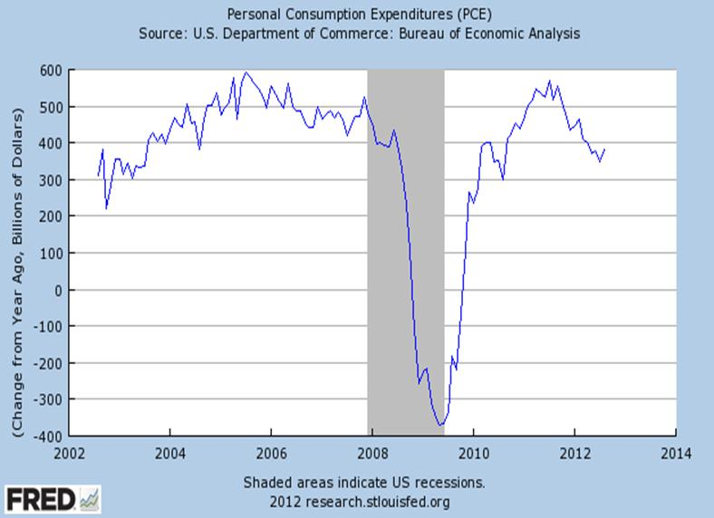
Industry Analysis: Change in Expenditures
Notes:
Haley The graph below, presented by the U.S Department of Commerce: Bureau of Economic Analysis, indicates that the economy is recovering from the recession; therefore, companies in this industry expect growth by 2012.

Slide 7
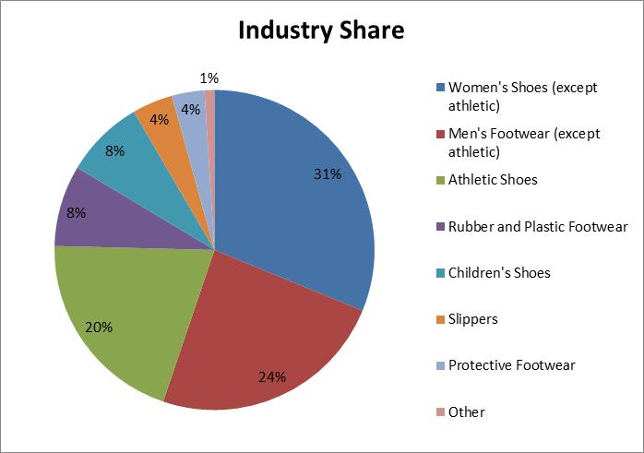
Industry Analysis: Footwear Type Distribution
Notes:
Hayley J. With the increasing focus on an active and healthy lifestyle, there is an increasing need to provide products to all consumers in the market. Women have taken an increasingly active role and vow to have a product that is functional. In addition, women currently consume the largest percentage of the shoe sale market .

Slide 8
Industry Analysis: SATRA
Shoe and Allied Trade Research Association
Built upon strengths of knowledge, research, and testing
Help to control manufacturing costs and improve quality through the evaluation of materials and production.
Moist Heat Setting – reduced manufacturing time
Advanced Moisture Management Test – correcting problems efficiently
New comprehensive testing facility in China
Notes:
Hayley J.

Slide 9
Industry Analysis: Spokespeople
Under Armour
Cam Newton
Tom Brady (previously with NIKE)
Ray Lewis
Miles Austin
Adidas
Reggie Bush
David Beckham (soccer)
Yao Ming (basketball)
Nike
Aaron Rodgers
Mark Sanchez
Patrick Peterson
Tim Tebow
Tiger Woods
Michael Jordan
Lance Armstrong (contract terminated in Oct. 2012)
LeBron James
Kobe Bryant
Kevin Durant
Notes:
Hayley J.

Slide 10
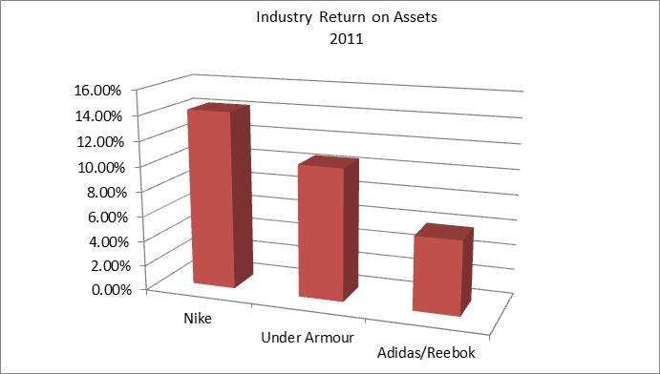
Industry Analysis: ROA
Notes:
Hayley J.

Slide 11
Industry Analysis: Return On Assets
Notes:
Hayley J.

Slide 12
Industry Analysis: Return on Equity
(Shown in Percent form)
Notes:
Paige

Slide 13
Industry Analysis: Bankruptcy Prediction
Bankruptcy Prediction
Nike | 4.695
Under Armour | 4.572
Adidas Group | 2.236
Desire a high z-score
Less possibility of bankruptcy
Notes:
Paige

Slide 14
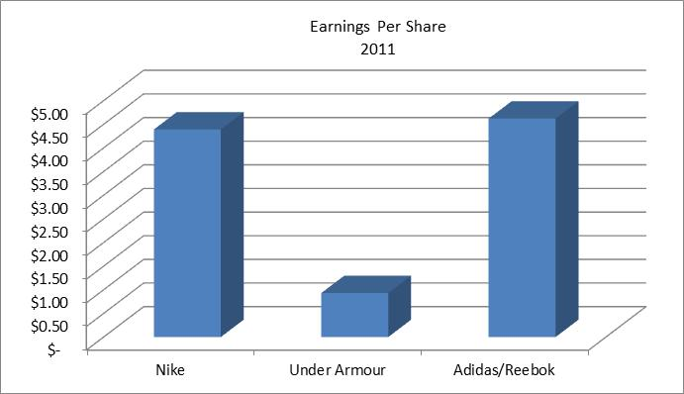
Industry Analysis: EPS
Notes:
Laura

Slide 15
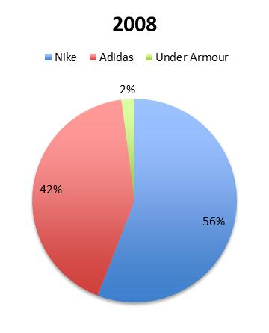
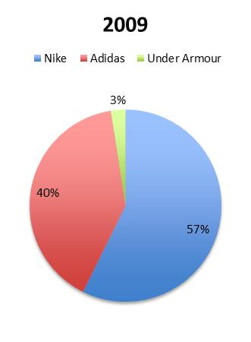
Industry Analysis: Market Share
Notes:
Laura

Slide 16
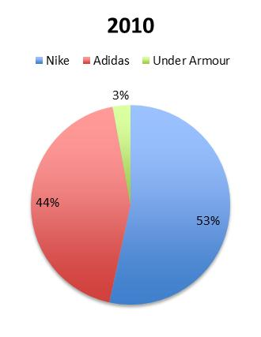
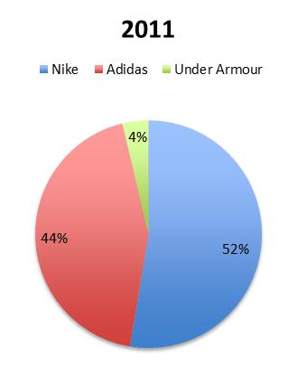
Industry Analysis: Market Share
Notes:
Laura

Slide 17
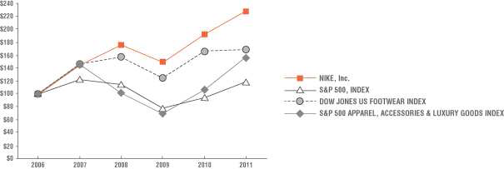
Industry Analysis: Potential Growth for Industry
Notes:
Laura

Slide 18
SWOT Analysis - Adidas
Strengths Worldwide presence with international recognition Diversified products – shoes, equipment, clothing and accessories Workforce of over 45,000 employees | Weaknesses Revenues greatly depend on shoe sales Dependent on third party manufacturing
Opportunities Growing sporting goods industry in emerging countries Sponsorship agreements increase visibility | Threats Other successful brands in the market Consumers are becoming more cost-focused as opposed to brand-focused Copycats hurt brand image
Notes:
Haley

Slide 19
SWOT Analysis – Under Armour
Strengths Innovation Financially strong Strong distribution chain High profit to earning ratio | Weaknesses High pricing Not cost efficient No set marketing strategy Young company
Opportunities Use widely known athletes as spokespeople Lower prices (lower costs) Become more relatable | Threats Economic recession Strong competition within the market Male-dominated focus
Notes:
Haley

Slide 20
SWOT Analysis - Nike
Strengths Cost effective manufacturing network Brand Equity Strong R&D capabilities | Weaknesses Higher inventory than competitors Declined liquidity
Opportunities Growing sporting goods industry in emerging countries | Threats Competitive landscape Rising manpower costs Product counterfeiting risk
Notes:
Haley

Slide 21
Company Analysis

Slide 22
Company Compatibility Profile: Managerial Factors
0% Weak Neutral (50) Strong 100%
1. Corporate Image, Social Responsibility |  |  |  | X
2. Use of Strategic Plans and Strategic Analysis |  |  |  | X
3. Environmental Assessment and Forecasting |  |  |  | X
4. Speed of Response to Changing Conditions |  |  | X
5. Flexibility of Organizational Structure |  |  |  | X
6. Management Communication and Control |  | X
7. Entrepreneurial Orientation |  |  |  | X
8.Ability to Attract and Retain Highly Creative People |  |  |  | X
9. Ability to Meet Changing Technology |  |  |  | X
10. Ability to Handle Inflation |  |  | X
11. Aggressiveness in Meeting Competition |  |  |  | X
Notes:
Dan

Slide 23
Company Compatibility Profile: Competitive Factors
0% Weak Neutral (50) Strong 100%
1. Product Strength, Quality, Uniqueness |  |  |  | X
2. Customer Loyalty and Satisfaction |  |  |  | X
3. Market Share |  |  | X
4. Low Selling and Distribution Costs |  |  | X
5. Use of Experience Curve for Pricing |  | X
6. Use of Life Cycle of Products and Replacement Cycle |  |  |  | X
7. Investment in New Product Development by R&D |  |  |  | X
8. High Barriers to Entry into the Company’s Markets | X
9. Advantage Taken of Market Growth Potential |  |  |  | X
10. Supplier Strength and Material Availability |  |  | X
11. Customer Concentration |  |  |  | X
Notes:
Dan

Slide 24
Company Compatibility Profile: Financial Factors
0% Weak Neutral (50) Strong 100%
1. Access to Capital when Required |  |  |  | X
2. Degree of Capital Utilization |  |  | X
3. Ease of Exit from the Market | X
4. Profitability, Return on Investment |  |  |  | X
5. Liquidity, Available Internal Funds |  |  |  | X
6. Degree of Leverage, Financial Stability |  |  |  | X
7. Ability to Compete on Prices |  |  |  | X
8. Capital Investment, Capacity to Meet Demand |  |  |  | X
9. Stability of Costs |  |  |  | X
10. Ability to Sustain Effort in Cyclic Demand |  |  |  | X
11. Price Elasticity of Demand |  |  |  | X
Notes:
Gage

Slide 25
Company Compatibility Profile: Technical Factors
0% Weak Neutral (50 Strong 100%
1. Technical and Manufacturing Skills |  |  |  | X
2. Resource and Personnel Utilization |  |  | X
3. Level of Technology Used in Products |  |  |  | X
4. Strength of Patents and Processes |  |  |  | X
5. Production Effectiveness and Delivery Schedules |  |  |  | X
6. Value Added to Product |  |  | X
7. Intensity of Labor to Produce to the Product |  |  |  | X
8. Economies of Scale |  |  |  | X
9. Newness of Plant and Equipment |  |  | X
10. Application of Computer Technology |  |  | X
11. Level of Coordination and Integration |  |  |  | X
Notes:
Gage

Slide 26
Assessment of Cultural Elements
Founders’ beliefs
Key executives’ style
Maturity of organization
Openness and trust
Recognition for performance
Notes:
Dan

Slide 27
Questions?
Notes:
Dan

