Slide 1
Strategic Management in Action Chapter 5 – Functional Strategies
Team 3 (Nike) – Paige Adams, Laura Freeman, Hayley Jacobs, Dan Lawson,
Gage Mitchell, Haley Smith

Slide 2
strategic management in action: process
Corporate Strategies
Decided in the beginning
Developed over time
Overall vision
Mission(s)
Corporate and Competitive Strategies
Competitive advantages discovered thru implementation
Use SWOT Analysis
Exploit possible competitive advantages
Counteract possible threats

Slide 3
strategic management in action: process - Nike
Nike
Business Model – To market high-end consumer products manufactured in cost-efficient supply chains
Adjust business model to embrace responsibility practices
1998 - Established a corporate responsibility department
Criticized for work conditions
“Industry Leader”; competitors had the same conditions

Slide 4
Nike SWOT Analysis
Strengths Extremely competitive Doesn’t own factories Strong R&D Global brand image | Weaknesses Revenue heavily dependent on footwear sales Dependent on retailer sector (highly price sensitive)
Opportunities Product development International marketing Nike has become a fashion image | Threats Main strategy has been replicated by competitors Consumers are looking more at price than brand

Slide 5
functional strategies – the product
Product – a good or service
Shoes
Athletic wear
Nike+
NikeID
Three Stages of the Product
Design
Product Operations
Marketing

Slide 6
product design and development strategies
Timing
New Movers
Followers
Who
R&D
Cross Functional Teams
How
Process
Type of Research

Slide 7
nike - product design and development strategies
First Mover
Innovation
“Always on the Offense”
See each challenge and risk as opportunity
Cross Functional Team
R&D, Product Designers, Specialists
Coaches and Athletes

Slide 8
production operations
Process of creating goods and services
Where produced
Capacity, location, and layout
How produced
Supply chain, quality, planning

Slide 9
Nike production operations
Primary Product, but also Service
Easily detectible for our tangible products such as Nike shorts and shoes
Difficult to detect for services like Nike+
Operate in more than 160 Countries
Main distribution center: Memphis, TN
900 contracted factories
Produced near suppliers of raw materials

Slide 10
Plan
Nike’s Process
Design
Make
Move
Sell
Use
Reuse

Slide 11
marketing
Efficiently and effectively presenting products
Two C’s
Customers and Competitors
Marketing Mix – 4 P’s
Product
Pricing
Promotion
Place

Slide 12
Nike marketing
Traditional
TV and Print Ads
Dropped by 40% in three years
Implementing
Social Media
“Connecting today is a dialogue.”

Slide 13
Functional Strategies – The People
High – performance practices lead to:
High individual performance
High organizational performance
Nike
Lean Manufacturing
Worker Surveys
Human Resource Management (HRM) training

Slide 14
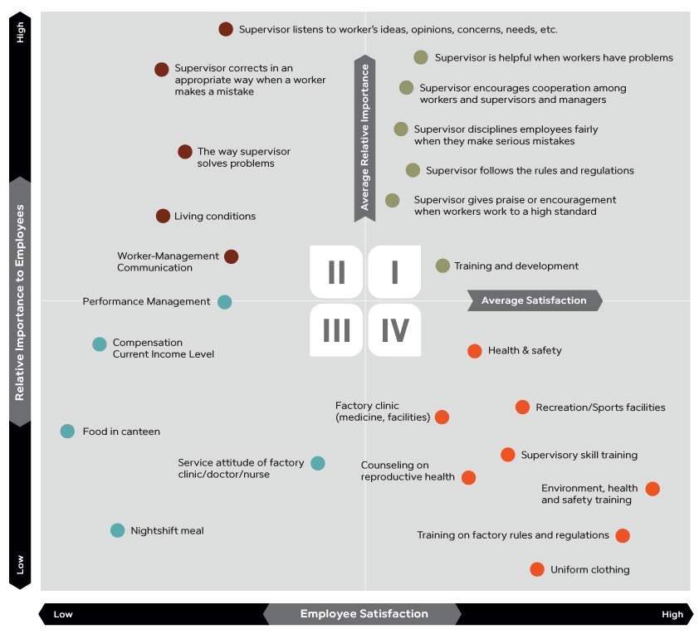

Slide 15
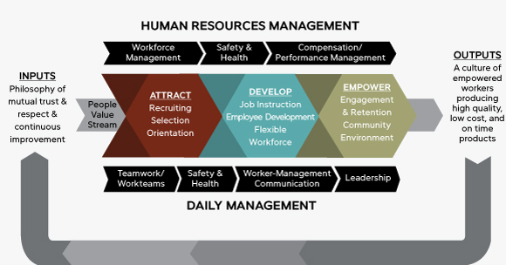
Culture of Empowerment model

Slide 16
Strategic choices in HR
Getting people into the organization
Making sure they have the knowledge/skills
Assessing how well they do jobs
Motivating high levels of effort

Slide 17
Competitive “Dance”
Offensive – exploit and strengthen its competitive position
Defensive – protect its competitive advantage and turf
Frontal assault
Attack weaknesses
All-out attack
Avoid head-on challenges
“Guerrilla” attacks
No areas to attack
Retaliation is expected
Counterattacks
No incentive to attack

Slide 18
Evaluating Competitive Strategy
Determine what happened
Increase in sales revenues, market shares, average donations, blood donors
Why?
Has the market changed?
Are resources being used effectively and efficiently?
Changes may be needed!

Slide 19
Implementing various functional strategies
Implementing the strategies very simply means doing them
Involves deciding what work processes and work activities will need to be done, and then just doing it
Managing organization’s functional area might keep it from exploiting its key resources

Slide 20
evaluating Strategies & Making Changes
Self Checkout Counters
Lower labor costs
Reduces impulse buys by 45%
What should retailers do now?
Nike Self Checkout Counters?
No; Prefers quality customer service
Loves impulse buys
SHOE LACES
SOCKS

Slide 21
evaluating Strategies & Making Changes
Performance measures at functional level
Quantitative
Qualitative
Must be measured against some standard
Strategy evaluation involves looking at what was done, what was supposed to be done, assessing any variances, and trying to determine what happened.

Slide 22
Coordinating with other organizational strategies
Organizational levels
Functional (marketing, HR, production, operations, etc.)
Business (competitive)
Corporate
Strategic choices
Affect or affected by implementation of functional strategies
It is important for an organizations functional strategies to be managed strategically so that its resources, capabilities, and core competencies can be developed into sustainable competitive advantage.

