Slide 1
Blue Ocean Strategy Chapter 1
Team 2 – Jakeb, Cedric, David, Cody
September 16, 2014

Slide 2
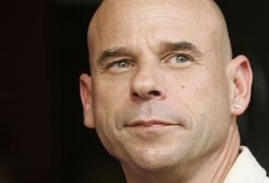
Creating Blue Oceans
Circus- Cirque du Soleil
CEO –Guy Laliberté
Created by group of street performers
Utilized the supply of experienced well trained performers
Supplier power = strong
Did not compete with Ringling Bros. and Barnum & Bailey in already dwindling market share.

Slide 3
New Market Space
Cirque du Soleil’s success It appealed to a whole new group of customers:
Adults and corporate clients prepared to pay a price several times greater for an out-of this world performance.
Realized: “the only way to beat the competition is to stop trying to beat the competition”

Slide 4
New Market Space
Red Oceans: all the industries in existence today
(known as the market space)
Blue Oceans: all the industries not in existence today
(Unknown market space)

Slide 5
New Market Space
Red Ocean
Industry boundaries are defined and accepted
Competitive rules of the game are known
Competition for share of market; companies outperform their rivals. Cutthroat competition turns the red ocean bloody.
Prospects for growth and profits become strained

Slide 6
New Market Space
Blue Ocean
Defined by untapped market space
Opportunity for a highly profitable growth
Generally created within red oceans by expanding existing industry boundaries i.e. Cirque du Soleil.

Slide 7
New Market Space
Disclaimer:
“It will always be important to swim successfully in the red ocean by outcompeting rivals. Red oceans will always matter and will always be a fact of business life. But supply exceeding demand in more industries, competing for a share of contracting markets, while necessary, will not be sufficient to sustain high performance…To seize new profits and growth opportunities, they also need to create blue oceans.”

Slide 8
The Continuing Creation of Blue Oceans
100 years back?
Industries as basic as automobiles, management consulting, or aviation had just began to merge.
30 years back?
Multibillion-dollar industries jump out like cell phones, discount retail express delivery packages and more.
Future?
Industries never stand still.

Slide 9
The Continuing Creation of Blue Oceans
U.S Government expanded the system for classifying industry sector.
Originally S.I.C
Standard Industrial Classification (numerical codes)
Established 1937
Purpose: to create uniform metrics for measuring and analyzing data across various agencies within the government.
Used by U.S Census, Bureau of Labor Statistics , IRS, Social Security Administration to name a few.
Codes are updated every 3 years.

Slide 10
The Continuing Creation of Blue Oceans
N.A.I.C.S
North American Industry Classification System
Implemented in 1997 to reflect changing economic conditions
Between Canada, Mexico, United States
[NAFTA] & North American Agreement on Labor Cooperation (NAALC)

Slide 11
The Continuing Creation of Blue Oceans
N.A.I.C.S
SIC codes have a hierarchical, top-down structure that begins with general characteristics and narrows down to the specifics. The first two digits of the code represent the major industry sector to which a business belongs. The third and fourth digits describe the sub-classification of the business group and specialization, respectively. For example, "36" refers to a business that deals in "Electronic and Other Equipment." Adding "7" as a third digit to get "367" indicates that the business operates in "Electronic, Component and Accessories." The fourth digit distinguishes the specific industry sector, so a code of "3672" indicates that the business is concerned with "Printed Circuit Boards."

Slide 12
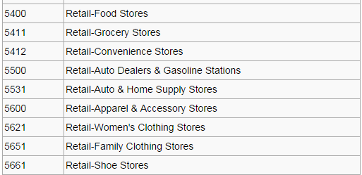
The Continuing Creation of Blue Oceans

Slide 13
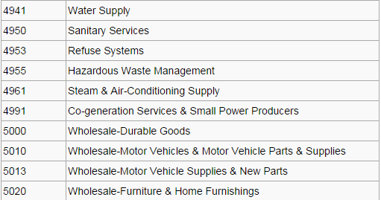
The Continuing Creation of Blue Oceans

Slide 14
The Rising Imperative of Creating Blue Oceans
The Sharks are multiplying (and the food source is not).
Technology
Globalization
Tiger sharks, the new neighbors
The best of the best of the best, sir—with honors
Who cares anymore?
Times are getting hard for brand loyalty—what difference does it make
In search for bluer pastures.
Back to the drawing board—its time for a new strategy

Slide 15
From Company and Industry to Strategic Move
Eww, what is it?
This and that company—are no more
Strategy—the difference maker.
You’re so demanding
Value Innovation

Slide 16
Value Innovation: The Cornerstone
Value innovation, the cornerstone of blue ocean strategy, is the simultaneous pursuit of differentiation and low cost, creating a leap in value for both buyers and the company.
Value Innovation= Value and Innovation
Ignoring Innovation= incremental changes
Ignoring Value= unmarketable products

Slide 17
Why Is It Controversial?
Value-Cost trade-off
Quality vs. Costs

Slide 18
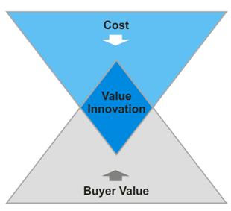
Value Innovation Chart
Value to buyers comes from the offering’s utility minus its price
Value to the company is generated from the offering’s price minus its cost,
Value innovation is achieved only when the whole system of utility, price, and cost is aligned.

Slide 19
Chipotle's Case
Cost Savings:
Minimum Marketing
Simple Layout
The Menu
Customer’s Value
Taste, Value, Convenience

Slide 20
Formulating Blue Ocean Strategy
Reconstruct market Boundaries
Chipotle – Quick service, healthy food; simultaneously
Focus on the big picture, not the numbers
Chipotle – fresh food is not as cheap, but consumers desire this
Reach beyond existing demand
Chipotle – existing demand lied in the unhealthy yet fast food market
Get the strategic sequence right
Utility, Price, Cost, Adoption = both Chipotle and customers win

Slide 21
Execution Principles
Overcome key organizational hurdles
Chipotle – tipping point leadership, overcoming hurdles of expanding market capabilities
Build execution into strategy
Chipotle - all levels of organization devoted to the culture of fresh, healthy, and environmentally friendly

Slide 22
Conclusion
Blue Ocean Strategy is not for everyone
Some companies were meant to stay in the Red Ocean
There is so much opportunity that is yet to be discovered

Slide 23
Blue Ocean Strategy Chapter 1
Team 2 – Jakeb, Cedric, David, Cody
September 16, 2014

