Slide 1
Analytical Tools and Frameworks
Group 4
Mason Hart
Dan Lanjewar
Cleto Cordero

Slide 2
Developing Analytical Tools And Frameworks
There are an impressive array of tools and frameworks to compete in red oceans
In the absence of analytics, Executives cannot be expected to act on a call to break away from existing competition and enter blue oceans
Effective blue ocean strategy should be about risk minimization not risk taking
To address the imbalance and in the quest for blue oceans we will look at the U.S. wine industry

Slide 3
U.S. Wine Industry helps make sence of Blue Ocean Strategy
The $20 billion industry is intensely competitive
California wines dominate 2/3 of the market
Imports from Europe, South America, and new domestic producer have the other 1/3 of the market
The Number of brands has exploded while the consumer market has remained stagnant with little to no growth
The top eight companies produce 75% and the other estimated 1,600 produce 25%
Overwhelming competition, Mounting Price pressure, Increasing bargaining power of retail and distribution channels, and flat demand despite overwhelming choice

Slide 4
What’s next
With regards to conventional strategic thinking, the industry is highly unattractive
How do we break out of this red ocean of bloody competition and make the competition irrelevant?

Slide 5
The Strategy Canvas
An analytic framework that is central to value innovation and the creation of blue oceans
It is both a diagnostic and an action framework for building a compelling blue ocean strategy
The strategy Canvas allows you to understand where the competition is currently investing, The factors that the industry currently competes on, and what consumer receive from the existing competitive offerings on the market

Slide 6
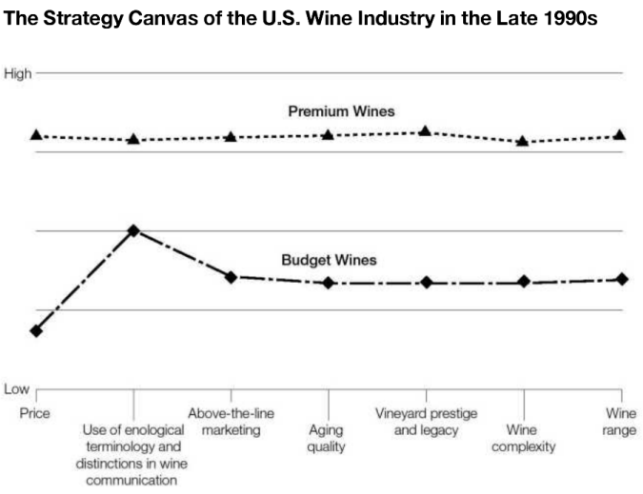

Slide 7
Market Perspective
Figure 2-1 shows that though there are nearly 1,600 wine companies in the U.S. there is enormous convergence of there value curves
Despite the plethora of competitors, when premium or budget wines are plotted on the strategy canvas we discover that from the market point of view all of them essentially have the same strategic profile
Higher Price = High Offering and High Costs
Lower Price = Low Offering and Low Costs

Slide 8
Setting the Brand Apart
To set a company on a strong, profitable growth trajectory in the face of these industry conditions, it won’t work to benchmark competitors and try to outcompete by offering a little more for a little less
Such a strategy may nudge sales up but will hardly lead to the path to blue oceans

Slide 9
Setting the Brand Apart
To shift the strategy canvas you must begin by reorienting your strategic focus
Competitors -> Alternatives
Customers -> Noncustomers
You must redefine the problem the industry focuses on and reconstruct buyer value elements
In the case of the wine Industry conventional wisdom led wineries to focus on over delivering on prestige and quality
This focuses on existing connoisseurs rather than noncustomers

Slide 10
Casella Wines
[yellow tail] – an Australian winery
Redefined the problem of the wine industry to a new one
How to make a fun and nontraditional wine that’s easy to drink for everyone?
Casella turned to the four actions framework to find blue oceans

Slide 11
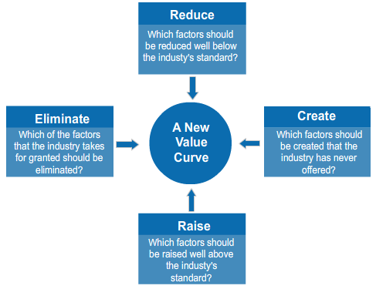
The Four Actions Framework Figure 2-2

Slide 12
The Four Actions Framework
The four questions address that there is a fundamental change in what buyers value
They allow you to explore how to reconstruct buyer value to offer buyer an entirely new experience
Hence making the existing rules of competition irrelevant
When applying the four action framework to the strategy canvas of your industry, you get a revealing new look at old perceived truths

Slide 13
[yellow tail]
A social drink available to everyone
Beer drinkers, cocktail drinkers, and other drinkers of nonwine beverages
In the space of two years [yellow tail] emerged as the fastest growing brand in the history of both the Australian and U.S. wine industries and the #1 imported wine in the U.S.
By August 2003 they became the number one sold red wine in a 750-ml bottle, outstripping California labels

Slide 14
[yellow tail]
By making a fun easy to drink wine they leaped over tall competitors with no promotional campaign, mass media, or consumer advertising
They didn’t simply steal sales, they grew the market

Slide 15
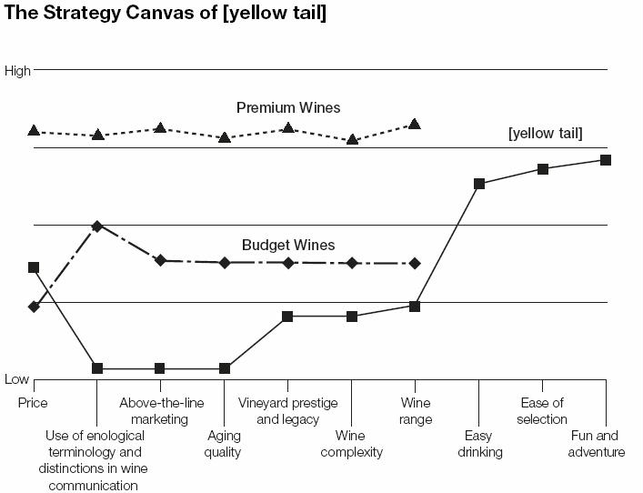

Slide 16
[yellow tail]
By focusing on easy to drink, easy to select, and fun and adventure and eliminated or reduced everything else yellow tail was able to expand the market and create a new demand that proved to be a great success

Slide 17
Eliminate-Reduce-Raise-Create Grid
Ask companies to ACT on all four questions in four actions framework
Key to creation of Blue Oceans

Slide 18
Four Immediate Benefits of Acting
Push to Simultaneously pursue differentiation and low cost Breaks value-cost tradeoff
2. Flags companies only focused on raising and
creating Keeps cost structure low

Slide 19
Eliminate-Reduce-Raise Create Grid: [yellow tail]
Eliminate Enological terminology Aging qualities Above-the-line marketing | Raise Price vs. budget wines Retail store involvement
Reduce Wine complexity Wine range Vineyard prestige | Create Easy drinking Ease of selection Fun and adventure

Slide 20
Eliminate-Reduce-Raise Create Grid: Cirque de Soleil
Eliminate Star performers Animal shows Aisle concession sales Multiple show arenas | Raise Unique venue
Reduce Fun and humor Thrill and danger | Create Theme Refined environment Multiple productions Artistic music and dance

Slide 21
Three Characteristics of Good Strategy
Focus
Divergence
Compelling Tagline
These define Blue Ocean Strategy!

Slide 22
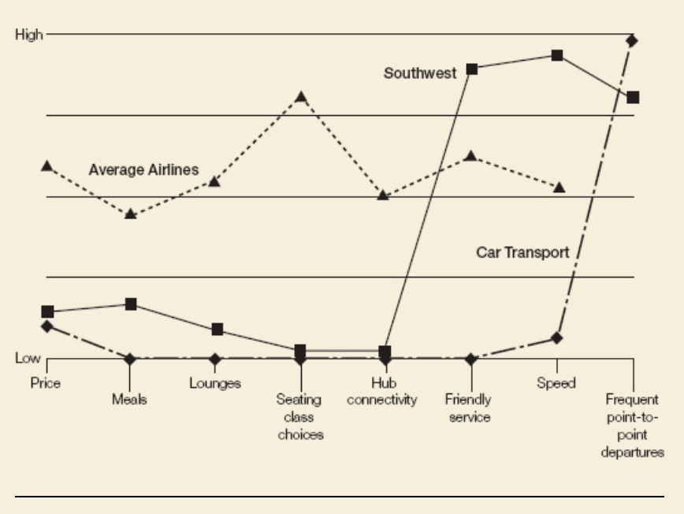
Three Characteristics: Focus
Company does not diffuse its efforts across all key factors
-Southwest Airlines: Focuses only on three factors

Slide 23
Three Characteristics: Divergence
Not benchmarking competitors but instead looking at alternatives
Applying the four actions Differentiate profile from industry average profile. Become unique.
Ex: Southwest Airlines
-Pioneered point-to-point travel between midsize cities
- As compared to hub-and-spoke systems
https://www.youtube.com/watch?v=Szn-TbvEL2I

Slide 24
Three Characteristics: Compelling Tagline
Makes your profile clear
Must deliver a clear message AND be truthful.
-or else lose customer interest and trust
[yellow tail]- “a fun and simple wine to be enjoyed every day”
Southwest Airlines- “The speed of a plane at the price of a car– whenever you need it.”

Slide 25
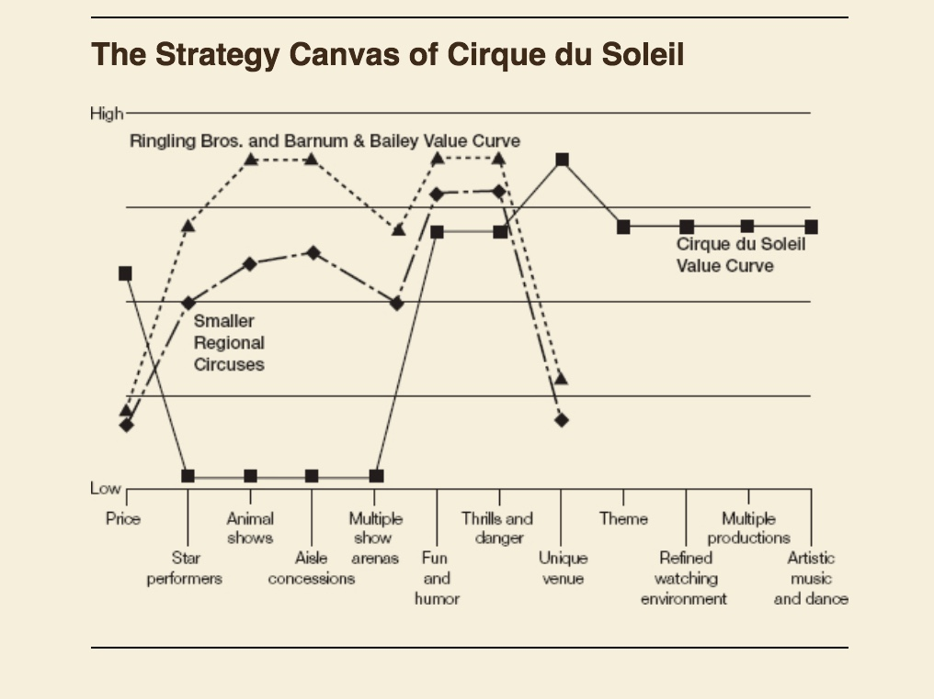
Cirque du Soleil’s Strategic Profile

Slide 26
Reading the Value Curves
Enables companies to see the future
Must understand how to read value curves
Wealth of strategic knowledge is embedded in the value curves on the status of a business

Slide 27
A Blue Ocean Strategy
Whether a business deserves to be a winner?
Focus, divergence, and compelling tagline that speaks to market
Lacks focus
Cost structure will be high
Lacks divergence
Strategy is a me-too
Lacks compelling tagline
Internally driven

Slide 28
A Company Caught in the Red Ocean
Value curve converges with its competitors
Company is caught within the red ocean of bloody competition
Explicit or implicit strategy trying to outdo it competition on the basis of cost or quality
Slows growth
Luck if the company benefits from being in an industry that is growing on its own accord

Slide 29
Overdelivery Without Payback
Does the company’s market share and profitability reflect these investments?
If not, strategy canvas signals that the company may be oversupplying customers
Company must decide which factors to eliminate and reduce to construct a divergent value curve

Slide 30
An Incoherent Strategy
Bowl of spaghetti
Zigzag with no rhyme or reason
May keep the business running and everyone busy, but does little to distinguish the company from the best competitor or to provide a clear strategic vision

Slide 31
Strategic Contradictions
Areas where company is offering a high level on one competing factor while ignoring others
Example- Costco trying to make its Website easy to use but not correcting how slow the site is
Inconsistencies can be found between the level of your offering and your price
Example- Costco offering less product for a higher price

Slide 32
An Internally Driven Company
The language used in strategy canvas gives insight as to whether a company’s strategic vision is built on an “outside-in” perspective
Analyzing the language helps a company understand how far it is from creating industry demand

