Slide 1
Reconstructing Market Boundaries Blue Ocean Strategy: Chapter 3
Presenters: Alyssa Barney, Amy Wolf, Cory Myres, and Hunter Heidenheimer

Slide 2
Reconstruct Market Boundaries
Red Oceans to Blue Oceans
Six Paths Framework
Challenges of the Six Fundamental Assumptions
1. Industry
2. Strategic Groups
3. Buyer Groups
4. Scope
5. Functional / Emotional Orientation
6. Time
Notes:
Alyssa
Discuss Red Ocean and Blue Ocean
Discuss Reconstructing Boundaries and what paths an industry should take to become successful
Look Across Alternative Industries
Strategic Groups
Buyer Groups
Scope
Time
Functional/Emotional Orientation

Slide 3
Path 1: Look Across Alternative Industries
Alternatives v. Substitutes
Consumer v. Seller Thought Process
Southwest’s Driving v. Flying
Your Team’s Company
Notes:
Cory
1. Alternatives
2. Restaurants and cinemas will entertain the customer but are completely different. Enjoy a night out.
3. We know that we have alternatives as a consumer, but we rarely, as sellers acknowledge the consumer has alternatives.
4. Our company, Southwest Airlines, was mentioned in the book citing it’s concentration on the alternative to flying, Driving. They stated that Southwest created a blue ocean by offering the speed of air travel at the cost of driving. They have plenty of substitute airlines, but only one real “Alternative” to the industry, and that’s driving.
5. Ask yourself, what alternatives do my customers have to my product? How does that industry act?

Slide 4
Path 2: Look Across Strategic Groups Within Industries
Strategic Group Dimensions
Price and Performance
In the case of Curves
Notes:
Hunter
1. Strategic groups refer to a group of companies within an industry that pursue a similar strategy. Strategic groups can be ranked in order roughly by two dimensions: 1) Price 2) Performance. Each jump in price tends to bring a corresponding jump in some dimensions of performance.
The key to creating a blue ocean across existing strategic groups is to break out of this narrow tunnel vision by understanding which factors determine customers’ decisions to trade up or down from one group to another.
Curves built primarily on the advantage of two strategic groups in the U.S. fitness industry - traditional health clubs and home exercise programs - and eliminated or reduced everything else. They mix the home exercise program with the health club scene.
Customers typically trade up from the regular scene to advance themselves. For instance, the women trade up from the home exercise program because they do not feel that they can work out with all of the distractions surrounding them at their home.
The women trade down from the health club scene because they do not necessarily desire all of the extras that health clubs offer.
Southwest Examples Cost, efficiency, time, whereas other companies focus on comfort and other features while charging a little more. Elaborate!
What are the different strategic groups in your industry?
Chipotle vs Taco Bell – cost vs. quality – cost cutting strategies.
Ford vs GM – what are the differences there
Apple vs Microsoft and other hardware manufacturers.
Yellow Tail -

Slide 5
Curves Strategy
Notes:
In the case of Curves
Why do customers trade up for the higher group?
Why do customers trade down for the lower one?

Slide 6
Path 2: Look Across Strategic Groups Within Industries
Strategic Group Dimensions
Price and Performance
In the case of Curves
Southwest Airline’s Strategic Groups
Your Company’s Strategic Groups
Notes:
Hunter
1. Strategic groups refer to a group of companies within an industry that pursue a similar strategy. Strategic groups can be ranked in order roughly by two dimensions: 1) Price 2) Performance. Each jump in price tends to bring a corresponding jump in some dimensions of performance.
The key to creating a blue ocean across existing strategic groups is to break out of this narrow tunnel vision by understanding which factors determine customers’ decisions to trade up or down from one group to another.
Curves built primarily on the advantage of two strategic groups in the U.S. fitness industry - traditional health clubs and home exercise programs - and eliminated or reduced everything else. They mix the home exercise program with the health club scene.
Customers typically trade up from the regular scene to advance themselves. For instance, the women trade up from the home exercise program because they do not feel that they can work out with all of the distractions surrounding them at their home.
The women trade down from the health club scene because they do not necessarily desire all of the extras that health clubs offer.
Southwest Examples Cost, efficiency, time, whereas other companies focus on comfort and other features while charging a little more. Elaborate!
What are the different strategic groups in your industry?
Chipotle vs Taco Bell – cost vs. quality – cost cutting strategies.
Ford vs GM – what are the differences there
Apple vs Microsoft and other hardware manufacturers.
Yellow Tail -

Slide 7
Path 3: Look Across the Chain of Buyers
Chain of buyers
Purchasers
Users
Influencers
Nordisk in the Insulin Industry
Southwest Airlines
Happy Employees = Happy Customers
Notes:
Amy
-Companies in an industry target different customer segments.
For example: Large vs. Small customers.
-An industry usually focuses on a single buyer group.
For example: The pharmaceutical industry focuses on influencers: doctors quest for better medications
The physicians influence the pharmaceutical industry to come out with the next new drug.
The office equipment industry focuses on purchasers: corporate purchasing departments
The clothing industry sells a majority of clothes to users, the individuals who are wearing their product.
-By looking across the chain of buyers, which consists of the purchasers, users, and influencers companies can gain new insights into how to redesign a company’s value curves to focus on a set of overlooked buyers, which can in return lead a company to the discovery of a blue ocean.
-Nordisk created a Blue Ocean in the insulin industry with the NovaPen launch in 1985, this took away the trouble of diabetic patients having to carry around syringes and needles and reduced the embarrassment of administering insulin greatly.
-The patient was able to carry almost a week’s worth of insulin
-With different technologies focused on diabetes patients, Nordisk shifted from an insulin company to a diabetes care company.
-Nordisk saw that they could break away from their competition and create a blue ocean by shifting industry’s longstanding focus on the users (People with diabetes) rather than the purchaser (doctors)
-Bloomberg example: shifted their company’s focus on buyers being IT managers to the realization that IT managers were not the ones that make or lose millions of dollars, the Traders and analyst were. Bloomberg offered a system specifically to offer traders better value by offering them easy-to-use key terminals and keyboards labeled with familiar financial terms. By focusing on users, Bloomberg was also able to see the paradox of traders’ and analysts’ personal lives, which enhanced their overall experience of using the Bloomberg terminals.
EXAMPLE FROM SOUTHWEST – focused on employee satisfaction, happy employees = happy customers.

Slide 8
Path 4: Look Across Complementary Product and Service Offerings
Complementary value or cost can affect the sale of your product or service
In the case of Vehicles (NABI)
Notes:
Hunter
1. Anything can affect demand for your business, such as ease of finding a babysitter affecting one’s decision to go to the movies. If someone says “it’s always crowded downtown and I can’t find parking, lets go to this other store that’s less popular” The fact that there is insufficient parking garages downtown has just affected a business. If a store has 1 thing I need but not the other 4, I’ll usually put the one thing down and go to a different store. It’s not worth my time to wait in line to buy the 1 item. So Target, Walmart, or United Grocery may have just lost a sale because the shipment of toothpaste, peanut butter, and jelly, weren’t in, only the ice cream I wanted
2. In the book it’ tells the story about the busses, the city had been focusing on the purchase price of the vehicle as it’s sole factor, however the bus would inadvertently cause road repair, it would need maintenance, and it would also have other costs associated with the use over the next decade.
3. What are some complimentary services or products that can affect Southwest Airlines? We can identify the equipment used to haul baggage from the building to the plane, the aircraft’s parts and repair and even the quality of airport services at the gate.
4. what complimentary services or products does your business have?
-If they’re having trouble answering Apple, ipad, iphone, macbook all work together on the iCloud – they design their business to have these complementary things that they can control the sale of.
Chipotle, what are the complementary services
Ford? Firestone tires? How did that affect ford in 2001

Slide 9
NABI
Notes:
Hunter

Slide 10
Path 4: Look Across Complementary Product and Service Offerings
Complementary value or cost can affect the sale of your product or service
In the case of Vehicles (NABI)
Southwest Airlines
Your Team’s Company
Notes:
Hunter
1. Anything can affect demand for your business, such as ease of finding a babysitter affecting one’s decision to go to the movies. If someone says “it’s always crowded downtown and I can’t find parking, lets go to this other store that’s less popular” The fact that there is insufficient parking garages downtown has just affected a business. If a store has 1 thing I need but not the other 4, I’ll usually put the one thing down and go to a different store. It’s not worth my time to wait in line to buy the 1 item. So Target, Walmart, or United Grocery may have just lost a sale because the shipment of toothpaste, peanut butter, and jelly, weren’t in, only the ice cream I wanted
2. In the book it’ tells the story about the busses, the city had been focusing on the purchase price of the vehicle as it’s sole factor, however the bus would inadvertently cause road repair, it would need maintenance, and it would also have other costs associated with the use over the next decade.
3. What are some complimentary services or products that can affect Southwest Airlines? We can identify the equipment used to haul baggage from the building to the plane, the aircraft’s parts and repair and even the quality of airport services at the gate.
4. what complimentary services or products does your business have?
-If they’re having trouble answering Apple, ipad, iphone, macbook all work together on the iCloud – they design their business to have these complementary things that they can control the sale of.
Chipotle, what are the complementary services
Ford? Firestone tires? How did that affect ford in 2001

Slide 11
Path 5: Look Across Functional or Emotional Appeal to Buyers
Functional v. Emotional appeal
Notes:
Cory
What is the product doing now? What could it be doing?
Extra Gum - What it do? Freshen yo bref? Ok lets watch this commercial… long lasting gum flavor? long lasting relationship mementos? This will tug at your heartstrings which has absolutely nothing to do with gum.
Now of course we need to watch a southwest commercial, What’s their demographic? This commercial is much more straight forward. Most
Extra Gum Commercial
http://youtu.be/wZu5l3PCCHs
Southwest Commercial
http://youtu.be/TR7JApjgIGw
Apple
https://www.youtube.com/watch?v=fmTpgSMJ96c
Ford
https://www.youtube.com/watch?v=X8uXrwhWVOM
Chipotle
http://youtu.be/Sul6EVtChdc

Slide 12
Extra Gum
Notes:
Cory

Slide 13
Southwest Airlines
Notes:
Cory

Slide 14
Apple, Inc.
Notes:
Cory

Slide 15
Ford
Notes:
Cory

Slide 16
Chipotle
Notes:
http://youtu.be/Sul6EVtChdc

Slide 17
Path 6: Look Across Time
Three Key Principles to Look Across Time:
Be Decisive
Irreversible
Clear Trajectory
Southwest Airline’s Fuel Hedging
A Competitive Cost Advantage
Saved Southwest 6 Billion Dollars
Notes:
Amy
http://bamedia.ba.ttu.edu/Mediasite/Play/c533e6cc435b47febbd12a36a0f19b7c1d?catalog=0225aad7-8d77-4dab-95ff-489c2b389702
Gary Kelly
Fuel hedging – Purchasing fuel stock options ahead of time. Like insurance for anyone, their way of ensuring they avoid the fluctuation of gas prices, which in return widens their competitive cost advantage. Started hedging and trading crude oil in the mid 80’s. When they begin a year, they would like to have 80% of their fuel hedged. Since they have began this, they saved around $3 billion and as of now, no other airlines have used this competitive strategy.
What are other companies in your industry doing to keep up with the advancement in technology?
Apple launching the first ever Iphone touch screens. After, Samsung and other mobile careers launched touch screens. Apple is constantly using their Research and Development to innovate their current products and develop new ones such as their Iwatch, which has the capability to hold your bank information and reduces the trouble of carrying credit cards.
What is your Team’s plan to keep up with the market?
-Ford creating fuel efficient/hybrid cars

Slide 18
Gary Kelly – Southwest’s Fuel Hedging
Notes:
http://bamedia.ba.ttu.edu/Mediasite/Play/c533e6cc435b47febbd12a36a0f19b7c1d?catalog=0225aad7-8d77-4dab-95ff-489c2b389702
Times of Start & Finish
34:30: Start
38:14: End
Make sure we have Silverlight TUESDAY
Gary Kelly

Slide 19
Path 6: Look Across Time
Three Key Principles to Look Across Time:
Be Decisive
Irreversible
Clear Trajectory
Southwest Airlines Fuel Hedging
A Competitive Cost Advantage
Has Saved Southwest 6 Billion Dollars
What are other companies in your industry doing to keep up with the advancement in technology?
What is your team’s plan to keep up with the market?
Notes:
Amy
http://bamedia.ba.ttu.edu/Mediasite/Play/c533e6cc435b47febbd12a36a0f19b7c1d?catalog=0225aad7-8d77-4dab-95ff-489c2b389702
Gary Kelly
Fuel hedging – Purchasing fuel stock options ahead of time. Like insurance for anyone, their way of ensuring they avoid the fluctuation of gas prices, which in return widens their competitive cost advantage. Started hedging and trading crude oil in the mid 80’s. When they begin a year, they would like to have 80% of their fuel hedged. Since they have began this, they saved around $3 billion and as of now, no other airlines have used this competitive strategy.
What are other companies in your industry doing to keep up with the advancement in technology?
Apple launching the first ever Iphone touch screens. After, Samsung and other mobile careers launched touch screens. Apple is constantly using their Research and Development to innovate their current products and develop new ones such as their Iwatch, which has the capability to hold your bank information and reduces the trouble of carrying credit cards.
What is your Team’s plan to keep up with the market?
-Ford creating fuel efficient/hybrid cars

Slide 20
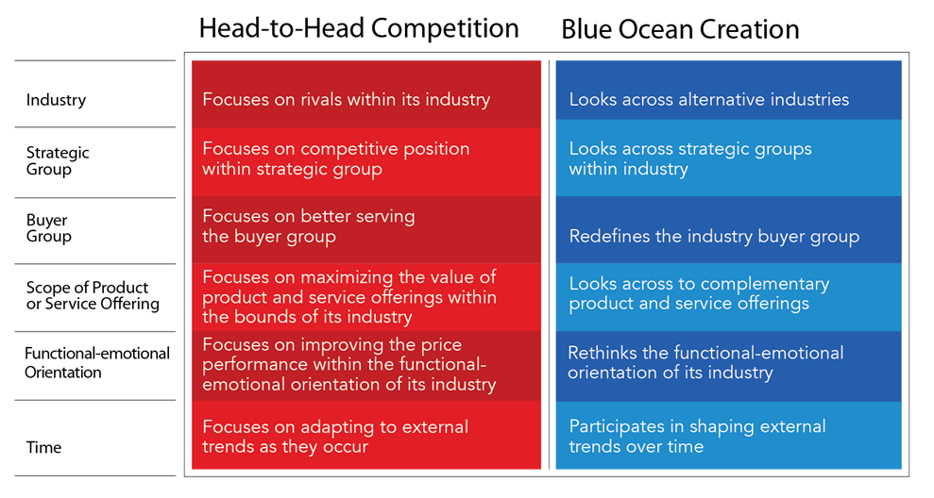
Conceiving New Market Space
Notes:
Alyssa
Connect this to Chapter 4 somehow – look to the future.

Slide 21
Notes:
Alyssa

