Slide 1
Reach Beyond Existing Demand
Nikki Chaib
Rachel Parrish
Banner Owen
Alex Gonzalez

Slide 2
How do you maximize the size of the blue ocean you are creating?
Should a company look at existing customers? Or drive for finer segmentation to accommodate buyer differences?
Typically, a market tends to expand and retain their existing customer base, in order to grow a share of their market.
The Blue Ocean Strategy focuses on the opposite. They focus on noncustomers and what they value in order for them to enter their market.
Instead of focusing on customer differences, they need to build on powerful commonalities in what buyers value. That allows companies to reach beyond existing demand to unlock a new mass of customers that did not exist before.
3 Tiers of Noncustomers
1st Tier: soon-to-be noncustomers
2nd Tier: refusing noncustomers
3rd Tier: unexplored noncustomers

Slide 3
First Tier Noncustomers
Closest to your market-they sit on the edge of your market
Known as “soon-to-be” noncustomers
They are waiting to jump ship and leave the industry as soon as the opportunity presents itself.

Slide 4
Second Tier Noncustomers
Known as Refusing Noncustomers
The second tier of noncustomers is people who refuse to use an industry’s offering. These are buyers who have seen the current offering as an option to fulfill their needs but have decided against participating.
Either do not use or cannot afford to use your offerings because they find the offerings unacceptable or beyond their means.

Slide 5
Third Tier Noncustomers
Farthest from your market
Known as Unexplored Noncustomers
They are noncustomers who have never considered the market’s offering as an option.
Typically, these customers have not been targeted or thought of as your potential customers by any player in the industry.

Slide 6
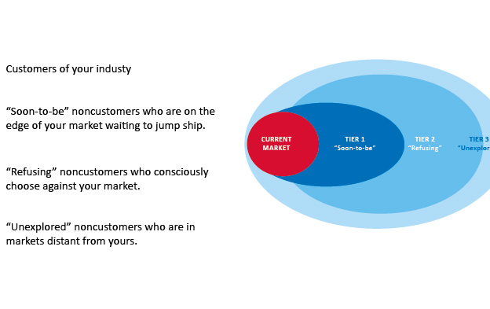
The 3 Tiers of Noncustomers

Slide 7
Go for the Biggest Catchment
By focusing on key commonalities across these noncustomers and existing customers, companies can understand how to pull them into their new market.
Even though “the natural strategic orientation of many companies is toward retaining existing customers and seeking further segmentation opportunities” seems the best way to go for competitive purposes, this will NOT create a blue ocean that expands the market and creates new demand.
You should focus on the tier that represents the biggest catchment at the time for you.

Slide 8
Go for the Biggest Catchment
To maximize the scale of your blue ocean:
Reach beyond existing demand to noncustomers and desegmentation opportunities while you formulate future strategies.
“If no such opportunities can be found, you can then move on to further exploit differences among existing customers.”

Slide 9
First-Tier of Noncustomers

Slide 10
First-Tier of Noncustomers
“Soon-to-be” noncustomers who are on the edge of your market waiting to jump ship.
Minimally purchase an industry’s offering out of necessity, but are mentally noncustomers of the industry.
These people view themselves as noncustomers.
As the number of these customers increases, the market grows stagnant and develops a growth problem.
Notes:
Closest to your market

Slide 11
Pret A Manger
British fast-food chain who tapped into the latent demand of first-tier noncustomers.
European professionals frequented sit down restaurants for lunch.
Too long
Not healthy
Too expensive
Notes:
These professionals were first tier noncustomers who were in search of better solutions

Slide 12
Pret A Manger
The European professionals shared three comonalities:
They wanted lunch fast.
They wanted it fresh and healthy.
They wanted it at a reasonable price
Pret used these commonalities to unlock untapped demand. They offered:
Quality sandwiches made fresh every day
Available at a speed faster than fast food restaurants at low prices
Notes:
Each store has its own kitchen
Nonfresh items are made by high quality producers
Their different types of breads came from countries that specialzed in them
No food was kept over to the next day….leftovers given to homeless
Instead of ordering, pay, wait, receive, sit down, it is browse, pick up, pay, leave.
Sells 25 million sandwiches a year
Pret A Manger looked at the first tier non customers who were waiting to jump ship from eating at restaurants every day, and created a blue ocean full of untapped demand.

Slide 13
Apple First-Tier Noncustomers
Tech savvy people or young people
These customers are always searching for something better.
If offered a leap in value, they would stay and increase their purchases.
Notes:
By reaching across existing customers and tapping into the world of noncustomers, a company can greatly increase demand for their product.
These people would jump ship if a better alternative came along. People who are wanting the latest greatest technology will jump ship if a different company offered something better than the iphone or ipad. When iphone first came out, these were people who had flip phones, who jumped ship to apples market.
Southwest – someone who wants first class, more amenities, etc. Someone who has a need to fly more globally than domestically. Or someone who flies southwest just because it’s the most convenient, but if american airlines started offering the same amenities, that customer might jump ship.
Chipotle -
Costco – If Sam’s offered higher end products. Or customers who shop at walmart, and jumped ship to costco when they came to lubbock
Exxon – customers buy gas either way. They will jump ship if exxon offered better service or something like that
Ford – customers who want a new body style, or people who want/need the ford credit.

Slide 14
Second-Tier of Noncustomers

Slide 15
Characteristics
These are refusing noncustomers.
These types of customers do not see a need in your product or do not have the means to purchase.
Their need is dealt with by other means or is ignored.

Slide 16
JcDecaux
Creation of outdoor advertising that would revolutionize the advertising market.
Broke the obstacle of their market for advertising by fulfilling the needs of municipalities and other companies looking for new ways of exposure.
The medium offered was both efficient in speed and cost for cities and JcDecaux.

Slide 17
Apple Based Examples
Apple-
Those that cannot afford the initial forthcoming of apples products.
Others that have become brand loyal to companies such as Samsung, Hewlett Packard, or Dell.
To break into these second-tier customers apple has come up with new and innovative technology that is both affordable and user friendly. Such as the iPhone 5c or the MacBook air. They have also integrated their products to draw away from other brands.

Slide 18
What About Yours?
Chipotle
Southwest
Costco
Exxon
Ford
How can your company break into their second-tier non customers?

Slide 19
Third-Tier of Noncustomers

Slide 20
Third-Tier Noncustomers
Farthest away from a Companies Market
The customers have never thought about a certain markets offerings
If companies make an effort and understand these non customers
They could pull them in

Slide 21
Third-Tier Noncustomers
Unexplored noncustomers
1. have not been targeted
2. thought of as potential customers
Their needs and business opportunities belong in other markets
Not always the case
Notes:
Companies would be surprised how many 3 teir non cust, they are forfeiting and losing opportunities
Oral care example

Slide 22
Examples
Apple
Started as a computer company
Moved to phones and portable computers
Chipotle
Alcohol – caused people to stay longer
Nice place but still fast food
Ford
Finally moving into eco boost and hybrids

Slide 23
Examples In the Book
Dentist offering whitening then oral care companies moving into the market
US aerospace industry
Navy, Marines, Air Force
All need different aircrafts but still have some commonalities
The combined factors lead to an aircraft for all three branches built by the JSF (Joint Strike Fighter)

Slide 24
Reaching Beyond
By reaching beyond the existing customers of each military branch
The JSF aggregated demand previously divided among the military branches
Lockheed Martin – awarded $200 billion dollar project
US looks at this as a great success because it won the support of all three branches

Slide 25
Summing it up
No Hard-and-fast rule to suggest which tier of noncustomers one should focus on
Focus on the biggest targets at the time
Finding commonalities across all three tiers
Not focusing on one tier – but look across all tiers
GOING FOR THE LARGEST CATCHMENT

Slide 26
CONCLUSION
Companies can not focus on existing customers only but also go for the future in attracting new customers
Attracting the noncustomers
By attaining information
Create that Blue Ocean!

