Slide 1
Blue Ocean Strategy Get the Strategic Sequence Right
Jonathan Kiser
Daniel Trejo
Blake Hiett
Daniel Hanson

Slide 2
Introduction
Discuss the Strategic Sequence and how to properly implement it into your business model
Validating your Blue Ocean ideas to ensure their longtime viability
With these you can dramatically reduce your business model risk

Slide 3
Strategic Sequence
Buyer Utility
No-Rethink
Yes
Price
No-Rethink
Yes
Cost
No-Rethink
Yes
Adoption
No-Rethink
Yes
A Commercially Viable
Blue Ocean Idea

Slide 4
Buyer Utility
The need to assess the buyer utility of your offering is self-evident.
Many companies, however, fail to deliver exceptional value because they are obsessed by the novelty of their product or service especially if technology plays a part in it.

Slide 5
Phillips CD-i
Phillips CD-I failed to offer people a compelling reason to buy
Promoted as the “imagination machine” due to its diverse functions
Video machine, music machine, game player, and teaching tool
It did so many things that people were never able to understand it

Slide 6
Phillips Cont’d
Also lacked attractive software titles
Theoretically it could do almost everything, but in reality it could do very little
Phillips assumed that bleeding edge technology was equivalent to bleeding edge utility

Slide 7
To get around this trap, the starting point, is to create a strategic profile that passes the initial litmus test of being focused, being divergent, and having a compelling tagline that speaks to buyers.
By doing so, companies are ready to expressly assess where and how the new product or service will change the lives of its buyers
Such a difference in perspective is important because it means that the way a product or service is developed becomes less a function of its technical possibilities and more a function of its utilities to buyers

Slide 8
Buyer utility map helps managers look at this issue from the right perspective
It outlines all the levers companies can pull to deliver exceptional utility to buyers as well as the various experiences buyers can have with a product or service
It allows managers to identify the full range of utility spaces that a product or service can potentially fill

Slide 9
Utility levers – the ways in which companies can unlock exceptional utility for buyers
Most commonly used lever is customer productivity in which an offering helps a customer do things faster or better
To test the exceptional utility, companies should check whether their offering has removed the greatest blocks to utility across the entire buyer experience cycle for customers and non customers
The greatest blocks to utility often represent the greatest and most pressing opportunities to unlock expected value

Slide 10
Before the ford model T made its debut, the more than 500 automakers in the US focused on building custom made luxury vehicles for the wealthy
In terms of the buyer utility map, the entire industry focused in the image in the use phase creating luxury cars for fashionable weekends
Greatest blocks to utility for the mass of people were not in refining the autos luxury or stylish image rather they had to do with 2 other factors

Slide 11
1) convenience – cars were not able to go through bumpy, muddy roads.
2) risk in maintenance phase, cars being freely crafted and having multiple options, often broke down, requiring experts to fix them and experts were expensive and in short supply

Slide 12
The Ford model T eliminated these two utility blocks
Name the car for the great multitude came only in one color and one model
Ford also eliminated investments in image in the use phase instead for fancy, luxurious weekends
The model was made for every day use

Slide 13
Change in Strategic Price Decision
There are 2 reasons for this change:
Companies discovering volume generates higher returns than it used to.
To a buyer, the value of a product or service may be closely tied to the total number of people using it.
In the meantime, the rise of knowledge-intensive products also creates the potential for free riding.
Notes:
You must set the right strategic price to secure a strong revenue stream for your offering. This step ensures that buyers not only will want to buy your offering but also will have a compelling ability to pay for it. Many companies are starting to take a reverse course, first testing the waters of a new product/service by targeting novelty-seeking, price-insensitive customers at the launch of a new business idea; only over time do they drop prices to attract mainstream buyers.

Slide 14
Rival VS. Nonrival Goods
The use of rival goods by one firm precludes its use by another firm.
Ex. Scrap steel
The use of a nonrival good by one firm does not limit its use by another.
This makes competitive imitation not only possible but less costly.
The cost and risk of developing an innovative idea are borne by the initiator, not the follower.

Slide 15
Excludability
Excludability is a function both of the nature of the good and of the legal system.
Once ideas are out there, knowledge naturally spills over to other firms.
This lack of excludability reinforces the risk of free riding.
Notes:
A good is excludable if the company can prevent others from using it because of, for example, limited access or patent protection. CURVES EX.
All this means that the strategic price you set for your offering must not only attract buyers in large numbers but also help you to retain them.
Companies must start with an offer that buyers cant refuse and must keep it that way to discourage any free-riding imitations. This is what makes strategic pricing KEY.
When exceptional utility is combined with strategic pricing, imitation is discouraged.

Slide 16
Price Corridor of the Mass
Defined:
A tool used in helping managers find the right price for an irresistible offer, which, by the way, isn't necessarily the lower price.
The tool involves 2 distinct but interrelated steps (figure 6-5).

Slide 17
Price Corridor of the Mass Cont’d
Step 1: identify the Price Corridor of the Mass
Step 2: Specify a Level Within the Price Corridor

Slide 18
Three Levels of Cost
Streamlining and cost innovation
Partnering
Pricing innovation

Slide 19
Streamlining and cost innovation
raw materials be replaced by unconventional
Moving lactations of your plant
Finding a way to reduce steps in making something

Slide 20
Partnering
Provides a way for companies to secure needed capabilities fast and effectively while dropping their cost structure.

Slide 21
Pricing innovation
Selling to renting Ex blockbusters
Timeshare Ex Netjet
Slice-share Ex mutual fund managers
Equity interest Ex Hewlett-Packard

Slide 22
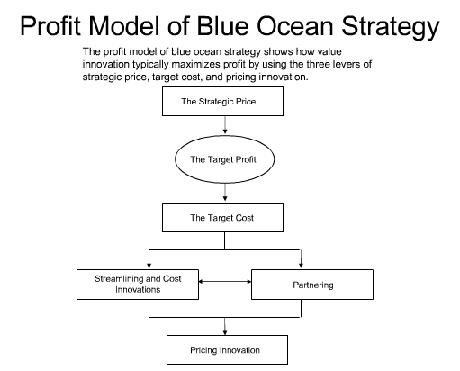

Slide 23
Adoption
You need your stakeholders to buy into your new business model
Employees
Let your employees know before you let the public know about your new business idea
Make sure everyone is on the same page
Business Partners
Partners want to make sure their revenue stream and market share won’t be affected
General Public
A new and innovative idea might that might threaten established political and social norms, might scare off customers

Slide 24
Summary
Discussed the Strategic Sequence and how to properly implement it into your business model
Validated your Blue Ocean ideas to ensure their longtime viability
With these your risk for your business model can be dramatically reduced

Slide 25
Any Questions?

