Slide 1
Blue Ocean Strategy Ch 7: Overcome Key Organizational Hurdles
Cleto Cordero
Dan Lanjewar
Mason Hart

Slide 2
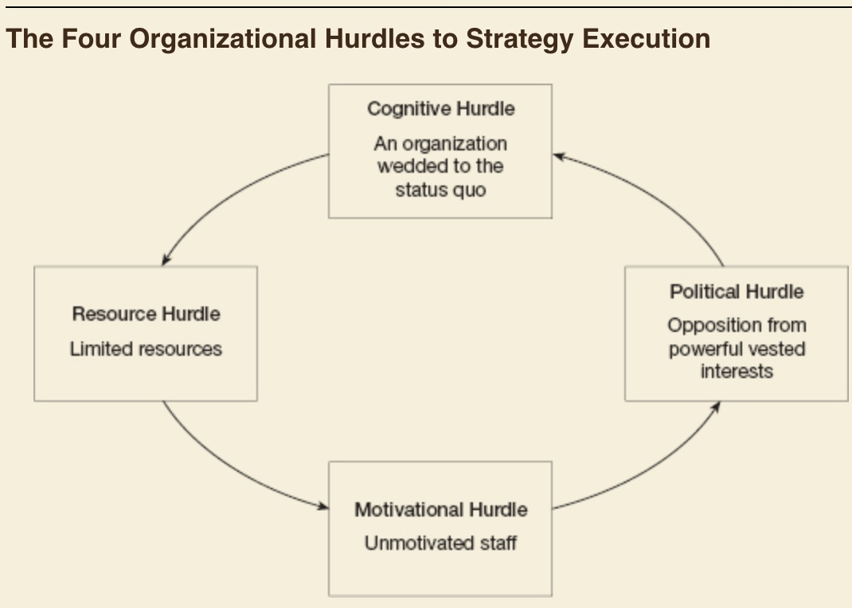
Four Organizational Hurdles in Executing BOS
Cognitive
Limited Resources
Motivation
Politics

Slide 3
Tipping Point Leadership
Ditch Conventional Wisdom
Allows you to overcome the four hurdles
Fast
At low cost
Win employees’ backing in executing a break from status quo
Change can happen quickly when energy is focused

Slide 4
Disproportionate Influence
Concentration- Key to unlocking an epidemic movement.
Tackle massive challenges by FOCUSING efforts on points of disproportionate influence
As a result get more bang for your buck

Slide 5
Breaking the Cognitive Hurdle
1. Direct experience
Numbers are forgettable and uninspiring
NYPD example
2. Meet with Disgruntled Customers
Listen to customers firsthand
Know where to direct efforts

Slide 6
Jump the Resource Hurdle
Most leaders are faced with the reality of limited resources
Reformist CEOS do one of two things:
Trim their ambitions and demoralize their work forced
Fight for more resources from their bankers and shareholders
Focus on multiplying the value of current resources
Three factors that can free resources:
Hot spots
Cold spots
Horse trading

Slide 7
Jump the Resource Hurdle (cont.)
Hot Spots: Low resource input, high potential performance gains
Low Spots: High resource input, low performance impact
Horse Trading: Trading your unit’s excess resources in one area for another unit’s excess resources to fill remaining resource gaps

Slide 8
Redistribute Resources to Your Hot Spots
To increase profits, increase costs; but not possible given the budget
Increments in performance could be achieved only with proportional increments in resources
Refocusing cops at subways decreased subway crime
Solution, even though the size of the police force remained the same
When there was a reallocation of staff and resources in the narcotics unit, drug crime plummeted

Slide 9
Redirect Resources from Your Cold Spots
Free up resources by pointing out cold spots
Bratton brought processing centers to the criminals
“Bust buses”
Cut time from 16 hours to one hour

Slide 10
Engage in Horse Trading

Slide 11
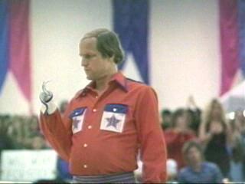
Identify Kingpins
For Strategic change to have a real impact
Trigger an epidemic movement of positive energy
Not by the mass; but by concentrating on leaders
Who are your Kingpins?
Notes:
.Identifying these key influencers is easy
Key influencers in the organization; people inside the organization who are natural leaders, who are well respected and persuasive

Slide 12
Place Kingpins in a Fishbowl
Fishbowl Management
Action and Inaction made Transparent
Based on transparency, inclusion, and fair process
Notes:
At the heart of motivating these kingpins is to shine a spotlight on their actions in a repeated and highly visible way
By doing this you prevent inaction and shine light on those who perform
For it to work it must be transparent, include everyone, and have a fair process

Slide 13
Kingpins in the Fishbowl
Kingpins tend to perform well in light of their peers
And those who don’t will be held accountable
Creates a group atmosphere
For it to work, fair process must be the modus operandi
Notes:
By fair process, engaging all affected people in the process, explaining to them the basis of decisions and the reasons people will be promoted or side-stepped in the future, and setting clear expectations of what that means to employees’ performance.

Slide 14
Atomization
Unless employees believe in the attainability of the strategic change, it’s not likely to succeed
So we make Atoms not grand strategic visions
Notes:
These bite sized atoms are to help employees remain in a positive attitude and know that what we are doing is attainable

Slide 15
Political Hurdle
“Even the best and brightest are regularly eaten alive by politics, intrigue, and plotting.”
There will be a fight against the strategic change
Angels
Devils
Notes:
To overcome these political forces, leaders focus on three disproportionate influence factors: leveraging angels, silencing devils, and getting a consigliere on the top management team.
Angels have the most to gain form the strategic shift
Devils have the most to lose from it

Slide 16
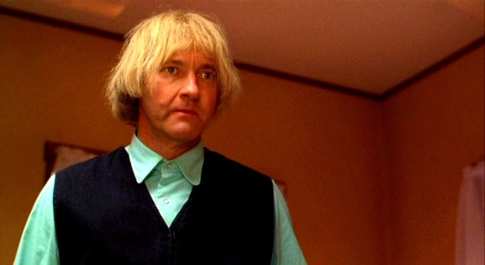
Consigliere
Politically adept and highly respected
Knows in advance all the land mines and who will fight and who will support
Notes:
This is the right hand man going through the change to protect against the political hurdels

Slide 17
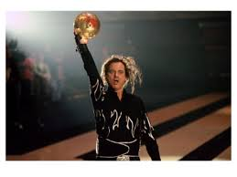
Leverage Your Angels and Silence Your Devils
Who are my Devils?
Who will lose the most by the future blue ocean strategy
Who are my Angels?
Notes:
Who are my Devils? Who will fight me?
Who are my Angels? Who will gain from the strategic shift?
Upper management and the consigliere Indentify these and strive to create a win-win outcome.
The key to winning over the devils is knowing all their likely angles of attack and building counterarguments backed by irrefutable facts and reason.

Slide 18
Challenging Conventional Wisdom
Conventional Wisdom
Focused on moving the mass
Expensive and longtime frames
Few leaders can afford
Tipping Point Leadership
Transforming the extremes
People, acts, and activities that exercise a disproportionate influence on performance

Slide 19
