Slide 1
Industry Analysis
Presented By: Lindsey Moore John Limberg Matt Martinez
Joseph Morgan

Slide 2
Business environment
Consists of all the external influences that affect a firms decisions and performance
With the vast number and range of external influences, management needs a system or framework that can help them monitor and analyze environmental conditions
Environmental influences can be classified by source
PEST analysis

Slide 3
PEST Analysis
Environmental scanning framework
Provides a simple yet systematic approach to identifying those factors that are likely to shape the competitive conditions within an industry
The key to an effective environmental analysis is distinguishing the vital from the important

Slide 4
PEST Analysis
Political
Economic
Social
Technological
Recognizing these basic forces is important to understand and predict how an industry might change and evolve over time
Key step in thinking about future scenarios and the opportunities and threats the industry might face

Slide 5
Industry Environment
The core of a firms business environment is formed by its relationships with three sets of players:
Customers
For a firm to make a profit it must understand and create value for its customers
Suppliers
In creating value, the firm acquires goods and services from its suppliers, so it must understand and manage relationships with them
Competitors
The ability to generate profitability depends on the intensity of the competition among firms that compete for the same value-creating opportunities, so the firm must understand its competition

Slide 6
Industry Analysis
The starting point for industry analysis is simply,
“What determines the level of profit in an industry?”
Three factors are used to determine profits earned by a firm in an industry
The value of the product to customers
The intensity of competition
The bargaining power of the producers relative to their suppliers
Industry analysis brings all three factors into a single analytical framework

Slide 7
Analyzing Industry Attractiveness
The basic premise that underlies industry analysis is that the level of industry profitability is neither random nor the result of entirely industry-specific influences
It is determined by the systematic influences of the industry’s structure
Small markets can support much higher profitability than large markets for the simple reason that small markets can more easily be dominated by a single firm

Slide 8
Porter’s Five Forces (Figure 2.3)
Industry Competitors/ Rivalries
Bargaining Power of Suppliers
Competition from Substitutes
Bargaining Power Buyers
Threat of Entry
Notes:
http://youtu.be/mYF2_FBCvXw

Slide 9
Competition From Substitutes
Used Car Market
Mass Transit
Product Differentiation
Similar products

Slide 10
Threat of Entry
Capital Requirements
Access to Channels of Distribution
Government Regulations
Product Differentiation
Brand Awareness

Slide 11
Industry Rivalry
Excess Capacity
Exit Barriers
Product Differentiation
Price Competition
Similar Products
Concentration

Slide 12
Buyer And Supplier Power
Labor Unions
Price Sensitivity
Buyers’ Information

Slide 13
Applying Industry Analysis
Forecasting Industry Profitability
Positioning the Company
Strategies to Alter Industry Structure

Slide 14
Forecasting Industry Profitability
Ultimately, our interest in industry analysis is not to explain the past, but to predict the future.
Three Stages:
Examine how current levels of competition & profitability are the result of current structure
Identify trends that are changing the industry’s structure
Identify how these changes will affect the five forces of competition

Slide 15
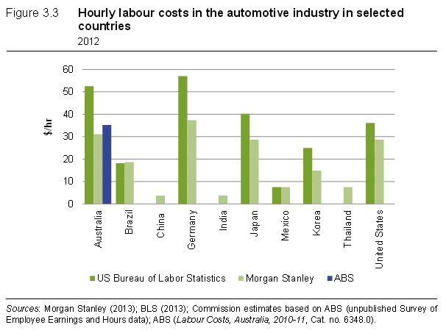
Forecasting Industry Profitability

Slide 16
Forecasting Industry Profitability

Slide 17
Positioning the Company
Recognizing and understanding the competitive forces that a firm faces within its industry allows managers to position the firm where competitive forces are weakest.
Effective positioning requires the firm to anticipate changes in the competitive forces likely to impact industry

Slide 18
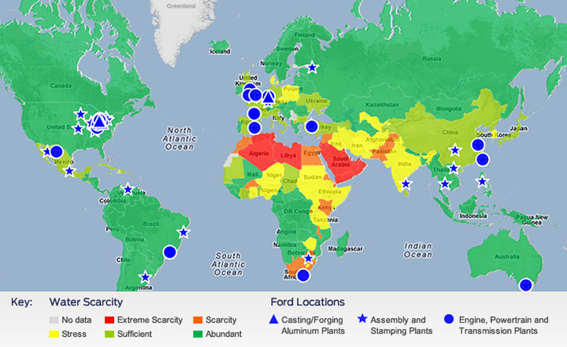
Positioning the Company

Slide 19
Strategies to Alter Industry Structure
Identify opportunities to alleviate competitive pressures
First, identify features that depress profitability
Second, Consider which features are an option to change through strategic initiatives.

Slide 20
Issues with 5 Forces Model
Critics of Porter’s framework state the model:
Offers too simplified a view of product/market competition. It ignores important variables and doesn't account for the complexities of many industries.
Others feel that the model is based upon a flawed premise

Slide 21
Defining the Industry
Identifying the main players and then examining some key structural characteristics that determine their competition and buying power.
The key to defining market boundaries is substitutability
Defining market boundaries depends on purpose and the context of the analysis

Slide 22
Choosing an Appropriate Level of Analysis
Market Segmentation is to identify attractive segments, to select strategies for different segments, and to determine how many segments to serve.
5 stages of the segmentation process:
1. Identify possible segmentation variables
2. Construct a segmentation matrix
3. Analyze segmentation attractiveness
4. Identify key success factors in each segment
5. Analyze the attraction of broad vs. narrow scope

Slide 23
Adding Additional Forces?
Should complements be considered? The importance of complements to most products means that we should take them into account
The government has a powerful influence on each of the other 5 forces and can directly influence industry attractiveness, so we should also consider the government as another force, though maybe not by itself.

Slide 24
Dealing With Dynamic Competition
The 5 forces model ignores the dynamic forces of innovation and entrepreneurship
In today’s industrial climate is less stable and displays hyper competition
To have sustained success you need to constantly recreate and renew your competitive advantages

Slide 25
Does Industry Matter?
Due to structural conditions, some industries are naturally more profitable than others
But research has shown that industry environment is a relatively minor determinant (less than 20%) of a firm’s profitability
It’s more important to choose the correct strategy than the correct industry

