Slide 1
Foundations of Strategy Chapter 5 Business Strategies in Different Industry and Sectoral Contexts

Slide 2
Introduction
Purpose is to help understand how managers adapt their strategies to fit their environments, how they go about predicting change and adapting their strategies
Starting point is the industry life cycle

Slide 3
What To Expect
Consider the extent to which industries follow a common development pattern
Examine the changes in industry structure over the cycle
Explore implications for business strategy
Study the challenges of managing in environments where the ownership is not in private hands and where profit is not necessarily the primary aim

Slide 4
The Industry Life Cycle
Best-known and most enduring marketing concepts is the product life cycle
Products are born, sales grow, reach maturity, go into decline and ultimately die
Supply-side equivalent of the product life cycle
Likely to be a longer duration than that of a single product
Four phases: Introduction, Growth, Maturity, and Decline
Two factors:
Demand growth
The production and diffusion to knowledge

Slide 5
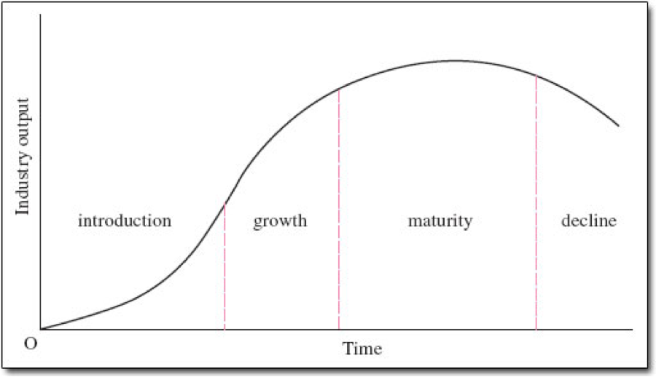
Industry Life Cycle

Slide 6
Demand Growth
Life cycle and the stages within it depend on changes in an industry’s growth rate over time
Introduction- Small sales and low rate of market penetration
Growth- Accelerating market penetration as technical improvements and increased efficiency open up the mass market
Maturity- Increasing market saturation
Decline- Becomes challenged by superior substitute products

Slide 7
The Production and Diffusion of Knowledge
New knowledge in the form of product innovation is responsible for an industry’s birth
Knowledge creation and diffusion are a major influence on industry evolution
In the introduction phase, no dominant product technology and compete for attention
Over time, customers become more knowledgeable
Transition is reflected in the emergence of dominant designs and technical standards and in a change of focus away from product innovation to process innovation

Slide 8
Dominant Designs and Technical Standards
Product architecture that defines the look, functionality and production method for the product
Refers to the overall configuration of a product or system
Technology or specification that is important for compatibility
EFMPlus becomes technical standards for DVDs and is currently the dominant design

Slide 9
Cont.
Network effects- need for users to connect in some way with one another
Unlike a proprietary technical standard, a firm that sets a dominant design does not usually oven intellectual property
Dominant designs exist in processes and business models

Slide 10
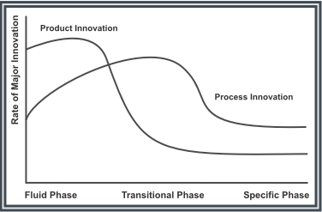
Product to Process Innovation
The emergence of a dominant design marks a critical juncture in an industry’s evolution
Shift from radical to incremental product innovation

Slide 11
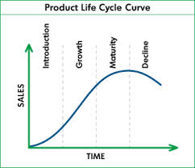
Strategy at Different Stages of The Life Cycle
Introduction, Growth, Maturity, Decline
Notes:
It is important to categorize industries according to their stages of development to alert us of competition likely to emerge and the strategies that are likely to be affective.
Introduction- limited to early adopters, competing technologies, wide variety of features, high skilled labor, advanced countries, few companies, product innovation and establishment
Growth- Increasing market penetration, standardization of technology, quality improves, exporting, entry mergers and exits, developing brand, process innovation
Maturity- Customers become knowledgeable and price sensitive, technology improves, attempts to differentiate, Deskilling of labor, Production shifts to newly industrializing countries, heavy price competition, lower input costs
Decline- obsolescence, little innovation, expensive to differentiate, exporting from countries with lowest labor costs, price wars and exits

Slide 12
Introduction
Early Stages of Life Cycle
As legitimacy is reached # of firms increases rapidly
‘de novo’
‘de alio’
Born Global- Eyeview
Ex. 3D television
Notes:
De novo- start up companies
De alio- existing firms who expand their portfolios into emerging industries
Born Global- firms that are from inception globally recognized due to the internet and selling output in multiple countries
Eyeview provides specialized information to corporate clients on how to create effective websites. Its audio and video materials are developed in different languages.

Slide 13
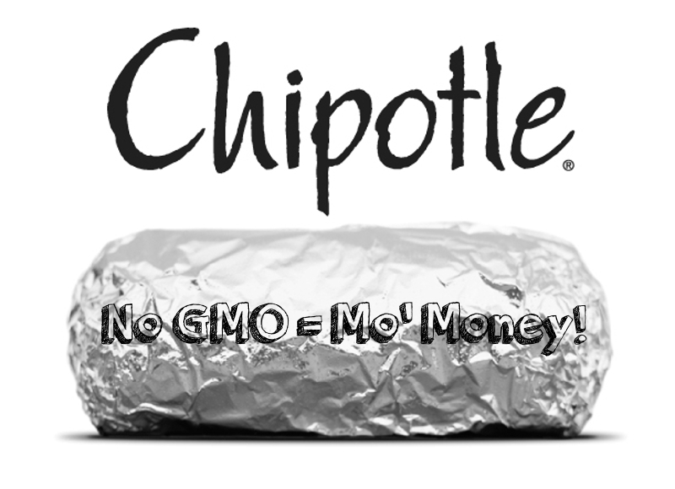
Growth
Competition and dominant design emerge
Key challenges
Scaling up
Investment requirements grow
Reduce cost and labor skills
Notes:
One of the more-successful growth stories in recent memory. The company's stock performance confirms as much; the shares have risen approximately 1,300% since Chipotle's IPO in 2006, over 1,000% in the last five years, and over 80% in the last year alone.

Slide 14
Maturity
Competitive advantage
Quest for efficiency and commoditization
Standardization
Cost efficiency through scale
low wages and low overheads
Shakeouts (Pontiac)
Notes:
Costco is in a maturity stage. Though profitable, slower growth in sales. Strong brand awareness. Shares the market with established competitors.

Slide 15
Decline
The key features of declining industries
Lack of technical change
A declining # of competitors, some new entry as firms acquire the assets of existing firms cheaply
High average age of physical and human resources
Aggressive price competition
America’s top ten declining Industries
Manufactured Home Dealers, Record Stores, Photofinishing, Wired Telecommunications Carriers, Apparel Manufacturing, Newspaper Publishing, DVD Game and Video Rental, Mills, Formal Wear and Costume Rental
Notes:
The transition to decline intensifies pressure for cost cutting.
A company must recognize the decline to encourage the orderly exit of industry capacity and to capture residual demand.

Slide 17
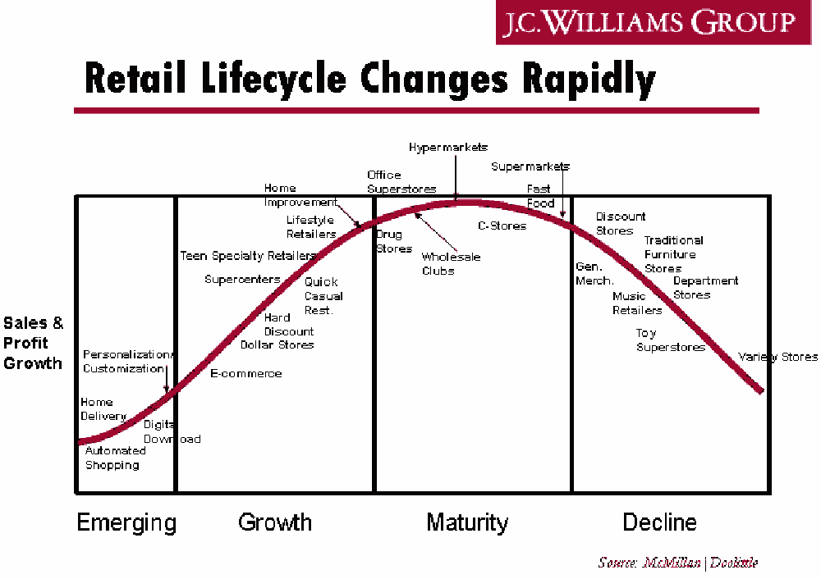

Slide 18
Public and not-for-profit sectors
Defined in relation to ownership, funding and the interests they serve
Public sector
Flood prevention systems, street lighting, and national defense
http://www.youtube.com/watch?v=XKugEizYsic
Notes:
The problem we run into with public goods is that they can be consumed for free. Every household has the incentive to rely on someone else paying which results in market failure.

Slide 19
Features that Impact Strategy
Multiple, potentially conflicting goals
Distinctive constraints and different levers
An absence of market forces
Monopoly power
Less autonomy and flexiblity
Increased accountability
Less predictability

Slide 20
Multiple, potentially conflicting goals
Public sector- shaped by Political considerations have multiple, intangible aims. Ex: Local gov’t increase taxes to pay for street lights
Private sector- primacy of shareholder’s interest easier to prioritize and reconcile claims. Ex: Chick-fil-a on their beliefs.

Slide 21
Distinctive constraints and different levers
Public sector- must take into account public opinion, political factions, tax-raising capacity.
**have different tools at their disposal for achieving their aims.
Ex: Use of regulatory framework or legislation

Slide 22
An absence of market forces
Public sector- Absence of market forces Harder to make resource allocation decisions
Less autonomy and flexibility
Public sector- subject to direct political influence managers may be highly constrained in actions they take.

Slide 23
Increased accountability
Public sector- subject to public scrutiny; they are appointed to act in public’s best interest.
Less predictability
“A week is a long time in politics”- pressure from media, frequent changes in political leadership, make it difficult to plan for future

Slide 24
Additional factors: Not-for-profits
1. The employments of volunteers-
hard to attract volunteers with special skills.
hard to manage performance of unpaid staff
2. Fundraising-
without fundraising they cannot achieve goals

Slide 25
Oster’s six forces model
Threat of new entrants
Relations among existing organizations
User Groups
Supplier Industry
Funding Groups
New Substitutes

Slide 26
Stakeholder Analysis
Process of identifying, understanding and prioritizing the needs of key stakeholders.
Needs and goals of stakeholders often conflict
Ongoing process of balancing and multiple objectives and relationships

Slide 27
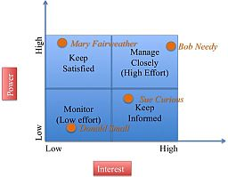
Stakeholder power/interest grid

Slide 28
Scenario Planning
Scenario Analysis- how might the future unfold? How should we prepare?
Pioneered by oil company Royal Dutch Shell.
Industry where life of investment projects (50 yrs) far exceeded time horizon
Develop strategy based upon findings

Slide 29
Steps in building and using scenarios
Define purpose of analysis
Decide on time horizon
Identify key trends
Identify key uncertainties
Creating internally consistent scenarios
Identifying indicators of unfolding scenarios
Assessing strategic implications of each scenario

