Slide 1
Technology-Based Industries and the Management of Innovation Foundations of Strategy: Chapter 6
Alyssa Barney, Amy Wolf, Cory Myres, and Hunter Heidenheimer
Notes:
Hunter

Slide 2
Learning Objectives
Links between Technology & Competition
Potential for Innovation
Key Issues in Designing Technology Strategies:
Timing
Innovation
Industry Standards
Notes:
Hunter
Examine links between technology and competition in technology-intensive industries. Such as: Apple and Ford
Explore potential for innovation to establish competitive advantage
Key Issues in designing technology
Timing: Do we want to lead or to follow? For example: Apple, they had to choose to lead and become the first company to produce the touch screen IPhone. Now, almost all phones are touch screen. Choosing to lead was a beneficial decision for the company. Another example: Southwest chose to lead in fuel hedging and the other airline companies chose not to follow. This decision made Southwest gain billions of dollars and the other companies just sat back and didn’t follow. Why would they not want to save billions?
Alternative Strategies for Exploiting Innovation: For example: the airlines industry discussed giving passengers the ability to talk on their phone during flight, but because of the discussion regarding the distraction and harm to peace, they have installed wifi in some planes.
Setting the Industry Standard and Managing Risk: For example: Southwest changing the industry standard for turnover times, they had to manage and make sure that all of their planes and flights were quality-filled to ensure the passengers are safe and happy.

Slide 3
How Will This Help You?
Analyze Technology Effectiveness
Identify Innovation
Formulate Strategies for Innovation
Manage Technology
Design
Notes:
Hunter
-Analyze how technology affects industry structure and competition
-identify factors that determine the returns to innovation and evaluate the potential for an innovation to establish competitive advantage
Formulate strategies for exploiting innovation and managing technology
Focus on: the relative advantage of being a leader or a follower in innovation
Identify and evaluate strategic options for exploiting innovation (Chart)
How to win standards battles
How to manage risk
Design your organizational conditions needed to implement such strategies successfully

Slide 4
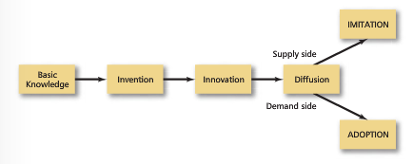
Competitive Advantage in Technologically Based Industries
Invention and Innovation
Innovation Process
Notes:
10 pages Cory
Invention is the creation of new products and processes through the development of new knowledge from new combinations of existing knowledge.
Innovation is the initial commercialization of invention by producing and marketing a new good or service by using a new method of production.
Innovation Process
Basic Knowledge
Invention
Innovation
Diffusion
Learning objectives
Analyse how technology affects industry structure and competition;
ID factors that determine returns to innovation and evaluate potential for innovation to establish competitive advantage;
Form strategy for exploiting innovation and managing technology focusing in particular on
Relative advantage of being a leader or a follower in innovation;
ID and eval strategic options for exploiting innovation;
how to win standards battles
how to manage risk
Design the organizational conditions needed to implement such strategies successfully.
Links between technology and competition in technology-intensive industries
potential for innovation to establish sustainable competitive advantage.
key issues in designing tech strategies, including timing, alternative strategies for exploiting an innovation, setting industry standards and managing risk
examine org. conditions for the successful implementation of tech based strategies.

Slide 5
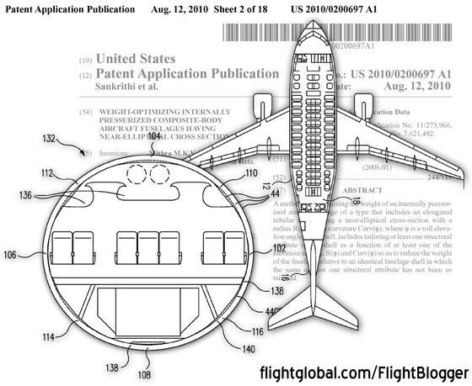
Property Rights in Innovation
Patents
Copyrights
Trademarks
Trade Secrets
Notes:
Cory
Intellectual Property -
Patents - exclusive rights - secured by letters patent or by a patent to the exclusive control and possession of a particular individual or party
Copyrights - the exclusive legal right, given to an originator or an assignee to print, publish, perform, film, or record literary, artistic, or musical material, and to authorize others to do the same. Trademarks - a symbol, word, or words legally registered or established by use as representing a company or product. Trade Secret - a secret device or technique used by a company in manufacturing its products.

Slide 6
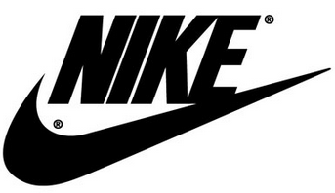
Property Rights in Innovation
Patents
Copyrights
Trademarks
Trade Secrets
Notes:
Cory
What are some examples of Patents, Copyrights, Trademarks and Trade Secrets? Patent - Boeing 737 - only boeing can make this
Copyright - Texts, Books, Art, Music, Photos
Trademarks - Nike swoosh
Trade Secrets - KFC, Coca-Cola

Slide 7
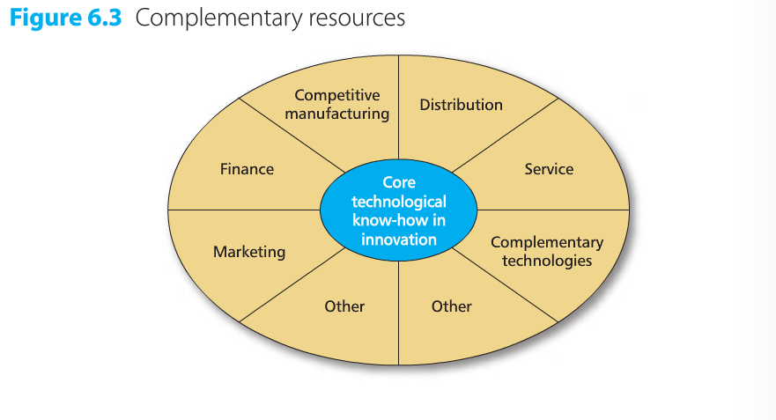
Lead-Time / Complementary Resources
Lead-Time
Complementary Resources
Notes:
Lead time is how much time your product has before any competitor can reverse engineer or replicate your product or service

Slide 8
Tacitness and Complexity of the Technology
Tacitness
Complexity
Notes:
Full Definition of TACIT. 1 : expressed or carried on without words or speech <the blush was a tacit answer — Bram Stoker> 2 : implied or indicated (as by an act or by silence) but not actually expressed <tacitconsent> <tacit admission of guilt>
Complexity adds to the Lead time or could prevent lead time. If it’s too complicated for you to produce then someone else may be producing it. If it’s too complicated for the other industry participants then your lead time increases.
Atomic Bomb Allies vs Axis WWII
US developed an atomic bomb in

Slide 9
Alternative Strategies to Exploit Innovation
Licensing
Outsourcing
Strategic Alliance
Joint Venture
Internal Commercialization
Notes:
Amy
License: grant a license to (someone or something) to permit the use of something or to allow an activity to take place.
-Ford licensing their logo to appear on a Movie
-Apple licensing their logo to appear on a movie
-Reese’s licensing Betty Crocker on their brownie logo
Licensing is only viable where ownership in an innovation is clearly defined by patents and copyrights. Thus, in pharmaceutical companies, licensing is widespread because patents are clear and defensible.
Outsourcing: Contracting out a business process to an outside party.
https://www.youtube.com/watch?v=_wR3LhFlgGo
-Ford outsources tires for their cars and trucks, good year, Michelin, dunlop
-Southwest does not outsource for pilots because of their aircraft
-Apple outsources labor of making the Apple products mainly to China to afford paying employees higher wages in America for engineering, sales, and in Apple stores
-Costco DOES NOT outsource from foreign countries
Strategic Alliance: partnerships in which two or more companies work together to achieve objectives that are mutually beneficial. Companies may share resources, information, capabilities and risks to achieve this.
https://www.youtube.com/watch?v=x3oeqa-_mf0
Southwest’s Rapid Reward Partners: Best Western, Hyatt, Marriott, Dish, and more.
Exxon: Next Generation Algal Biofuels. The strategic alliance between Synthetic Genomics, Inc (SGI) and ExxonMobil Research and Engineering Company (EMRE), represents a comprehensive research and development agreement to explore the most efficient and cost effective ways to produce next generation biofuels using photosynthetic algae.
Chipotle: Chipotle Mexican Grill is joining forces with the non-profit organization FamilyFarmed.org for a national fund-raising program to support its efforts to create new markets for sustainable farmers.
Joint Venture: is a business agreement in which the parties agree to develop, for a finite time, a new entity and new assets by contributing equity. They exercise control over the enterprise and consequently share revenues, expenses and assets.
https://www.youtube.com/watch?v=-OkLAZf9Vbs
Internal Commercialization: is the process or cycle of introducing a new product or production method into the market

Slide 10
Characteristics of the Innovation
Ability of company to establish clear property rights in an innovation determines the choice of strategy
Pharmaceutical Companies
Apple
Notes:
Amy
http://www.southwest.com/rapidrewards/earn-with-partners
http://www.aa.com/i18n/AAdvantage/programInformation/oneworld/overview.jsp
http://corporate.exxonmobil.com/~/media/Brochures/2008/news_pub_poc_overview.pdf
http://www.familyfarmed.org/strategic-partnership-with-chipotle-mexican-grill/
http://www.syntheticgenomics.com/images/AlgalBiofuelsFactSheet.pdf
http://smallbusiness.chron.com/examples-successful-strategic-alliances-13859.html
http://daymondjohn.com/power_journal/perfect-example-of-licensing-and-brand-extension/
http://newsroom.kelloggcompany.com/2012-09-24-Kellogg-Company-And-Wilmar-International-Limited-Announce-China-Joint-Venture
Point 1)
Characteristics of Innovation:
HELP COME UP WITH EXAMPLES OF CHARACTERISTICS OF COMPANY’S PROPERTY RIGHTS THAT HELP DETERMINED THEIR CHOICE OF STRATEGY
Example from book: Licensing is only viable where ownership in an innovation is clearly defined by patents and copyrights. Thus, in pharmaceutical companies, licensing is widespread because patents are clear and defensible.
Conversely, Jobs and Wozniak developers of Apple I and II had little option than to go into business themselves because the absence of proprietary technology ruled out licensing.

Slide 11
Resources and Capabilities of the Firm
Choice of HOW to Innovate:
Licensing: Few Resources
Joint Ventures and Strategic Alliances: Resources from 2 Firms
Notes:
Amy
http://www.southwest.com/rapidrewards/earn-with-partners
http://www.aa.com/i18n/AAdvantage/programInformation/oneworld/overview.jsp
http://corporate.exxonmobil.com/~/media/Brochures/2008/news_pub_poc_overview.pdf
http://www.familyfarmed.org/strategic-partnership-with-chipotle-mexican-grill/
http://www.syntheticgenomics.com/images/AlgalBiofuelsFactSheet.pdf
http://smallbusiness.chron.com/examples-successful-strategic-alliances-13859.html
http://daymondjohn.com/power_journal/perfect-example-of-licensing-and-brand-extension/
http://newsroom.kelloggcompany.com/2012-09-24-Kellogg-Company-And-Wilmar-International-Limited-Announce-China-Joint-Venture
Point 1)
Characteristics of Innovation:
HELP COME UP WITH EXAMPLES OF CHARACTERISTICS OF COMPANY’S PROPERTY RIGHTS THAT HELP DETERMINED THEIR CHOICE OF STRATEGY
Example from book: Licensing is only viable where ownership in an innovation is clearly defined by patents and copyrights. Thus, in pharmaceutical companies, licensing is widespread because patents are clear and defensible.
Conversely, Jobs and Wozniak developers of Apple I and II had little option than to go into business themselves because the absence of proprietary technology ruled out licensing.

Slide 12
Timing Innovation: To Lead or Follow?
Early Mover Advantages Depends On:
Extent to Which Innovation can be Protected
Importance of Complementary Resources
Potential to Establish a Standard
Notes:
Amy
Extent to Which Innovation can be Protected by property rights or lead-time advantages:
if an innovation is appropriable through a patent, copyright or lead-time advantage, there is an advantage in being an early mover.
Example: pharmaceuticals, Apple with the IPhone,
2) Importance of Complementary Resources
The more important are complementary resources in exploiting an innovation, the greater the costs and risks of pioneering.
3) Potential to Establish a Standard
The greater the importance of technical standards, the greater the advantages of being an early mover in order to influence those standards and gain the market momentum needed to establish leadership.

Slide 13
Managing Risks
Two Main Resources of Uncertainty:
Technological
Market
Useful Strategies for Limiting Risk Include:
Cooperating with Lead Users
Limiting Risk Exposure
Flexibility
Notes:
Amy
Technological: Ex: Apple: you dont know how exponential the growth is going to be
Market: Everyone, in 2008 took a big hit in the airline industry, but SW planned ahead by fuel hedging
Chipotle: We don’t know how fast the industry will grow for chipotle and health food in the food industry
Limiting Risk Exposure: Less risk = less damage, if you can limit the exposure of the new iphone by making it so complex, less people have the opportunity to copy the product,
Flexibility means there is always room for improvement

Slide 14
Competing for Standards
Why do we have standards?
Interoperability
Types of Standards:
Public
Private
Mandatory
De Facto
Notes:
7 pages Alyssa

Slide 15
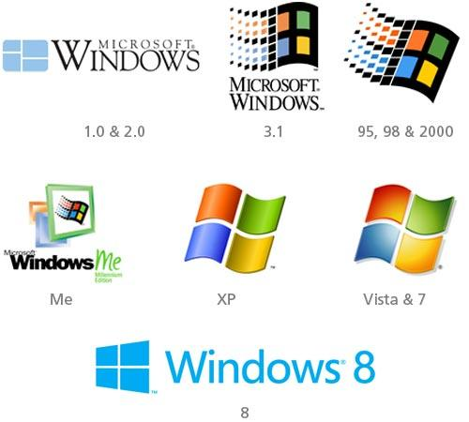
Example of De Facto Standards
Notes:
Alyssa
http://electronicdesign.com/embedded/what-s-difference-between-de-jure-and-de-facto-standards

Slide 16
Why Standards Appear: Network Externalities
Several Sources:
Products Where Users are Linked to a Network
Availability of Complementary Products/Services
Economizing on Switching Costs
Positive feedback
Tipping
Notes:
Alyssa

Slide 17
Winning Standards Wars
Assemble Allies
Pre-empt the market
Manage expectations
Evolutionary Strategy vs. Revolutionary Strategy
Notes:
Alyssa

Slide 18
Creating Conditions for innovation
Managing Creativity:
Organizing for Creativity
Invention to Innovation:
Balancing Creativity & Commercial Direction
Organizational Approaches to the Management of Innovation
Innovation at 3M
Notes:
7 pages Hunter

Slide 19
Recap Learning Objectives
How does technology affect industry structure?
How does technology affect competition?
What are the factors that determine returns to innovation and evaluate potential for innovation to establish competitive advantage?
What conditions must be present to implement strategy successfully?
Notes:
Cory
Remind the class about what they just learned
Learning objectives
Analyse how technology affects industry structure and competition;
ID factors that determine returns to innovation and evaluate potential for innovation to establish competitive advantage;
Form strategy for exploiting innovation and managing technology focusing in particular on
Relative advantage of being a leader or a follower in innovation;
ID and eval strategic options for exploiting innovation;
how to win standards battles
how to manage risk
Design the organizational conditions needed to implement such strategies successfully.
Links between technology and competition in technology-intensive industries
potential for innovation to establish sustainable competitive advantage.
key issues in designing tech strategies, including timing, alternative strategies for exploiting an innovation, setting industry standards and managing risk
examine org. conditions for the successful implementation of tech based strategies.

Slide 20
Conclusion Activity
How has your company been an innovator in their industry?
How does your company compete on standards?
Do you think your company has a competitive advantage?
Notes:
Alyssa

