Slide 1
Build Execution Into Strategy
TEAM 6 Amy | Alyssa | Cory | Hunter
Notes:
Cory
Amy -
Fair Process “Buy In” Video from SW.
https://www.youtube.com/watch?v=3RI08CwiLjw
Hunter -
Fair Process Video three E Explanation. 4:56
http://youtu.be/BpkpG2XnDfM
Transforming unpopular changes to frontline innovation with fair process and relational coordination 2:27
https://www.youtube.com/watch?v=lZd8m7alpmo
Cory - Employee Engagement 4:16
http://youtu.be/y4nwoZ02AJM

Slide 2
Learning Objectives
Awareness
Employee/Management Relations
Planning v. Implementation
Fair Process
Poor Execution
Power of Fair Process
The Three E Principles
Intellectual and Emotional Recognition Theory
How it all fits together with the Blue Ocean Strategy
Notes:
Cory
Today we’re going to talk a lot about the execution of the strategy.
The first thing we want you to notice is the employee management relations, How you plan, versus how you implement and be able to tie that into how the management who designs the vision or strategy and how they interact with the employees.
this all ties into the fair process.
We first must look at some mistakes and some poor execution principles with Alyssa Barney, without knowing what doesn’t work, we could possibly pick those paths in the future. Then we’ll have Amy up here to speak about the Power of Fair Process. She’ll speak to you about how the fair process implemented properly can effectively change the organization and act as a catalyst for the change by motivating employees. Pay particular attention again to the employee/management relation aspect.
The Three E principles will be covered by Hunter who will walk you through Engagement, Explanation, and Expectation Clarity. These will help you build trust and commitment with your employees.
We all know that this information is important but I’ll follow it up by enhancing the understanding of WHY the process is important.
Alyssa will follow up with some thoughts on the Intellectual and Emotional recognition Theory.

Slide 3
Poor Process
Can Ruin Strategy Execution
Good Strategy v. Successful Strategy
Example: Lubber
Levels of the Organization
Notes:
Alyssa
p172

Slide 4
Notes:
Alyssa

Slide 5
Fair Process
John W. Thibaut and Laurens Walker
Psychology of Justice + Study of Process = Procedural Justice
Goal: Create People’s Buy-In Up Front
Voluntary Cooperation
Notes:
Amy
p174
Fair Process “Buy In” Video from SW.
https://www.youtube.com/watch?v=3RI08CwiLjw
What is fair process? How does it allow companies to build execution into strategy?
-Traces back to two social scientists: John W. Thibaut and Laurens Walker. They combined their interest in the psychology of justice with the study of process and created the term procedural justice. The focused their attention on legal settings, they investigated to see what made people trust a legal system so that they will comply with laws without being coerced.
- People care less about the outcome and more about the process itself. Satisfaction and rose when procedural justice was exercised.
-Fair process builds people’s buy-in up front
-People believe a level of playing field exist within a process. Therefore, this encourages voluntary cooperate in strategic decisions.
-Voluntary cooperation is more than mechanical execution “getting the job done”. Involves going beyond the best of their abilities to execute resulting strategies
Examples: ?????

Slide 6
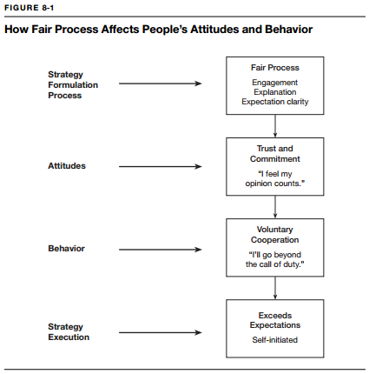
How Fair Process Affects People’s Attitudes and Behaviors
Notes:
Amy

Slide 7
Notes:
Amy

Slide 8
Three E Principles of Fair Process
Engagement
Explanation
Expectation Clarity
Notes:
Hunter
p175

Slide 9
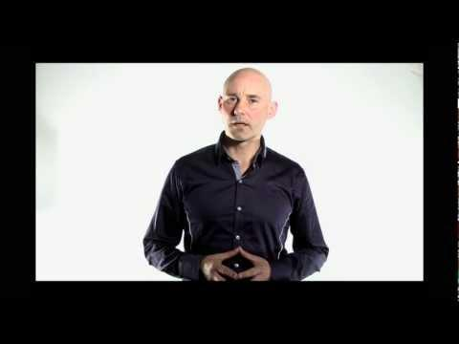
Three E Principles of Fair Process
Notes:
Hunter
p175
Fair Process Video three E Explanation. 4:56
http://youtu.be/BpkpG2XnDfM

Slide 10
Transforming unpopular changes to frontline innovation with fair process and relational coordination
Notes:
Hunter
p175 Transforming unpopular changes to frontline innovation with fair process and relational coordination
https://www.youtube.com/watch?v=lZd8m7alpmo

Slide 11
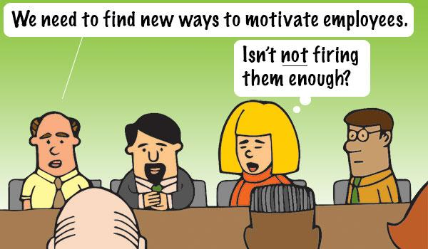
Why does fair process matter?
Strategy Shapes Attitudes
Severity of Effects on Strategy Execution
Notes:
Cory
181
Fair Process - how do you wish to be treated?
Motivate the workers to work for you, not against you. When you change the strategy it may not be popular and it could cause such a drastic drop in morale that the workers respond with not only not completing their duties, but actively prevent company from developing. Strategy Shapes the way the company’s gears work together.
I’ll talk about the severity of the effects on strategic execution.

Slide 12
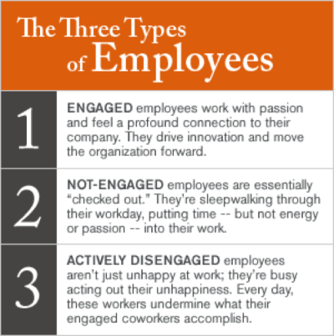
Notes:
Cory
181
We’ve discussed the poor processes, and this is the real reason it can ruin strategy execution. the book has discussed the Sales force of the company Lubber acted as what this figure shows as Actively Disengaged. the sales team fought the changes and
There’s a difference between Employee A Keeping customers and Acquiring new customers, Employee C keeping customers but not giving too much more effort to acquire new business, and employee C who legitimately doesn’t want the business to have any customers and destroys relationships with the customers you already have, as well as scaring off any potential customers because their outlook of their job is bleak.
Do you agree with the naming of these three categories?
I have a short video about Employee Engagement

Slide 13
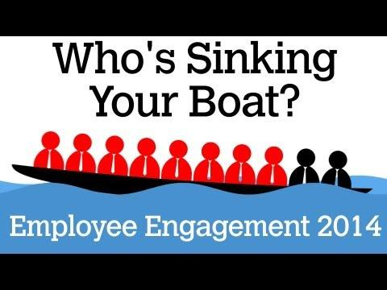
Notes:
Cory
Employee Engagement
http://youtu.be/y4nwoZ02AJM 4:16

Slide 14
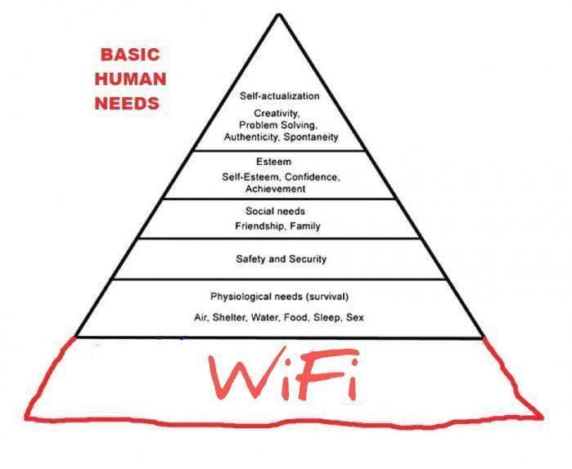
Maslow’s Hierarchy of Needs
Notes:
Cory
181
We’ve seen Maslows hierarchy of needs before, but motivating our employees by giving them the opportunity to realize the top of the pyramid is the important thing. in general we understand that an income can provide the means for Physiological needs, Safety and security, and the Means for Social Needs. the employee must have these in order for a leader to build the opportunity for the employee to even concern herself with Esteem and Self-actualization. We could go in depth with these things but you should have already taken Organizational Behavior.
What they didn’t go over is The most important need that is more of a new development in behavioral studies. A very basic Human need. Slide. WiFi Appears

Slide 15
Attitudes Shape Behaviors
Notes:
Cory
It’s the Esteem and the Self Actualization that really comes from leadership in the workplace.
How you implement the Strategy by bringing the three Es into play
You Engage, Explain, and ensure that you clarify what you expect. this builds trust, and Confidence, fitting into the Esteem level of the pyramid.
It shapes the ATTITUDE through ensuring that their opinion counts.
What happens next is the motivation of worker converts from a “not engaged” behavior to Voluntary cooperation or “Engaged”. Actively wanting to help or make the company better because they believe in a cause.
This leads to the strategy actively moving forward and is self initiated.
You need to understand that through Maslows Hierarchy of needs the employee has the need to be creative, solve problems, have Confidence, and be able to Achieve. These boil down to one theory Intellectual and Emotional Recognition Theory and Alyssa Will walk you through this theory.

Slide 16
Intellectual and Emotional Recognition Theory
Linked to Fair Process
Importance of the Individual
Herzberg’s Study on Motivation
Violation of Fair Process
Employee Engagement
Notes:
Alyssa
p181
Some helpful links:
http://books.google.com/books?id=hDzMIC8mij4C&pg=PA290&lpg=PA290&dq=intellectual+and+emotional+recognition+theory&source=bl&ots=zIhWBfjJzI&sig=7lqhQQ3VFlKrh1-sQhzUjpDU3Vk&hl=en&sa=X&ei=sFZRVPryM4ingwTCs4KYDA&ved=0CCcQ6AEwAQ#v=onepage&q=intellectual%20and%20emotional%20recognition%20theory&f=false
http://www.academia.edu/8611540/Interpersonal_Understanding_and_Theory_of_Mind_doctoral_thesis_
http://www.ncbi.nlm.nih.gov/pubmed/17613679

Slide 17
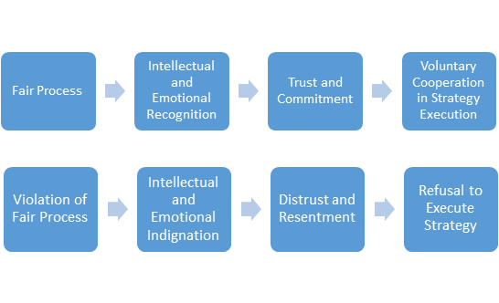
Fair Process: The Execution Consequences
Notes:
Alyssa

Slide 18
Fair Process and Blue Ocean Strategy
Intangible Capital
What is it?
Trust
Commitment
How does it affect your company?
Notes:
Hunter
p183

Slide 19
Summary / Looking Ahead
Awareness
Employee/Management Relations
Planning v. Implementation
Fair Process
Poor Execution
Power of Fair Process
The Three E Principles
Intellectual and Emotional Recognition Theory
How it all fits together with the Blue Ocean Strategy
Notes:
Amy
summarize and connect to things we’ve done so far
Very briefly review “a tale of two plants” from p176 Very briefly look ahead to Ch9
-Today we discussed the Execution of Strategy
-The first thing we wanted you to notice is the employee management relations, How you plan, versus how you implement and be able to tie that into how the management who designs the vision or strategy and how they interact with the employees.
this all ties into the fair process.
-We looked at some different poor execution principles with Alyssa Barney, without knowing what doesn’t work, we could possibly pick those paths in the future. (remind of examples) -I spoke about the Power of Fair Process. She’ll speak to you about how the fair process implemented properly can effectively change the organization and act as a catalyst for the change by motivating employees. Pay particular attention again to the employee/management relation aspect.
-The Three E principles was covered by Hunter who walked you through Engagement, Explanation, and Expectation Clarity. These will help you build trust and commitment with your employees.
Cory discussed details on WHY this process is important
Alyssa followed by discussing Intellectual and Emotional recognition Theory.

