Slide 1
Chapter 1: Creating Blue Oceans
Team 2: Cynthia Lopez, Christine Everett, Tobias Contreras, Tara Visker, Valerie Villarreal, and Chris Rogers

Slide 2
Cirque du Soleil
Cirque du Soleil is a Canadian entertainment company founded in 1984 that was founded by street performers
In less than twenty years they had achieved levels of revenue that had taken Ringling Bros. and Barnum & Bailey more than a hundred years to attain.
This was being accomplished in a declining industry, strategic analysis pointed to limited growth due to alternative forms of entertainment

Slide 3
Cirque du Soleil
Ringling Bros. and Barnum & Bailey set the industry standard while smaller circuses had scaled down versions to compete the best they could
Cirque du Soleil succeeded in achieving this rapid growth by catering to adults and corporate clients instead of children
Thus creating new market space that had untapped potential, instead of competing with current competitors in that industry

Slide 4
Red Oceans and Blue Oceans
Red Oceans represent all the industries in existence today ex: Ringling Bros and Barnum & Bailey
Blue Oceans represent untapped market space and the opportunity for highly profitable growth ex: Cirque du Soleil
Red Oceans are bloody from cutthroat competition for finite profits
Blue Oceans however are calmer waters with potential, however they demand creation, and are riskier due to uncharted territory

Slide 5
Red Oceans and Blue Oceans
Surviving in Red Oceans will always remain important. A company must learn how to outcompete their rivals
However with supply exceeding demand in many existing industries. Companies must create Blue Oceans in order to seize new profit and growth opportunities.
“The only way to beat the competition is to stop trying to beat the competition.”

Slide 6
Continued
The history of industry shows us that the market universe has never been constant
Blue oceans have continuously been created over time

Slide 7
Continued
To focus on the red ocean is therefore to accept the key constraining factors of war and to deny the distinctive strength of the business world: the capacity to create new market space that is uncontested

Slide 8
The Impact of Creating Blue Oceans
There was a study to set out the impact of creating blue oceans on a company’s growth in both revenues and profits in a study of the business launches of 108 companies.
86% of the launches were line extensions; incremental improvements within the red ocean of existing market space. They accounted for only 62% of total revenues and a mere 39% of total profits
The remaining 14% of launches were aimed at creating blue oceans. They generated 38% of total revenues and 61% of total profits.

Slide 9
Continued
Given that business launches included the total investments made for creating red and blue oceans, the performance benefits of creating blue waters is evident.

Slide 10
The Rising Imperative of Creating Blue Oceans
Several driving forces behind rising imperative
Technological advances
Increased number of industries
Globalization increasing

Slide 11
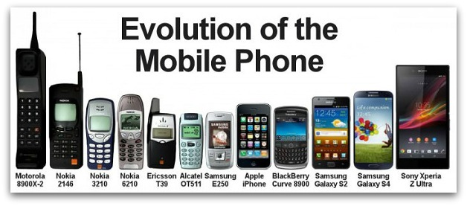
Technological Advances
Improved industrial productivity
Unprecedented array of products and services

Slide 12
Increased Number of Industries
Supply
Demand

Slide 13
Globalization is Increasing
Niche markets and monopolies are disappearing
Supply is on the rise, but what about demand?
Declining population in many market.

Slide 14
The Rising Imperative of Creating Blue Oceans
What is the result?
Accelerated commoditization of products and services
Increasing price wars
Shrinking project margins
Brands are becoming more similar
Causing people to select brand based on price
Overcrowded industries
Differentiating companies becomes harder

Slide 15
The Rising Imperative of Creating Blue Oceans
What does all of this suggest?
“The business environment in which most strategy and management approaches of the 20th century evolved is disappearing.”
Red oceans will only get bloodier
Managers must focus on blue oceans

Slide 16
Leave the Red Ocean Behind
Using the company as a basic unit of analysis assists in understanding the roots of high performance or does it?
Not the case these days
A distinguished set of strategic, operational, and organizational characteristics isn’t always the answer to “lasting, excellent, or visionary” companies

Slide 17
In Search of Excellence
Built to Last
Bestseller
Surveyed companies such as Atari, Data General, National Semiconductor
Within 5 years after the book’s success, the surveyed companies failed
Bestseller
Surveyed the entire life span of companies while its analysis was limited to firms that were more than 40 years old
Deficiencies in surveyed companies were discovered

Slide 18
Companies from Bestselling Books
Industry sector performance as contributing factor vs actual companies
Hewlett-Packard (HP) and the entire computer-hardware industry outperforming others
Importance of outperforming competition within industry continuously
“Visionary” companies?
Company as the unit of analysis not effective

Slide 19
Industry as the Unit of Analysis
Industries are constantly created and expanded
Industry conditions and boundaries are not known completely
Competition head-on in a specific industry space is not necessary
Cirque de Soleil and the creation of a new market space
Industry does not work as a unit of analysis

Slide 20
Strategic Moves
Managerial actions and decisions involved in making a major market-creating business offering
Compaq making blue ocean strategic moves when acquired by Hewlett-Packard
Historical pattern of blue ocean creation
Differences in auto, computer, and entertainment industries
Common factor of strategic moves

Slide 21
Strategic Moves (continued)
Moves which lead the way to great stories of profits and growth
Delivery of products
Capture of new market space
Leap in demand
Creation of blue oceans and high performance
Necessary to examine companies stuck in red oceans
Differences and similarities between red and blue ocean companies
Any company can achieve blue ocean success
Not realistic to be perpetually excellent all the time

Slide 22
Red Ocean/ Blue Ocean
Red ocean - followed conventional approach by racing to beat competition
Blue ocean - didn’t use competition as their benchmark - used value innovation

Slide 23
Value Innovation
Called value innovation because instead of focusing on beating the competition, you focus on making the competition irrelevant by creating a “leap” in value for buyers and for your company, thereby opening up new and uncontested market space

Slide 24
Emphasis on Value and Innovation
Value without Innovation - focus on value creation which improves value but is not enough to make a company stand out in the market place
Innovation without Value - more of a technological drive, market pioneering, or futuristic - often shooting beyond what buyers are ready to accept/ pay for

Slide 25
When does Value Innovation Occur?
When companies align innovation with utility, price and cost position
A new method of thinking about/ executing strategy
Results in creation of blue ocean and breaks away from competition
Example: Cirque du Soleil

Slide 26
Circuses vs. Cirque du Soleil
Other Circuses
Focused on benchmarking one another
Animal shows
Hiring start performers
Multiple show arenas
Pushing aisle concession sales
Rising costs without rising revenues, downward spiral of circus demand

Slide 27
Circuses vs. Cirque du Soleil Cont.
Sought to offer fun and thrill of the circus, as well as artistic richness of theater
Gained new understanding of circus customers AND circus non-customers
Created a blue ocean of new market space

Slide 28
Creating Value Innovation
Kept clowns - shifted from slapstick to enchanting
Glamorized tent - element many circuses has started to forfeit
Sophisticated external finish, higher level of comfort
Added story lines - resembling theater performance
By introducing multiple productions and giving more reason to come to circus more often - dramatically increased demand

Slide 29
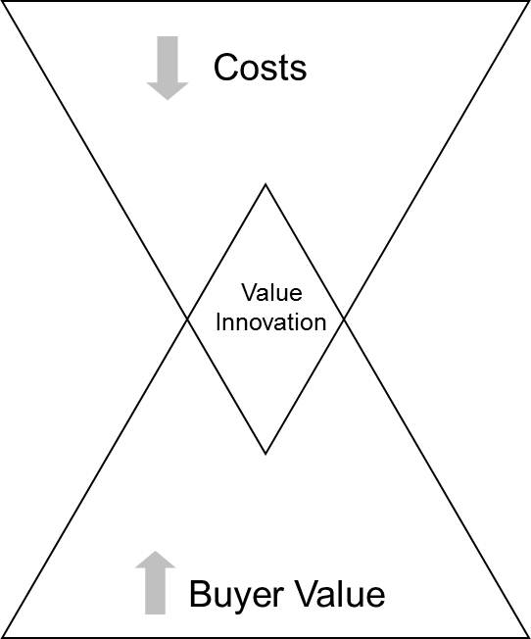
No Animals
No “Famous” Performers
Ticket costs priced against theater
Blue Ocean
More than “circus”
Elegant Feel
Added Story Line
http://samidob.wordpress.com/2011/01/07/blue-ocean-strategy-combined-with-the-business-model-canvas/

Slide 30
Differentiation and Low Cost
Deriving costs down while driving up value for buyers
Buyer value = utility and price that company offers to buyer
Value to company = price and its cost structure
Achieved only when company’s utility, price, and cost activities are ALL aligned

Slide 31
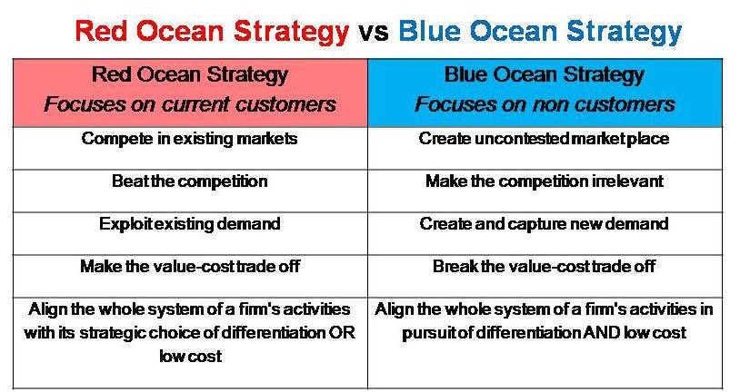
http://www.simonassociates.net/blue-ocean-strategy-2/

Slide 32
How Cirque du Soleil did it…
Achieved both differentiation and low cost by reconstructing elements in existing boundaries - broke best practice rules
Reconstructed elements across alternatives - using a little of them and none of them in their entirety
Created blue ocean of new, UNCONTESTED market space

Slide 33
Formulating and Executing Blue Ocean Strategy
Economic Conditions and Blue Oceans
Red oceans are favored
Opportunity and Risk
Strategy?
6 principles of Blue Oceans

Slide 34
Six Principles of Blue Ocean Strategy
Reconstruct market boundaries
Focus on the big picture, not the numbers
Reach beyond existing demand
Get the sequence right
Search risk
Planning Risk
Scale Risk
Business Model Risk
Formulation Principles
Risk factor minimized

Slide 35
Six Principles of Blue Ocean Strategy
5. Overcome key organizational hurdles
6. Build execution into strategy
5. Organizational risk
6. Management risk
Execution Principles
Risk factor minimized

Slide 36
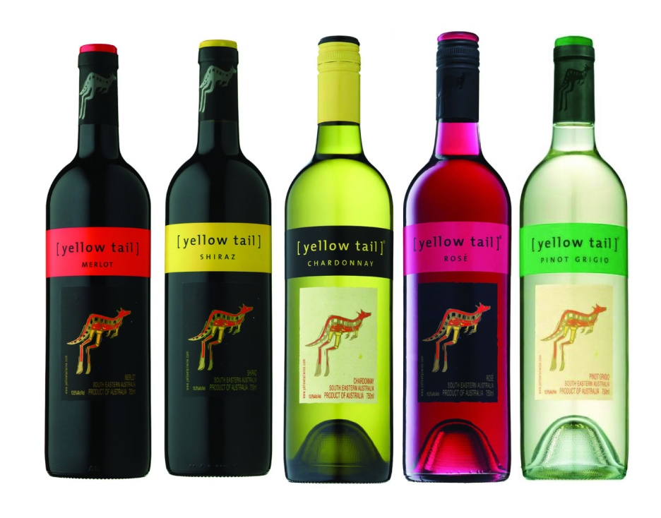
1. Reconstruct Market Barriers
Yellow Tail Wine

Slide 37
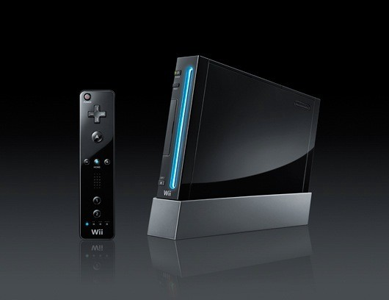
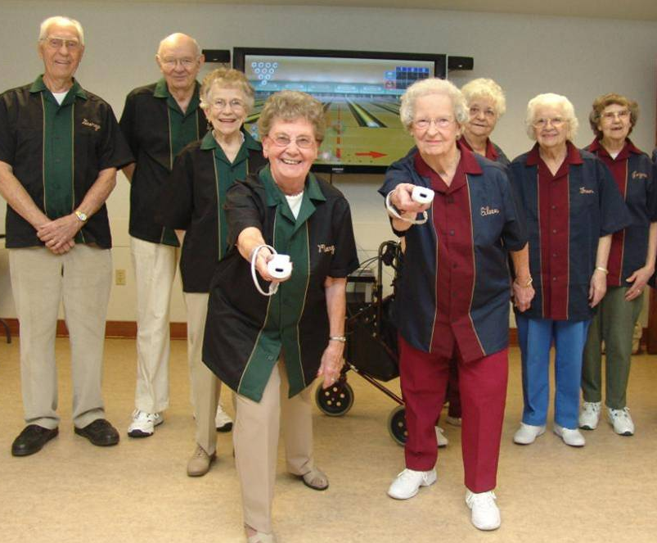
2. Focus on the Big Picture
Wii

Slide 38
3. Reach Beyond Existing Demand
NetJets

Slide 39
4. Get the Sequence Right
TATA Motors: Nano car
Buyer Utility Price Cost Adoption=Blue Ocean Idea

Slide 40
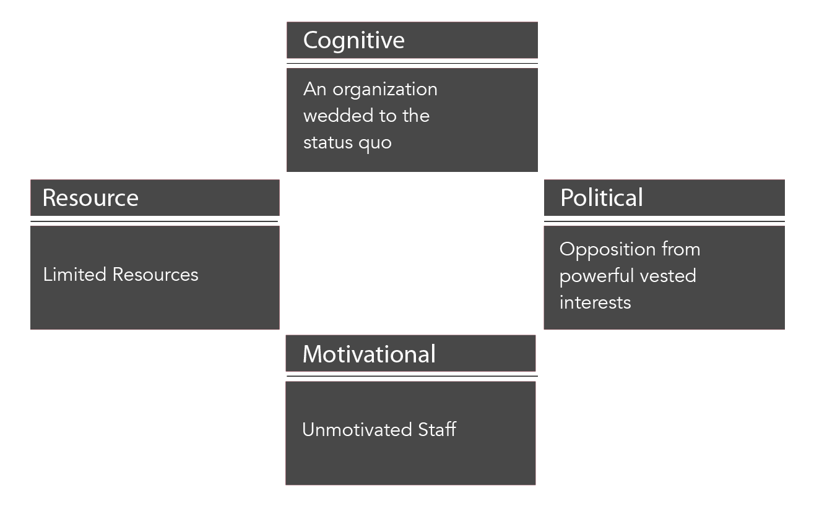
5. Overcome Key Organizational Hurdles
Apple
Tipping Point Leadership

Slide 41
6. Build Execution into Strategy

