Slide 1
Blue Ocean Chapter 2: Analytical Tools and Frameworks
Team 2: Chris Rogers, Cynthia Lopez, Jeremiah Contreras, Valerie Villarreal, and Tara Visker

Slide 2
Introduction
The past decade has been spent trying to find analytical tools and frameworks for blue ocean strategists
Where red ocean strategists have tools like porters five forces, blue ocean strategists have a lack of analytical tools for guidance
This chapter examines strategies used by companies looking to make a move to blue oceans

Slide 3
U.S. Wine Industry
$20 Billion dollar industry that is intensely competitive
There has been an increase in supply of wine makers, while the demand for wine in the U.S. has remained stagnant
This has lead for the top eight companies to dominate controlling 75% of the market, while the other estimated 1600 wineries make up the other 25%

Slide 4
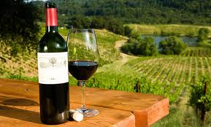
U.S. Wine Industry
The U.S. Wine industry faces intense competition, mounting price pressure, and flat demand
For strategists, they are looking on how to break into blue ocean from this scenario
The first tool that they will use to guide them is called Strategy Canvas

Slide 5
Strategy Canvas
Strategy Canvas is both a diagnostic and an action framework
It has two purposes 1. capture the current state of play in the known market 2. propel users to action by reorienting focus. Ex: competitors to alternatives, and customers to noncustomers.
The horizontal axis of a strategy canvas contains factors an industry competes on, while the vertical axis shows how much each company invested in that factor

Slide 6
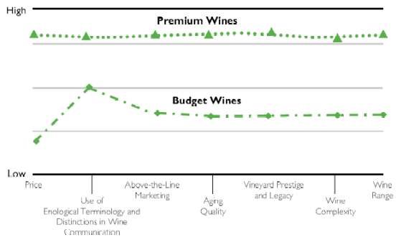
Strategy Canvas

Slide 7
Strategy Canvas
In the U.S. wine industry example research showed the over delivery on prestige and quality
They determined many drinkers were turned off by wine, saying that they saw it as pretentious and intimidating
The new solution for creating a blue ocean in this market should be; How to create a fun and nontraditional wine that is fun for everyone to drink?

Slide 8
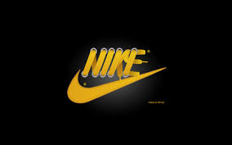
Strategy Canvas
This could be extremely useful for the company we are doing our industry analysis on Nike
They would be considered at the top of their current market, however they could grow and expand by looking at a strategy canvas
This would allow them to point out key areas to reorient on, and create blue oceans for themselves.

Slide 9
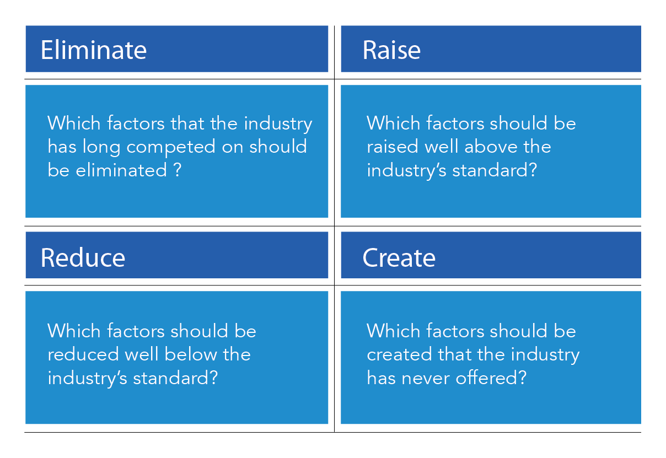
The Eliminate-Reduce-Raise-Create Grid

Slide 10
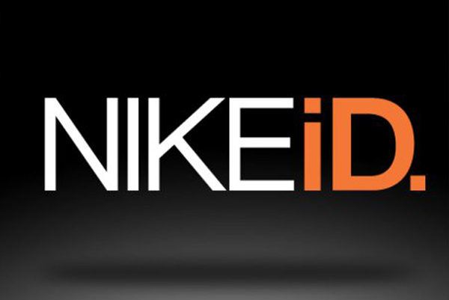
Nike’s ERRC Grid
Eliminate
  Cookie Cutter Shoes
  One color scheme

Slide 11
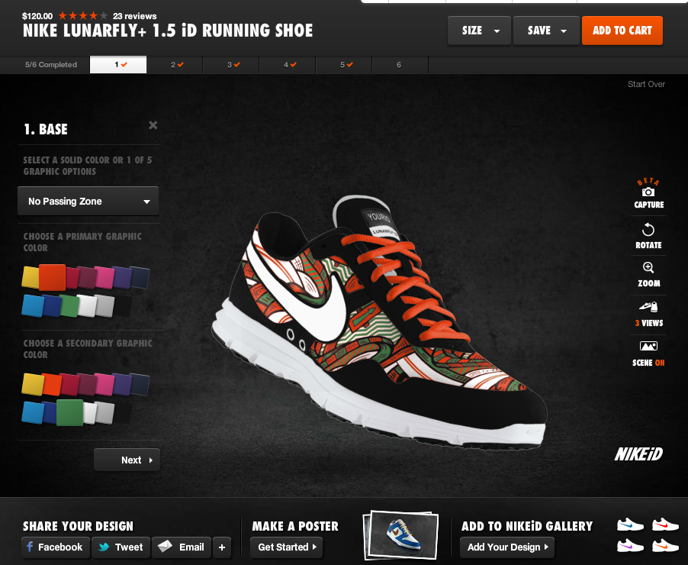
Nike Id

Slide 12
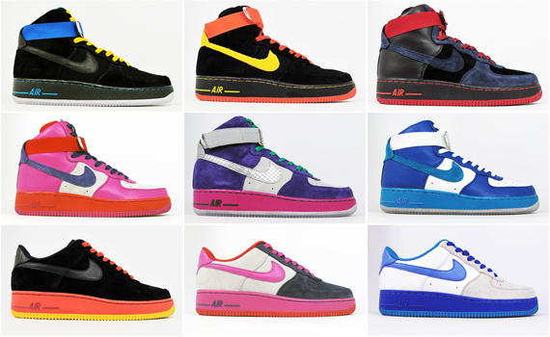
Nike ID

Slide 13
ERRC Grid Continued
Reduce
  Barrier of athletes and “joe’s”
  Nike Commercial

Slide 14
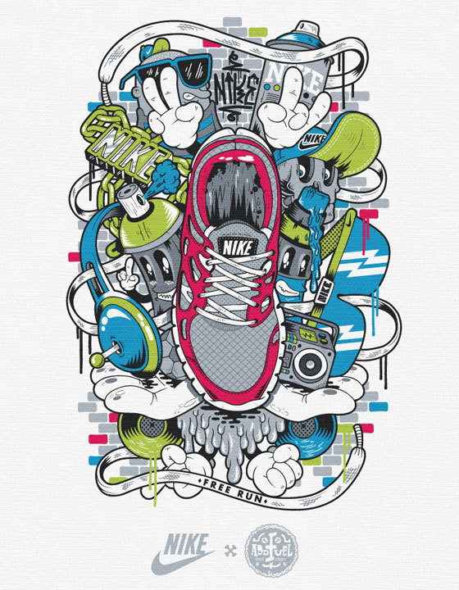
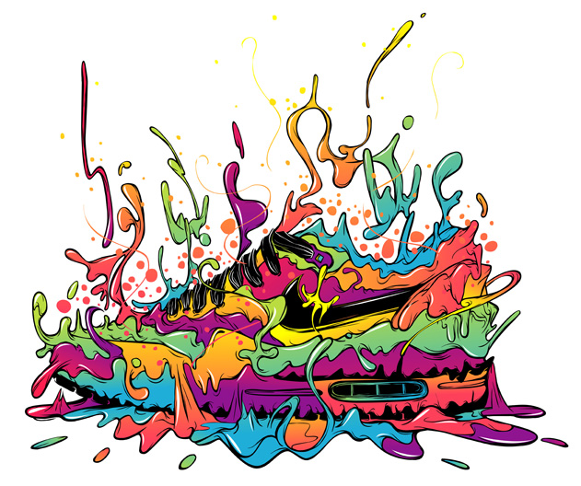
ERRC Grid Continued
Raise
  “Coolness” of Shoes

Slide 15
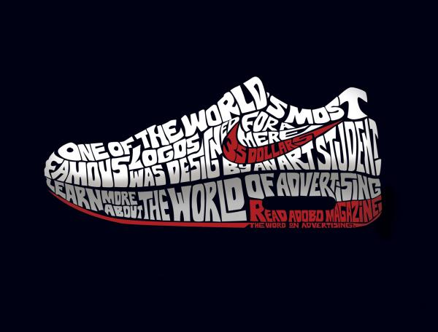
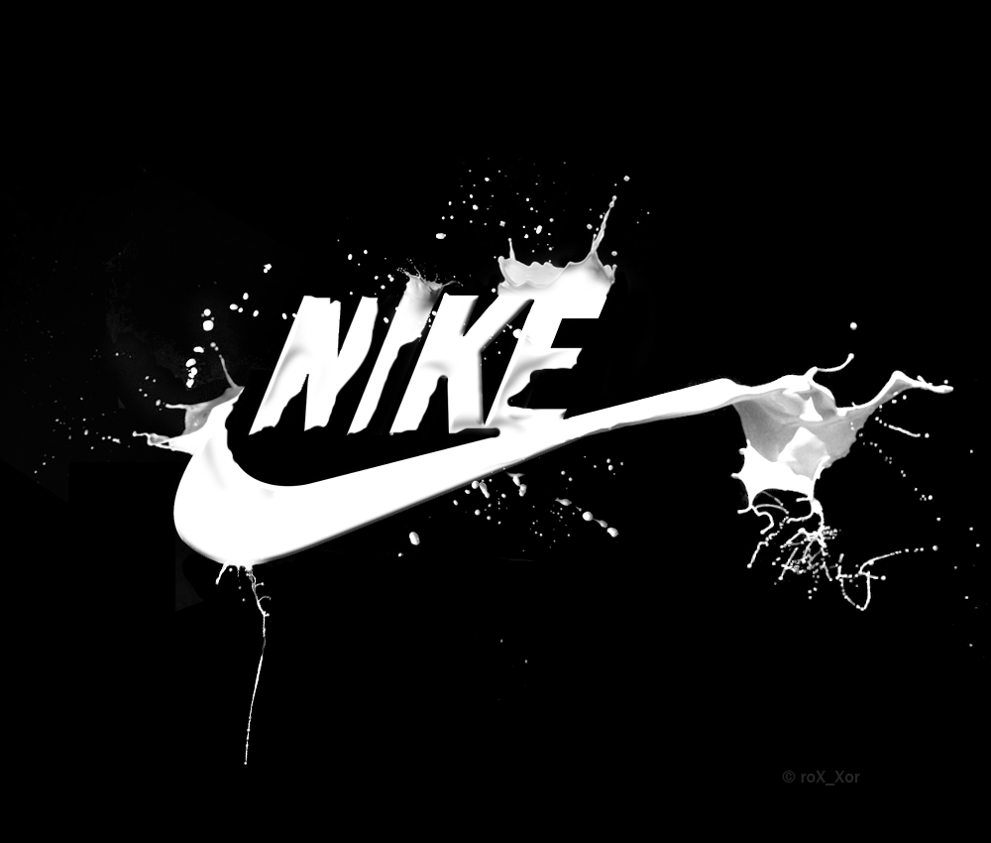
ERRC Grid Continued
Create
  Icon
  Lifestyle Brand

Slide 16
Three Characteristics of a Good Strategy
Focus
Divergence
Compelling Tagline

Slide 17
Three Characteristics of a Good Strategy
[yellow tail], like Cirque du Soleil, created a unique and exceptional value curve to unlock a blue ocean.
Focus: does not diffuse its efforts across all key factors of competition
Tagline: “a fun and simple wine to be enjoyed every day”
Diverges: value curve diverges from the other players;, a result of not benchmarking competitors but instead looking across alternative

Slide 18
Focus
Every great strategy has focus, and a company’s strategic profile should clearly show it.

Slide 19
Divergence
When a company’s strategy is formed reactively as it tries to keep up with the competition, it loses its uniqueness
The value curves of blue ocean strategists always stand apart. By applying the four actions of eliminating, reducing, raising, and creating, they differentiate their profiles from the industry’s average profile.

Slide 20
Compelling Tagline
A good strategy as a clear-cut and compelling tagline.
A good tagline must not only deliver a clear message but also advertise an offering truthfully, or else customers will lose trust and interest.

Slide 21
Nike
Focus- Nike has been focusing on athletic wear since 1950. Most used brand for athletic wear in many schools
Divergence- New shoes that have the technology to track your movements and send them via bluetooth to an app. Basketball shoes that can measure your vertical jump
Compelling Tagline- “Just do it”

Slide 22
Reading the Value Curves
In the value curve of an industry is strategic knowledge on current status and future of a business
Companies must understand how to read value curves in order to see future in the present

Slide 23
A Blue Ocean Strategy
“Does this business deserve to be a winner?”
  Focus
  Divergence
  A compelling tagline that speaks to market

Slide 24
A Blue Ocean Strategy
Value curve lacking focus:
  COST STRUCTURE tends to be high and BUSINESS MODEL tends to be complex in implementation and execution

Slide 25
A Blue Ocean Strategy
Value curve lacking divergence:
  Company’s strategy is a “me too” or no reason to stand apart in marketplace

Slide 26
A Blue Ocean Strategy
Value curve lacking compelling tagline:
  Likely to be internally driven or an example of innovation for innovation’s sake
  No great commercial potential
  No natural take off capability

Slide 27
Company Caught in the Red Ocean
When value curve converges with its competitors
Strategy tends to be trying to outdo competition on bases of cost or quality
  Signals slow growth
  Unless in a lucky industry that grows on its own accord

Slide 28
Over-Delivery Without Payback
When value curve shows it delivers high levels across all factors then the question is:
  “Does the company’s market share and profitability reflect these investments?”
    If no, company may be oversupplying customers

Slide 29
Over-Delivery Without Payback Cont.
To “value innovate” company must decide which factors to eliminate and reduce and those to raise/ create in order to construct a divergent value curve

Slide 30
An Incoherent Strategy
When a company’s value curve can be described as being “low-high-low-low-high-low-high” signals that a company doesn’t have a coherent strategy
  Strategy must be based on independent sub strategies

Slide 31
Sub Strategies
Individually may make sense and keep business running but collectively they do little to distinguish company from the best competitor
  Often a reflection of an organization with divisional or functional silos

Slide 32
Strategic Contradictions
Areas where a company is offering a high level on one competing fact while ignoring others that support that fact
  Example: Investing heavily in making company’s Web site easy to navigate, BUT failing to correct site’s slow speed of operation

Slide 33
An Internally Driven Company
How does a company label the industry’s competing factors?
  Are they stated in terms buyers understand and value or are they in operational jargon

Slide 34
An Internally Driven Company Cont.
Language used gives insight to a company’s strategic vision
  Built on an “outside-in” perspective
    Driven by the demand side
  Or “inside out” perspective
    Operationally driven
Analyzing language helps a company understand how fat it is from creating industry demand

Slide 35
Conclusion
Tools introduced in this chapter are essential analytics
It is intersection between:
  Analytic techniques
  Six principles of formulating (in later chapters)
  Executing blue oceans
That allow companies to break from competition and into uncontested market space

