Slide 1
Blue Ocean Strategy: Chapter 3, Reconstruct Market Boundaries
Stuart Jones, Charles Knight, Matthews Worede, Luis Garcia, Michael Tibbitts, Jacob Eassa

Slide 2
Reconstruct Market Boundaries
1st principle of blue ocean strategy: Reconstruct market boundaries to break from the competition and create blue oceans
Challenge: Successfully identify commercially compelling blue ocean opportunities

Slide 3
6 Paths Framework
6 Basic approaches to remaking market boundaries
Have a general application across industries
Present companies with commercially viable Blue Ocean ideas
Based on looking at familiar data from a new perspective
Challenge the assumptions governing many company’s strategies that keep these companies trapped in Red Oceans

Slide 4
Assumptions by Companies When Forming Their Strategies
Define their industry similarly and focus on being best within it
Look at their industry as strategic groups, and try to be best in their strategic group
Focus on the same buyer group
Define the scope of the products and services offered by their industry similarly
Accept their industry’s functional or emotional orientation
Focus on the same point in time as well as current competitive threats

Slide 5
6 Paths Framework
Companies need to look across:
Alternative industries
Strategic Groups
Buyer Groups
Complementary product and service offerings
Functional-Emotional orientation of an industry
Time

Slide 6
Path 1: Looking Across Alternative Industries
Substitutes vs alternatives: cinema vs restaurant
Companies neglect to think about actions from companies in alternative industries
NetJets:
Created a blue ocean by looking at alternative industries
Problem: flying commercial or private jet?
NetJets offers part ownership of a corporate jet- convenience of a private jet at the price of a commercial airline ticket
Access to more than 550 airport, as opposed to 30 for commercial
Low call time- 4 hours notice

Slide 7
Path 1: Looking Across Alternative Industries
NTT DoCoMo: i-mode
Red ocean in telecommunication industry in Japan due to deregulation
Ease of use of mobile phones vs infinite amount of info on internet
i-mode was a cell phone that cost more than a typical mobile phone, but less than a computer; most importantly, it cut down on the data and focused only on what the user needed.
Brought billing into one simple bill, instead of a flurry of bills.
By focusing on key factors that lead buyers to trade across alt industries and eliminating everything else, businesses can create blue oceans

Slide 8
PATH 2: Look Across Strategic Groups Within Industries

Slide 9
Strategic Groups
Strategic groups: a group of companies within an industry that pursue a similar strategy
To break out of this tunnel vision
which factors determine customers’ decisions
trade up and down from one group to another

Slide 10
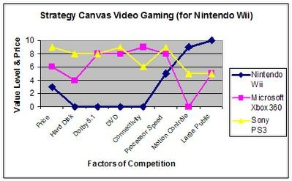
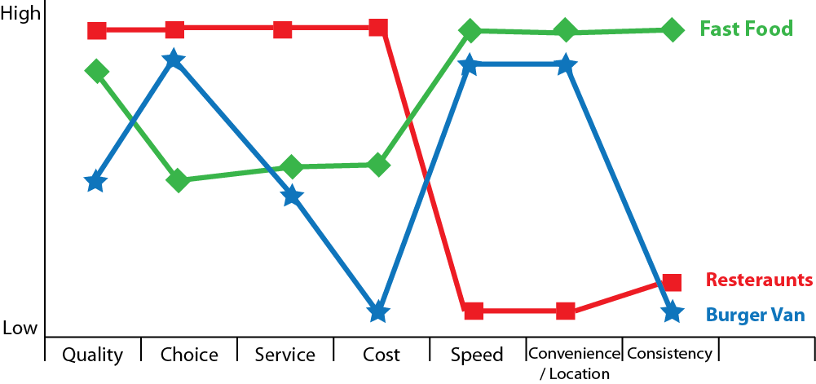
Strategic Canvas Examples
Look within the industry
Identify what you are good at
Trade up and down

Slide 11
Dimensions
Price & Performance
A jump in price brings a jump in performance
Improve competitive within strategic groups
You create a new strategic group
Best of both worlds

Slide 12
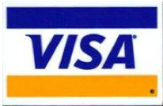
Strategic Group Mapping
High
Medium
Low
Customer Service
Locations
Security
Exclusivity
Products

Slide 13
Future for VISA

Slide 15
Path 3
Corporations Purchasing Agent – Concerned with costs
Corporate User – More concerned with ease of use
Companies in industries tend to target different customer segments (i.e. large vs. small)
Ex: The pharmaceutical industry focuses overridingly on influencers: doctors

Slide 16
Path 3 Main Concept
By challenging an industry’s conventional wisdom about which buyer group to target can lead to the discovery of a new blue ocean.
If a company looks across buyer groups, companies can gain new insights.

Slide 17
Novo Nordisk Example
-Novo Nordisk, Danish insulin producer that created a blue ocean in the insulin industry
-Insulin industry, like pharmaceutical industry, focused on the key influencers: doctors.
-The industry then geared its attention and efforts to produce purer insulin in response to doctors' goal for better medication
-Since companies were only competing on the purity of insulin, the technology behind the injections never progressed.
-Novo Nordisk broke away from the competition and created a blue ocean by shifting the industry's long standing focus on doctors, to the patients.

Slide 18
Novo Nordisk Example
-Novo noticed that insulin presented the patient with significant challenges in the administering phase.
-The usual vials of insulin left patients to handle syringes, needles, the insulin, and administering the correct dosage.
-This led Novo to the blue ocean opportunity of the "NovoPen", which was launched in 1985.
-The NovoPen resembled a normal pen that contained an insulin cartridge with roughly one weeks worth of insulin.
-The pen had an integrated click mechanism, making it extremely simple to control the dosing and administer the insulin.

Slide 19
Novo Nordisk Example
-Patients could carry the pen with them and inject with ease and convenience.
-To dominate the blue ocean the NovoPen had unlocked, Nordisk followed up with the NovoLet in 1989.
-The NovoLet was a prefilled disposable insulin injection pen with a dosing system for even greater convenience and ease of use.
-In 1999, the Innovo was introduced. With an integrated memory and cartridge based delivery system, the Innovo could display the dose, the last dose, and the elapsed time to ensure proper dosage and schedule.
-Nordisk's blue ocean strategy shifted the industry from an insulin producer to a diabetes care company.
-Novo Nordisk now controls more than a 60% share in Europe and 80% in Japan of insulin prefilled devices.

Slide 20
Bloomberg Example
Bloomberg was one of the largest and most profitable business information providers in the world.
In 1980’s bloomberg realized the industry focused on purchasers: IT managers.
Bloomberg decided it was the traders and analysts who made the real impact.
When markets are active, traders and analysts must make rapid decisions, making every second count.

Slide 21
Bloomberg Example
Bloomberg designed a system specifically to offer traders better value.
The system included two flat-panel monitors so that traders could see all the information they needed.
Bloomberg included an analytic capability so the users could run “what if” scenarios to compute returns on investments.
Once Bloomberg switched focus to the users, he was able to see the paradox of traders and analysts’ personal lives

Slide 22
Bloomberg Example
The traders and analysts had tremendous income but not spare time to enjoy it.
Bloomberg added information and purchasing services that enhanced traders’ and analysts personal lives.
By shifting its focus upstream from purchasers to users, Bloomberg created a value curve that was different from any seen in the industry.
Traders and Analysts worked together to force the IT managers to purchase Bloomberg terminals.

Slide 23
Path 4: Look Across Complementary Product and Service Offerings
Untapped value is often hidden in complementary products and services.
The key is to define the total solution buyers seek when they choose a product or service
Think about what happens before, during, and after your product is used

Slide 24
Visa Example
In order to capitalize on blue oceans Visa could:
Offer a credit building seminar for younger customers
Offer a credit report rating service to customers

Slide 25
NABI
Hungarian bus company
Not satisfied with the way the bus industry catered to its customers
Companies consumed with offering buses at the lowest possible price
Decreased quality and costed municipalities more in repair and maintenance over time
Not environmentally friendly

Slide 26
NABI continued…
Created a fiberglass bus
Cut maintenance costs
Made body repairs faster
Cut fuel emissions (fiberglass is lighter than steel)
Lower manufacturing costs and more room inside the buses
All of this created a value curve that diverted from the industry’s average curve

Slide 27
NABI continued…
While NABI charged a higher price for its buses, the design and quality of the buses lowered maintenance and fuel costs over the buses lifespan making their design more practical
Created unprecedented industry factors
Aesthetic design
Customer friendliness
Lower floors made it easier to board and gave more room for seats

Slide 28
NABI
Captured 20% of the U.S. market
More than $1 billion in orders
Named by the Economist Intelligence Unit in 2002 as one of the 30 most successful companies in the world.
All of this is a result of successfully identifying blue ocean opportunities and looking across complementary product and service offerings

Slide 29
Things to Consider
What is the context in which your product or service is used?
What happens before, during, and after?
Can you identify the pain points?
How can you eliminate these pain points through a complementary product or service offer?

Slide 30
Path 5
Functional appeal
Emotional Appeal
Overview of companies/Industries the implemented both.

Slide 31
Functional appeal
QB house barber shop in japan, created a blue ocean strategy shift from an emotional one to a highly functional one.
Took an hour haircut ritual, to a 10 minute quick trip
Results large market share growth and expansion in china, Malaysia Singapore.

Slide 32
Emotional appeal
Cemex’s changed the cement business in Mexico.
Sold in retail bag, in a do-it yourself fashion. Very unattractive market, most families needed cement to build but were not interested in spending there money on cement. Most families spend their extra income on parties, festivals, and quinceanera.
Created a festive environment through a system called patrimonio.
Cemex’s enjoys 15% market share selling the cement at a higher price

Slide 33
Trend
Investment banks, and insurance companies are moving towards a more functional approach
Getting rid of brokers and increasing their reliability on technology

Slide 34
Path 6: Look Across Time

Slide 35
Forming the Basis of
Blue Ocean Strategy
Three Principles of Developing a
Blue Ocean Strategy
Trends must:
be decisive to your business.
be irreversible.
have a clear trajectory.

Slide 36
Trends
Observable Trends:
A Discontinuity in technology
Rise of a new lifestyle
A change in Regulatory Environments
A change in Social Environments
Usually only one or two will have any decisive impact on a particular business.
It is possible to identify a trend or major event without being able to predict its direction

Slide 37
Responding to External Trends
All industries are affected by external trends.
They are tasked with identifying and adapting to these trends, while developing strategies that allow them to capitalize on them wherever possible.
Managers and projecting trends.
Developing blue ocean strategies.
Looking across time-from the value a market delivers today to value it might deliver tomorrow.

Slide 38
Look Across Time Process for Developing a Blue Ocean Strategy
Identify a trend that follows the Three Principles.
Consider the Blue Ocean that would conclude from following this trend through.
Work backwards from that conclusion and determine what steps would need to be taken to reach it.
Determine what must be changed today to unlock this new blue ocean.

Slide 39
A Look at the Rise of Apple
Observed illegal music file sharing of the 1990’s.
Visualized the conclusion of the trend.
Transition from physical CD’s.
MP3 players.
Itunes - Breaking key customer annoyance factors.
Protecting their blue oceans.

Slide 40
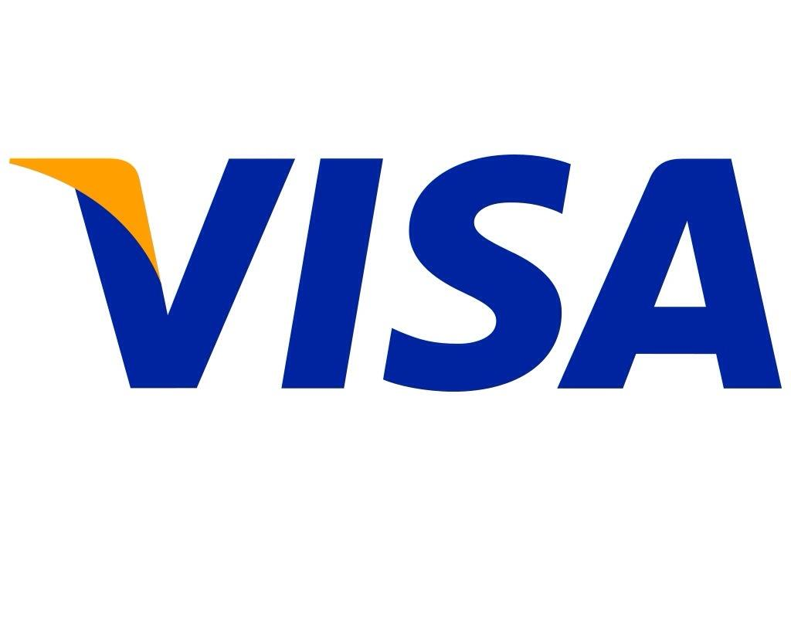
A Look at Visa Today
Longer 0% percent APR Periods.
Creative Perks.
Varied reward redemption choices.
Mobile payment opportunities.
Chip and PIN cards.

Slide 41
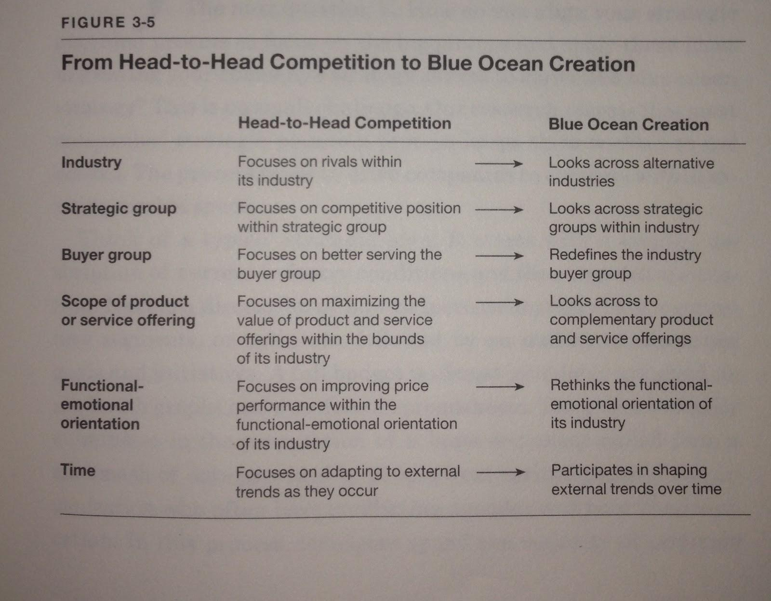

Slide 42
Questions?

