Slide 1
Get the Strategic Sequence Right Chapter 6 Blue Ocean Strategy
Jacqueline Torres
Carly Pyle
Gabriel Flores
Olivia Garcia
Gabriella Cabello

Slide 2
Strategic Sequence of fleshing out and validating blue ocean ideas to ensure their commercial viability
By understanding the right strategic sequence and how to assess blue ocean ideas along the key criteria in that sequence, you can dramatically reduce business model risk

Slide 3
The Right Strategic Sequence
Buyer Utility
Price
Cost
Adoption

Slide 4
The Sequence of Blue Ocean Strategy
Buyer Utility
Is there exceptional buyer utility in your business idea?
Price
Is your price easily accessible to the mass of buyers?
If No- Rethink
Cost
Can you attain your cost target to profit at your strategic price?
If No- Rethink
If Yes then move on to the next
If No - Rethink
If Yes then move on to the next
If Yes then move on to the next
Adoption
What are the adoption hurdles in actualizing your business idea? Are you addressing them up front?
If Yes then you have a commercially viable blue ocean idea
If No- Rethink

Slide 5
The Six Stages of the Buyer Experience Cycle
 | Purchase | Delivery | Use | Supplements | Maintenance | Disposal
Customer Productivity
Simplicity
Convenience
Risk
Fun and Image
Environmental friendliness
The Six Utility Levers

Slide 6
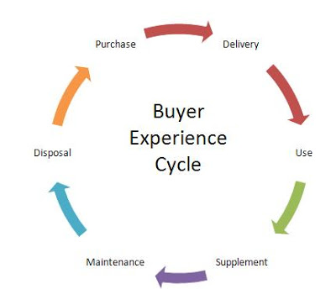
The Six Stages of the Buyer Experience Cycle
At each stage, managers can ask a set of questions to gauge quality of buyer’s experience

Slide 7
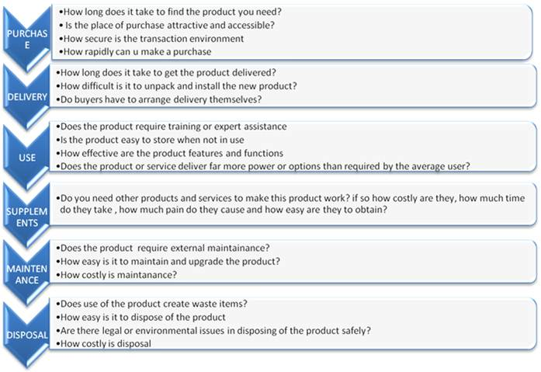

Slide 8
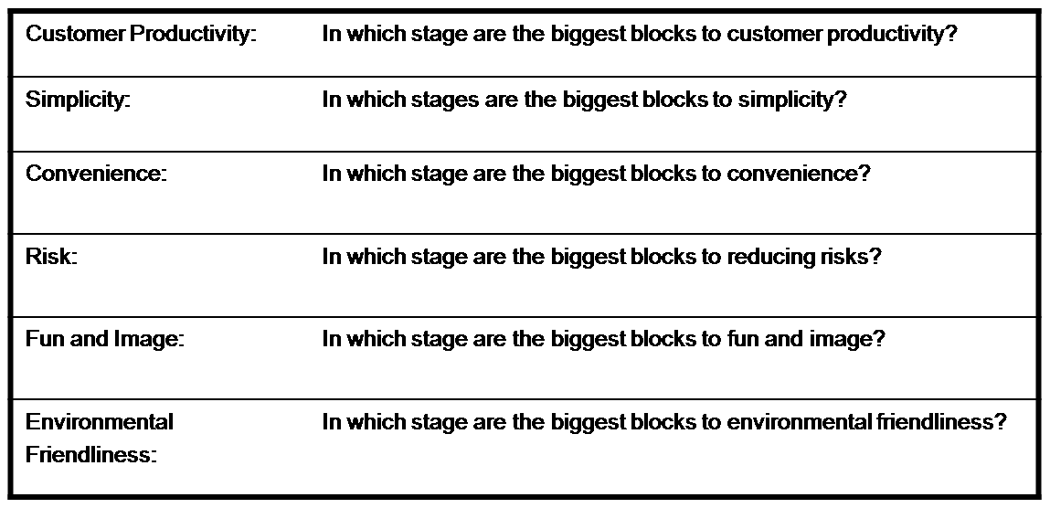
Uncovering the Blocks to Buyer Utility

Slide 9
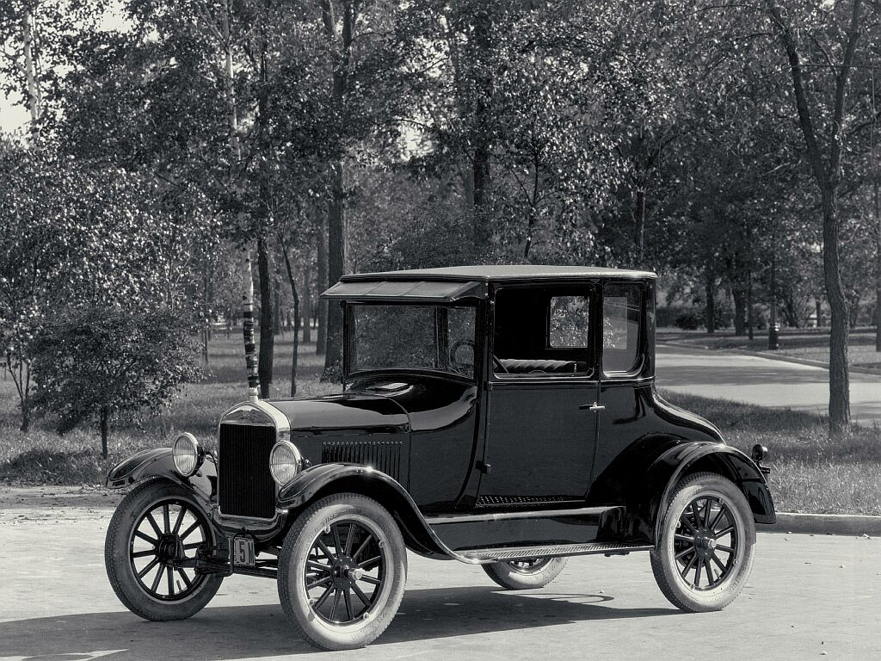
Ford T Model
Focused on Image in the Use Phase for fashionable weekend outings
Block to Utility- Convenience in the Use Phase & Risk in the Maintenance
Decided to eliminate these 2 utility blocks
The aim is to check whether your offer passes the exceptional utility test
Where are the greatest blocks?

Slide 10
From Exceptional Utility to Strategic Pricing
Know from the start what price will capture the mass of target buyers
2 reasons- Volume is key & total amount of people using it
Network externalities- all-or-nothing proposition

Slide 11
From Exceptional Utility to Strategic Pricing
Rise of knowledge intensive products creates potential for free riding
Rival good- one firm precludes its use by another
Non rival good- one firm does not limit its use by another
Makes Competitive imitation not only possible but less costly
Cost & risk of developing an innovative idea are borne by the initiator not the follower

Slide 12
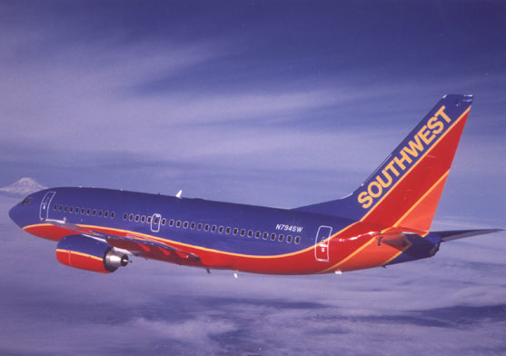
From Exceptional Utility to Strategic Pricing
Challenge- when excludability is considered
Excludability- function both of the nature and of the good of the legal system
Lack of excludability reinforces the risk of free riding – vulnerable to imitation
When exceptional utility is combined with strategic pricing, imitation is discouraged

Slide 13
Price Corridor of the Mass
Help managers find the right price of an irresistible offer
Involves 2 distinct but interrelated steps

Slide 15
Step 1: Identify the Price Corridor of the Mass
Companies first must look at the products and services that mostly resemble their idea in term of form
Main challenge is understanding the price sensitivities of those people who will be comparing the new product and services offered outside the group of traditional competitors

Slide 16
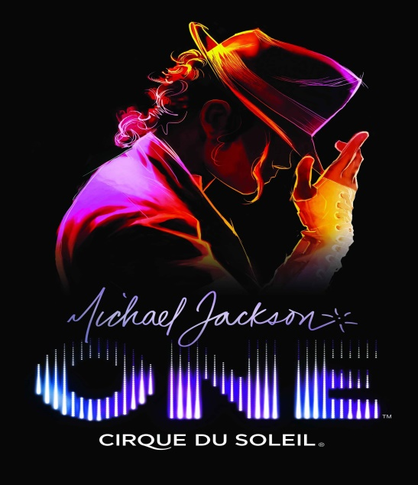
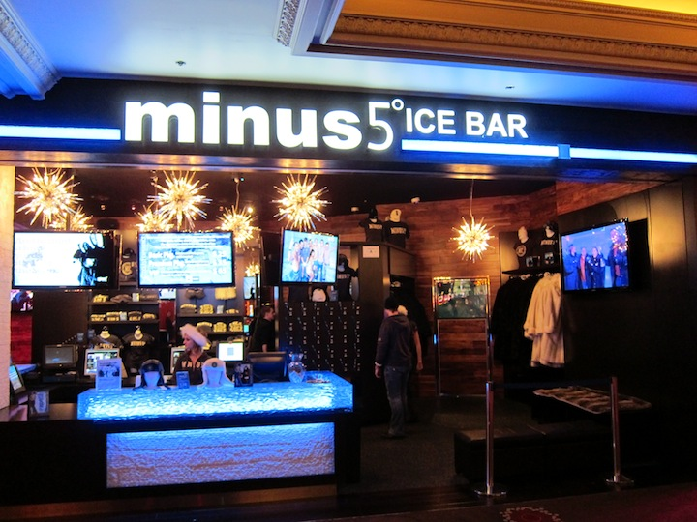
Step 1: Identify the Price Corridor of the Mass cont.
Products and services fall into two categories:
Different form, same function
Ex. Ford’s Model T vs. horse-drawn carriage
Different form and function, same objective
Ex. Cirque du Soleil vs. bars

Slide 17
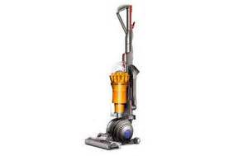
Step 2: Specify a Level Within the Price Corridor
Two principal factors:
The degree to which the product or service is protected legally through patents or copyrights
The degree to which the company owns some exclusive asset or core capability
Ex. Dyson
Companies with uncertain patent and asset protection should consider pricing in the middle of the corridor
Companies that do not have protection, they must set a relatively low price
Ex.

Slide 18
Step 2: Specify a Level Within the Price Corridor cont.
If any of the following apply:
Their blue ocean offering has high fixed costs and marginal variable cots
Their attractiveness depends heavily on network externalities
Their cost structure benefits from steep economies of scale and scope. In these cases, volume brings with it significant cost advantages, something that makes pricing for volume even more key

Slide 19
From Strategic Pricing to Target Costing
Maximize Profit – Blue Ocean Idea
A company should start with the strategic price and then deduct its desired profit margin from the price to arrive at the target cost.
Price-minus Costing
Essential if you are to arrive at a cost structure that is both profitable and hard for potential followers to match

Slide 20
Model T. Ford
Scrap the standard manufacturing system – hand made from start to finish
Assembly Line
Replaced skilled craftsmen with ordinary unskilled laborers,
Worked one small tasks faster and more efficiently
From 21 days to 4 days
Cutting Labor hours by 60%
If not, could not have met its strategic price profitability

Slide 21
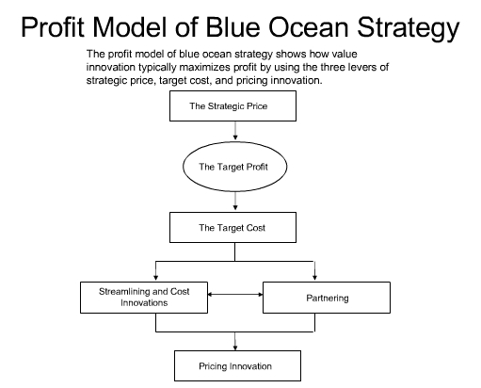

Slide 22
Cost Target
3 Principal Levers
Streamlining and Cost innovations
Partnering
Pricing Innovation

Slide 23
Streamlining and Cost Innovations
Streamlining operations and introducing cost innovations from manufacturing to distribution.
Can product’s or service’s raw materials be replace by unconventional, less expensive
Ex: Metal to plastic
Call center from U.K. to Bangalore
Can High-Cost, low-value-added activities in your value chain be significantly eliminated, reduced or out sourced?
Prime real estate locations to lower cost locations?

Slide 24
Partnering
Provides a way for companies to secure needed capabilities fast and effectively while dropping their cost-structure.
Companies to leverage other companies’ expertise and economies of scale.
Closing gaps in capabilities through making small acquisitions when do so is faster and cheaper, providing access to needed expertise that has already been mastered.
AT&T buys Direct TV

Slide 25
Changing Price Model of the Industry
Example: Blockbuster rented out $80 video tapes
Time-share
NetJets; made jets accessible to a wide range of corporate customers.
Slice-share
Mutual fund managers–brought high quality
Equity interests
Give products to customers in return for an equity interest in customer’s business

Slide 26
Cost Target
3 Principal Levers
Streamlining and Cost innovations
Partnering
Pricing Innovation
When a company’s offering successfully addresses the profit side of the business model, the company is ready to advance to the final step in the sequence of blue ocean strategy

Slide 27
From Utility, Price, Cost to Adoption
Impact of a new business idea: fear and resistance
It provokes it in three factors:
Employees
Business partners
General public
Notes:
So the whole presentation was structured to present the information on how the strategic sequence would help create a blue ocean into a new business idea. I’m going to cover the factors that come into play when a strategic sequence is constructed. When a person falls into a certain routine its hard to adapt into a new business setting. Therefore the whole new impact of the new business idea brings about fear and resistance in employees, business partners, and the general public. Before even moving forward you a company needs to address and overcome fear and resistance.

Slide 28
Employees
Expensive
Merrill Lynch
Decrease in stock prices
Morgan Stanley Dean Witter & Co.
Increase in stock prices
Notes:
One of the factors that a new business idea effects would be employees. The whole new business idea is carried out and executed by the employees of the company. If you don’t effectively communicate with them the business idea things may not work out. Take for example, Merrill lynch a financial managing and advising company, that failed to address the new business idea and its threats to its employees. In consequence they resisted against the concept causing the stock price to decrease by 14%. In contrast the company Morgan Stanley Dean Witter & Co. a financial services corporation had perfect communication with its employees by having an open discussion with them. The market and its employees understood that a need for e-ventures so the company’s stock prices rose by 13%.

Slide 29
Business Partners
Revenue streams or market positions are threatened
Notes:
Even more damaging than employees resistance is the resistance of the business partners who fear that their market positions and revenue streams will decrease. That was the problem faced by SAP a software corporation that decided to introduce AcceleratedSAP to the market. The new business program affected the way the company did business by dropping some of its biggest customers and focusing on a new customer pool. To solve the problem of the business partners not wanting to implement the program ASAP executives talked to their business partners and convinced them about cooperating. They would gain more business.

Slide 30
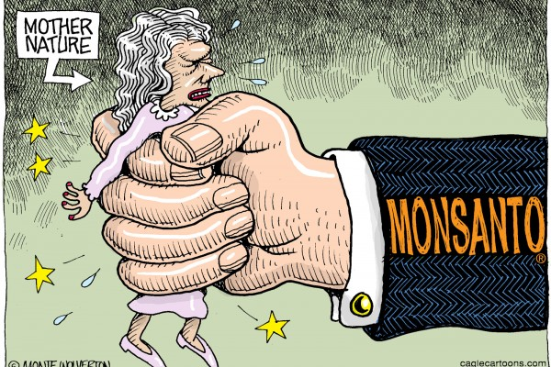
General Public
Threatens to establish social or political norms
Monsanto
European environmental groups
Notes:
Many times the company has the right business idea that the employees and the business partners agree with, but that still doesn’t mean that everything will be okay. The general public also affects the blue strategy of implementing the strategic sequence of unit, price, cost, and adoption. The general public can turn things around 360 degrees. Take Monsanto for example. They make genetically modified foods. When they introduced their products to the European consumers they didn’t take it so well. They are known for being big environmentalists. What Monsanto should have done was educate the consumers and the public about the advantages that Monsanto was presenting such as decreasing world famine and diseases. They should of given their consumers the option of organic or genetically modified instead of labeling everything the same.

Slide 31
Blue Ocean Idea Index (BOI)
Implementing all four steps
 |  | Philips CD-i | Motorola Iridium | DoCoMo i-mode Japan
Utility | Is there exceptional utility? Are there compelling reasons to buy your offering? | - | - | +
Price | Is your price easily accessible to the mass if buyers? | - | - | +
Cost | Does your cost structure meet the target cost? | - | - | +
Adoption | Have you addressed adoption hurdles up front? | - | +/- | +
Notes:
The company should build their blue ocean business strategy in the strategic sequence but the main point is to integrate them all together. The blue ocean idea index is a simple but robust test on how to view the system.

Slide 32
The End
Any questions?

