Slide 1
Chapter 7 Overcome Key Organizational Hurdles
Jacqueline Torres
Carly Pyle
Olivia Garcia
Gabriel Flores
Gabriella Cabello

Slide 2
The Four Organizational Hurdles to Strategy Execution
Cognitive
An Organization wedded to the status quo
Political
Opposition from powerful vested interests
Motivational
Unmotivated Staff
Resource
Limited Resources
Notes:
Companies have to let go of conventional wisdom because its effecting change from occuring. Conventional wisdom asserts that the greater the change, the greater the resources and time you will need to bring about results, instead flip that conventional wisdom, and go to the tipping point leadership. This allows you to overcome these four hurdles fast and at low cost while winning employees backing in executing a break from the status quo

Slide 3
Tipping Point Leadership in Action
Example: NYPD
In the early 1990s New Yorkers were under siege by crime, murder was at an all-time high
With miserable pay, dangerous working conditions, long hours and little hope for advancement morale was at rock bottom
Competition the criminals was strong and rising
Notes:
Strapped for cash , wedded to the status quo unmotivated and underpaid, unhappy customers (citizens of new york)

Slide 4
Breaking out of the red ocean
Bill Bratton- commissioner of NYPD
No increase in the budget, he turned New York City into the safest large city in the US
Felon crime fell 39% ,murders 50%, and theft 35%
Customers- the public now had confidence in the NYPD
Patrolman were not satisfied with their job
Bratton just fundamentally shifted the organizational culture and strategy

Slide 5
The Pivotal Lever: Disproportionate Influence factors
Mounting a massive challenge is not about putting forth an equally massive response where performance gains are achieved by proportional investments in time and resources, its about conserving resources and cutting time by focusing on identifying and then leveraging the factors of disproportionate influence

Slide 6
Break Through the Cognitive Hurdle
Cognitive Hurdle- Mental blocks that prevent employees from seeing a need for the changes
Hardest battle
Make people aware of the need for a strategic shift and agree to its causes

Slide 7
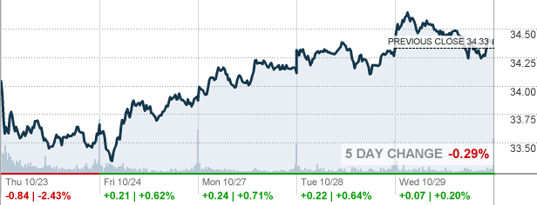
AT & T
Growth & Valuation
Earnings growth (last year) +171.20%
Earnings growth (this year) +2.81%
Earnings growth (next 5 years) +4.49%
Revenue growth (last year) +1.03%
P/E ratio 10.6
Price/Sales 1.47
Price/Book 1.97

Slide 8
Don’t Rely on Numbers
Creates hostility and suspicion between organization
Can easily be manipulated
Messages through communication seldom stick to people
Tipping Point Leadership does not rely on numbers to break cognitive hurdle

Slide 9
Tipping Point Leadership
Act of disproportionate influence- Making people experience harsh reality firsthand
“Seeing is believing”
Experiences that don’t require touching, seeing, or feeling actual results are non-impactful and easily forgotten
Tipping Point Leadership builds on this insight a fast change in mindset that is internally driven of people’s own accord

Slide 10
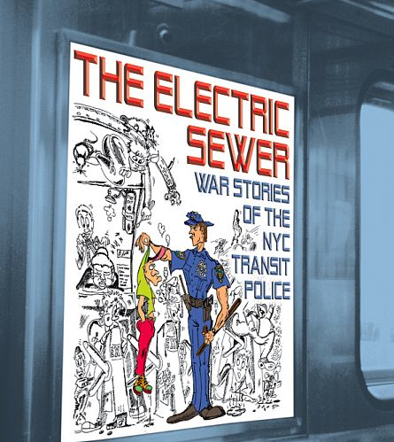
Ride the “Electric Sewer”
To Break the status quo, employees must come face-to-face with worst operational problems
Shocking, inescapable, but actionable
“Reeked of fear”
Showing worst reality to your superiors can shift mindset fast

Slide 11
Meet with Disgruntled Customers
Listen to your disgruntled customers firsthand
Boston’s Police District 4- housed the Symphony Hall, Christian Science Mother Church
Community in downward spiral
Few felt endangered by large crimes
“Broken Windows”

Slide 12
When you want a need for a strategic shift and break from the status quo?
Break the case with numbers?
Make managers and employees come face-to-face with worst operational problems?
Listen to disgruntled customers?
Outsource your eyes and send out market research questionnaires?

Slide 13
Jump the Resource Hurdle
Hot Spots – low resources but high potential performance gains
Cold Spots- high resources input but low performance impact
Horse Trading- trading units excess resources in one area to another’s to fill remaining resources gaps.

Slide 14
Redistribute Resources to Your Hot Spots
New York police
Increase profits (lower crime), increase costs (police officers)
Target hot spots and force remained constant

Slide 15
Redirect Resources from Your Cold Spots
New York Transit police
Freeing up resources for use in hot spots
“bust buses”

Slide 16
Engage in Horse Trading
Trade excess resources you don’t need for those that you need.
New York Transit Police (excess cars)
New York Division of Parole (excess office space)

Slide 17
Jump the Motivation Hurdle
Must alert employees to the need for a strategic shift and identify how it can be achieved with limited resources.
People must not recognize what needs to be done, but they must also act on that insight in a sustained and meaningful way.

Slide 18
Zoom in on Kingpins
These are the people inside the organization who are natural leaders, who are well respected and persuasive or have the ability to unlock or block access to key resources.
NYPD – Bratton
76 precinct heads as his key influencers and Kingpins
Each controlled 200 – 240 officers
Natural ripple effect of touching and motivating 36,000 officers to embrace new policing system.

Slide 19
Place Kingpins in a Fishbowl
Where kingpins’ actions and inaction are made as transparent to others as are fish in a bowl of water.
NYPD – Bratton
Biweekly crime strategy review meeting known as Compstat to review all 76 precinct commanders
Intense performance culture was created in weeks because no kingpin wanted to be shamed in front of others, and they all wanted to shine in front of their peers and superiors

Slide 20
Atomize to Get the Organization to Change Itself
Framing of the strategic challenge – one of the most subtle and sensitive tasks of the tipping point leader.
NYPD
Bratton’s foal in NY was turn such a huge city from being the most dangerous place in the country into the safest.
To make attainable – bite-size atoms that officers at different levels could relate to.
Block by block, precinct by precinct, and borough by borough

Slide 21
Knock Over the Political Hurdle
Organizational politics is an inescapable reality of corporate and public life
Influence factors
Angels
Devils
Consigliere
Notes:
While a company can have the best team in the world and they can be the most efficient as well, there as still some things a company has to deal with in the behind the scenes part. Take politics for example. It’s a touchy subject and even if a company isn’t biased there will always be some kind of political problem. Either with in the company or externally. There are three main factors that can influence politics; angels, devils, and consigliere. Angels are the people that have the most to gain from the strategic shift. Devils are the ones who have the most to lose from it. A consigliere is a politically adept but highly respected insider who knows in advance all the land mines, including who will fight you and who will support you. In the rest of my part of the presentation I will be analyzing main points that tipping point leaders focus on to overcome political hurdles.

Slide 22
Secure a Consigliere on Your Top Management Team
Top Management Team
Attributes:
Marketing
Operations
Finance
Consigliere
Notes:
To start off most leaders while choosing their team consider people with marketing, operations, and finance attributes that will help aid the company. Tipping point leaders go an extra step trying to find a consigliere. They know that if they have this kind of person on their side, it will help reduce problems that may appear in the future. For example, William Bratton, from NYPD, always made sure that he had a insider in his top management team. Bratton and Timoney work side by side. Timoney knew all the ropes and was highly respected due to his 20 years in different ranks. One of the main helps that Timoney gave Bratton was that he told his who on the top team would side with him and who wouldn’t when he knew Bratton wanted to implement something new in the police department.

Slide 23
Leverage Your Angels and Silence Your Devils
Who are my devils?
Who will fight me? Who will lose the most by the future blue ocean strategy?
Isolate your detractors
Who are my angels?
Who will naturally align with me? Who will gain the most by the strategic shift?
Get the higher and wider voice to fight with you

Slide 24
Challenging Conventional Wisdom
Conventional theory vs. Tipping point leadership
Conventional theory is the theory of organization change rests on transforming the mass
Tipping point leadership is the strategy of changing the mass by focusing on extremes

Slide 25
The End.
Any questions?

