Slide 1
Industry Analysis
Jacqueline Torres
Gabriela Cabello
Gabriel Flores
Carly Pyle
Olivia Garcia

Slide 2
Introduction
The primary task for this chapter is to identify the sources of profit in the external environment.

Slide 3
Objectives
Be familiar with a number of frameworks used to analyze an organization’s external environment and understand how the structural features of an industry influence competition and profitability.
Be able to use evidence on structural trends within industries to forecast changes in competition and profitability and to develop appropriate strategies for the future.

Slide 4
Objectives
Understand the value and challenge of undertaking industry analysis and be able to provide a critique of Porter’s five forces framework
Be able to analyze competition and customer requirements in order to identify opportunities for competitive advantage within an industry.

Slide 5
The Mobile Phone Industry
In the early years Motorola, Ericsson, Nokia and Siemens dominated the design, production and marketing of mobile phones and had a strong presence in the mobile communications infrastructure business.
As the industry progressed the technology and with the demand of the end-user it became difficult for a single handset manufacturer to retain leading expertise.

Slide 6
The Mobile Industry
The early leaders transformed themselves into systems integrators and assemblers, thus opening it up for more specialized firms to produce components, subassemblies and software.
More established telecom equipment manufactures entered the industry such as Sony, Sharp, LG, Samsung

Slide 7
The Mobile Industry
The handset market was shaken up even more with the introduction of the IPhone and Google’s development of the Android mobile operating system.
Depressing industry profitability, differentiation problems

Slide 8
From environmental analysis to industry analysis
Business environment
All the external influences that affect its decisions and performance
It may become difficult for managers to monitor all the external influences
Starting point to begin to do so is some kind of system or framework for organizing information.

Slide 9
Organizing external influences
Classifying influences
Political
Economic
Social
Technological
Also know as a PEST analysis
Notes:
PEST analysis has become popular as an environmental scanning framework because it provides a simple yet systematic approach to identifiying those factors that are likely to shape the competitive conditions within an industry. Understanding these basic forces is important in understanding and predicitn how an industry might change and evolve over time and is a key initial step in thinking about future scenarios and the opportunities and threats that the industry might face.

Slide 10
Organizing external influences
Proximity
Micro-environment
Task environment
Macro-environment

Slide 11
Pest Analysis example
Political
Licenses – the governments select companies to provide access to the wireless spectrum
Standardization- adopting a standard connector for charging phone batteries, making it easier for end-users
Restrictions on usage- governments place restrictions on the use of mobile phones
Notes:
This not only affects the services operator but also the nature and level of demand for different types of handsets
Restrictions on usage are not likely to affect the competitive position of a handset frim but may provide incentives for new technologies to be developed

Slide 12
PEST Analysis
Economic
The level of economic activity- Recession, affects the sales of handsets
The rapid take-up of mobile technologies in developing economies- offer a more economical and efficient solution than land lines to communications infrastructure problems

Slide 13
PEST Analysis
Social
Health Scares- concerns have been raised about the amount of radio waves that people can safely absorb
Changes in fashion- mobile phones are increasingly being viewed as a fashion accessory by younger age groups

Slide 14
PEST Analysis
Technological
Characterized by rapid changes in technology, creating winners and losers
Battery life, development of 4G systems and secure encryption.

Slide 15
PEST Analysis
Judgment of this exercise is to be used
Identifying those factors that are likely to be the most important in shaping industry conditions
But before the industry conditions you must understand the relations with the industry environment

Slide 16
Industry Environment
Customer- for a firm to make a profit it must create value for customers
Suppliers- in creating value, the firm acquires goods and services from suppliers
Competitors- the ability to generate profitability depends on the intensity of competition among firms that compete for the same value- creating opportunities.
Notes:
Thus a firm must undestand how the general environment may affect not only them but also their industry environment of all their key relationships

Slide 17
Determinants of Industry Profit
The value of the product to customers
The intensity of competition
The bargaining power of the produces relative to their suppliers

Slide 18
Analysis Industry Attractiveness
The basic premise is the level of industry profitability is neither random nor the result of entirely industry-specific influences – it is determined by the systematic influences of the Industry’s structure.
AT&T versus Pharmaceutical Company
Small Markets support much higher profitability than large market
Small Markets can more easily be dominated by a single firm

Slide 19
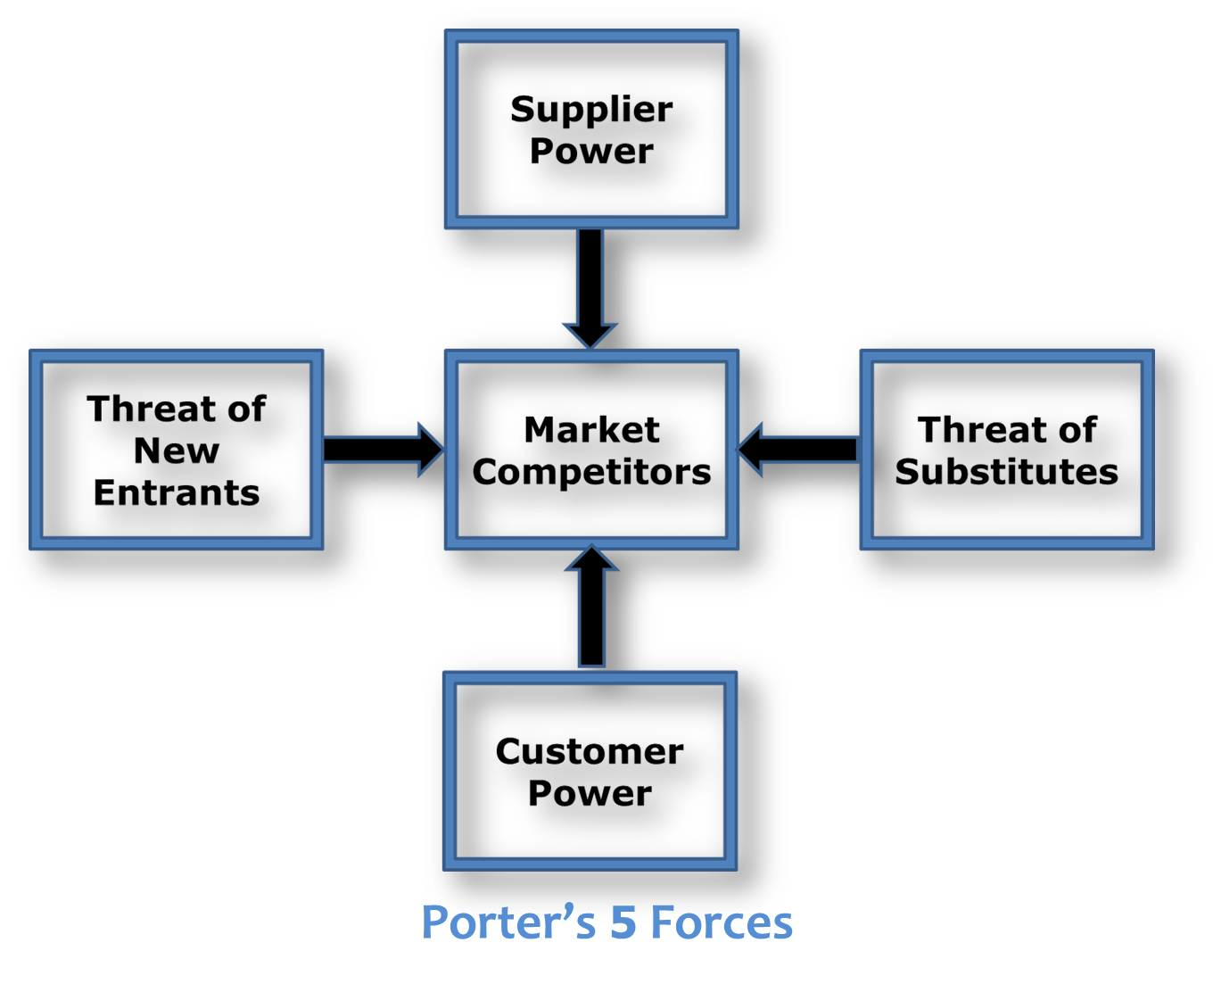
Porters Five forces of Competition
Horizontal – Competition from substitutes, entrants and rivals
Vertical – Power of Suppliers and Buyers

Slide 20
Competition from Substitutes
The price customers are willing to pay for a product depends, in part, on the availability of substitute products.
The existence of close substitutes means the customers will switch to substitutes in response to price increases for the product.
Ex: Travel agencies, newspapers and telecommunication providers

Slide 21
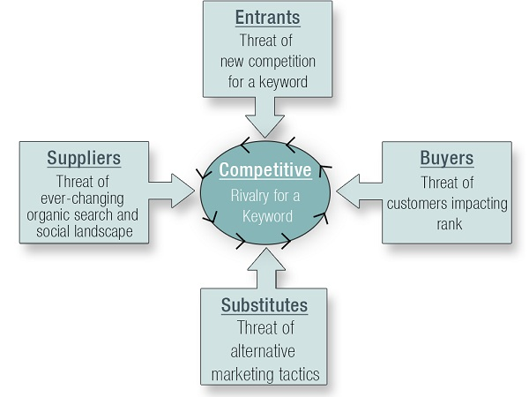
Structural Determinants of the five forces of competition

Slide 22
Threat of Entry
If an industry earns a return on capital in excess of its cost of capital, it will act as a magnet to firms outside the industry.
If the entry of new firm is unrestricted, the rate of profit will fall toward its competitive level.
For the Mobile Phone Industry:
There are over 50 companies with only four top companies in the wireless service industry that controls 80% of the Market.
Verizon, AT&T, Sprint, T-Mobile, U.S. Cellular, Metro PCS, Cricket, Virgin Mobile and Boost.

Slide 23
Threat of Entry
Capital Requirements – Costs of getting established in an industry can be so large as to discourage all but the largest companies.
Ex: Cell phone towers and advertising costs.
Economies of Scale – In industries that are capital or research or advertising intensive, efficiency requires a large-scale operation.
Ex: Metro PCS and ClearTalk compared to AT&T.

Slide 24
Threat of Entry
Absolute Cost Advantages – Established Firms may have a unit cost advantage over entrants irrespective of scale.
Product Differentiation – In an industry where products are differentiated, established firms possess the advantages of brand recognition and customer loyalty.

Slide 25
Threat of Entry
Access to Channels of Distribution – For Many new suppliers of consumer goods, the principal barrier to entry is likely to be gaining distribution.
- Ex: Apple IPhone6 are not sold in smaller smaller markets.
Governmental and Legal Barriers – regulatory requirements and environmental and safety standards often put new entrants at a disadvantage to established firms because compliance costs tend to weigh more heavily on new comers.

Slide 26
Threat of Entry
Retaliation – Barriers to entry also depend on the entrants’ expectations as to possible retaliation by established firms.
Ex: Apple IPhone6 are not sold in smaller smaller markets.
Effectiveness of Barriers to Entry – Industries protected by high entry barriers tend to earn above average rates of profit.

Slide 27
Rivalry between established competitors
The major determinant of the overall state of competition and the general level of profitability is competition among the firms within the industry
The industry of competition between firms is the result of interactions between six factors

Slide 28
Six Factors
Concentration
Diversity of Competitors
Product Differentiation
Excess Capacity and Exit Barriers
Cost Conditions: Scale Economies and the Ratio of fixed to variable

Slide 29
Concentration
Refers to the number and size distribution of firms competing in the market
Is measured by the concentration ratio: the combined market share of the leading producers

Slide 30
Diversity of Competitors
The extent to which a group of firms can avoid price competition in favor of collusive pricing practices depends on how similar they are in their origins, objectives, costs and strategies
Different national origins, costs, strategies and management styles are factors that affect the Europe and North America car market

Slide 31
Product Differentiation
The more similar the offerings among rival firms, the more customers are willing to switch between them
The price is the sole basis for competition in Indistinguishable products
In highly differentiated products, price competition is weak

Slide 32
Excess Capacity and Exit Barriers
Why does industry profitability tend to fall so drastically during periods of recession?
The key is the balance between demand and capacity
Excess capacity may also be part of a structural problem resulting from declining demand
Barriers to exit are costs associated with capacity leaving an industry

Slide 33
Cost Conditions: Scale Economies and the Ratio of fixed to variable costs
When excess capacity causes price competition, how low will prices go?
The key factor is cost structure
Fixed costs are high relative to variable costs, firms will take on marginal business at any price that covers variable costs
Scale economies encourage companies to compete on price in order to gain the cost benefits of greater volume

Slide 34
Bargaining power of buyers
Firms compete in two types of markets: markets for inputs and in markets for outputs
Input markets purchase raw materials, components and financial and labor service
Output markets sell their goods and services to customers
Two sets of factors that are important in the strength of buying power are: buyers’ price sensitivity and relative bargaining power.

Slide 35
Buyers’ Price Sensitivity
The extent to which buyers are sensitive to the prices charged by the firms in an industry depends on four main factors.
The greater the importance of an item as a promotion of total cost, the more sensitive buyers will be about the price they pay
The less differentiated the product is the more willing the buyer is to switch suppliers on the basis of price
The more intense the competition among buyers, the greater their eagerness for price reductions from their sellers
The more critical an industry’s product to the quality of the buyers product or service, the less sensitive are buyers to the prices they are charged

Slide 36
Relative Bargaining Power
Factors that influence the bargaining power:
Size and concentration of buyers relative to suppliers
Buyers’ Information
Ability to integrate vertically

Slide 37
Bargaining Power of Suppliers
The firm in the industry that are the buyers and the producers of inputs that are the suppliers
Key issues are: ease with which the firms in the industry can switch between different input suppliers and the relative bargaining power of each party

Slide 38
Porter’s five forces framework applied to the mobile handset industry
Competition from substitutes
The threat of entry
Rivalry between established competitors
Buyer and supplier power

Slide 39
Applying Industry Analysis
Industry structure drives competition, which drives industry profitability
Forecasting industry profitability
Positioning the firm
Strategies to alter industry structure

Slide 40
Forecasting Industry Profitability
If industry’s profitability is determined by structure of that industry, we can use observations of structural trends
Long term & result of fundamental shifts in customer buying behaviors, technology and firm strategies
Current observations can be used to identify emerging structural trends

Slide 41
To Predict Future Profitability:
Examine industry’s current & recent levels of competition & profitability
Identify trends that are changing the industry’s structure
Identify how these structural changes will affect the 5 forces of competition and resulting profitability of the industry

Slide 42
The Future of Horse Racing
Betfair
Find a new revenue model and pay attention to what ‘punter wants’
Impact of these changes on competition has been long predicted

Slide 43
Positioning the Firm
Understand competitive forces allows managers to position the firm
Effective positioning requires firm to anticipate changes in competitive forces likely to impact industry
Ex. Survivors- Vivid Entertainment
Differentiated its DVDs & initiated legal moves

Slide 44
Strategies to Alter Industry Structure
Understanding structural characteristics of industry determines the intensity of competition and level of profitability
Ex. US Airline Industry
American Medical Association
Apple

Slide 45
Key Issues and Challenges
5 forces model offers systematic approach to analyzing competition & practical insight
Too simplified product/competition- omits important variables
Model is flawed and not supported by strong empirical evidence

Slide 46
Defining the Industry
Main Players?
Service based-blurred boundaries
Industry- group of firms that supplies a market
Key to defining market boundaries- Substitutability
Key to Geographical Boundaries of a market- price

Slide 47
Choosing an appropriate level of analysis
What are the industries’ boundaries?
Segmentation is the process of partitioning a market on the basis of characteristics that are likely to influence consumers’ purchasing behavior
It is particularly important if competition varies across different submarkets such that some are more attractive than others
Ex. “We cut the market and then cut it again, looking for the most profitable customers to serve”- Dell’s CEO Kevin Rollins
Notes:
Step one we have an industry. But who are we selling to? Who are we getting our supplies from? Is this product in only one style?
That are a lot of questions that we need to ask ourselves when deciding our industry and purpose. That is where market segmentation comes into play.
Segmentation like the books states is the process of partitioning a market on the basis of characteristics that are likely to influence a consumers’ purchasing behavior.
Step two we segment out industry. What do we get out of this? Well once segmenting our industry we will have a better idea of who to target and how to target them. After all it is the consumer that provides us our revenues. But we also have to be careful. Competition may either be weak or strong depending on your industry. You want to know how to make your industry attractive particularly your product.

Slide 48
5 Stage Analysis
Identify attractive segments
Select strategies for different segments
Determine how many segments to serve

Slide 49
Stages
Identify possible segmentation variables
Construct a segmentation matrix
Analyze segmentation attractiveness
Identify key success factors for each segment
Analyze the attraction of broad vs. narrow scope

Slide 50
Case Insight
Mobile phone
Motivations
Product attributes
User characteristics
Geography

Slide 51
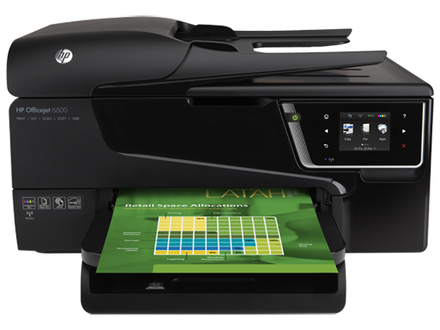
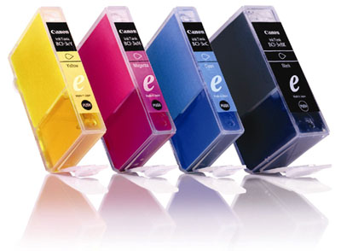
Adding Additional Forces
Complements vs
Increase the value
of a product
Substitutes
Reduces the value of a product

Slide 52
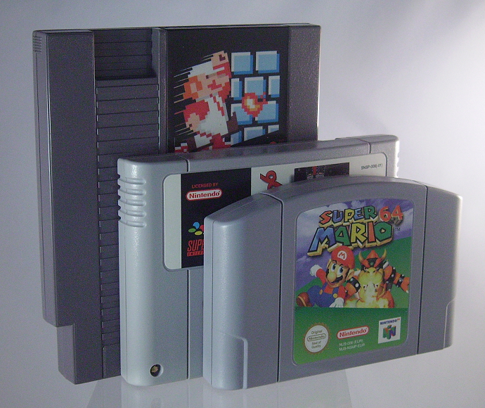
Monopolization

Slide 53
Dealing with Dynamic Competition
Entry occurs slowly so that profits are undermined
… Recent decades
Hypercompetition-intense and rapid competitive moves
Structure less stable
Continuous recreation and renewing competitive advantages

Slide 54
Does Industry Matter?
Are firms more profitable if they’re in a profitable industry?
Ex Apple and the IPhone
The correct choice of firm strategy may be more important than the correct choice of industry

Slide 55
From industry attractiveness to competitive advantage: Identify key success factors
How do you succeed in an industry?
Must supply the customer what they want to buy
Survive competition

Slide 56
Key success factors
Prerequisites for success
How does the firm survive competition?
What do customers want?
Analysis of demand
Who are our customers
What do they want?
Analysis of competition
What drives competition?
What are the main dimensions of competition?
How intense is competition?
How can we obtain a superior competitive position?
Key Success Factors

