Slide 1
Resources and Capabilities
Jacqueline Torres
Olivia Garcia
Carly Pyle
Gabriella Cabello
Gabriel Flores

Slide 2
Introduction
We shift our focus from the external environment to the internal environment. We look within the firm and concentrate our attention on the resources and capabilities that firms possess.

Slide 3
Objectives
Appreciate the role of a firms resources and capabilities as a basis for formulating strategy
Identify and appraise the resources and capabilities of a firm
Evaluate the potential for a firm’s resources and capabilities to confer sustainable competitive advantage
Use the results of resource and capability analysis to formulate strategies that exploit internal strengths while defending against internal weakness
Identify the means through which a firm can develop its resources and capabilities
Recognize the difficulties that managers face in developing the resources and capabilities of the organization

Slide 4
Hyundai Motor Company
Hyundai was seen as a shoddy company that provided shoddy cars
They were the butt of many jokes but has had a remarkable example of capability over a short period of time
They started producing cars in 1967, they assembled a Ford compact car but within 30 years it had acquired the sufficient ability to develop its own car designs launching the Accent in 1994
They set clear goals and objectives for each phase
Had little experience of overseas operation but saw it as an opportunity for expansion, they entered a joint venture with a domestic firm
Established Production plants in India, USA, Europe, and China

Slide 5
Hyundai Motor Company
Customized the car for each countries needs, thus helping differentiate what they had to offer to their different customers
China-introduced a mid-size model in order to meet their need for an up market appearance
India-They took their compact car but adjusted the structure and height of the car in order to meet the needs of the local road conditions
To overcome the perception of Hyundai having poor quality vehicles Chung Mong Koo the chairman introduced 10 year/100,000 mile warranties

Slide 6
Role of Resources and Capabilities in Strategy Formulation
It has become increasingly apparent that Competitive advantage rather than industry attractiveness is the primary source of superior profitability

Slide 7
Strategy
Industry Key Success Factors
Competitive Advantage
Organizational Capabilities
Resources
TANGIBLE
Financial ( Cash, Securities, borrowing capacity)
Physical ( plant, equipment, land, mineral reserves)
INTANGIBLE
Technology (patents, copyrights, trade secrets)
Reputation (brands, relationships)
Culture
HUMAN
Skills/know-how
Capacity for communication and collaboration
Motivation

Slide 8
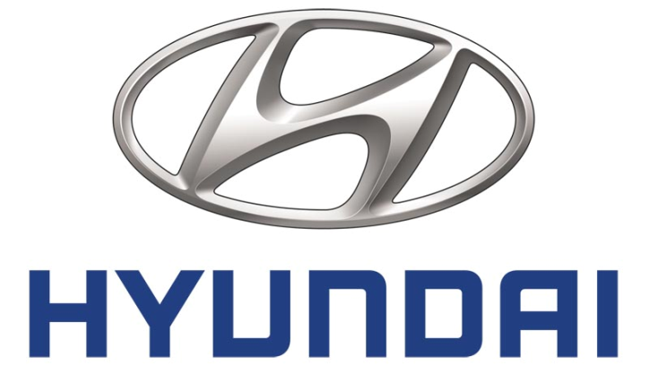
Illustrative Examples of Resources Classified by the Type for the Hyundai Motor Company
Tangible Resources- 3 car production bases in Korea & 7 overseas manufacturing plants in China, Europe & India, later Russia & Brazil
Intangible Resources- Building its brand
Human Resources-Recruited experienced senior staff, locating in less developed areas

Slide 9
Identifying the Organization’s Capabilities
Organizational Capability- firm’s capacity to deploy resources for a desired end result
“The best part of my job is knowing that I’m making a difference in the company as a whole” -Management Assistant AT&T

Slide 10
Core Competences
Make a disproportionate contribution to ultimate customer value
Provide a basis for entering new markets

Slide 11
AT & T Core Competences
Scaling- AT&T Labs knows how to create and develop technologies and services that can meet the needs of few or many
Integration of Software Components-expertise and knowledge of complex systems give us the unsurpassed ability to rapidly integrate anything—from "home grown" software to "off-the-shelf" products
Service/Process Innovation- AT&T Labs has attracted some of the world's greatest scientists, engineers and developers
Integration of Network Components- Running such a large and complex network for over 100 years has given AT&T Labs an incomparable knowledge of networks and the components that comprise them.
Network Management: Came up with groundbreaking technologies in the Labs that enabled them to monitor, anticipate, and act before failures can happen. Our expertise in network management is what makes our network the best in the industry in both reliability and performance.

Slide 12
Classifying Capabilities
Functional Analysis- identifies organizational capabilities in relation to each of the principal functional areas of the firm
Value Chain Analysis- separates the activities of the firm into a sequential chain

Slide 13
Functional Areas | Capability | Exemplars
Corporate Functions Management Information Research & Development Marketing | Financial Control Management Development Strategic innovation Integrated MIS network linked to managerial decision making Innovation new product development Responsiveness to market trends | Exxon Mobil General Electric, Shell Google, Haier Wal-Mart, Capital One, Dell Computer 3M, Apple MTV, L’Oreal

Slide 14
AT & T’s Capabilities by Functions
Function | Illustrative Capability
Corporate Functions | Strategic Innovation Financial Control International Management
Management Information | Network linked to managerial decision making
Research & Development | Innovative new product development
Operations | Continuous Improvements in Operations Flexibility and Speed of Response
Product Design | Design Capability
Marketing | Brand Management
Sales & Distribution | Customer Service

Slide 15
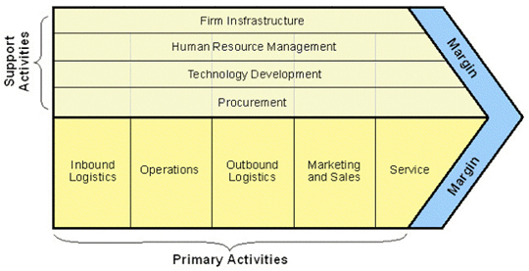
Porter’s Value Chain

Slide 16
Type of Activity | Generic Value Chain Level | Illustrative examples
Primary Activities | Inbound Logistics | Purchasing, Supply Chain Management, Component Manufacture
 | Marketing & Sales | Market Research, Advertising, Pricing
 | Service | Warranty, phone servicing arrangement
Support Activities | Infrastructure | Global Communications, Risk Management, Customer Focus Approach
 | Human Resource Management | Training& Skills Development, Staff Recruitment
 | Technology Development | Technology managed design & manufacturing

Slide 17
The Nature of Capability
Organizational Capability – Requires the efforts of various individuals to be integrated with one another and with capital equipment, technology and other resources.
Organizational Process – The sequences that comprise organizational processes can be mapped using a flowchart
Routinisation – Is an essential step translating directions and operating practices into capabilities –only by becoming routine do processes become efficient and reliable

Slide 18
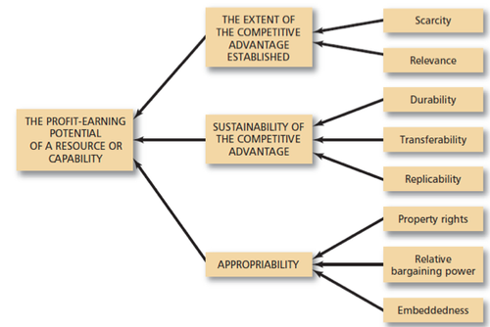
Appraising Resources and Capabilities

Slide 19
Establishing Competitive Advantage
Scarcity – If a resource or capability is widely available within the industry, then it may be essential to compete, but it will not be a sufficient basis for competitive advantage
Relevance – A resource or capability must be relevant to the key success factors in the market.

Slide 20
Sustaining Competitive Advantage
Durability – Some resources are more durable than others and therefore are a more secure basis for competitive advantage
Transferability – The simplest means of acquiring the resources and capabilities necessary for imitating another firm’s strategy is to buy them
Replicability – If a firm cannot buy a resource or capability, it must build it.

Slide 21
Appropriating The Returns To Competitive Advantage
Property rights – The less defined, the greater the importance of relative bargaining power in determining the division of returns between the firm and its individual members.
Relative bargaining power – The more closely an organizational capability is identified with expertise of individual employees and the more effective those employees are at deploying their bargaining power.
Embeddedness – The degree to which economic activity is constrained by non-economic institutions.

Slide 22
Putting resource and capability analysis to work: A practice guide
Step 1: Identify the key resources and capabilities
Step 2: Appraising resources and capabilities
Step 3: Developing strategy implications

Slide 23
Step 1: Identify the key resources and capabilities
What factors determine why some firms in an industry are more successful than others.
AT&T key success factors:
Loyal customers
Faster speed
Offer a variety of plans and pricing options

Slide 24
Step 1: Identify the key resources and capabilities cont.
What capabilities and resources do these key success factors imply?
Sales
Marketing
Brand strength
Effective supply chain management

Slide 25
Step 2: Appraising resources and capabilities
Appraising resources and capabilities is not about data, its about insight and understanding
Two key criteria:
Importance: which resources and capabilities are most important in conferring sustainable competitive advantage
Assessing relative strengths: The firms strengths and weaknesses as compared to its competitors

Slide 26
Step 2: Appraising resources and capabilities cont.
Benchmarking: the process of comparing one’s business processes and performance to industry best practices from other companies
Determine what and where improvements are needed
Analyze how other organizations achieve their high performance levels
Use information to improve their performance
Importance and relative strength within a company will help us determine what the key strengths and weaknesses are

Slide 27
Step 3: Developing strategy implications
Exploiting key strengths: Key task is to formulate a strategy to ensure that these resources are deployed to the greatest effect
Managing key weaknesses: Key function is to outsource
What about superfluous strengths?
Lower the level of investment from these resources and capabilities

Slide 28
Developing resources and capabilities
Managers generally know about acquiring resources
Tangible
Intangible
Human
Notes:
Tangibles:
Raw materials, plant & equipment
Intangibles:
Building a brand or managing intellectual capital
Human:
Recruiting or retaining the services of talented individuals such as AT&T is was honored to be included once again in the annual Hispanic Business 2014 Best Companies for Diversity list. Coming in at third place, AT&T is no stranger to the list, having been named to the top spot last year
Yes companies can be well prepared with all the ammunition needed to be the best but if they can’t link them all up it will not have any effect. Possibly the most difficult problem in developing capabilities is that we know little about the linkage between resources and capabilities. Capabilities are not simply the outcome of the resources upon which they are based.

Slide 29
Help is needed linking resources and capabilities:
GM
Honda
Walt Disney
Pixar
Ericsson and Siemens
Cisco
Notes:
Take these companies for example:
These examples were noted in 2012 when the book was published.
-In the car industry we have GM with the higher R&D and output than Honda, yet Honda still seems to be the world leader in power train technology.
-With animated movies, we have competition between Pixar and its mother Walt Disney. Both producing similar animations yet Walt Disney being the industry giant still has a few things to work on. Pixar is becoming successful pretty fast.
-In telecom equipment Cisco showed established companies such as Ericsson and Siemens that they too were a threat while establishing leadership in the new era of package switching.

Slide 30
Path dependency and the role of early experiences
Managers &Time
Wal-Mart
Royal Dutch Shell
Exxon
Notes:
There is one resource that does seem to be critical to the development of capabilities: managers with the requisite knowledge for capability building.

Slide 31
The linkage between resources and capabilities
The structure of organizational capability involves the coordination between the members integrating their skills with one another and other resources.
Efficiency and effectiveness
Organizational learning
Culture

Slide 32
Are organizational capabilities rigid or dynamic?
Core capabilities as core rigidities
Flexibility in organizational routines
Dynamic capability
Start-up vs established firms
Notes:
So we talked about establishing capabilities over a period of time. This should help the employees know what the company wants and establish a brand and goals among one another for the whole company but does that really help?
Dorothy Leonard, a professor of business administration, argues in a book that she wrote that core capabilities are simultaneously core rigidities- they inhibit the firms ability to access and develop new capabilities.

Slide 33
Approaches to capability development
Purpose
Acquiring capabilities:
Merger
Acquisitions
Alliances
Relational capability
Notes:
At&T & Direct TV

Slide 34
Internal development: focus and sequencing
Limiting the number and scope of the capabilities
Develop and supply the products that supply the capabilities

Slide 35
Any Questions?

