Slide 1
The nature and sources of competitive advantage
Jacqueline Torres
Gabriela Cabelo
Olivia Garcia
Ramon Flores
Carly Pyle

Slide 2
Introduction
Focuses more deeply on competitive advantage
Focus on the dynamic relationship between competitive advantage and the competitive process
Competition provides the incentive for establishing advantage and is the means by which advantage is worn away

Slide 3
Objectives
Understand the meaning of the term’s competitive advantage and identify the circumstances in which a firm can create a competitive advantage over a rival
Predict the potential for competition to wear way competitive advantage through imitation
Recognize how resource conditions create imperfections in the competitive process that offer opportunities for competitive advantage

Slide 4
Objectives
Distinguish the two primary types of competitive advantage: cost advantage and differentiation advantage
Use the value chain framework to analyze potential sources of cost and differentiation advantage and to recommend strategies for enhancing competitiveness
Appreciate the pitfalls of being stuck in the middle and the challenge of achieving effective differentiation and low cost

Slide 5
Singapore Airlines
Singapore Airlines has a reputation for providing its passengers with a high-quality air travel experience
Been acknowledged as the Worlds Best Airline 21 out 22 times that the title has been awarded
They have based its strategy on two main pillars- its planes and its people

Slide 6
Singapore Airlines
On average the age of the SIA fleet is 74 months as opposed to the industry average of around 160 months
By having newer planes, it also helps keep maintenance cost low and the planes are newer and more fuel efficient
They also spend less time in hangars and more time in the air

Slide 7
Singapore Airlines
They Spend $70 million a year putting employees through 110 hours of retraining annually
They focus on cutting cost, they use senior members to retrain and do it within the airline offices
They also are innovative, they were one of the first airlines to introduce fully reclining seats, in-flight mobile telephone, and fax services, and biometric technology to simplify and speed up check-in times

Slide 8
Singapore Airlines
They dominate the business class market segment on many of its routes and it is this segment that is particularly sensitive to the level of economic activity
In 2009 SIA posted a full year loss and its load factors were below the industry average

Slide 9
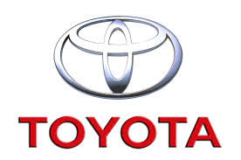
The Emergence of Competitive Advantage
When two or more firms compete within the same market, one firm possesses a competitive advantage over its rivals when it earns a higher rate of profit

Slide 10
External Sources of Change

Slide 11
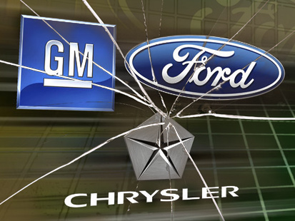
Global Financial Downturn
2003-2008 price of oil tripled
Pushed to the edge of bankruptcy

Slide 12
Competitive Advantage from Responsiveness to Change
Entrepreneurship- external change creates opportunities for profit
Responsiveness:
1. Anticipate Changes
2. Speed
Time- Based Competition- notion of speed as a source of competitive advantage

Slide 13
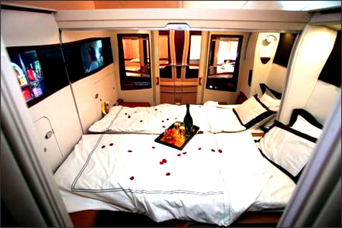
Singapore Airlines
Gaining or losing competitive advantage as a consequence of external change
Airbus 380 Aircraft

Slide 14
Competitive Advantage from Innovation: ‘new game strategies’
Key Source of Competitive Advantage- Innovation
Strategic Innovation- creating value for customers from novel products, experiences or modes of product delivery
Ex. Southwest Airlines, Apple

Slide 15
How Do We Go About Shaping Innovative Strategies?
New Industries- launching products creating new markets
New Customer Segments- new customer segments for existing product concepts
New Sources of Competitive Advantage- novel approach to create value and not a whole new industry

Slide 16
Sustaining Competitive Advantage
The ability for one firm to earn a higher profit than its rivals within the same market
Imitation is the most direct form of competition
Isolation mechanisms- to describe the barriers that protect a firm’s profits from being driven down by the competitive process

Slide 17
Process of Competitive Imitation
Identification
Incentive
Diagnosis
Resource acquisition

Slide 18
Identification: obscuring superior performance
The firm must be able to identify that a rival possesses a competitive advantage.
A simple barrier to imitation is to obscure the firm’s superior profitability.
Avoiding competition through avoiding disclosure of a firm’s profits is much easier for a private than a public company.
Ex. Pedigree

Slide 19
Incentives: Deterrence and pre-emption
The firm must believe that by investing in imitation, it to can earn superior returns.
If a firm can persuade rivals that imitation will be unprofitable, it may be able to avoid competitive challenges.
A firm can also use deterrence and pre-emption.
Deterrence: single aggressive intentions to imitators
Pre-emption: exploit all available investment opportunities

Slide 20
Incentives: Deterrence and pre-emption cont.
The ability to sustain competitive advantage using pre-emption depends on:
The market must be small relative to the minimum efficient scale of production.
There must be first-mover advantage that gives an incumbent preferential access to information and other resources, putting rivals at a disadvantage.

Slide 21
Diagnosing competitive advantage: ‘causal ambiguity’ and ‘uncertain imitability’
Diagnosis: The firm must be able to diagnose the features of its rival’s strategy that give rise to the competitive advantage.
Rely on multiple sources of competitive advantage to create ‘casual ambiguity’
Casual ambiguity: the situation where it is difficult or impossible to map the connections between actions and results. When causal ambiguity exists the source of a successful firm’s competitive advantage is unknown.
Uncertain imitability: the situation where there is ambiguity associated with the causes of a competitor’s success.
Ex. Wal-Mart

Slide 22
Acquiring resources and capabilities
Resource acquisition: The firm must be able to acquire through transfer or replication the resources and capabilities necessary for imitating the strategy of the advantaged firm.
Base competitive advantage on resources and capabilities that are immobile and difficult to replicate.
Two ways a firm can acquire resources and capabilities: it can buy them or it can build them
First-mover advantage: the initial occupant of a strategic position or niche gains access to resources and capabilities that a follower cannot match.

Slide 23
Types of Competitive Advantage
A firm can achieve a higher rate of profit over a rival in one of two ways:
Services at lower costs
Customer is willing to pay a price premium
The Firm Possesses:
Cost Advantage
Similar product at lower cost
Differentiation advantage
Price premium from unique product

Slide 24
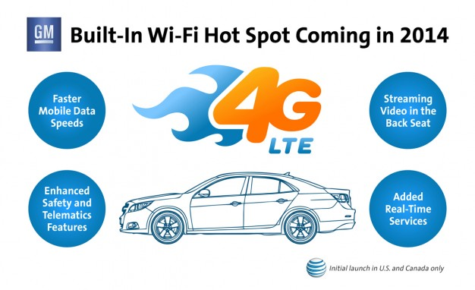
Differentiation Advantage

Slide 25
Cost Advantage

Slide 26
Strategy and Cost Advantage
7 principal determinants of a firm’s unit costs
We refer to these as cost drivers
Cost Drivers varies across industries, across firms within an industry and across the different activities within a firm.

Slide 27
The Drivers of Cost Advantage
Economies of Scale
Economies of Learning
Production Techniques
Product Design
Input Costs
Capacity Utilization
Residual Efficiency

Slide 28
The Value Chain Analysis for Cost Advantage
Break Down the firm in separate Activities
The Separateness of one activity from another
The importance of an activity
The dissimilarity of activities in terms of cost drivers
Establish the relative importance of different activities in the total cost of product
AT&T Video

Slide 29
Value Chain Analysis Cont.
3. Compare costs by activity
- To establish which activities the firms performs relatively efficiently
4. Identify Cost Drivers
Ex: Equipment, weekly production volume, and downtime between.

Slide 30
Value Chain Analysis Cont.
5. Identify Linkages
The Cost of one activity may be determined, in part, by the way in which other activities are performed.
6. Identify Opportunities for Reducing Costs
By identifying areas of comparative ineffiency and the cost drivers for each, opportunities for cost reduction become evident.

Slide 31
Strategy and differentiation
Differentiation advantage: when a firm is able to obtain from its differentiation a price premium in the market that exceeds the cost of providing the differentiation
Commodities: lacking physical differentiation
Cemex Cement
Amazon Bookselling
Notes:
So we talked about one type of competitive advantage… here’s a second one.

Slide 32
Principal stages of value chain analysis for differentiation advantage
Construct a value chain for the firm and the customer
Identify the drivers of uniqueness in each activity
Select the most promising differentiation variables for the firm
Locate linkage between the value chain of the firm and that of the buyer

Slide 33
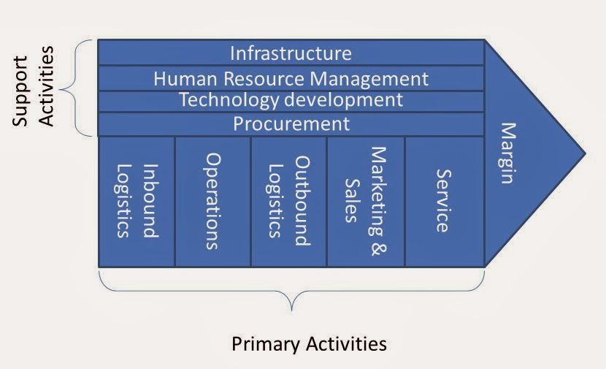
Construct a value chain for the firm and the customer
Downstream in the value chain
2) Identify the driver of uniqueness in each activity

Slide 34
3) Select the most promising differentiation variables for the firm
Supply side considerations :
What can we produce at a lower cost?
Are there any linkages among activities?
How can uniqueness be sustained?

Slide 35
4) Locate linkages between the value chain of the firm and that of the buyer
Obtain a premium on the product that exceeds the cost of differentiation

Slide 36
Using the Value Chain to explore Singapore Airlines’ differentiation Opportunities and initiatives
Porter’s Generic Categories | Illustrative Examples of Industries fitting Porter’s Categories
Inbound Logistics | Aircraft
Operations | Ticketing
Outbound Logistics | Flight Connections
Marketing & Sales | Promotion
Service | Pre and post flight service
Firm Infrastructure | Management Systems
HRM | Recruitment and Reward
Technology Development | IT Systems
Procurement | Acquisition of Aircraft

Slide 37
3 Generic Strategies
Cost Leadership
Differentiation
Focus
“Stuck in the middle”
Source of Competitive Advantage
Low Cost
Differentiation
Cost Leadership
Differentiation
Industry Wide
Focus
Single Segment

Slide 38
Questions?

