Slide 1
Technology-Based industries and the management of innovation
Team 2: Chris Rogers, Christine Everett, Jeremiah Contreras, Valerie Villarreal, Tara Visker, and Cynthia Lopez

Slide 2
Introduction
This chapter covers business environments where technology is a key driver of change and an important source of competitive advantage
We will examine industries where technology has the potential to create competitive advantage
This competitive advantage can lead to a larger market share if applied correctly

Slide 3
Opening case: eBook Readers
First commercial eBook reader was launched in 1997 by Softbrook Press a California start up
This caught the attention of Gemstar who bought them out and started their own ebook product line
Gemstar wanted to launch a large marketing campaign and was arranging more book publishers to have books an ereaders
However they had financial and legal troubles and could not pursue this campaign anymore

Slide 4
Opening Case cont.
Competition heated up again when Sony entered the market, and Amazon created their kindle In 2007
This lead to the release of Apple’s ipad reshaping the industry
eBook sales took off with Apple and Amazon controlling most of the market share
The importance of this case is how a simple eBook reader turned into the emergence of tablet computers

Slide 5
Competitive Advantage in Technology-Intensive Industries
Principle link between technology and competitive advantage is innovation.
The quest for competitive advantage causes firms to invest in innovation.
Innovation responsible for new industries
Innovation main reason why some firms are able to dominate their industries.

Slide 6
The Innovation Process
Invention is the creation of new products and processes through the development of new knowledge or from new combinations.
Innovation is the initial commercialisation of invention by producing and marketing a new good service or by using a new method of production.

Slide 7
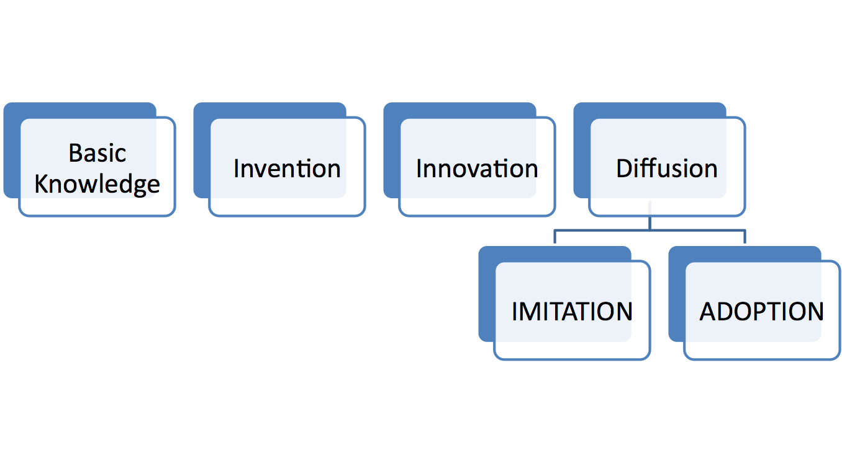
The Innovation Process

Slide 8
The Profitability of Innovation
Regime of appropriability is used to describe the conditions that influence the distribution of returns to innovation.
The profitability of an innovation to the innovator depends on the value created by the innovation and the share of that value that the innovator is able to appropriate.

Slide 9
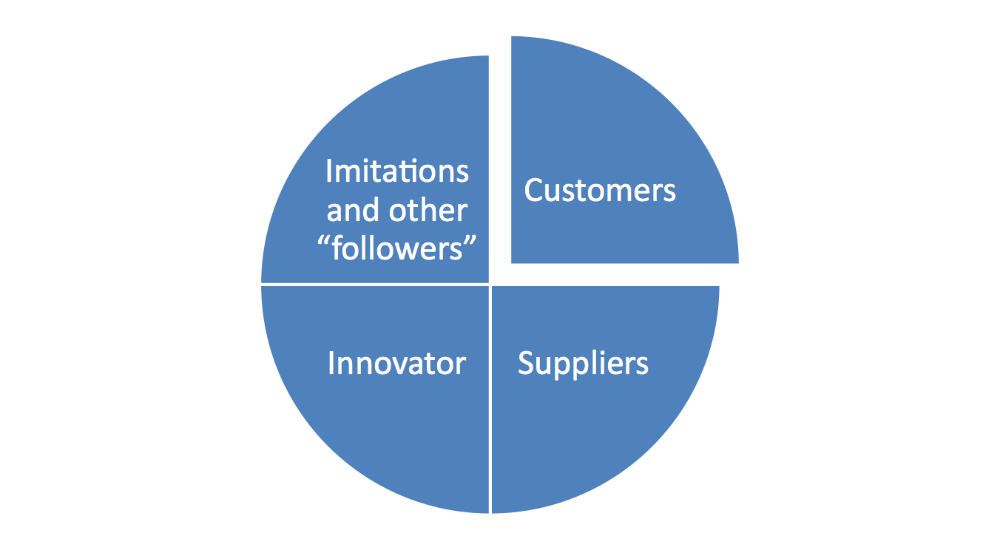
The Profitability

Slide 10
Property Rights in Innovation
Intellectual property:
  Patents
  Copyrights
  Trademarks
  Trade secrets
Business method patents have generated considerable controversy.

Slide 11
Complexity of Technology
Codifiable knowledge:
  Can be written down
  Need strong patents and copyrights
Second key factor is complexity

Slide 12
Lead-Time
This is the time it will take followers to catch up.
Examples:
  Microsoft, Intel and Cisco Systems
Lead time allows a firm to move down its learning curve ahead of followers

Slide 13
Complimentary Resources
Bringing new products and processes to market requires not just invention, it also requires the diverse resources and capabilities needed to finance, produce, and market innovation.
They can be specialized or unspecialized

Slide 14


Strategies to Exploit Innovation
How and when should we enter the market?
Depends on what products we offer

Slide 15
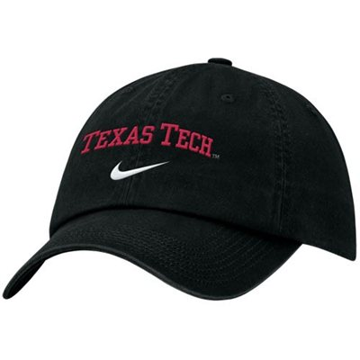
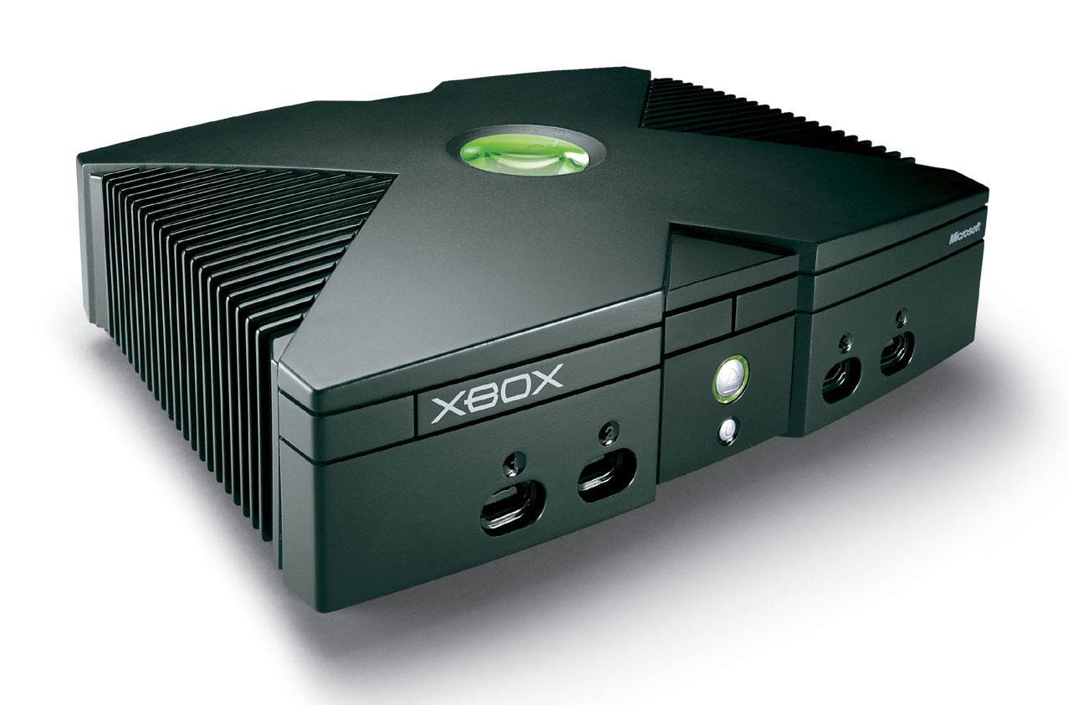
Alternative Strategies
Licensing
  Texas Tech licensed products
Outsourcing Certain Function
  Microsoft Xbox

Slide 16
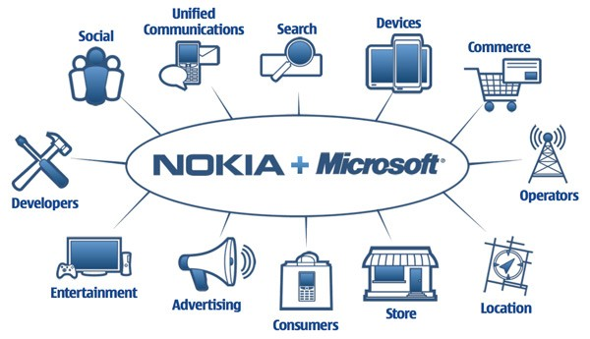

Continued
Strategic Alliance
Joint Venture

Slide 17
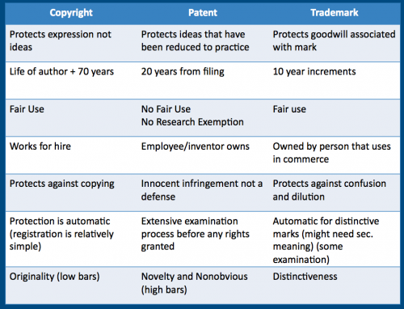
Characteristics of Innovation
Clear Property rights

Slide 18

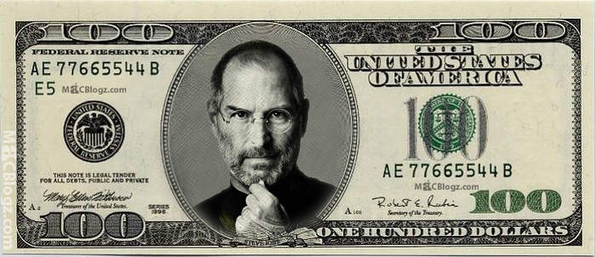
Resources and Capabilities of Firm
Different strategies require different resources
  Startups
  Large Firms

Slide 19
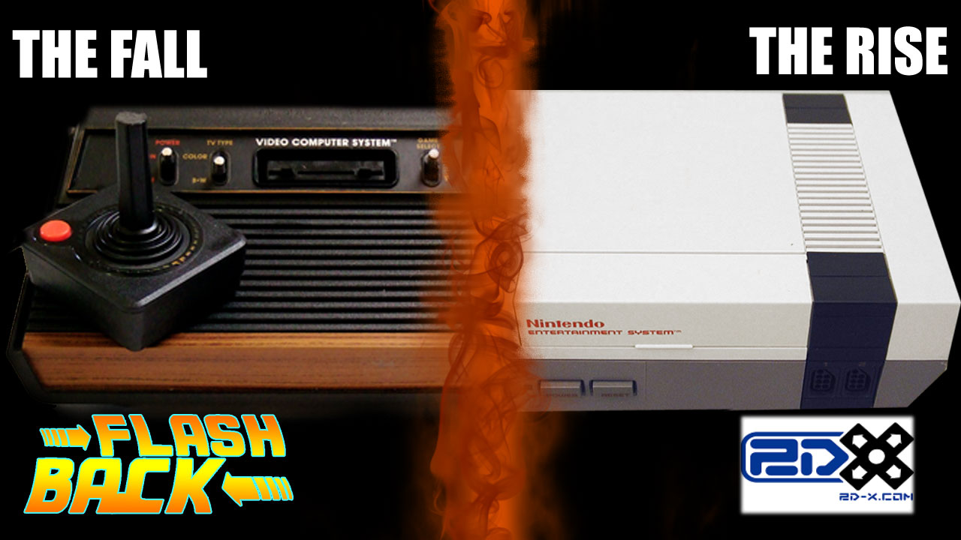
Timing Innovation
Early movers depend on:
  Protection by proprietary rights
  Importance of complementary resources
  Potential to establish a standard

Slide 20
Managing Risk
Two sources of uncertainty
  Technological
  Market
Strategies to Limit Risk
  Cooperating with lead users
  Limiting risk exposure
  Flexibility

Slide 21
Competing for Standards
Establishment of standards is a key event in industry evolution.

Slide 22
Types of Standard
A standard is a format, an interface, or a system that allows interoperability. It can be public or private.

Slide 23
Types of Standard
Public (open) standards are those that are available to all either free or for a nominal charge.
Private (proprietary) standards are those where the technologies and designs are owned by companies or individuals

Slide 24
Types of Standard
Mandatory standards are set by government and have the force of law behind them
De facto standards emerge through voluntary adoption by producers and users

Slide 25
Why standards appear: network externalities
A network externality exists whenever the value of a product to an individual customer depends on the number of other users of that product.
Network externalities do not require everyone to use the same product or even the same technology, but rather that the different products are compatible with one another through some form of common interface.

Slide 26
Several sources of network externalities
Products where users are linked to a network.
Availability of complementary products and services.
Economizing on switching costs

Slide 27
Types of Standard
The implication of network externalities is that they create positive feedback.
Learning effects cause the dominant technology and design to be continually improved and refined.

Slide 28
Winning Standards Wars
In markets subject to network externalities, control over standards is the primary basis for competitive advantage.
ex. Sony and Apple lost their standards wars but returned as winners in other markets.
Most of the losers in standards wars become mere footnotes in the history of technology.
ex. Lotus in spreadsheet software. Netscape in browsers, WordPerfect in work processing software

Slide 29
What can we learn from standard wars?
The first key issue is to determine whether we are competing in a market that will converge around a single technical standard
The second strategic issue in standards setting is recognizing the role of positive feedback.

Slide 30
Winning Standards Wars
Building a ‘bigger bandwagon’, according to Shapiro and Varian, requires the following:
Before you go to war, assemble allies
Pre-empt the market
Manage expectations
The lesson that has emerged from the classic standards battles of the past is that in order to create initial leadership and maximize positive feedback effects, a company must share the value created by the technology with other parties.

Slide 31
Winning Standards Wars
Achieving compatibility with existing products is a critical issue in standards battles. Advantage typically goes to the competitor that adopts an evolutionary strategy rather than one that adopts a revolutionary strategy.

Slide 32
What are the key resources needed to win a standards war?
Control over an installed base of customers
Owning intellectual property rights in the new technology
The ability to innovate in order to extend and adapt the initial technological advance
First-mover advantage
Strength in complements
Reputation and brand name

Slide 34
Creating Conditions for Innovation
Invention Vs. Innovation
  Complementary
  Invention - creativity
  Innovation - collaboration + cross functional integration

Slide 35
Managing Creativity
Associated with particular personality traits
  Catalyst of interaction is play
Play - permits unconstrained forms of experimentation
Organizing for creativity
  Secure and cozy
    Creative abrasion within innovative teams
Microsoft’s development Team
  Open criticism
  Intense disagreements

Slide 36
Balancing Creativity and Commercial Direction
Must be directed and harnessed
Many creative companies are formed by innovators leaving established companies
  Disney and Pixar
    John Lasseter - had been fired from Disney 20 years before

Slide 37
Approaches to Management of Innovation
Cross-Functional product development teams
  Effective for integrating creativity with functional effectiveness
Product Champions
  Provides means for incorporating individual creativity within organizational processes and linking invention to subsequent commercialization
  3M Corporation

Slide 38
Continued
Buying Innovation
  Acquisitions may involve licensing, patent purchases, signing marketing agreements
    Google’s acquisition of eBook Technologies
Open Innovation
  Firms look wider in sourcing technology and in sharing knowhow and ideas
  Ideas from beyond their own borders
    P&G’s “Connect and Develop” innovation model

Slide 39
Continued
Corporate Incubators
  Established to fund/ nurture new businesses
  Popular during IT boom at end of 1990’s
  Key Problem:
    Become “orphanages”
  IBM - Innnovation Jam - a massive onlinestorming process to generate, select and develop new business ideas
  Cisco Systems - Emerging Technology Business Group

Slide 40

Competitive advantage in technology-intensive industries
  Innovation process
  Profitability of innovation
Strategies to exploit innovation: how and when to enter
  Alternative strategies and managing risks
Competing for standards
  Types of standards and winning standards wars
Creating the conditions for innovation
  Managing creativity and the challenge of integration

Slide 41

Objective | Summary
Analyze how technology affects industry structure and competition | Technological change often changes industry dynamics and firms that succeed in these industries recognize market characteristics and adapt effectively
Identify factors that determine that returns to innovations and the potential for these innovations to establish competitive advantage | Four factors: property rights, the tacitness and complexity of the technology, lead-time, and complementary resources

Slide 42

Objectives | Summary
Formulate strategies for exploiting innovation and managing technology, focusing on: -advantages of being a leader/follower in innovation -Strategic options for exploiting innovation -how to win standards battles -how to manage risk | Choice of strategy depends on the characteristics of the innovation and resources and capabilities of the firm. Deciding on a optimal strategy is complex but we have reviewed a range of analytical principles that improve the chances of success
Organizational conditions needed to implement strategies successfully | Organizing for innovations requires different organizational structures/management systems. We have considered approaches/practices that enhance creativity/likelihood of success

