Slide 1
Introduction and Objectives
Business Strategy- concerned with how a firm competes
Corporate Strategy- concerned with where a firm competes

Slide 2
When we refer to the scope of the firm we are directing our attention to a range of product/market activities:
Product Scope- how specialized the firm is in terms of the range of products it supplies
Vertical Scope- the range of vertically linked activities the firm encompasses
Geographical Scope- the geographical spread of activities for the firm

Slide 3
Introduction and Objectives
We consider the factors that influence the scope of the firm’s activities and the key challenges managers face in developing and implementing corporate strategy.

Slide 4
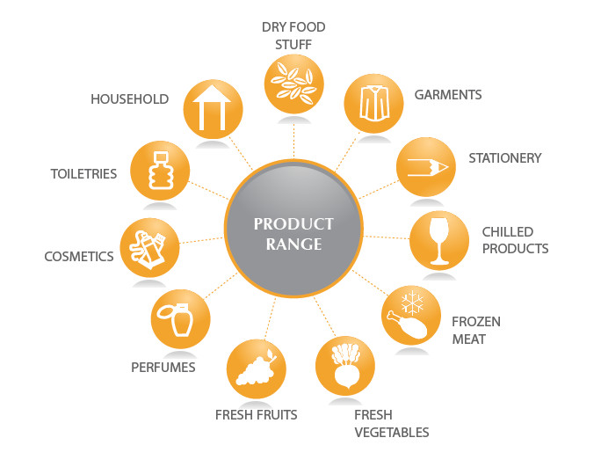
The Scope of the Firm
Deciding “what business are we in?” is the starting point for strategy for a company
This includes the Product scope, which refers to the range of different products a company might produce
Also the Vertical Scope, which refers to how integrated they are in that industry, if they outsource, or produce it all themselves

Slide 5
The Scope of the Firm
The Scope for a business is likely to change over time
For the past two decades their has been a trend for companies to “refocus on their core business and reduce their product range
Phillip Morris Companies inc. (renamed Altria Group) has sold off 7-up, Miller Brewing, and Kraft foods.

Slide 6
The Scope of the Firm
However not all companies have taken this approach
Microsoft has expanded into application and networking software, information services, entertainment systems, and video game consoles
Also Google is not just a search engine company, and has expanded into a wide array of technological products

Slide 7
The Scope of the Firm
Vertical Integration is similar to Vertical Scope, it refers to how integrated a company is into the multiple steps of producing a products
As mentioned before the trend for de-integration has been evident, with more companies outsourcing
The pharmaceutical industry has seen a lot of de-integration in the form of companies outsourcing research, marketing, and advertising for their products

Slide 8
Key Concepts for Analyzing Firm Scope
Three concepts that are key to analyzing corporate strategic decisions and shifts over time:
Economies of scope
Transaction costs
Costs of corporate complexity

Slide 9
Economies of Scope
Economies of Scale
Economies of Scope
Reductions in average costs
Result from an increase in the output of a single product
Cost economies from increasing the output of multiple products

Slide 10
Economies of Scope
Tangible Resources:
Distribution networks, IT systems, sales forces, and research laboratories
Offer economies of scope by eliminating duplication between businesses
Single shared facility

Slide 11
Economies of Scope
Intangible resources:
Brands, corporate reputation, and technology
Ability to extend to additional businesses at low marginal cost
Brand extension
Starbucks: ice cream, packaged cold drinks, home espresso machines, audio CD’s and books

Slide 12
Economies of Scope
Organizational Capabilities:
Result from the ability to transfer capabilities between businesses within the diversified company
Ex: general management capabilities

Slide 13
Transaction Costs
Market mechanism: where individuals and firms, guided by market prices, make independent decisions to buy and sell goods and services
Administrative mechanism: decisions concerning production and resource allocation are made by managers and imposed through hierarchies

Slide 14
Transaction Costs
Types of Transaction Costs:
Making a purchase
Negotiating and drawing up a contract
Monitoring to ensure contract is being fulfilled
Arbitration and litigation should a dispute arise

Slide 15
Costs of Corporate Complexity
The more arenas, the greater organizational complexity
Managing strategically diverse businesses is not just building and sustaining different capabilities, can require:
Different strategic planning systems
Different approaches to the control of HR management
Different top management styles and skills

Slide 16
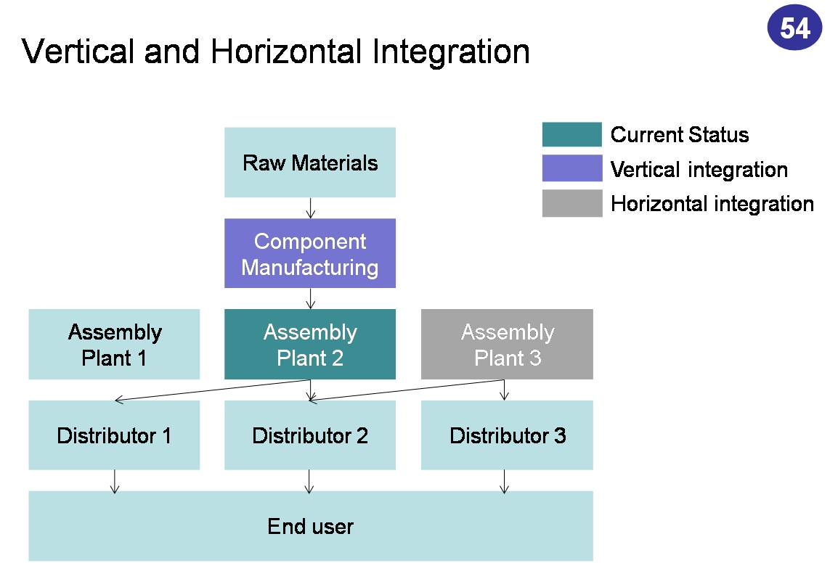
Diversification
What is it?
Vertical Integration
Horizontal Integration

Slide 17
Benefits and cost of Diversification
Growth
Risk reduction
Value creation

Slide 18
Continued
Exploiting economies of scope
Internal capital markets
Internal labor markets

Slide 19
When does Diversification Create Value?
Attractiveness and cost-of-entry test
Better off test

Slide 20
Other things
Related and unrelated diversification
Recent trends

Slide 21
Vertical Integration
Greater the extent to which a firm’s ownership extends over consecutive stages of the value chain, the great the degree of vertical integration
Backward
Forward

Slide 22
Incentive Problem
Changes the incentives
Profit incentives
High - powered incentives
Low - powered incentives

Slide 23
Types of Vertical Integration
Long term contracts
Spot contracts
Relational contracts
Vendor partnerships
Relational contracts
Franchising

Slide 24
“How do we manage a multi-business firm in ways that generate as much value as possible?”
Represent graphically the individual businesses of a multi-business company in key strategic variables that determine their potential for profit
Variables: attractiveness of their market and their competitive advantage within that market
Allocating resources, formulating business unit strategy, analyzing portfolio balance, and setting performance targets

Slide 25
Business unit competitive advantage:
Market share, return on sales relative to competitors, and relative position with regard to quality, technology, manufacturing, distribution, marketing, and cost
Industry attractiveness axis:
Market size, market growth rate, market profitability, cyclicality, inflation recovery and international potential

Slide 26
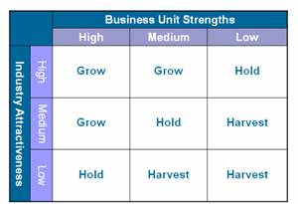
Notes:
Source: http://www.presentationhelpdesk.com/ge-mckinsey-matrix.html
26

Slide 27
Similar to GE/McKinsey but also uses single indicator as a proxy for each of these dimensions:
Industry attractiveness: rate of market growth
Competitive advantage: relative market share
Four quadrants: predict patterns of profits and cash flow and indicate strategies to be adopted
Simplicity is both useful but limited

Slide 28
Notes:
Source: http://mizwar.web.id/?p=26
28

Slide 29
Similar to BCG and GE/McKinsey but involves the characteristics of the parent company
Focus: the fit between a business and its parent company
Horizontal axis: shows parent’s potential for creating additional profit within the business
Vertical axis: measures the potential for value destruction by the parent
More difficult to use than the GE/McKinsey or BCG matrices

Slide 30
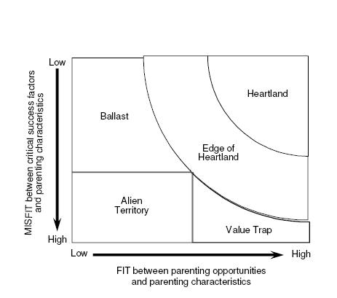
Notes:
Source: https://www.longato.co.uk/bus-strateg/
30

Slide 31
Summary
Corporate strategy is about deciding in which businesses to engage and, for top management, often represents some of the most important and difficult decisions they are likely to take.
Long-term adaptation to market conditions through diversification is likely to be much more successful if it is based on sound strategic analysis.

Slide 32
Summary
Deciding what parts of the value chain to engage in requires systematic thought. Managers need to not only decide what activities they will undertake internally and what they will outsource but also how to best organize their arrangements with buyers and suppliers.

