Slide 1
Blue Ocean Strategy
CHAPTER 9
CONCLUSION: The Sustainability and
Renewal of Blue Ocean Strategy
By: Cedric, David, Cody, Jakeb

Slide 2
Executing Blue ocean strategy
Figure 9-1
Imitation Barriers to blue ocean strategy
  Value innovation does not make sense to a company’s conventional logic
  Blue ocean strategy may conflict with other companies brand image
  Natural monopoly: The market often cannot support a second player.
  Patents or legal permits block imitation
  High volume leads to rapid cost advantage for the value innovator, discouraging followers from entering the market.
  Network externalities discourage imitation
  Imitation often requires significant political, operational and cultural changes
  Companies that value-innovate earn brand buzz and a loyal customer following that tends to shun imitators.

Slide 3
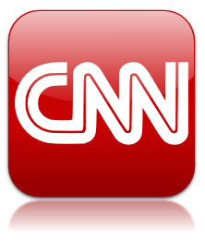

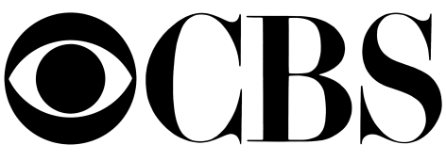

Barriers to Imitation
A value innovation move does not make sense based on conventional strategic logic.
When CNN was introduced, for example, NBC, CBS, and ABC ridiculed the idea of twenty-four-hour, seven-day, real-time news without star broadcasters. CNN was referred to as Chicken Noodle News by the industry. Ridicule does not inspire rapid imitation.

Slide 4
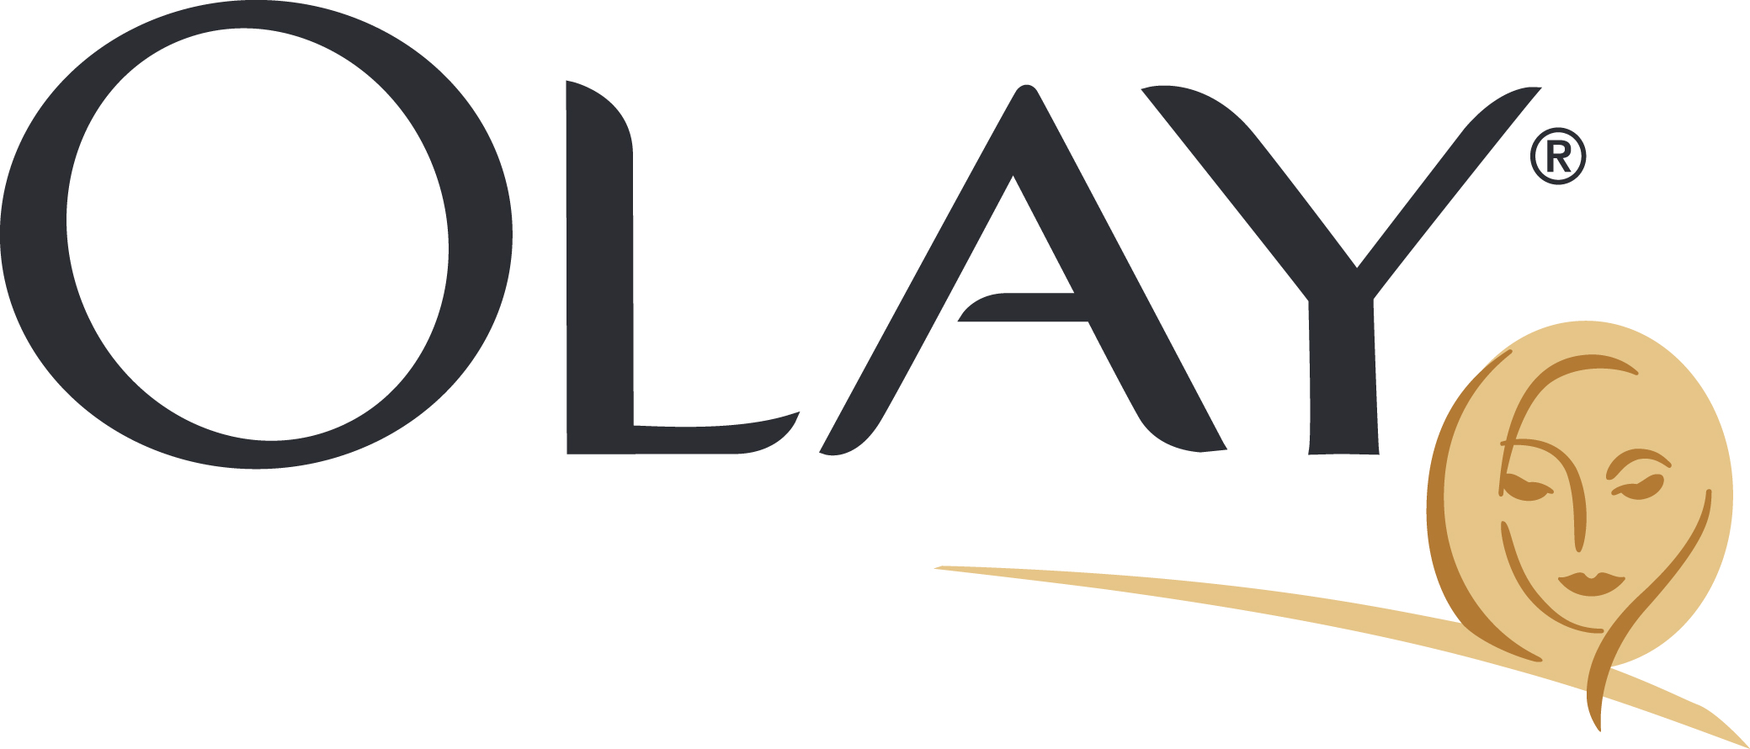
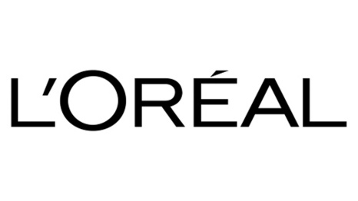
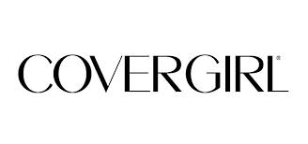
Barriers to Imitation
Brand image conflict prevents companies from imitating a blue ocean strategy.
The blue ocean strategy of The Body Shop, for example—which shunned beautiful models, promises of eternal beauty and youth, and expensive packaging— left major cosmetic houses the world over action less for years because imitation would signal an invalidation of their current business models.

Slide 5


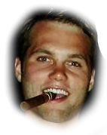

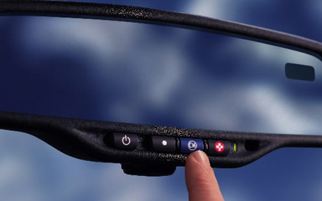



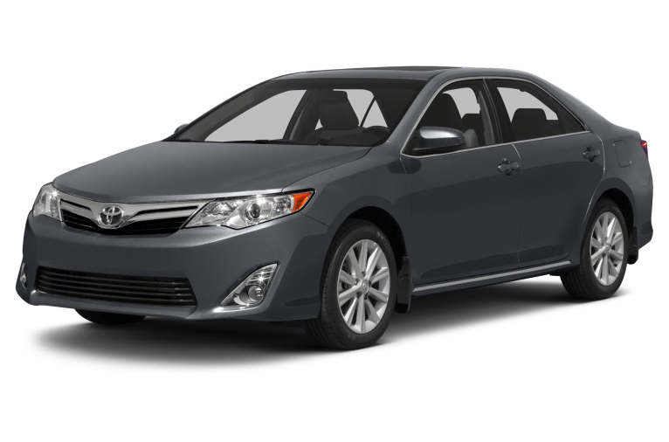
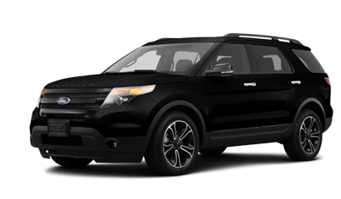

Slide 6
Barriers to Imitation
Natural monopoly blocks imitation when the size of a market cannot support another player.
For example, the Belgian cinema company Kinepolis created the first megaplex in Europe in the city of Brussels and has not been imitated in more than fifteen years despite its enormous success. The reason is that the size of Brussels (Capital of Belgium) could not support a second megaplex, which would cause both Kinepolis and its imitator to suffer.

Slide 7
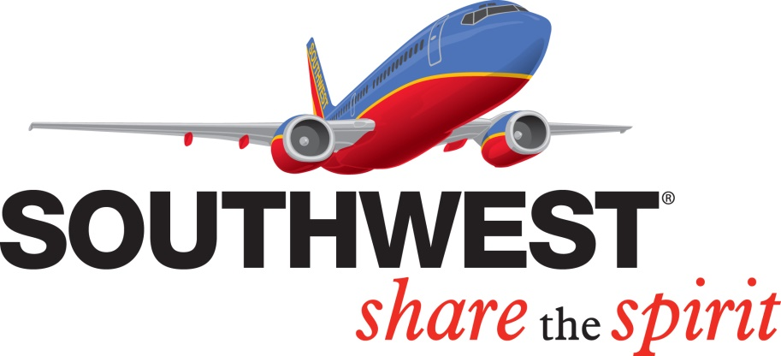


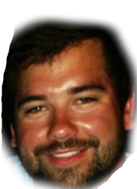






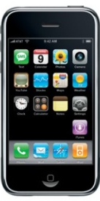
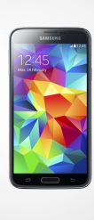

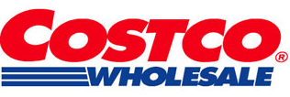

Slide 8
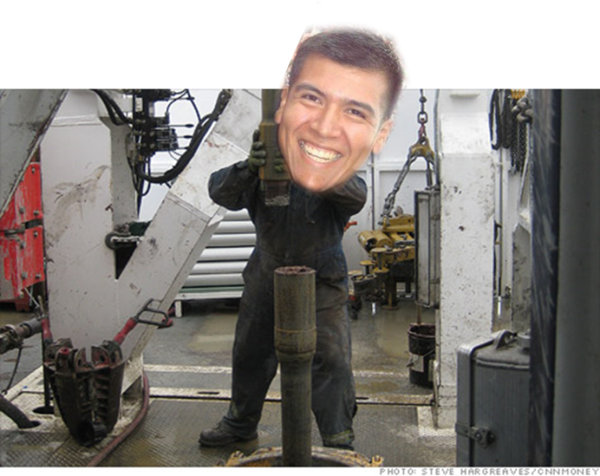
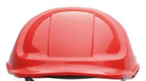

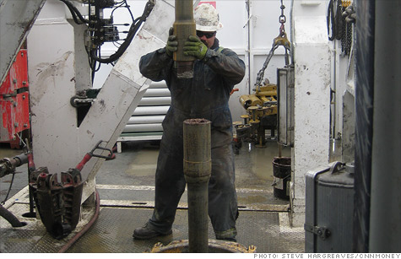
Barriers to Imitation
Patents or legal permits block imitation

Slide 9
Executing Blue ocean strategy
Figure 9-1
Imitation Barriers to blue ocean strategy
  Value innovation does not make sense to a company’s conventional logic
  Blue ocean strategy may conflict with other companies brand image
  Natural monopoly: The market often cannot support a second player.
  Patents or legal permits block imitation
  High volume leads to rapid cost advantage for the value innovator, discouraging followers from entering the market.
  Network externalities discourage imitation
  Imitation often requires significant political, operational and cultural changes
  Companies that value-innovate earn brand buzz and a loyal customer following that tends to shun imitators.

Slide 10
High Volume Relationship With Value Innovation
High Volume leads to rapid cost advantage for the value innovator, discouraging followers from entering the market

Slide 11

Cost Savings

Slide 12
Externalities
Network externalities discourage imitation

Slide 13
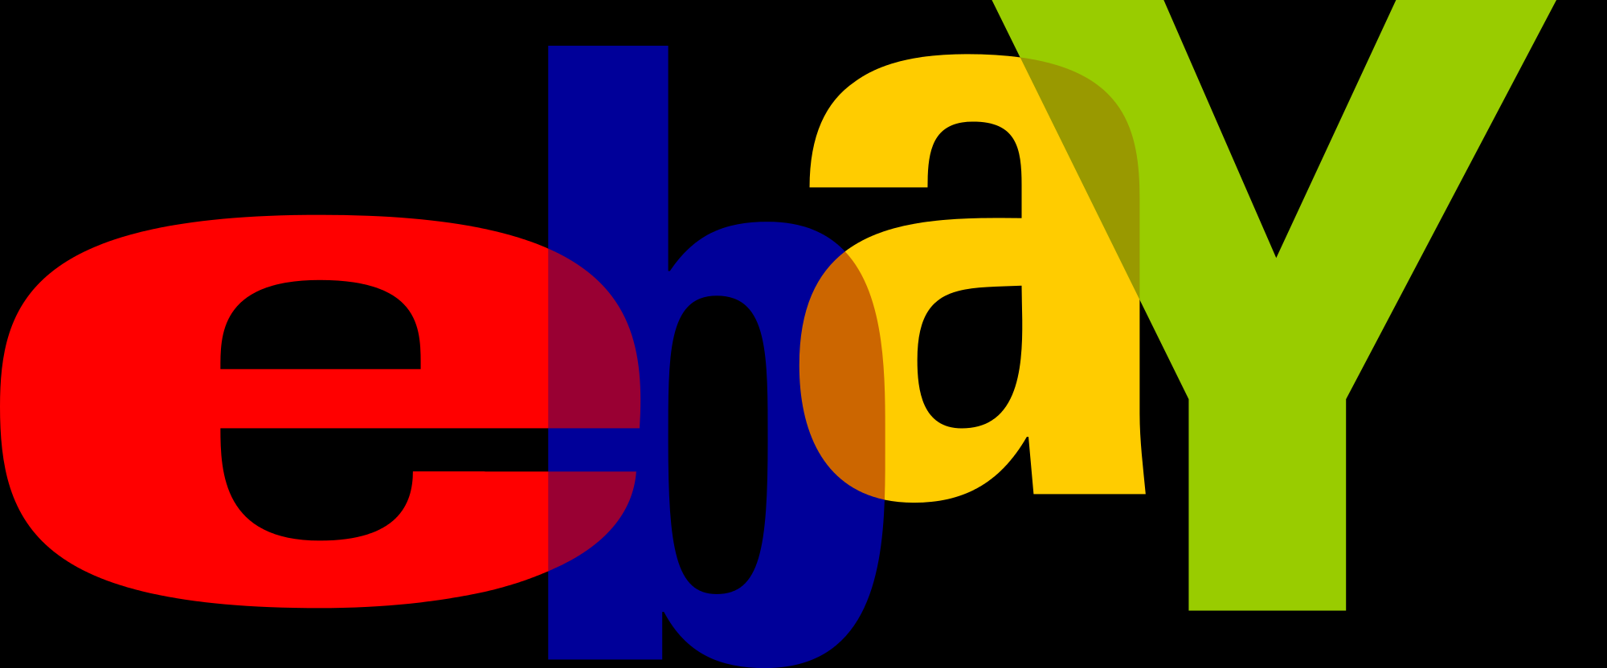

Incentives

Slide 14
The Cost of Imitation
Imitation often requires significant political, operational, and cultural changes
Politics often get in the way of innovation

Slide 15
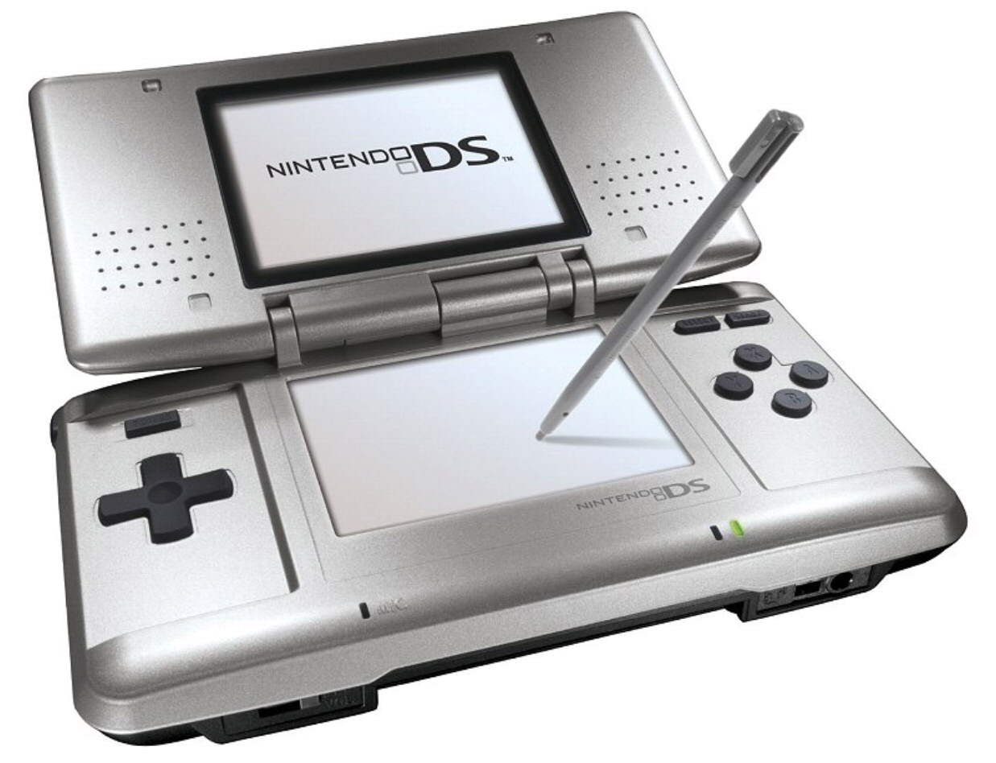
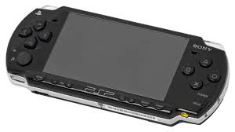
Politics

Slide 16
Value-Innovation
Companies that value-innovate earn brand buzz and a loyal customer following that tends to shun imitators

Slide 17
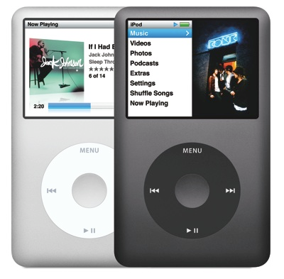
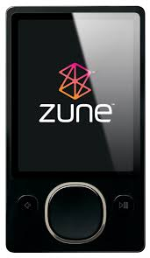
Innovation Over Imitation

Slide 18
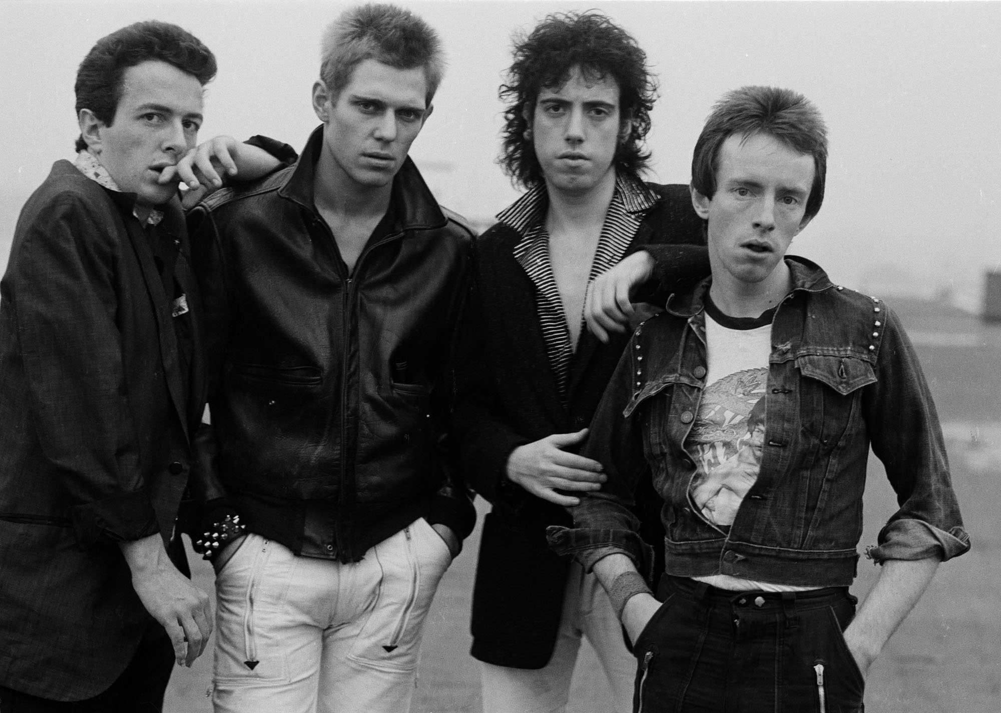

“Should I stay or should I go”

Slide 19
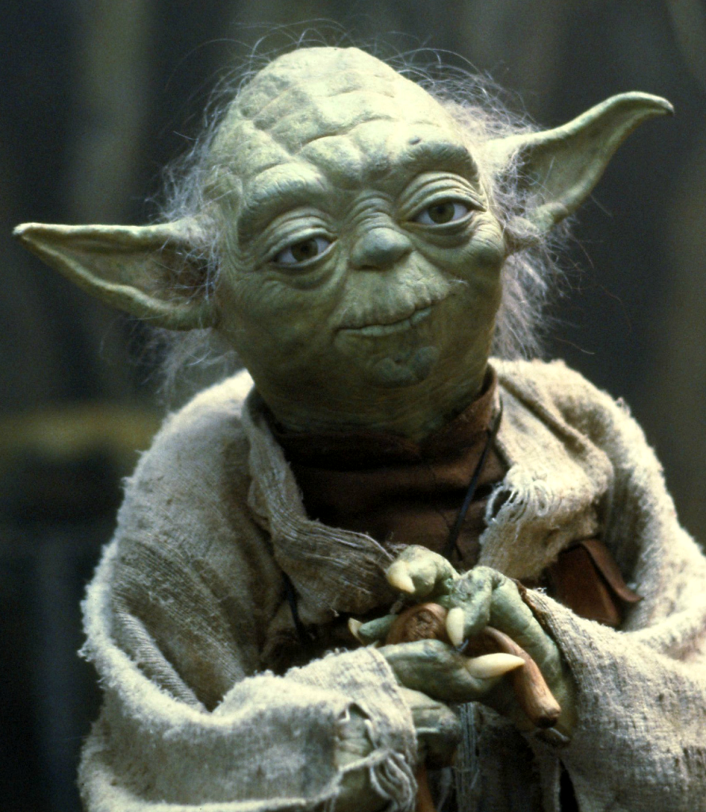
“You must unlearn what you have learned.”

Slide 20

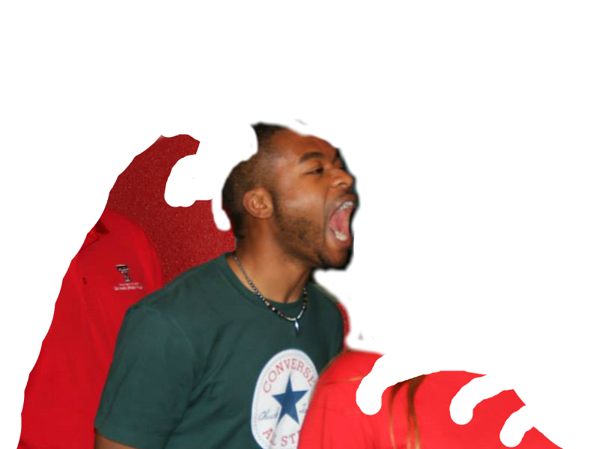



Slide 21
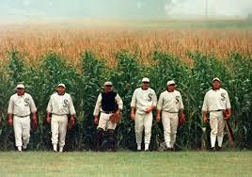
“If you build it, they will come.”

Slide 22
Concluding Blue Ocean Strategy
Questionnaire
What is one way your company is executing Blue Ocean Strategy already?
What is one way your company can move into more Blue Oceans?
What is a barrier of imitation with this new strategy?

