Slide 1
Corporate Strategy
Team 3 – 001

Slide 2
Business Strategy
Corporate Strategy
Competitive Advantage
How should we compete?
Industry Attractiveness
Scope of the firm
Product scope
Diversification
Geographic scope
Vertical Scope

Slide 3
The Scope of the Firm
What business are we in?
This and other corporate strategic decisions encompass:
the breadth of the firm’s product range (product scope)
the extent of its involvement in the industry value chain (vertical scope)

Slide 4
The Scope of the Firm
The scope of a firm’s business is likely to change over time
Trend of last two decades has been to refocus but a few companies have moved in the opposite direction (Microsoft and Google)
Similar trends are evident with respect to vertical scope

Slide 5
Key Concepts for Analysizing Firm’s Scope
Economies of Scope
Transaction Costs
Costs of Corporate Complexity

Slide 6
Economies of Scope
Economies of scope are cost economies from increasing the output of multiple products
Tangible Resources are used to eliminate duplication between shared facilities.

Slide 7
Economies of Scope
Intangible resources can be extended to additional businesses at low marginal cost and includes brand extension
Organizational Capabilities can also be transferred between businesses to create economies of scope.

Slide 8
Transaction Costs
Transaction costs include all of the costs associated with organization across markets
Decisions to expand scope have to do with the relative difference in transaction costs and administrative costs
Trends in this area led to the “downsizing” or refocusing of many firms and the increased outsourcing of services

Slide 9
The Costs of Corporate Complexity
Firms may benefit from economies of scope by avoiding transaction costs, but must incur additional management costs to do so
Engaging in different business that require different capabilities involves greater organizational complexity

Slide 10
Diversification
The expansion of an existing firm into another product line or field of operation
Related or unrelated
Horizontal or vertical

Slide 11
Benefits and Costs of Diversification
Growth
In the absence of diversification firms are prisoners of their industry
Risk Reduction
“Don’t put all your eggs in one basket”
Shareholders can diversify risk by holding diversified portfolios of share rather than shares in diversified companies
Portfolio diversification by individual shareholders is typically cheaper than business diversification by companies
The primary beneficiaries tend to be managers: stable profits are likely to mean job security

Slide 12
Benefits and Costs of Diversification
Internal Capital Markets
The corporate headquarters allocating of capital between the different business through the capital expenditure budget
Two key advantages
Diversified firms can avoid the costs of using the external capital market
Better access to information on the financial prospects of their different businesses than that typically available to external financiers

Slide 13
Benefits and Costs of Diversification
Internal Labor Markets
Efficiencies from the ability to transfer employees, managers, and technical specialists between their divisions and rely less on hiring and firing
Attracting a higher caliber of employee
Informational advantages of its employees

Slide 14
When does diversification create value?
Michael Porter proposes 3 “essential tests” to be applied in deciding whether diversification will create shareholder value:
The attractiveness test
The cost-of-entry test
The better-off test

Slide 15
The Attractiveness and Cost-of-Entry Tests
The industries chosen for diversification must be structurally attractive or capable of being made attractive
Although diversification allows a firm to access more attractive investment opportunities than are available in its own industry, it faces the challenge of entering the new industry
The cost of entry must not capitalize all future profits
Cost of entry may not counteract the attractiveness of the industry

Slide 16
The Better Off Test
Either the new unit must gain a competitive advantage from its link with the corporation, or vice versa
In most of diversification decisions, it is the better-off test that dominates

Slide 17
Diversification and Performance
How do diversified firms perform relative to specialized firms?
Consistent relationships between diversification and performance are lacking

Slide 18
Diversification and Performance
Does related diversification outperform unrelated diversification?
Findings of research are inconsistent
Related diversification offers greater potential benefits than unrelated diversification, but managing the linkages creates greater management complexity
The distinction of “related” and “unrelated” is not always clear

Slide 19
Recent Trends in Diversification
As the rate at which technologies products become obsolete increases and competitive advantage in core business erodes, firms are finding it desirable to create (or acquire) “growth options” in other industries

Slide 20
Vertical Integration
Refers to a firm’s ownership of vertically related activities
Backwards Integration
Forward Integration
Full or Partial Integration

Slide 21
Benefits & Costs
Positive Aspects
Eliminate Transaction Costs
Facilitate transaction specific investments
Cost savings on physical integration of processes
Negative Aspects
Restrict benefits from scale economies
Reduce Flexibility
Increase Risk

Slide 22
Technical Economies of Vertical Integration
Cost savings that arise from the physical integration process

Slide 23
Transaction Costs in Vertical Exchanges
Differences in Optimal Scale Between Different Stages of Production
The Incentive Problem
High-powered Incentives
Low-powered Incentives
Flexibility
Compounding Risk

Slide 24
Designing Vertical Relationships
Contracts
Spot Contracts
Long-term Contracts
Vendor Partnerships
Contractual
Relational Contracts
Franchising

Slide 25
Recent Trends in Vertical Integration
Mutual Dependence
Outsourcing
Virtual Corporation

Slide 26
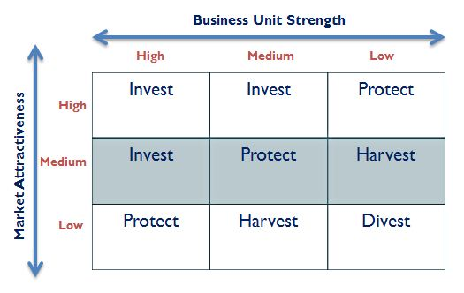
The GE/McKinsey Matrix

Slide 27
BCG’s Growth-Share Matrix

Slide 28
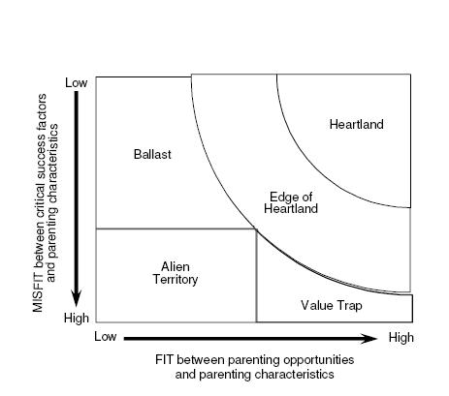
Ashridge Portfolio Display

