Slide 1
Chapter 9:Sustainability and Renewal of Blue Ocean Strategy
By: Chris Rogers, Jeremiah Contreras,
Valerie Villarreal, Christine Everett, Cynthia Lopez, and Tara Visker

Slide 2
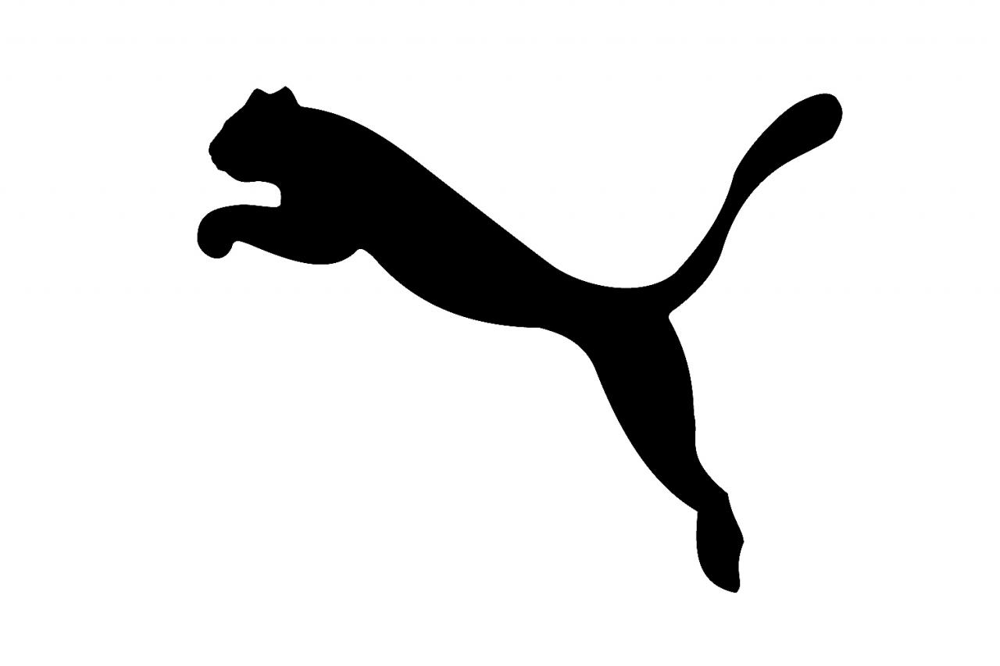
Puma
PUMA

Slide 3
Limitation Barriers to Blue Ocean Strategy
Value innovation does not make sense to a company’s conventional logic
The new CEO wants to change their focus
Blue ocean strategy may conflict with other companies’ brand image
Adidas and Puma
Natural monopoly blocks imitation when the size of a market cannot support another payer
Being under Nike in the shoe and apparel industry, it’s hard for Puma to create a blue ocean strategy

Slide 4
Patents or legal permits block imitation
The high volume generated by a value innovation leads to rapid cost advantages, therefore discouraging followers from entering the market

Slide 5
Network externalities also block companies from easily and credibly imitating a blue ocean strategy
Puma is in a red ocean with Nike because Nike is so popular today, the younger generation doesn’t know Puma

Slide 6
Imitation often requires significant political, operational, and cultural changes
Puma is going through a change; Forever Faster
Companies that value-innovate earn brand buzz and a loyal customer following that tends to shun imitators
Nike is seen everywhere; where as Puma is fading out

Slide 7
Puma
Although Puma isn’t the sports brand that’s popular in the US, it still is in competition with Nike. It’s most known in the soccer and track world. They focus more on the “faster” outlook.

Slide 8
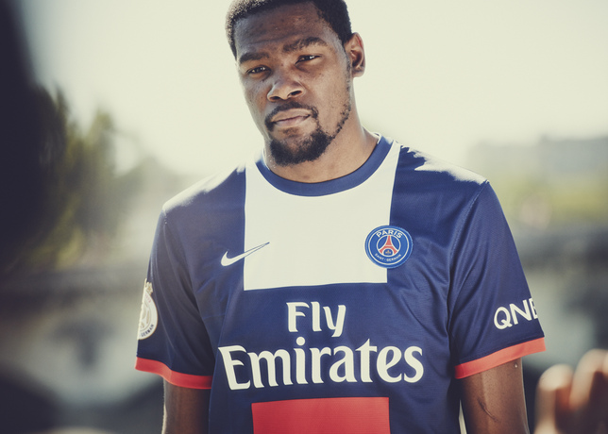
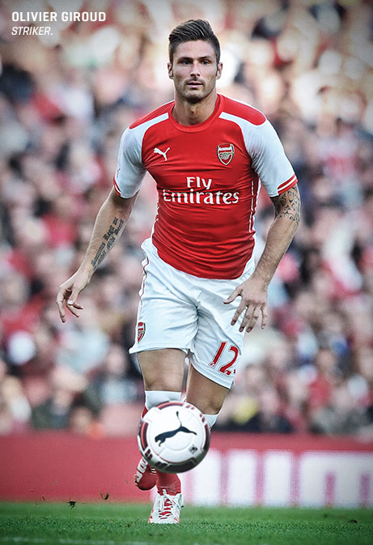
Nike
Puma

Slide 9
Sustainability of Blue Ocean Strategies
When creating blue oceans it is important to know when imitators will come and imitate your success.
These imitators will eventually come sooner or later depending on how hard it is to imitate
There are several imitation barriers to consider including: patents, network externalities, natural monopolies, innovation based on conventional logic

Slide 10
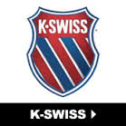
Sustainability and K Swiss
K Swiss has undergone many struggles in the last few years resulting in their common stock being bought out for $4.75 a share by E-Land World Limited
Before this buyout it would be apparent that they needed a blue ocean move to better compete with giants in their industry like Nike, and Adidas

Slide 11
Renewal of Blue Ocean Strategies
When imitators become entering your blue ocean or the ocean is to red from competition you will need to innovate again
Monitoring Value Curves can be a great indicator of when to innovate again, or whether there are still large profits to be had
Using the six principles of blue ocean strategy should serve as support for making a another blue ocean move

Slide 12
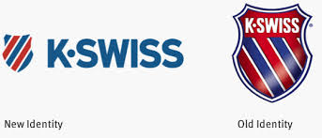
Renewal of Blue Ocean and K Swiss
K Swiss is currently undergoing rebranding in an effort to reimage themselves.
It has been two years since being bought out, and it would seem a great time to innovate and move to a blue ocean if they wish to be successful
K Swiss has struggled as of late, and if they wish to continue as a company, they will need to innovate and move out of their red ocean battles with Nike, and other giants

Slide 13
Nike ≠ Conventional Logic
Began distribution from the truck of Phil Knight’s car but started with:
Bill Bowerman (coach) from University of Oregon
Different types of running shoes
Inventions were ignored
Phil Knight
Way of living + athletics
Takes a chance for Tiger and it pays off (Blue Ribbon Sports)

Slide 14
Natural Monopoly
Nike impacted the shift in the Fitness Revolution
“Idea that exercise and game-playing ceased to be something the average American did for fun,' instead Americans turned to working out as a cultural signifier of status.”
Other companies could not carry such a large influence or impact on the industry

Slide 15
Brand Image
Connected emotionally with consumers
First ad didn’t even feature a product
“Just do it” has held strong for over 25 years
Then took risks on unknown athletes
Success from the careers of these athletes became associated with Nike
Drew a larger audience which in turn lead to higher volume and more advantages over the market than others
Introduces loyalty such as to the Air Jordan line
“Big athlete, big brand, big product”

Slide 16
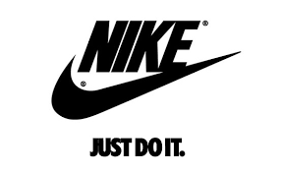
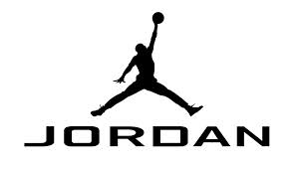
Brand Image

Slide 17
Return to Drawing Board
Scandals with athletes
Departed from “Big athlete, big brand, big product”
Distanced itself from Tiger Woods
Issues with company practices in Indonesia
Terrible conditions
Nike issued a code of conduct
Still an issue later on in public eye
Competitors took advantage to gain consumers during this time

Slide 18
Current Status of Nike
Official sponsor of NFL apparel
Introduced other spectrums of the brand
“Find your Greatness” was a viral hit
Not just profit focus but consumer focus
Loyalty still holds strong and is unmatched
“Just do it”
Most Valuable Sports Brand in the world
Notes:
http://www.fastcompany.com/3037687/just-watch-it-the-history-of-nike-in-3-minutes

Slide 19
Summary
Imitation Barriers to Blue Ocean Strategy
Value innovation, brand image, natural monopoly, patents, high volume, network externalities, etc.
Importance of adjusting when needed to maintain your blue ocean creator status or when to create another blue ocean
Not addressing changing issues could turn your blue ocean red
Nike is still #1 in this blue ocean

