Slide 1
Blue Ocean Strategy:
Reach Beyond Existing Demand
Mathews Worede, Charles Knight, Luis Garcia, Stuart Jones, Michael Tibbetts, Jacob Eassa

Slide 2
Reach Beyond The Existing Demand
Key to achieving value innovation.
By obtaining the largest demand for a new offering, this can reduce the risk associated with creating a new market.

Slide 3
Challenge the Norm
Focusing on the existing customer.
Driving for finer segmentation to accommodate buyer differences.
Results in creating too-small target markets due to competition.

Slide 4
Maximizing Blue Oceans
Companies need to concentrate on non customers instead of current customers.
Move away from focusing on customer differences, and find commonalities in what buyers value.
This allows for a company to reach beyond existing demand to unlock untapped potential customers.

Slide 5
Callaway Example
U.S. golf industry fought to win greater share of existing customers.
Callaway decided to look at customers who had not taken up golf.
Difficulty of sport reduced the size of the market.
Callaway introduced the “Big Bertha”.

Slide 6
Callaway Example Cont.
The “Big Bertha” not only converted non customers, but also pleased existing customers in the market.
Excluding the pros, many existing customers were frustrated with the difficulty of the game and this product lessened difficulty.

Slide 7
Visa Example
Visa is one of the biggest market share holders for credit cards.
Many potential customers are weary of credit cards due to interest rates and taxes.
Visa (along with other companies) started providing rewards for use of their card.

Slide 8
Visa Example Cont.
Along with capturing portions of untapped customers with the rewards, current Visa users were pleased with the new offerings.
This reach beyond existing demand not only grew Visa’s customer base, but also kept their current customers satisfied and coming back.

Slide 9
Questions to think about for your company
Does your company focus on capturing a greater share of existing customers, or on converting non customers of the industry into new demand?
Does your company seek out key commonalities in what buyers value, or do they strive to embrace customer differences through finer customization and segmentation.

Slide 10
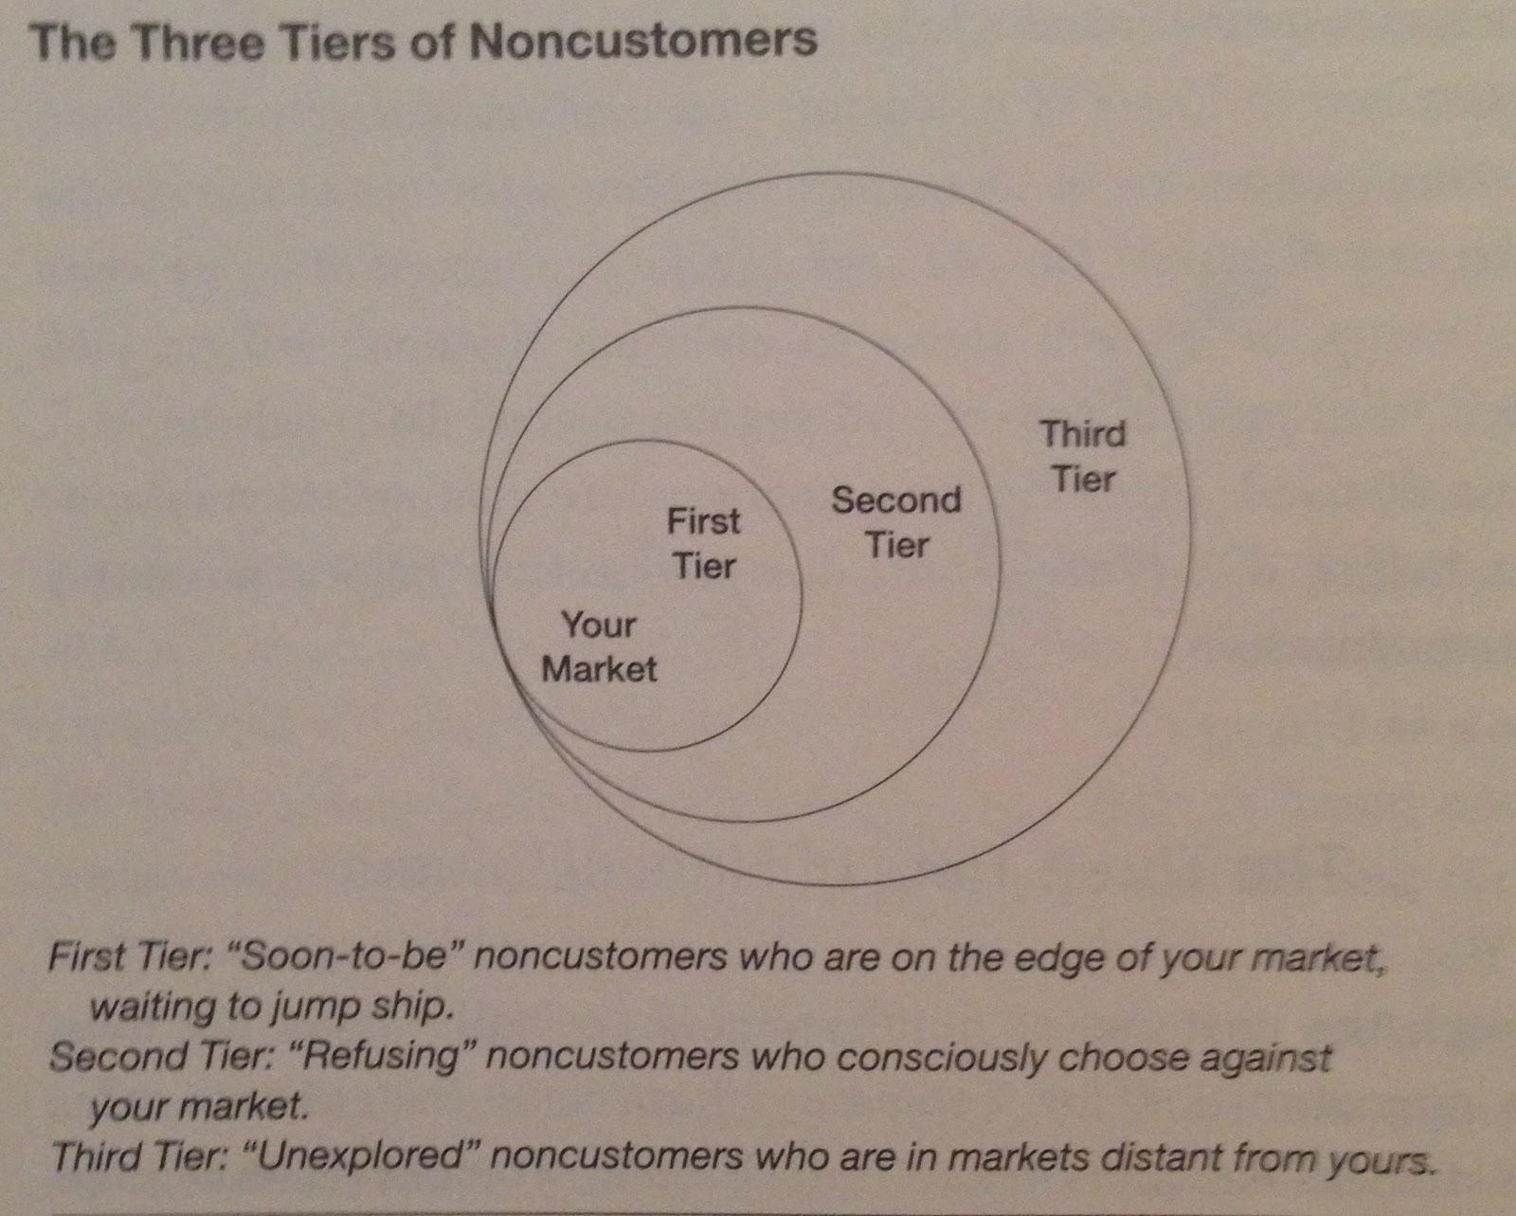
Intro To Three Tiers of Noncustomers

Slide 11
First-Tier Noncustomers
Soon-to-be noncustomers
Minimally use current market offerings
Searching for something better
Little loyalty
Sit on the edge of the market
Effect on the market:
as the number of soon-to-be noncustomers increases, a market becomes stagnant and develops a growth problem
Have an ocean of untapped demand waiting to be released

Slide 12
Pret A Manger Example
British fast-food chain that opened in 1988
Expanded its blue ocean by tapping into the huge latent demand of first-tier noncustomers
Market situation:
Before Pret, professionals in European city centers primarily went to restaurants for lunch
Sit-down restaurants provide a nice meal and setting, but also take a long time, are quite costly, and usually not healthy
This led to a high and rising number of noncustomers
Professionals increasingly started grabbing food on the run

Slide 13
Pret A Manger Example
These first-tier noncustomers were in search of a better solution
Pret A Manger took note of these noncustomers and identified what drove them otherwise known as commonalities
They want lunch fast,
They want it fresh and healthy, and
They want it at a reasonable price

Slide 14
Pret A Manger Example
In order to unlock and aggregate the untapped demand of these consumers, they developed what came to be known as the Pret Formula
Pret Formula: “Offers restaurant quality sandwiches made fresh every day from only the finest ingredients, and it makes the food available at a speed that is faster than that of restaurants and even fast food”
It also delivers this in a sleek setting at reasonable prices
Changing the customers ordering experience from fast food’s queue-order-pay-wait-receive-sit down purchasing cycle to a much faster browse-pick up-pay-leave cycle
Where sit-down restaurants have seen stagnant demand,
Pret has been converting the mass of soon-to-be noncustomers into core customers

Slide 15
The Lesson
Noncustomers tend to offer far more insight into how to unlock and grow a blue ocean than do relatively content existing customers
Look for the commonalities across their responses
Focus on these, and not on the differences between them
This will give you insight into how to desegment buyers and unleash an ocean of latent untapped demand.

Slide 16
Visa Example
http://youtu.be/TVOsBVDXSzc?t=1s

Slide 17
Second Tier Noncustomers
•Refusing noncustomers
•People who can’t afford or do not use
•Needs are dealt by other mean or ignored
•Look for similar responses across
•Don’t focus on the differences

Slide 18
Second Tier Example
•Outdoor advertising space
•Inefficient for small companies, couldn’t afford
•“Street Furniture” by JCDecaux
•Switched Refusing Noncustomers to customers
•Focused on the things that turned customers away

Slide 19
Visa Processing Fees
•Visa processing fees were cheaper
•Tapped into the smaller businesses
•With more merchants, more customers
•Accepted worldwide

Slide 20
Visa Locations
•More locations worldwide
•More ATMs; more convenient for customers
•Refusing noncustomers were now reached

Slide 22
Third Tier Noncustomers
Typically these "unexplored" noncustomers have not been targeted or thought of as potential customers
Their needs and the business opportunities associated with them have been thought to belong to other markets
EX: Tooth whitening provided exclusively by dentists, not oral care product companies. When oral care companies looked at the needs of these non customers they found an ocean of demand waiting to be tapped.

Slide 23
Third Tier Noncustomers (Cont)
Joint Strike Fighter (JSF) Program
Looked at military branches as potentially unexplored noncustomers that could be aggregated into a new market of higher performance, lower cost fighter planes.
Searched for commonalities across the three branches
Most aircraft performed the same missions across branches

Slide 24
Third Tier Noncustomers (Cont)
Two Highest Cost Components of aircraft: Avionics (software) & Engines
Shared use would present enormous cost reductions, especially since most branch’s performed the same missions
JSF looked to understand what features were required by the different branches
Navy: Durability & Maintainability
When far away at sea, maintenance hangars are hard to come by, especially coupled with the hard impact of flying from carrier landing and wear and tear caused by salty air
Marines: Short Takeoff & Robust Countermeasures
Remote and hostile conditions present the need for aircraft that can perform like a jet fighter, but maneuver like a helicopter
Low altitude expeditionary nature also presents the need for countermeasures such as radar jammers, and flares to deter enemies

Slide 25
Third Tier Noncustomers (Cont)
Air Force: Speed & Tactical Agility
Air superiority needs the fastest, most advanced technology in aviation including stealth technology and tactical agility
JSF’s Plan:
JSF set out to cut away all the attributes that were too specific pertaining to each branch and only keep the core values that were the most important
Finally they developed one aircraft that could be used by all three branches and still cater to each one’s needs
The F-35 was the solution; it reduced costs from $190 million/aircraft to $33 million
By reaching beyond the existing customers of each of the three branches, JSF aggregated demand that was previously divided. Their acumen lead to a strategic profile that provided exceptional value but also winning support of all three branches

Slide 26
Go for the Biggest Catchment
No hard-and-fast rule to suggest which tier of noncustomers you should focus on and when.
You should focus on the tier that represents the biggest catchment at the time. You should also explore whether there are overlapping commonalities across all three tiers.
The natural strategic orientation of many companies is toward retaining existing customers and seeking further segmentation opportunities

Slide 27
Continued
The point here is not to argue that its wrong to focus on existing customers or segmentation but rather to challenge these existing, take-for-granted strategic orientations.
What the book suggest is that to maximize the scale of your blue ocean you should first reach beyond existing demand to noncustomers and desegmentation opportunities as you formulate future strategies.
If no such opportunities can be found, you can then move on to further exploit differences among existing customers.

