Slide 1
Blue Ocean Strategy: Reach Beyond Existing Demand

Slide 2
Reach Beyond Existing Demand
Addresses the question: “How do you maximize the size of the blue ocean you are creating?”
Brings us to the third principle of blue ocean strategy
REACH BEYOND YOUR EXISTING DEMAND
A key component of achieving value innovation

Slide 3
How To Achieve This?
Companies should challenge two conventional strategy practices:
The focus on existing customers
The drive for finer segmentation to accommodate buyer differences
“As companies compete to embrace preferences through finer segmentation, they often risk creating too-small target markets.” (p.101)

Slide 4
Maximizing Their Blue Oceans
“To maximize the size of their blue oceans, companies need to take a reverse course. Instead of concentrating on customers, they need to look at noncustomers. And instead of focusing on customer differences, they need to build on powerful commonalities in what buyers value.” (p. 102)
This would allow companies to reach beyond the existing demand to catch new customers they were never able to reach before.

Slide 5
Callaway Golf
Instead, Callaway looked at why other sports enthusiasts and the country club members had not taken up golf as a sport.
Found a key commonality of its noncustomers: hitting the golf ball was perceived as too difficult.
“This understanding gave Callaway insight into how to aggregate new demand for its offering.” (p. 102)
The answer: BIG BERTHA
a golf club with a large head that makes it easier to hit the ball

Slide 6
BIG BERTHA
The Main Point:
This new golf club not only converted noncustomers of the golfing industry but also pleased existing golf customers “making it a runaway bestseller across the board”
This new club also made the existing customers realize they were taking advantage of how the game was actually played and made them accept the responsibility to improve.
This is a great example of “Reaching Beyond Existing Demand”

Slide 7
What To Do?
“By looking to noncustomers and focusing on their key commonalities-not differences…
Callaway saw how to aggregate and offer the mass of customers and noncustomers a leap in value.” (p. 103)
Figure out what you want. Is it to:
Capture a greater share of existing customers?
Convert noncustomers of the industry into new demand?
“To reach beyond existing demand, think noncustomers before customers, commonalities before differences, and desegmentation before pursuing finer segmentation.”

Slide 8
The Three Tiers of Noncustomers
“There are three tiers of noncustomers that can be transformed into customers. They differ in their relative distance from your market.” (p. 103)
We’ll look at each tier to understand how you can attract them and expand your blue ocean.

Slide 9
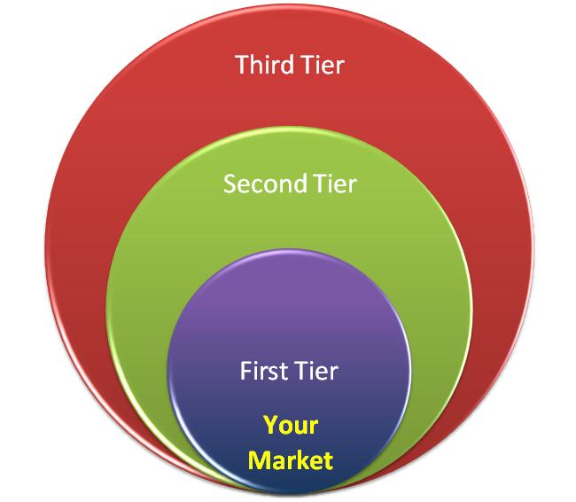
The Three Tiers of Noncustomers
First Tier: “Soon-to-be” noncustomers who are on the edge of your market, waiting to jump ship.
Second Tier: “Refusing” noncustomers who consciously choose against your market.
Third Tier: “Unexplored” noncustomers who are in markets distant from yours.

Slide 10
First-Tier Noncustomers
Closest to your market-they sit on the edge of your market.
“They are buyers who minimally purchase an industry’s offering out of necessity but are mentally noncustomers of the industry. They are waiting to jump ship and leave the industry as soon as the opportunity presents itself.” (p. 103)
When offered a leap in value, they would not only stay, but their purchase frequency would multiply.

Slide 11
First Tier Noncustomers Cont’d
Pret A Manger-fast food company (1988)
Expanded their blue ocean by “tapping into the huge latent demand of their first-tier noncustomers.”
These first-tier noncustomers were in search for a better solution for lunch-instead of a nice, expensive sit down meal, they needed something fast and cheap.
Shared three commonalities
They wanted lunch fast
They wanted it fresh and healthy
They wanted it at a reasonable price
=AN UNTAPPED DEMAND

Slide 12
Pret A Manger
In addition to offering healthy alternatives, Pret A Manger speeds up the customer ordering experience.
On average, customers spend 90 seconds from the time they get in line to the time they leave the restaurant.
These three commonalities were a huge hit for lunchers on the go
Over 25 million sandwiches a year from its 130 stores in the U.K.
Its growth potential even made McDonald’s buy a 33% share of the company.

Slide 13
Second-Tier Noncustomers
Either do not use or cannot afford to use your offerings because they find the offerings unacceptable or beyond their means.
“People who refuse to use your industry’s offerings. These are buyers who have seen your industry’s offerings as an option to fulfill their needs but have voted against them.” (p. 103)
In the Callaway example, these would be the sports enthusiasts who could have chosen golf but had consciously chose against it.

Slide 14
Second-Tier Noncustomers Cont’d
JCDecaux-Outdoor advertising
Many companies refused to use outdoor advertising because it offered limited space or they could not afford it.
So, JCDecaux expanded their advertising from buses and billboards located only on the outskirts of town to actual bus stations and billboards located in downtown cities to convert second-tier customers.

Slide 15
JCDecaux
This gave JCDecaux the idea to expand to outdoor/street furniture
Increased the average exposure (time)
Richer contents
More complex messages
Rollout campaign time decreased from 15 days to 3 days
Led to a flock in the industry from second-tier noncustomers!
Number one street furniture-based ad space provider worldwide
283,000 panels in 33 countries

Slide 16
Third-Tier Noncustomers
Farthest from your market
“They are noncustomers who have never thought of your market’s offerings as an option.” (p. 104)
Typically, these customers have not been targeted or thought of as your potential customers by any player in the industry.
Tooth whitening service example

Slide 17
U.S. Defense Aerospace Industry
The inability to control aircraft costs is a key vulnerability in the long-term military strength of the U.S. leaving no viable plan to be able to replace the aging fleet of fighter aircraft.
In Fall 2001, Lockheed Martin was given the $200 billion JSF contract-the largest military contract in history.

Slide 18
U.S. Defense Aerospace Industry
Needs:
The Navy-durable aircraft that would survive the stress of landing on carrier decks and maintainability
The Marines-the need for short takeoff vertical landing (STOVL) and robust countermeasures
The Air Force-fastest and most sophisticated aircraft with super tactical agility and stealth technology
=three distinct and separate segments needing to be combined into one aircraft to cut costs

Slide 19
U.S. Defense Aerospace Industry
The Joint Strike Fighter (JSF) program challenged this industry practice
JSF searched for key commonalities across the three branches
JSF found that the highest-cost components of the three branches were the same: avionics (software) and the engines
JSF is now called the F-35

Slide 20
U.S. Defense Aerospace Industry
“The aim was to build one aircraft for all three divisions by combining those key factors while reducing or eliminating everything else.” (p. 111)
The result: ONE aircraft and a dramatic decrease in costs. This means the price per aircraft was significantly lower but had a leap in value in performance for all three branches.
The JSF reduced costs from $190 mil per aircraft to $33 mil per aircraft

Slide 21
Go for the Biggest Catchment
Even though “the natural strategic orientation of many companies is toward retaining existing customers and seeking further segmentation opportunities” seems the best way to go for competitive purposes, this will NOT create a blue ocean that expands the market and creates new demand.
You should focus on the tier that represents the biggest catchment at the time for you.
While exploring whether there are overlapping commonalities across all three tiers of noncustomers.

Slide 22
Go for the Biggest Catchment
To maximize the scale of your blue ocean:
Reach beyond existing demand to noncustomers and desegmentation opportunities while you formulate future strategies.
“If no such opportunities can be found, you can then move on to further exploit differences among existing customers.” (p. 115)
But, be aware:
You might end up landing in a smaller space
You might lose existing customers to other companies that are willing to offer a leap in value

Slide 23
Takeaways
“Noncustomers tend to offer more insight into how to unlock and grow a blue ocean than do relatively content existing customers.” (p. 106)
Look for commonalities across their responses to gain insight as to what your company needs to expand their customer base.
“There is no hard-and-fast rule to suggest which tier of noncustomers you should focus on and when.” (p. 114) Go for the biggest catchment.

