Slide 1
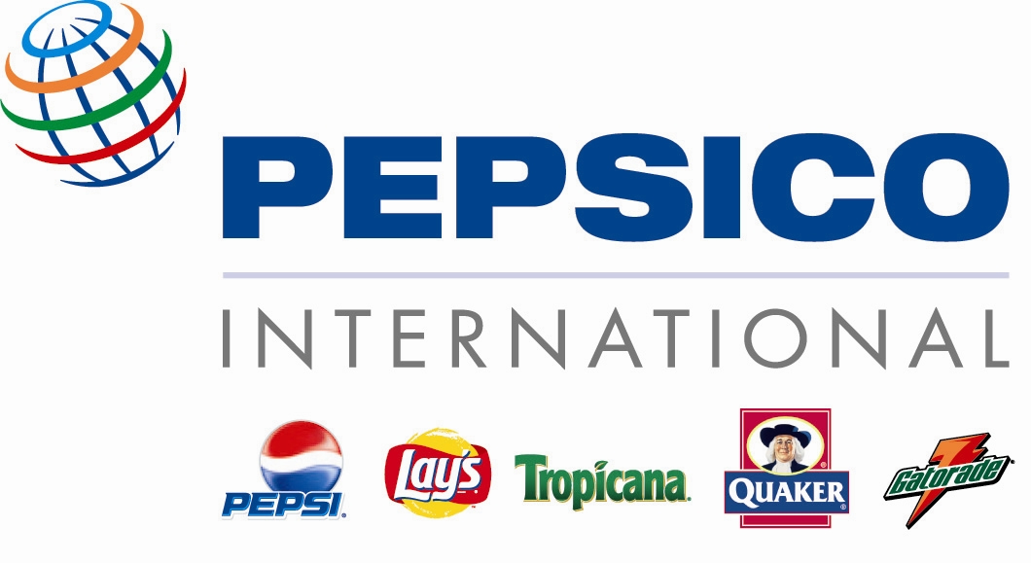
Industry and Competitive Situation Analysis
Team 4:
Katy Neely
Matt Tevis
Andrew McDonald
Shelly Brown
Hunter Pond

Slide 2
PepsiCo: Mission, Vision, and “Performance With Purpose”
Our Mission
“Our mission is to be the world's premier consumer products company focused on convenient foods and beverages. We seek to produce financial rewards to investors as we provide opportunities for growth and enrichment to our employees, our business partners and the communities in which we operate. And in everything we do, we strive for honesty, fairness and integrity.’
Our Vision "PepsiCo's responsibility is to continually improve all aspects of the world in which we operate – environment, social, economic – creating a better tomorrow than today."
“Our vision is put into action through programs and a focus on environmental stewardship, activities to benefit society, and a commitment to build shareholder value by making PepsiCo a truly sustainable company.”
Performance with Purpose “At PepsiCo, we're committed to achieving business and financial success while leaving a positive imprint on society – delivering what we call Performance with Purpose. “
“Our approach to superior financial performance is straightforward – drive shareholder value. By addressing social and environmental issues, we also deliver on our purpose agenda, which consists of human, environmental, and talent sustainability.”

Slide 3
PepsiCo: Products
Pepsi-Cola
Pepsi, Mountain Dew, Mug Root Beer, Sierra Mist, Slice, Aquafina, SOBE, Lipton…
Gatorade
Gatorade Thirst Quencher, Propel Fitness Water, Tiger Woods Line, G2…
Frito-Lay
Grandmas Cookies, Oberto Jerky, Miss Vickie's Potato Chips, TrueNorth, Flat Earth…
Tropicana
Premium Juices, Tropicana Twister, Dole, Naked Juices…
Quaker
Quaker Oatmeal, Life Cereal, Cap’n Crunch Cereal, Aunt Jimima, Rice-a-Roni…

Slide 4
The Packaged Food Industry
Worldwide Leaders:
General Mills
Kellogg
PepsiCo
Kraft

Slide 5
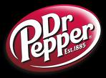
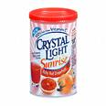
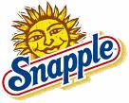
The Beverage Industry
Market Leaders:
Coca-Cola
Dr. Pepper/Snapple
Kraft Foods

Slide 6
Competition and Risk
Local
Regional
National
Multi-National
Global
Advertising
Marketing
Brand Image/Quality
Legal Risks

Slide 7
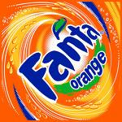
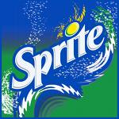
PepsiCo vs. Coca-Cola
Coca-Cola Company
Brands
Full Throttle Energy Drinks, Simply Juices, Sprite, Fanta, Dasani, PowerAde, Vitamin Water, Odwalla…
Current Strategy and Goals
Customers
Competition and Risk
Acquisitions

Slide 8
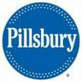
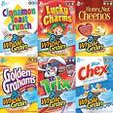
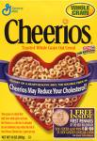
PepsiCo vs. General Mills
General Mills
Brands
Betty Crocker, Pillsbury, Cheerios Cereal, Fruit Roll-Up’s, Chex Mix, Haagen Dazs, Old El Paso, Yoplait…
Current Strategy and Goals
Customers
Competition and Risk
Acquisitions

Slide 9
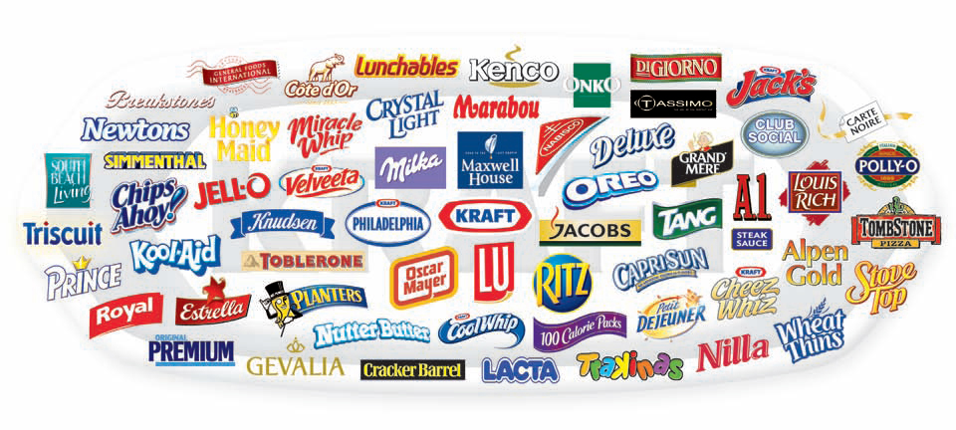
PepsiCo vs. Kraft Foods
Kraft Foods
Brands
Capri Sun, Kool-Aid, Cheese Nips, Cool Whip, Jell-O, Kraft Macaroni & Cheese, Oscar Meyer, Philadelphia Cream Cheese…
Current Strategy and Goals
Customers
Competition and Risk
Acquisitions

Slide 10
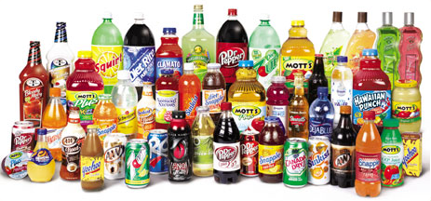
PepsiCo vs. Dr. Pepper Snapple Group
Dr. Pepper Snapple Group
Brands
7-Up, Canada Dry, Mott’s Apple Juice, Hawaiian Punch, Yoo-hoo Milk, Sunkist…
Current Strategy and Goals
Customers
Competition and Risk
Acquisitions

Slide 11
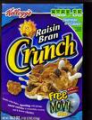
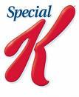
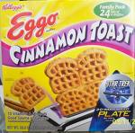
PepsiCo vs. Kellogg
Kellogg’s
Brands
Eggo’s, Frosted Flakes Cereal, Raisin Bran Cereal, Special K Cereal, Pop-Tarts…
Current Strategy and Goals
Customers
Competition and Risk
Acquisitions

Slide 12
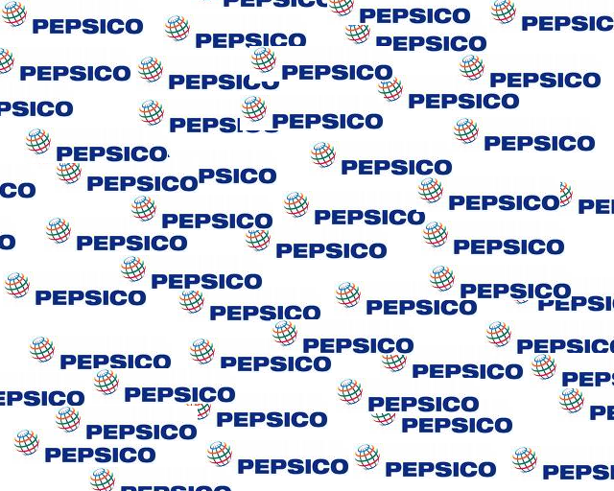
Economic Factors
Costs
Governmental Rules and Regulations
Alternative Energy
“Consumers and government officials are increasingly focused on the impact companies have on the environment. PepsiCo is committed to maintaining high standards for product quality, safety and integrity and to reduce their impact on the environment through water, energy and packaging initiatives. PepsiCo plans to continue to invest in programs that help reduce energy costs, conserve energy and use clean energy sources, such as their wind turbine project in India which supplies more than two-thirds of the power used by our Mamandur beverage plant each year. PepsiCo is also currently working on new packaging initiatives to further reduce the amount of plastic used in their beverage containers, and continue to partner with community organizations to increase recycling efforts.”

Slide 13
Political Factors
Federal and International Laws
FDA, EPA, OSHA…
Sustainability
Environmental Policies
2007 and 2008, PepsiCo honored by the Environmental Protection Agency (EPA) “Energy Star Partner of the Year” for energy conservation.

Slide 14
Social Factors
Work and business attitudes
Employee benefits
Legal Services, bonuses, flexible medical packages, paid vacations, stock options, etc.
SharePower
Diversity and Inclusion Efforts
2006-ranked top 10 for Diversity Inc’s “Top 50 Companies for Diversity.”

Slide 15
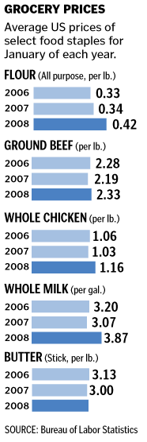
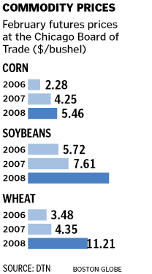
Technological Factors
Rising food costs
Emerging markets
Tropicana Twister strategy
“Twitter” generation

Slide 16
Geographical Factors
PepsiCo World Headquarters
Frito-Lay North America (FLNA)
PepsiCo Beverages North America (PBNA)
Quaker Foods North America (QFNA)
Foreign Markets
PepsiCo International (PI)
PepsiCo World Headquarters
PBNA
PI
FLNA

Slide 17
PepsiCo: SWOT Analysis
Strengths
Brand Recognition. PepsiCo, Frito Lay, Gatorade, Quaker, and Tropicana.
Brand Loyalty. PepsiCo has loyal customer base for its products.
Brand Diversification. PepsiCo not only produces Pepsi-Cola but snack products and juices as well.
Global Participation. PepsiCo brands are not only sold in the U.S., but in more than 200 countries world-wide.
Strong Financial Position. PepsiCo brings in over $80 Billion in revenues yearly.
Weakness
Non-Carbonated Drinks. The U.S. market shows a recent trend that is shifting towards non-carbonated drinks.
Health Food Alternatives. Consumers are becoming increasingly health conscious.
Un-Tapped Markets/Globalization. There are other markets that can be explored and tapped into.
Acquisition and/or Merger. PepsiCo needs access to other markets.
Niche Marketing/Products. Pepsi ironically is one of the weaknesses of PepsiCo products, due to the fact that it is distant from its leader, Coca-Cola.

Slide 18
SWOT Analysis Continued
Opportunities
Opportunities in International Markets. PepsiCo’s operations outside of the U.S. significantly contribute to their revenue and profitability. Because per capita consumption of their products is still relatively low overseas, they expect to see a significant opportunity to grow in the global market by expanding existing businesses and through acquisitions, especially in up and coming markets.
Environmental sustainability. Pepsico also has incorporated a consideration of environmental sustainability.
Revitalizing North American Beverage Business. “We plan to capitalize on our new “Refresh Everything” campaign, which features new brand identities for trademarks Gatorade, Pepsi, Sierra Mist and Mountain Dew, as well as key product innovations like new SoBe Lifewater, sweetened with PureVia, an all-natural, zero-calorie sweetener recently approved by the U.S. Food and Drug Administration. In non-carbonated beverages, we will work to identify untapped thirst occasions and to deliver even more functional benefits.”
Threats
Competition. The food and beverage industry is very competitive market with PepsiCo’s top competitors being Coca-Cola, Dr. Pepper, Snapple, and Kraft Foods.
Consumption and Demand. Shifts in consumer consumption patterns of beverages and snack foods add a risk to PepsiCo. It is important for them to keep up with their competitors to maintain a steady advantage.
Commodity prices. Rises in commodity prices can potentially reduce profits for PepsiCo by increasing the cost of goods sold.
Foreign exchange risks. international operations comprise nearly one-fifth of company’s annual business segment operating profit. A loss of foreign market share could be potentially detrimental to their corporation.
Interest rates. PepsiCo’s portfolio deals with interest rates and includes primarily cash equivalents and short-term marketable securities. Unfavorable interest rates may result in adverse interest expense on their income statement.

Slide 19
PepsiCo: BCG Matrix
TROPICANA
PEPSI
FRITO-LAY

Slide 20
PepsiCo’s Organizational Chart
PepsiCo
PepsiCo Americas Food (PAF)
PepsiCo Americas Beverage (PAB)
PepsiCo International (PI)
United Kingdom and Europe (UKEU)
Middle East, Africa, and Asia (MEAA)
Pepsi Americas Bottling (PAB)
Pepsi Bottling Group (PBG)
Frito-Lay North America (FLNA)
Quaker Foods North America (QFNA)
Latin Americas Foods (LAF)

Slide 21
Growth Chart

Slide 22
Total Revenue
Billions

Slide 23
Net Income
Billions

Slide 24
Total Equity
Billions

Slide 25
Index of Sustainable Growth

