Slide 1
Industry and Competitive analysis: Southwest Airlines
Group 5:
Meghan Davidson
Berklye Dominguez
Justin Pickard
Michael Simpson
Andrew Vargas

Slide 2
Industry Characteristics
Service Industry
Air Transportation
Perishable
Available Seat Miles (ASMs)
Four Airline Categories:
International
National
Regional
Cargo/Air Freight

Slide 3
Industry Analysis
Environmental Scan
Economic
Political
Geographical
Social
Technological
Competitive
Porters 5 Forces

Slide 4
Economic Factors
Business Cycle
Short Booms & Long Busts
Investment
Capital intensive
Employment
Largest Expense
High Volume

Slide 5
Political Factors
Government Regulation
Civil Aeronautics Act, 1938
Federal Aviation Act, 1958
Deregulation
Airline Deregulation Act, 1978
Southwest
Wright Amendment

Slide 6
Geographical Factors
Location
Dallas
Size
Large Area
Tactical
Hub and Spoke
Point to Point

Slide 7
Social Factors
Pollution caused by the airline industry
Airline industry contributes an estimated two-three percent of global greenhouse gas emissions
Emissions are released in a higher level of the atmosphere
Getting the Green Light for Aviation
Reduce and eliminate aviation impact on the environment
Aircraft is 60% more fuel efficient than 30 years ago

Slide 8
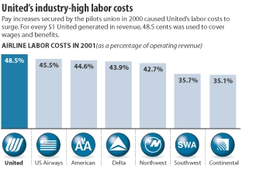
Social Factors Cont.
Work and Business attitudes
Labor Unions
About 80-85% of workers are part of union
Several different ones: Pilots, Flight Attendants, and Machinists
Cause high labor costs for airlines

Slide 9
Technological Factors
Fuel Efficient aircraft and fuels are being developed
Technology development for lighter aircraft and fuel efficient engines
Air Traffic Control System
NextGen
Updated tracking and better routes

Slide 10
Technological Factors Cont.
Airlines Forecasting and Algorithms
Algorithms more accurate can have huge cost savings for companies
Better forecasting allows customers to receive better price
Life Cycle of an Aircraft
Average for Top 6 airlines is 13 years
Broadband to create Revenue
Market to grow to $986 million dollars
Ex. Southwest charging for internet use

Slide 11
Competitive Factors
Entry and Exit of Major Changes
Entry into the market requires high capital
Compete on small margins
Growth rate that is seen as good is 2-3%
Competition Size
The largest seven airlines in US have more than 80% of market share
11 major airlines

Slide 12
Competitive Factors Cont.
Competitive Edge
Fly as cheaply and quickly as possible with no mistakes
Price of Plane Tickets
No layovers and prefer point to point
No lost luggage
Discounts or specials
Good Customer Service
Market Segments
Locate in cities that have steady flow of traffic
Convenience of location

Slide 13
Business Altering Factor
9/11 Attacks devastated the airline industry
Restrict air travel for the next four days
String of layoffs started to occur
140,000 announced layoffs would take place
Made Airlines restructure their business model
$15 billion dollar bailout was approved

Slide 14
Key Success Factors of Industry
Attracting and Maintaining customers
Satisfying new and potential passengers
Managing its fleet
Airplanes being fully utilized
Managing its people
Employees are happy and union is pleased
Handling its finances
Enough money is coming in from planes

Slide 15
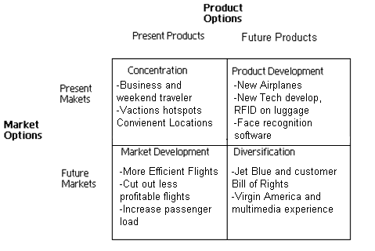
Growth Vector Analysis

Slide 17
Industry Rivalry
Competition
High
Deregulation
Price
Profits
Low

Slide 18
Threat of New Entrants
Regional Carrier startups
Barriers to Entry:
High Startup costs
Brand Name Recognition
Frequent Flyer Miles
Post-Entry Competition

Slide 19
Availability of Substitutes
These threats come from outside the Airline Industry
Automobiles
Trains
Buses
Other factors to consider
Cost
Time
Convenience

Slide 20
Availability of Substitutes
Telecommunications
Business Travelers
NetJets

Slide 21
Buyer/Supplier Power
Buyer Power
Low airline carrier buying power
Consumers
Supplier Power
Labor
Jet Fuel
Aircraft Manufacturers

Slide 22
History of Southwest Airlines
Southwest Airlines began in 1971 by Herb Kelleher and Rollin King.
It began in Texas flying between the triangle: Dallas, San Antonio, and Houston.
Since 1987, Southwest has had the lowest ratio of complaints per passenger boarded.

Slide 23
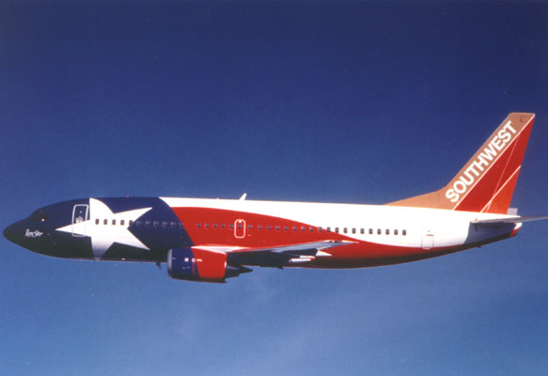
History continued
Southwest led the way with Internet innovations.
It is the United States’ most successful low fare, high frequency, point-to-point carrier.

Slide 24
Strategy and Performance
In 2007, Southwest implemented a new boarding system along with a Business Select product offering an improved Customer Airport Experience.
“NO-HIDDEN-FEE-ZONE” developed trust and commitment with customers.
In 2008 they made significant improvements in their network optimization capabilities and their revenue management.
2008 proved to be another industry leading year. They led the airline industry in Customer Service and Operational Excellence.

Slide 25
Strategy and Performance cont.
Despite the difficulties 2008 brought, Southwest managed to turn a profit for a 36th consecutive year. Also:
Net income = $178 million
More revenues per flight
Unit revenue year-over-year up 7.8%
Some downturns:
Year-over-year profit down 37.6%
Earnings per diluted share down 34.4%
Jet fuel prices up 30%

Slide 26
2008 a Positive Year
Overall the revenues for Southwest grew 11.8% and are already prepared for an economic crisis.
Expanded growth of their fleet is suspended due to economic crisis but continue to expand their revenue initiatives:
Appeal to more business travelers
Enhance the overall Customer Experience
Create more revenue per flight
Code share relationship with Canada and Mexico
Rapid Rewards program and southwest.com
Expand route map

Slide 27
SWOT Analysis
Strengths
The use of inner city airports
Successful advertising
The use of the same plane type
It’s the fourth largest domestic airline
Best low cost airline in the industry
36 consecutive years of profitability
Weaknesses
Multiple stops to destination
Lost touch with travel agents
No international flights
No segmented seating
Lack of exposure toward online booking agents

Slide 28
SWOT Analysis
Opportunities
Downturn in economy
National and International markets
Industrial research and development
Increased Internet advertising
Twitter/Facebook advertising
Threats
Gas and oil price fluctuations
Decline of leisure travel
Annual airline security costs increased
Cut-back of business travelers
Terrorist attacks

Slide 30
Assets to Southwest Airlines
Southwest Airlines’ assets that give it competitive strength:
Short flights to and from smaller airports
Provides easy online booking
The pilots don’t belong to a national union
The employees
“If they’re happy, satisfied, dedicated, and energetic, they’ll take real good care of the customers. When they customers are happy, they come back. And that makes the shareholders happy.” Herb Kelleher

Slide 31
Some Awards
There are many awards that Southwest Airline has won. A few include:
Multiple times in the Top 5 in the Fortune Top 100 Best Businesses to Work For
12th on Fortune’s Most Admired list in 2007
Forbes Platinum List in 2007
ranked by Business Week as one of the 50 Best Places to Launch a Career
Most Admired Companies Among Women by Professional Women’s Magazine in 2006
100 Best Corporate Citizens by Business Ethics magazine
Corporate 100 by Hispanic magazine since 2000
Top 100 Most Innovative Technology Organizations by InformationWeek in July 2007

Slide 32
Relative Cost Position
In addition to their very successful fuel hedging program, there are several other projects in the works to reduce fuel consumption:
Jet engine washing
Obedience to planned cruise levels and efficient airspeeds
Portable electric ground power or Gate Services for aircraft
Install RNP/RNAV technology into their fleet

Slide 33
Relative Cost Position cont.
Also, in the face of this economic crisis, Southwest was able to raise their liquidity by $1.1 billion in the fourth quarter of 2008 through multiple financing transactions.
They want to adapt to the constantly changing environment and at the end of 2008 they had a year-over-year available seat mile growth of nearly four percent and approximately 3,200 daily departures.
During 2008 Southwest raised the number of their fleet by 17 Boeing 737 aircrafts to end up with 537.
The company improved its scheduling tools and can now optimize their schedules more often which shifts capacity to more demanding routes.

Slide 34
Managerial Factors
Social Responsibility
Strategic Analysis
Aggressiveness in Meeting Competition

Slide 35
Competitive Factors
Product Strength, Quality, Uniqueness
Customer Loyalty and Satisfaction
Market Share

Slide 36
Financial Factors
Access to Capital
Ease of exit from market
Profitability, ROI

Slide 37
Technical Factors
Product effectiveness and delivery schedules
Value Added to Service
Equipment

Slide 38
Fuel Hedging
The number 1 reason Southwest posted a profit in 2008
Hedging is basically locking in the price of jet fuel for a certain time period.
In 2008, Southwest paid $51 a barrel for 70% of its oil, while its major competitors were paying over $140 a barrel.

Slide 39
Fuel Hedging cont.

Slide 41
Strategic Issues
In the past year Southwest added several more nonstop flights onto their list and they are hoping to add even more, further eliminating the multiple stops on their customers’ journeys.
They are hoping that they may break into the international market and create a whole new realm of opportunities for profit and growth.
Although they have had great success from their website, they want to still have the presence of the middlemen for older generations.

Slide 42
Strategic Issues cont.
Are entertaining the idea of changing long held ideas:
Deciding whether to assign seats
Serving in-flight meals is a possibility as well
Also thinking about adding a new aircraft if they do enter the international market.

