Slide 1
Apple Inc.
Team 5
Michelle Black
John Calhoun
Sebastien Coracin
Bryant Girardot
Kevin Michel

Slide 2
External Analysis
General External Environment
Economic Factors
Economic crisis
Positive growth of the industry
Currency rates
Political Factors
Copyright laws
Piracy

Slide 3
General External Analysis
Social Factors
Private life protection
Working condition of suppliers
Environment
Fashion
Technological Factors
Innovation competition
Convergence of technology

Slide 4
External Analysis
Competitor’s Presence in the Industry
Dell
Hewlett-Packard
Microsoft

Slide 5
External Analysis
Porter’s Five Forces
New Entrants
Barrier of innovation
Confidence of the customers
Rivalry
Intensive competition
Innovation as a key factor
Variety of competitors

Slide 6
Porter’s Five Forces
Substitute/ Complementary Products
Substitute
Traditional entertainment products
Complementary products
Computers device
Apple specific complementary products
Power of Suppliers
Raw material suppliers
Components suppliers

Slide 7
Porter’s Five Forces
Power of Buyers
Core customers basis
Apple’s popularity
Never Apple’s customers

Slide 8
Marketing Strategy
CRM
Personal Apple Stores
Complete Solution Program

Slide 9
Are You a Mac?
http://www.youtube.com/watch?v=KNnX6XRQBec&feature=related
Quality over Price
New Target Market

Slide 10
More Techniques
Licensing products

Slide 11
International Marketing
New Market Potential
Increased Revenue
European headquarters
Entry Barriers

Slide 12
Net-Sales for International Markets

Slide 13
Product Differentiation
Jonathan Ive
Benefits?
Price Threshold

Slide 14
Environmental Marketing
Intense scrutiny of producing to much waste
New Methods to counter act
Savings?

Slide 15
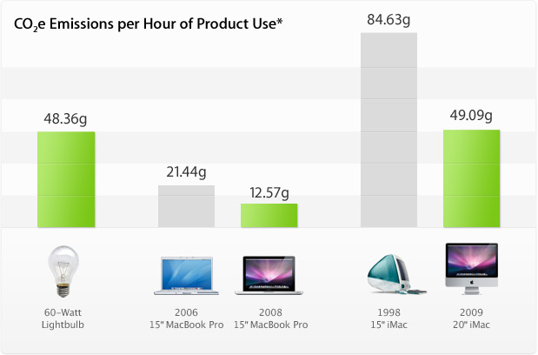

Slide 16
Brand Identity
Why does Apple need it?
Does a product create the brand?
Who creates the Identity?

Slide 17
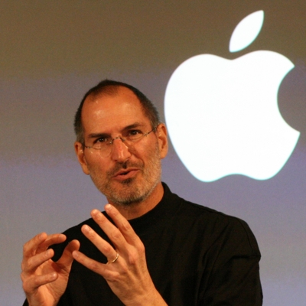
The Leader
Tao of Steve Jobs
4 Characteristics
His new vision

Slide 18
HRM
“Human Resource creates an overabundance of talent that drives our core businesses and allows us to seize strategic business opportunities. HR partners with each division to identify and develop the best talent in the industry. We are motivated to ensure the right people are in the right jobs to fuel our diverse and dynamic organization- and Apple’s Future”

Slide 19
HRM Continued
The 7 disciplines
Flex Benefits
Stock Benefits

Slide 20
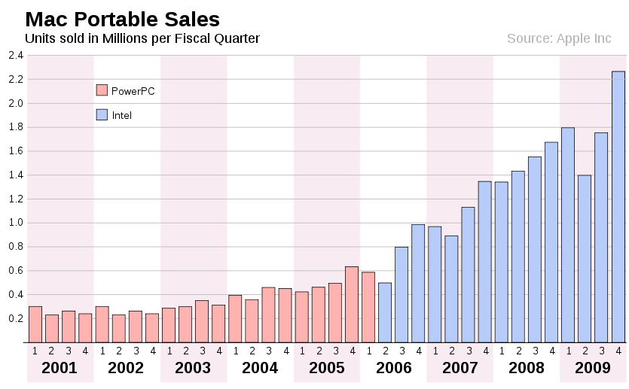
Bringing in the New Strategy
The switch from Power PC to Intel
The Birth of the iPad

Slide 21
Relative Cost Structure iPod relative cost comparison
iPod Touch | 174.99 | iPod nano | 134.99 | iPod shuffle | 54.99
Archos Vision 3 | 79.99 | Sony walkman | 99.99 | Archos Clipper | 24.99
MacBook Relative Cost Comparison
MacBook Pro 13.3 in | 1,499.99 | MacBook Pro 15.4 in | 2199.99
Hewlett-Packard (Turion) | 679.99 | Hewlett-Packard Pavilion | 699.99
Dell Inspiron 14 in | 449.99 | Dell Studio laptop | 799.99

Slide 22
$ in millions | 2005 | 2006 | 2007 | 2008 | 2009
Total Assets | 11,516 | 17,205 | 24,878 | 36,171 | 47,501
shareholders equity | 7,428 | 9,984 | 14,531 | 22,297 | 31,640
Earnings per share | 1.64 | 2.36 | 4.04 | 6.94 | 9.22

Slide 23
$ in millions | 2004 | 2005 | 2006 | 2007 | 2008 | 2009
Revenue | 8,279 | 13,931 | 19,315 | 24,006 | 32,479 | 36,537
Cash from Operations | 934 | 2,535 | 2,220 | 5,470 | 9,596 | 10,159
Earnings after Taxes | 276 | 1,335 | 1,989 | 3,496 | 4,834 | 5,704

Slide 24
SWOT Analysis
Strengths | Weaknesses
Strong brand image Robust Financial Performance Focused R&D driving innovation | Product recalls Patent infringement AT&T
Opportunities | Threats
Strong growth in Smartphone’s market segment Continuing growth in demand for mobile PCs | Intense competition Economic slowdown

Slide 25
Strengths
Strong brand image
Robust financial performance
Focused R&D driving innovation

Slide 26
Weaknesses
Product recalls
Patent infringement
AT&T

Slide 27
Opportunities
Strong growth in Smartphone's market segment
Continuing growth in demand for mobile PCs

Slide 28
Threats
Intense competition
Economic slowdown

Slide 29
Recommendations
Keep the innovation coming
Work with AT&T to help develop new solutions
Continue to give more people the opportunity to write programs
Continue to search for the next blue ocean.

