Slide 1
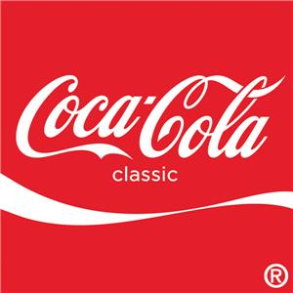
Team 6
Andrew Etlinger
Ashley Harris
Blake Green
Carolynn Schnaubelt
David Styers

Slide 2
Company Overview
Established in 1886
World’s #1 Soft Drink Company
Coca Cola owns 4 out of the top 5 soft drinks
Coca Cola, Diet Coke, Sprite, & Fanta
Operate in over 200 nations, with more than 500 brands, and over 3000 drinks
Mission Statement: “To refresh the world…..to inspire moments of optimism and happiness…and to create value and make a difference.

Slide 3
Geographic Distribution
Up until World War II, all Coca-Cola distribution was done within the United States.
Now Coca-Cola is the World’s largest beverage company, and operates in more than 200 countries.
Coca-Cola now has over 300 bottling partners around the globe to help meet the international demand of Coca-Cola.
One of 300+ partners is Hellenic, which is a Greek based company, and Coca-Cola merged with them in 2000 to form the second largest bottling company in the world as Coca-Cola Hellenic.
Coca-Cola Hellenic now distributes to 28 countries overseas.

Slide 4
Geographic Distribution (Consumption per capita)
Globally, Coca-Cola breaks up their global distribution into 5 regions. (North America, Latin America, Europe, Eurasia and Africa, and Pacific)
Over the last 20 years every region has seen significant growth. http://www.thecoca-colacompany.com/ourcompany/ar/map.html#/per-capita-consumption
Highest growth over the last 20 years was in the Eurasia and Africa region where consumption quadrupled.
Next were the Pacific and Europe regions followed by Latin America and North America.

Slide 5
Geographic Distribution (unit case volume)
Over 24.4 billion cases of Coca-Cola were sold across the globe last year.
Coca-Cola measures each regions unit case volume as a percentage of the total number of cases sold across the world last year. http://www.thecoca-colacompany.com/ourcompany/ar/map.html#/unit-case-volume
When ranked by these numbers, Latin America and North America are the front-runners with 28% and 23% respectively.
These two regions are followed by the last three regions, which are all very close to each other: Pacific 18%, Europe 16%, and Eurasia and Africa 15%.
These numbers have the regions stacked up quite differently

Slide 6
Recent Political Factors
Right now Coca-Cola is fighting the Obama Administration because they are trying to raise the tax on profits earned abroad for multinational companies in the U.S.
Also one of Coca-Cola’s Indian subsidiaries is looking at a 47 million dollar fine for pollution they caused from one of their plants that was closed down in 2005.
This plant has been said to be responsible for ruining the soil and groundwater around the village of Plachimada.

Slide 7
Political Factors in the Past
Until 1904 Coca-Cola contained 9 milligrams of cocaine, which was then replaced by caffeine.
In 1906 the Pure Food and Drug Act was passed.
Then, in 1909 the government tried to go after Coca-Cola and outlaw the drink under this act because they said it contained too much caffeine.
Case of United States vs. Forty Barrels and Twenty Kegs of Coca-Cola.
Judge ruled in favor of Coca-Cola, saying they had the right to use caffeine as they saw fit.

Slide 8
Technological Changes
One of the major keys to Coca-Cola’s success can be attributed to their bottling system.
Also recently Coca-Cola has begun to utilize green technology.
In 2007 the headquarters in Atlanta, Georgia was upgraded with green technology costing 3 million dollars.
Last year Coca-Cola announced that they were coming out with new eco-friendly bottles that leave no carbon footprint.

Slide 9
Porter’s Five Forces Overview
Porter’s Five Forces | Degree of Competition
Rivalry Among Existing Firms | High
Threat of New Entrants | High
Threat of Substitute Products | High
Bargaining Power of Suppliers | Low
Bargaining Power of Buyers | Moderate

Slide 10
Rivalry among Existing Firms
Concentration: High
Intense Competition
Coca Cola has the highest market share out of their competitors (43%) which means the have a very high concentration.
Industry Growth: Low (Growth rate is negative)
Consumers are turning to healthier beverages and 78% of Coca Cola’s sales are from carbonated beverages.
Fixed Costs: High
Coca Cola uses fixed costs efficiently
Bottling company creates a fixed costs for their syrup and adjusts it quarterly.

Slide 11
Rivalry among Existing Firms (cont.)
Differentiation/Switching Costs: Low-Different Products
Coca Cola has many different beverages, but they are a lot like other beverages in other industries.
Switching costs are very low, because many products taste alike and it is not hard to switch to a new beverage.
Excess Capacity: Coca Cola utilizes their excess capacity very well-Low
Diverse Competitors: High Competition
Not only do they produce soft drinks, but also teas, juices, water, and sports drinks, which causes competition to be very diverse.

Slide 12
Rivalry among Existing Firms (cont.)
Strategic Stakes: High rivalry
Cola war started in 1975 with PepsiCo and it still continues today as they continue to produce very similar drinks
Exit Barriers: High
Exit barriers are very high because Coca Cola has been investing a lot into their company for a long time
Rivalry Among Existing Firms | Degree of Competition
Concentration | High
Industry Growth | Low
Fixed Costs | High
Differentiation/Switching costs | Low
Excess Capacity | Low
Diverse Competition | High
Strategic Stakes | High
Exit Barriers | High

Slide 13
Threat of New Entrants
Economies of Scale: High
So many diverse products which create a high volume
Cost Disadvantages: High
Coca Cola uses a large amount of technology with the bottling companies that they have contracts with.
Capital Requirements: High
Coca Cola uses a large amount of capital to accommodate all of their product innovations.

Slide 14
Threat of New Entrants (cont.)
Access to Distribution Channels: High
Coca Cola has already established contracts with the best canning and bottling companies
Government Policy: High
Comply with the Federal Food, Drug & Cosmetic Act, Federal Trade Commission Act, the Lanham Act, state consumer protection laws, and many more individual state and country laws
Threat of New Entrants | Degree of Competition
Economies of Scale | High
Cost Disadvantages | High
Capital Requirements | High
Access to Distribution Channels | High
Government Policy | High

Slide 15
Threat of Substitute Products
A threat of substitutes exists when a product's demand is affected by the price change of a substitute product
Substitutes tend to limit the returns of an industry by placing a ceiling on prices that firms can charge and still maintain profitability
Substitutes Include: milk, beer, wine, coffee, tea, fruit juice, energy drinks or even water

Slide 16
Threat of Substitute Products (cont.)
Coca-Cola is in a unique position in the many of the substitutes for its carbonated soft-drinks are products produce by Coca-Cola or one of its subsidiaries. These include:
Minute Made Juices
PowerAde
DASANI Water
Bacardi Mixers
Coca-Cola distributes more than 3,300 different non-alcoholic beverage products world wide
Substitute threat level: High

Slide 17
Bargaining Power of Suppliers
Occurs when an industry’s suppliers have the power to raise prices or reduce the number of services or quality of products purchased by the industry
Within the carbonated soft drink industry, there are few independent suppliers. Coca-Cola is the largest player in the industry, having many of its suppliers vertically integrated into the company, taking most of the bargaining power away from the independent suppliers.
The overall bargaining power of the suppliers to the industry is considered to be quite low.

Slide 18
Bargaining Power of Buyers
Occurs when buyers can drive down the prices, demand higher quality or increased services
With high bargaining power, buyers can even force cutthroat tactics between competitors in an industry in order to receive the best possible deals

Slide 19
Bargaining Power of Buyers (cont.)
As the leader of the Soft Drink industry, Coca-Cola must continually monitor the Bargaining Power of Buyers in order to maintain its customer base.
Due to the fact that there is a large amount of rival and substitute beverages, low switching costs, low average income levels, and increasingly informed buyers, buyers in this market (large retail chains) tend to have a fairly high level of Bargaining Power.
Unfortunately, the end consumer’s bargaining power is relatively low because of the fragmentation of the consumers and the fact that no one person switching away from a Coca-Cola product will cause a significant change in the company.

Slide 20
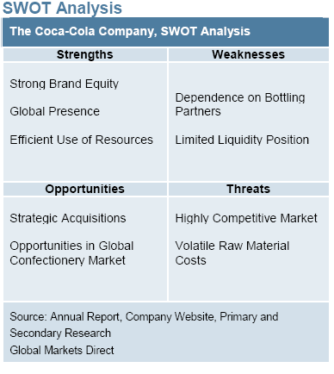

Slide 21
Strengths
Strong Brand Equity
Coca-Cola has a strong global brand equity/image
Wide range of non-alcoholic products
Uses advantage to attract new customers and retain loyal existing customers
Global Presence
Diversifies all over the world
Goal to accommodate various customer bases
Efficient Use of Resources
Coca-Cola’s efficiency utilizing the shareholders' money
Generating higher returns for its shareholders
Expanding Operating Margin
Indication of management is paying attention to improve profitability

Slide 22
Weaknesses
Dependence on Bottling Partners
Coca-Cola generates a large portion of its revenue from selling to its bottling companies
Bottling companies have has no legal affiliation or enterprise share with the company
Could pose a threat to Coca-Cola in the future
Limited Liquidity Position
Liabilities succeeded assets in 2008 causing a rate of debt
Unfavorable numbers could discourage investors and shareholders
A state of debt makes it more difficult to increase market funds

Slide 23
Opportunities
Strategic Acquisitions
Acquisitions are a positive boost and can create opportunity, particularly for invading new market and or the start up of new products or services
Coca-Cola has been keeping a strong eye on the growth of organic and inorganic growth of materials
Opportunities in Global Confectionery Market
Coca-Cola ‘s influence its powerful brand identity to increase positives
Makes it possible to capitalize on its powerful product portfolio
Growing Organic Food Market
The organic food industry is one of the most rapid growing food retail
Coca-Cola sees an opportunity to advance and grow as the demand for organic food forecasted to rise

Slide 24
Threats
Highly Competitive Market
Highly competitive levels for the sales and distribution of the non-alcoholic beverage industry
Poses a threat to The Coca-Cola Company
Volatile Raw Material Costs
Instability of the costs of raw materials could pose a key threat on the operational performance
Price fluctuations or shifts and non availability of raw materials
Changing Customer’s Tastes and Preferences
Time progresses, the change of customer's taste and preference is mostly inevitable
People are more conscious and apprehensive about public health consequences linked with obesity
Governmental Regulations
Various regulations by federal government agencies
Required to abide to certain health and safety regulations
Expose the company to new liabilities or may obstruct its existing operations

Slide 25
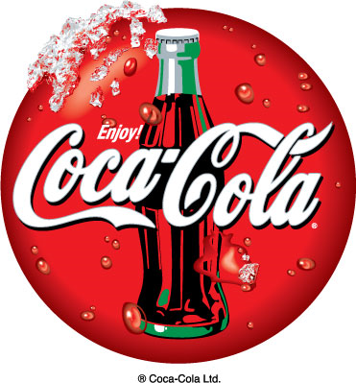
Competitive Factors
Competition in high the non-alcoholic beverage market
Main competitors
PepsiCo
Dr Pepper Snapple Group
PepsiCo and Coca-Cola have been competing for nearly a century
Dr Pepper, although a competitor, signed agreements with Coca-Cola
Coca-Cola occupies in a “red ocean” market space

Slide 26
Social Factors
A large part of the environmental scan is social factors which include factors such as education, family values, work and business attitudes.
The trademark LIVE POSITIVELY is a commitment to create a positive difference in the world.
There are seven core areas that are essential to their sustainability and the company considers it a part of everything they do.
Beverage Benefits
Active Healthy Living
Energy Management and Climate Protection
Community
Sustainable Packaging
Water Stewardship
Workplace

Slide 27
Beverage Benefits
The company wants to aspire to quench every thirst, make products consumers can trust in, and have a product for every situation based on individual needs.
Coca-Cola is devoted to the safety, quality, and consistency of their products and ingredients in every aspect.
At each stage of the manufacturing process there are a set of standards which are ingredient purchasing, concentrate and beverage production, and packaging and transportation.
The Coca-Cola Management System (TCCMS) sets the standards for the management of product safety and quality, environmental performance, and occupational health and safety throughout the system.

Slide 28
Active Healthy Living
The Coca-Cola Company encouraged active lifestyles by setting a goal of having at least one physical activity program in every country that they operate in by 2015.
The Coca-Cola Company feels a sense of responsibility to ensure that their consumers are educated about the products.
By the end of 2011 the company will have front-of-packaging (FOP) information per serving as well as Daily Guidance Indicators (DIGs), where allowed, on nearly all of their packaging.
The Coca-Cola Company adopted a global Advertising and Marketing to Children Policy which led the beverage industry.
The Coca-Cola Company adopted a global Advertising and Marketing to Children Policy which led the beverage industry.
A guiding principle Coca-Cola that has been implemented for over 50 years is to not market or advertise to children under the age of 12 or when the guardian is not present.

Slide 29
Energy Management and Climate Protection
By improving energy efficiency it helps Coca-Cola reduce costs and minimize environmental impact.
To achieve energy management and climate protection global targets they instituted an energy management system.
The energy management system monitors usage and areas of improvement for the global targets.
Global targets for the energy management and climate protection were established in 2008 with the World Wildlife Fund that will last all the way through 2015.
The only time the footprint of sparkling beverages has been certified by The Carbon Trust is from the top sellers of Coca-Cola one of which is Coca-Cola Zero.

Slide 30
Energy Management and Climate Protection (cont.)
In bottling and manufacturing operations The Coca-Cola Company is creating ways of improving areas of transportation and vending equipment.
In the company’s office buildings they are making improvements like repairs of leaks, insulation, and energy efficient lighting.
The Coca-Cola Company was the first company in North America to have the largest heavy-duty hybrid electric delivery fleet.

Slide 31
Community
The Coca-Cola Company has a strategy to grow along with new markets by being the first to enter and provide resources such as jobs and economic opportunities.
This helps the company to use local ingredients, sell and distribute locally, and employ locally.
The company has locations in over 200 countries with many small independent retailers acting as a backbone for the whole company.
In small communities local entrepreneurs run the distribution processes also known as Manual Distribution Centers to create local jobs and ensure products can reach everyone.
The Coca-Cola foundation works with bottling partners, governments, and local communities to assess what projects need to be done in order to improve their specific community needs.

Slide 32
Community (cont.)
Every year one percent of The Coca-Cola Company’s income is given back to help develop and sustain communities throughout the world. Since the company’s earliest days this has been an ongoing commitment for the company. At the end of 2008 the total charitable donations by The Coca-Cola Company was 82 million dollars.

Slide 33
Community (cont.)
Coca-Cola is one of the top purchasers of coffee, tea, citrus, and sugar in the whole world.
The Coca-Cola Company is an active member of the Sustainable Agriculture Initiative as well as the Better Sugarcane Initiative.
The Sustainable Agriculture Initiative is a group that engages stakeholders along the agricultural supply chain to share knowledge and support the development and implementation of internationally accepted criteria for sustainable agriculture.
The Better Sugarcane Initiative is a multi-stakeholder effort to reduce the impacts of sugarcane production.

Slide 34
Sustainable Packaging
By effectively protecting products during delivery customer needs are met and waste is prevented by proper packaging.
The company focuses on eliminating water losses, energy, and raw materials throughout the whole packaging process in order to extend further than just the packaging materials itself.
The Coca-Cola Company packaging goals focus on four priority areas for waste prevention which are:
Optimizing packaging efficiency
Increasing renewable resource use
Recovering packages for reuse
Increasing recycling material use

Slide 35
Sustainable Packaging (cont.)
Recently The Coca-Cola Company became committed to three packaging targets which are:
Improve packaging material efficiency per liter of product sold by seven percent by 2015
Recover 50 percent of the equivalent bottles and cans used by 2015
Source 25 percent of their PET plastic from recycled material by 2015
The trademark plantbottle is a new redesigned PET plastic bottle which is completely recyclable.

Slide 36
Sustainable Packaging (cont.)
To ensure the increasing percent of recovered containers The Coca-Cola Company focuses on four core packaging recovery models:
Comprehensive product stewardship programs in developed markets
Recycling cooperative programs in developing and emerging markets
Voluntary deposits on refillable packages in least-developed markets
Coca-Cola-operated recycling enterprises globally

Slide 37
Water Stewardship
Water is the primary ingredient in The Coca-Cola Company’s products which makes it vital to their business as well as to every community.
To help communities The Coca-Cola Company returns to nature and communities the total of water equivalent to what they take out and use for their production and products.
There are three areas in which The Coca-Cola Company practices water stewardship:
Reduce their water use ratio (efficiency) while growing their unit case volume
Recycle the water used in their operations (wastewater treatment)
Replenish the water use through community water access and watershed restoration and protection

Slide 38
Water Stewardship (cont.)
The Coca-Cola Company helps balance the water they use by partaking in local water replenishment projects that support nature and the community.
These projects cover more than 60 countries to help with water protection, conservation and providing access to clean water.
For example, The Coca-Cola Company established the Replenish Africa Incentive which is a commitment to providing access to safe drinking water to communities all through Africa.

Slide 39
Workplace
The Coca-Cola Company believes employee satisfaction is very important and that employees who are motivated and appreciated generate better-quality results.
The Coca-Cola Company strives to implement an inclusive work environment free of discrimination and harassment where every employee is treated fairly with dignity and respect.
The Coca-Cola Company is continuously improving health and safety standards by improving reporting and data precision, increase safety training, and strengthen focus on fleet safety.

Slide 40
Workplace (cont.)
The Coca-Cola Company has Supplier Guiding Principles that express their values and expectations for bottling and business partners.
Their suppliers are expected to conduct business ethically and incompliance with laws and regulations.
The Supplier Guiding Principles are incorporated in supplier agreements along with a pre-certification system for trademark marketing suppliers.
Included in the Supplier Guiding Principles are routine supplier audits and if a supplier is not upholding their part they will be given time to correct it or they risk contract termination.

Slide 41
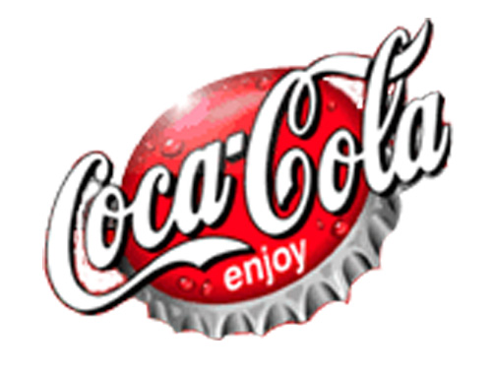
The End

