Slide 1
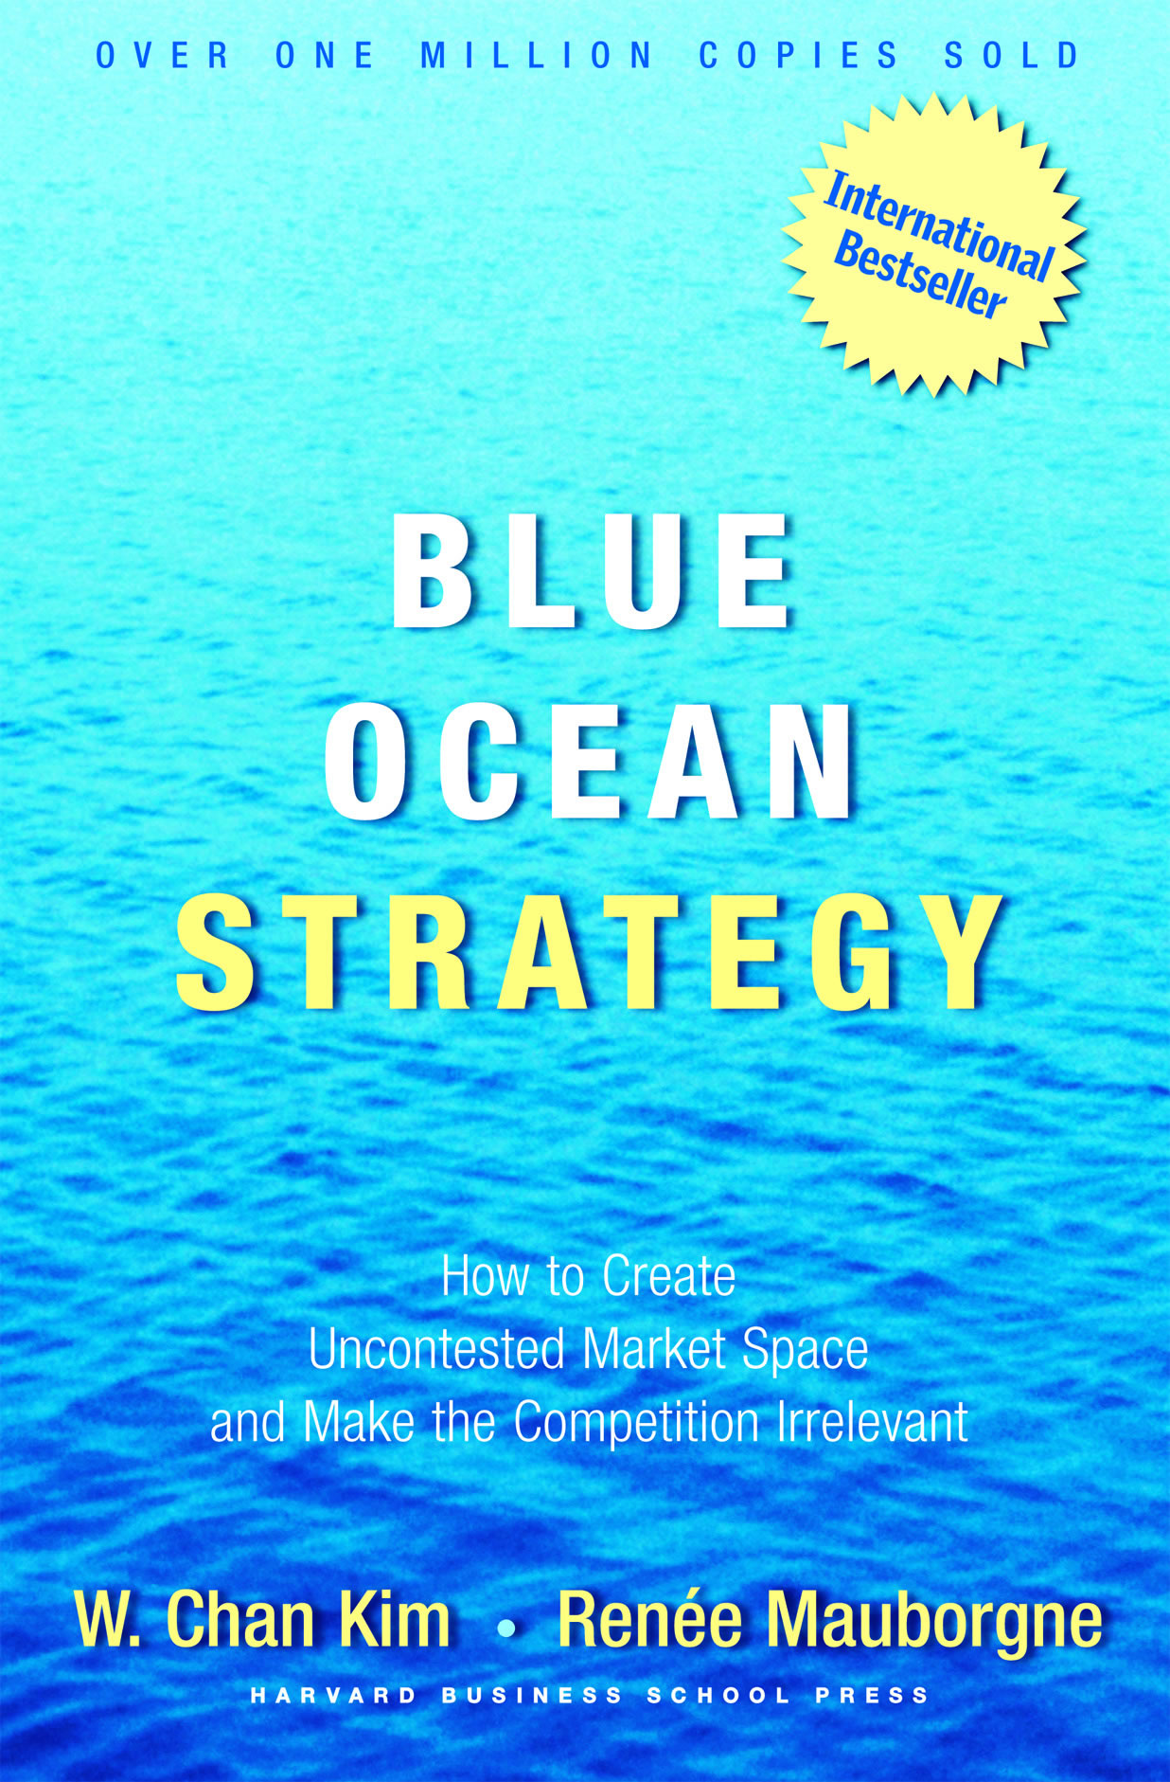

Slide 2
Six Paths Framework
Define their industry with similarities and focus on being the best within it
Look at their industries through the lens of generally accepted strategic groups (Ex. Luxury automobiles, economy cars, family vehicles) and strive to stand out in the strategic group they play in

Slide 3
Six Paths Cont.
Focus on the same buyer group, be it the purchaser, the user, or the influencer
Define the scope of the products and services offered by their industry similarly
Accept their industry’s functional or emotional orientation
Focus on the same point in time and often on current competitive threats in formulating strategy
Notes:
To break out of red oceans, companies must break out of the accepted boundaries that define how they compete
Systematic boundaries – alternative industries, strategic groups, buyer groups, complementary products, service offerings, functional-emotional orientation of an industry, and time

Slide 4
Path 1:
Look Across Alternative Industries
Substitutes vs. Alternatives
Why choose NetJets?
Dramatically cuts total travel time
Reduce the hassle of congested airports
Allow for point to point travel
Benefit from more productive and energized executives who can hit the ground running upon arrival
Notes:
Founded in 1964 by a group of men including two Air force Captains, a lawyer and private jet pilot. Splits a private jets ownership into 16 separate companies paying 375,000 dollars and additional air time flight fees for ownership on a 6 million + dollar jet. The purchaser is entitled to 50-400 flight hours depending on how many shares. It’s a multi-billion dollar business that has been attributed to its flexibility, shortened travel time, hassle free travel experience, increased reliability, and strategic pricing. Competition? In the past 7 years fifty seven fractional jet operations have been set up and of those…57 have gone out of business.

Slide 5
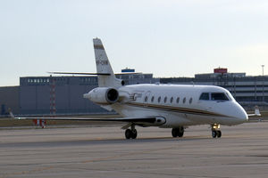
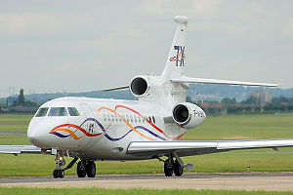
Cessna Citation XLS, Gulfstream G200, Dassault Falcon 7X, Boeing Business 737
Notes:
Some examples of small jets all the way up to the big bertha of Private class jets the Boeing 737

Slide 6
The Strategy Canvas of NetJets
Notes:
Other examples of business using alternative paths are: NTT DoComo created the I-mode (Half phone half PC), Home Depot offering expertise of professional home contractors, Southwest Airlines comparing flight time to car travel, and Intuit comparing the pencil to a fun and intuitive Quicken Software.

Slide 7
Path 2: Look Across Strategic Groups Within Industries
Strategic Groups – Refers to a group of companies within an industry that pursue a similar strategy
Built on two dimensions – Price and Performance
Curves – Texas-based women’s fitness company
Focused on two decisive advantages in the U.S.- Traditional Health Clubs and Home Exercise Programs
Specialized Machines
Strategic Placement
Low Variable and Maintenance Costs
Notes:
Curves is set to be opening a new store every 4 hours equating to 6 new stores a day.

Slide 8
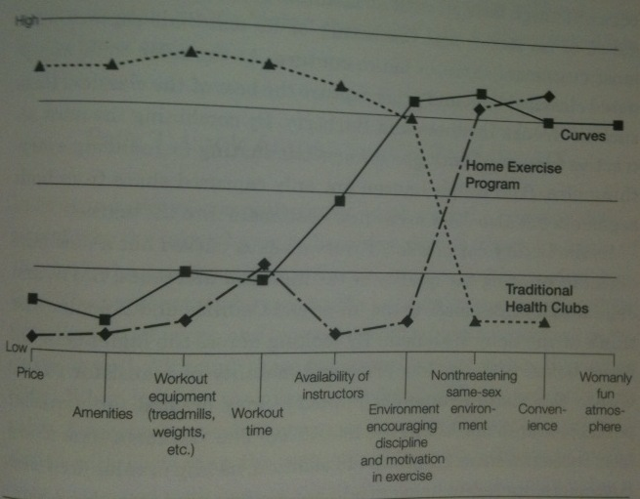
The Strategy Canvas of Curves
Notes:
Other Examples that have created blue oceans by looking across strategic groups : Ralph Lauren created “High fashion with no fashion” Brooks Brothers, Burberry and Polo Ralph Lauren. Toyota’s Lexus offering quality of the high end car lines closer to the price of Cadillac and Lincolns. The Sony Walkman having the fidelity of a boom box with the low price and mobility of transistor radios within audio equipment industry. Michigan based Champion Enterprises combining the low cost of pre fabricated housing with high end touches like fire places, skylights and vaulted ceilings.

Slide 9
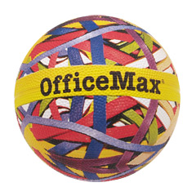
Path 3: Look Across the Chain of Buyers
Difference Between Purchasers, Users, and Influencers
Purchasers – Who pays for the product
Users – All of you who probably aren't paying attention or anybody who uses said product
Influencers – The group or person that has an adverse affect on the purchasing decision.
Notes:
Certain norms in a red ocean have led to practices that although might be rational in some cases, do not differentiate from the competition enough to be considered a blue ocean strategy. For instance, the office equipment industry relies on purchasers as their primary focus such as corporate purchasing departments. Clothing stores sell predominately to users, and Pharmaceutical industry has for years focused overridingly on influencers, doctors who prescribe their product. Too often we see firms that continue with the same practices and fail to question the alternatives. Challenging an industry's conventional wisdom about which buyer group to target can lead to the discovery of a new blue ocean.

Slide 10
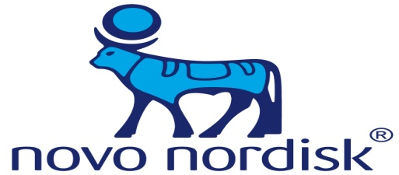
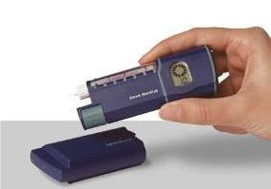
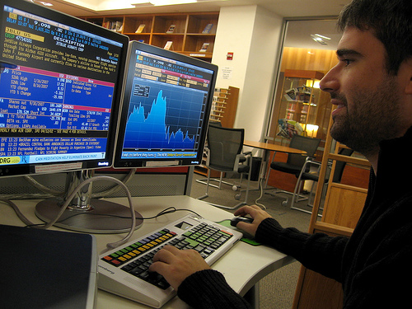
Company’s Who Questioned the Standards
- Insulin producer that created a blue ocean in the insulin industry.
- Business information provider
Innovo
Bloomberg Terminal
Notes:
Novo Nordisk – Historically, the insulin industry focused primarily on influencers – doctors. However, Novo Nordisk changed its focus to the primary user of the product, rather than the entity prescribing the product in the early 1980s. At the time, NOVO created an exact chemical copy of human insulin followed by the NovoPen and later the Innovo, which was a patented delivery system of insulin into the human body, without need of syringes or needles. By doing this, Novo was able to shift focus from the influencers to the users thus creating an untapped blue ocean of user friendly diabetes care equipment and medicine. Novo has continued to thrive in this industry by setting the standard for diabetes care, and continues to innovate diabetes technology and does so with the user in mind.
Bloomberg – Industry focus before bloomberg was intended to gain attention from purchasers, the IT managers who valued standardized systems, which made their lives easier. However, Bloomberg saw a blue ocean waiting to be tapped realizing that traders and analysts could utilize their information at a far higher rate than IT managers. They created an ease of use system for those who needed information at the click of a button without having to do calculations at the drop of a hat in order to know whether to buy, sell, or trade. As well as adding a personal touch to the information terminals by adding links to nearby services such as jewelry, flower shops, travel arrangements etc.

Slide 11
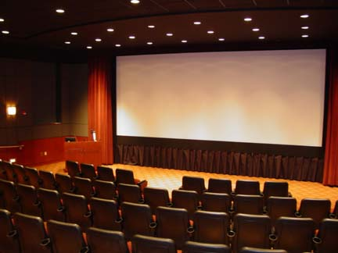
Path 4: Look Across Complementary Product and Service Offerings
Thinking outside of the defined boundaries to define a total solution which buyers seek
Notes:
Thinking outside the box leads to possible discovery of new blue oceans. The book notes the perceived value of going to the movie theaters for adults with young children is lessened by the fact that a babysitter must be found, yet no movie theater has come out with an in house babysitting service due to the nature of the business and the historically defined boundaries within the theater industry. Cinema operators should consider such details considering the adverse affect it has for demand for their business.

Slide 12
Path 4: Look Across Complementary Product and Service Offerings
Thinking outside of the defined boundaries.
- North American Bus Industries
Notes:
NABI, is a Hungarian bus company which saw the downfalls of the municipally run bus system and its misguided focus of cost management and the need for cost efficiency. The only problem was that the industry norm was focused on overhead costs, as opposed to ongoing variable costs such as maintenance, repairs, fuel usage, wear and tear on parts, and so on. NABI realized that the transit bus industry did not have to be a commodity price driven industry but that bus companies, focusing on selling buses at the lowest possible price had made it that way.

Slide 13
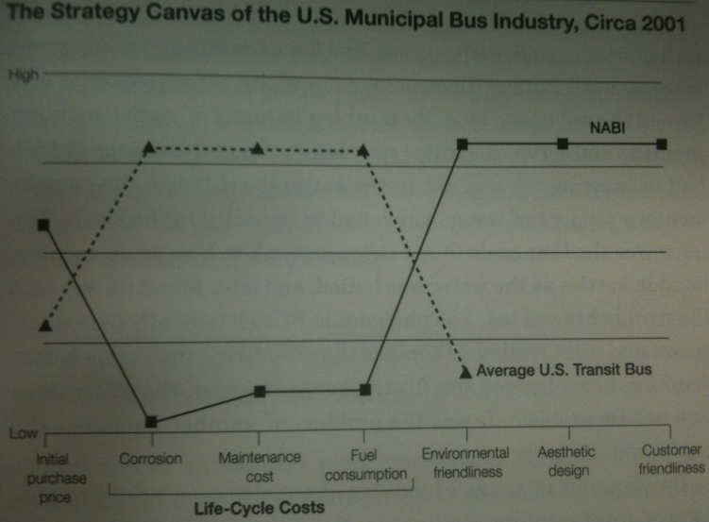
Total Solution of Complementary Activities
Notes:
By looking at a total solution of complementary activities, NABI created a bus unlike any the industry had seen before that encompassed all of the needs of the consumer, as well as the municipal needs for cost reduction. Fiberglass was used instead of steel, reducing costs of preventative maintenance, which made body repairs cheaper, as well as cut fuel consumption substantially.
Because NABI saw an opportunity to create a blue ocean out of the old red ocean model making the competition irrelevant it was able to capture 20% of the U.S market since its inception in 1993. The buses NABI built cut costs for citizens as well as municipalities, creating a win: win situation which is a trait of all blue ocean firms.

Slide 14
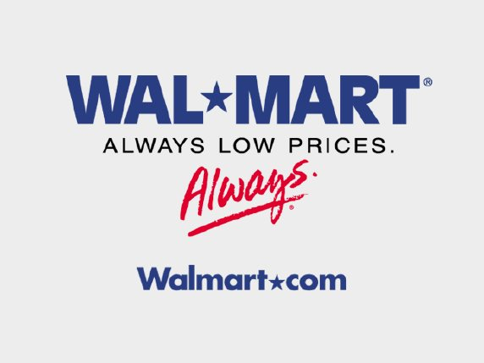
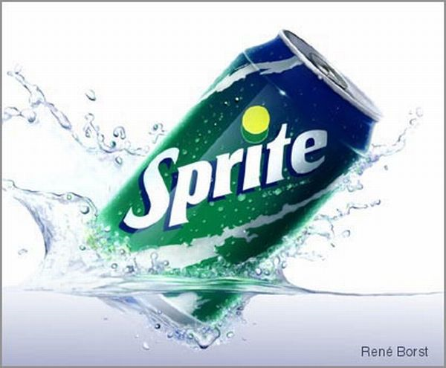
Path 5: Looking Across Functional or Emotional Appeals to Buyers
Notes:
Some industries compete principally on price and function largely on calculations of utility; Their appeal is rational.
Wal-Mart's inventory system allows them to cut costs due to up to date tracking of virtually every unit of inventory on hand to sold
They hold price bidding auctions with to competitors
Other industries compete on feelings and their appeal is emotional.
Use brand positioning to communicate a cool image to customers. Sprite sells the image along with the product almost as if consumers want to be in the commercial itself.

Slide 15
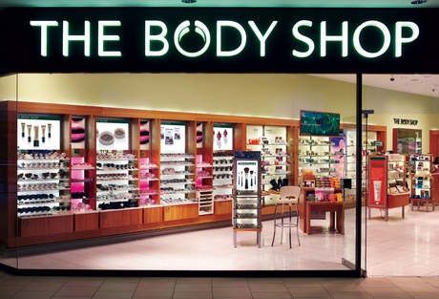
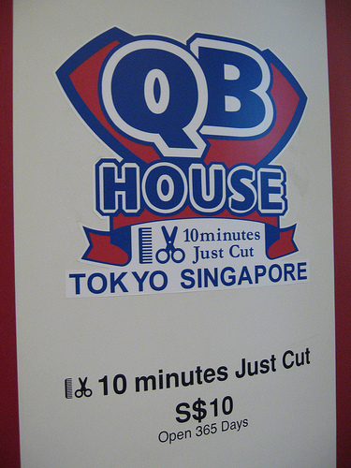
Infusing Functional and Emotional Appeals
Challenging the functional and emotional orientation of an industry creates new market space .
Example:
Swatch Transformed the functionally driven budget watch industry into an emotionally driven fashion statement and the body shop which did vice versa transforming the emotionally driven industry of cosmetics into a functional, no-nonsense cosmetics house.
Notes:
Swatch Transformed the functionally driven budget watch industry into an emotionally driven fashion statement and the body shop which did vice versa transforming the emotionally driven industry of cosmetics into a functional, no nonsense cosmetics house.

Slide 16
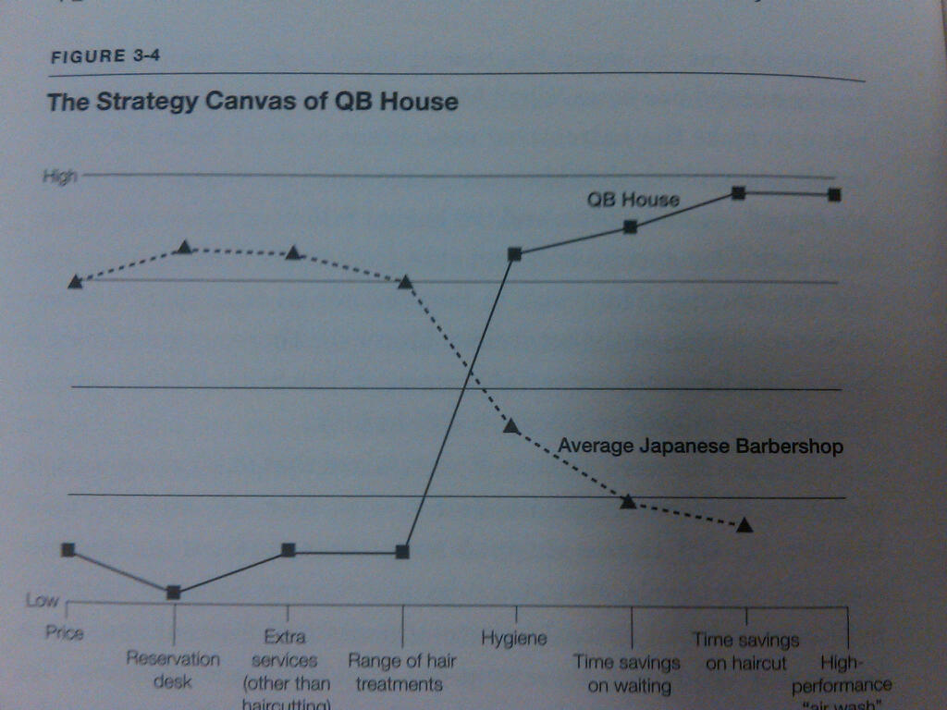
Quick Beauty House
significantly reduced the price from about $30 to around $9 while raising the hourly revenue per barber by about 50%.
Implanted a traffic light system which eliminates the need for a receptionist and allows customers to know when there is an available barber.
Notes:
In japan the haircutting process can take up to one hour due to the reutilization of the haircutting process. Hot towels are applied shaves are given and customers drink coffee or tea during the process. This creates a unique salon experience that evokes emotions but creates long waiting lines for potential customers and For the fast paced Professional this can be cumbersome. That’s why Quick Beauty created the 10 min “just cut” approach which ties in the good feelings of a new haircut with the time it takes to get you out the door and on your way.
they Stripped away the time consuming wash and dry system and implemented an air wash action, where an over head hose sucks up all remaining hair from the scalp. They also implemented a traffic light system which eliminates the need for a receptionist and allows customers to know when there is an available barber open. This significantly reduced the price from about $30 to around $9 while raising the hourly revenue per barber by about 50% with lower staff costs and less required retail space per barber

Slide 17
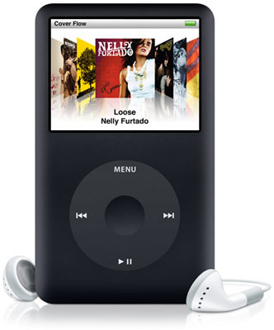
Path Six: Look Across Time
Principles to assessing trends over time
Decisive to your business
Must be irreversible
Must have a clear trajectory
Notes:
Many trends can be observed at any one time: for example a discontinuity in technology, the rise of a new lifestyle and or a change in regulatory or social environments.
Apple observed the flood of illegal music file sharing that began in the late 90s. This trend was underscored by the fast growing demand for MP3 players that played mobile digital music such as the smash hit iPod. They capitalized on this trend and launched iTunes which offered legal, easy to use and flexible song downloads. This allowed for customers to purchase one song from a catalog rather than having to buy the whole CD.
ITunes exceeded the free download services such as Kazaa, Lime Wire, and Napster by offering sound quality, easy navigation, and search and browse functions.

Slide 18
Utilizing Trends
Notes:
CNN created the first real time 24 hour news network based on the rising tide of globalization. Now you can get on demand up to date news from just about anywhere with a cable hook up.
Cisco systems created a similar market space by thinking across time trends. They noticed that there was a high demand for high-speed data exchange. They noticed that the world was burdened with slow data rates and incompatible computer networks. Today more than about 80% of all traffic goes through Cisco’s products.
HBO and showtime’s hit tv shows act on trends such as entourage, true blood, and sex and the city
Facebook has acted on an ever changing social trend via the internet. Rather than using your phone to contact friends, people are blogging on the internet while creating a vast network of interconnected contacts.

