Slide 1
Functional Strategies
Milos Kustudija
Matt zaney
Dustin pace

Slide 2
Strategic Management in Action: Functional
Situation Analysis
Strategy Formulation
Strategy Implementation
Strategy Evaluation
Functional

Slide 3
Strategic Management in Action: Process
Functional strategies are developed taking into account the organization’s overall vision, mission(s), and corporate and competitive strategies.
Specific functional strategies should support:
Business-level strategies
Corporate-level strategies

Slide 4
What Happens After the SWOT Analysis?
Availability of information about positive/negative aspects of both the external and internal environment.
Strategic issues are clear
Decision makers know how to address sustainable competitive advantage and high level of performance.

Slide 5
Organization Needs the Functional Strategies
Organization’s functional strategies are defined as goal-directed plans and actions of the organization's functional areas.
Organization’s main functional concerns:
Product
People
Support process

Slide 6
The Three Functional Concerns of Organizations
Fig 5.2
Inputs
Organizational Capabilities Used to Transform
Outputs
Resources
Three Functional Concerns
Goods
Services
Customers
Clients
Product Strategies
Design
Production – Operations
Marketing
People Strategies
HR
Support Process Strategies
Information Systems (IS)
Financial – Accounting Systems

Slide 7
Functional Strategies- The Product
Three main tasks associated with the product:
Design
Usually part of the organization’s R&D functional area
Production-operation
Process of creating and providing goods and services
Marketing
Directed at effectively and efficiently managing the two C’s (customers and competitors)

Slide 8
Functional Strategies – The People
HR strategies, like high performance work practices, contribute in getting competitive advantage.
HR strategies must closely align with other strategies in order to assure that:
Right number of skilled people are in the right place.
Right time and the org’s workforce being used effectively and efficiently.
Strategic choices in the HR area involve getting people into the organization, making sure they have a knowledge, and motivating high levels of effort.

Slide 9
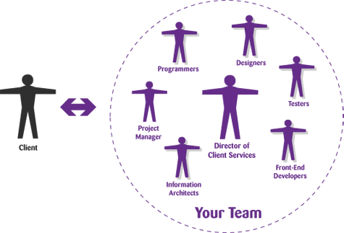
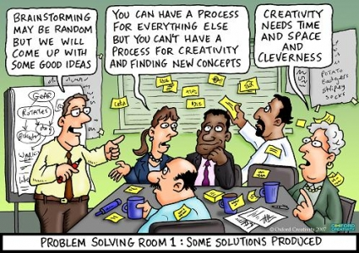
Examples of High – Performance Work Practices
Information Sharing
Self Directed Work Teams
Contingent Pay
Employee Suggestions Implemented
Attitude Surveys
Job Rotation
Total Quality Mgmt Programs
Problem Solving Groups

Slide 10
Functional Strategies – The Support Process
Two main organization’s support processes are:
information systems
financial-accounting systems.
Information system is a system for collecting, processing, storing, and disseminating any and all the information that managers need to operate a business.
Financial-accounting systems provides strategic decision makers with critical information for planning the organization’s future financial strategies
Strategic decisions here involve
Evaluating Financial Performance
Financial Forecasting/Budgeting
Optimum Financing Mix

Slide 11
Implementing the Various Functional Strategies
Implementation is done through the various work processes and activities unique to each functional area.
Implementing these strategies very simply means doing them.
Wisely coordination of functional strategies is key to managing strategically.

Slide 12
Evaluating Strategies and Making Changes
Strategy evaluation at the functional level involves:
using specific performance measures, quantitative and qualitative, for each functional area.
Performance must be compared with strategic goals established in each functional area.
Strategy evaluation involves looking at what was done, what was supposed to be done, assessing any variances, and trying to determine what happened.

Slide 13
Coordinating with Other Organizational Strategies
Functional strategies play an important role in:
Executing vision, missions, and goals.
Functional strategies must be coordinated with each other but also with the other organizational strategies.
Strategic coordination and interdependency reflects the fact that an organization is a system with interrelated and interdependent parts.

