Slide 1
Industry Analysis
Group 3
Mayra Garcia
Garrett Matthews
Nick Watkins
Lindsey Pacatte
Cory Logan
David Hayward
Gary Taylor

Slide 2
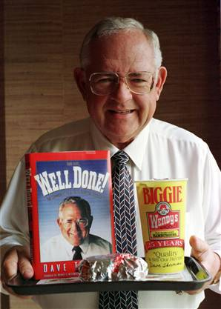
Wendy’s Organization
Wendy’s founded by Dave Thomas
Went to work for Hobby House
Turned the three restaurants
around became a millionaire

Slide 3
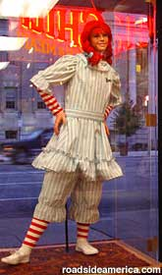
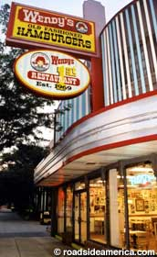
First Wendy’s
First Wendy’s November 15, 1969 Columbus Ohio
Offered a homey place and fast food
Made to order hamburgers

Slide 4
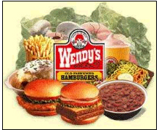
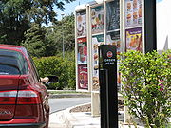
Dave’s Innovation
1st to offer never frozen and fresh beef
1st to offer salad bar and baked potato
Creation of modern day pick-up window

Slide 5
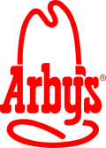
Wendy’s/Arby’s Merge
April 2008 Wendy’s and Arby’s parent companies Merge
Create 3rd largest fast-food restaurant chain in the United States with 12.5 B sales, 10,000 units
Today Wendy’s has more than 6,600 restaurants in the US and other markets

Slide 6
Industry Overview
8 million restaurants in the world and some 300,000 restaurant companies
Divided into full service and fast food
The fast food industry is exceedingly fragmented
The top 50 companies hold about 25 percent of industry sales.

Slide 7
Industry Overview
Wendy’s is a QSR
Competitors that we compared to Wendy’s are McDonalds, Jack-in-the-Box, and Sonic
Taken as a whole, restaurant sales have been increasing just over 5% annually.

Slide 8
Annual Sales
The full-service restaurant segment of the food industry is anticipated to generate $173 billion in sales
Fast food and quick service restaurant industry includes about 200,000 restaurants with combined annual revenue of $120 billion.

Slide 9
Diversifying Workforce
Made up of 12.2 million employees and is highly labor intensive.
Restaurant industry workers make up 9 percent of the nation’s workforce.
By 2015, the restaurant industry is predicted to add another 1.8 million positions.

Slide 10
Diversifying Workforce
Increasing number of foreign-born workers in the United States
According to the U.S. Census Bureau there are 33.5 million foreign-born individuals in the United States who make up 11.7 percent of the total population.
Presence of foreign-born workers in the restaurant workforce is anticipated to swell in the coming years.
The supply of workers age 16 to 24 has been declining

Slide 11
Porter’s Five Forces Model
Rivalry Among Existing Firms
Threats of New Entrants
Threat of Substitutes
Bargaining Power of the Customer
Bargaining Power of Suppliers

Slide 12
Rivalry among Existing Firms
Help measure the level of profitability
QSR has intense competition for growth in the market
Customers face low switching costs
QSR is labor intensive with low knowledge required
Low level of growth increases the rivalry

Slide 13
Rivals Continued
QSR does not face many exit barriers
The industry is risky to enter
All firms offer same basic items
Differentiate through design, variety, quality, and speed

Slide 14
Threat of New Entrants
Economies of Scale
Capital Investment Requirements
Access to Distribution Channels
Reaction of Other Industry Players

Slide 15
Threats of New Entrants
Economies of Scale
In mass production, as production efficiency increases; cost decreases
Total assets: cash, inventories, property and equipment, and trademarks

Slide 16
Threats of New Entrants
TOTAL ASSET |  | Data (in millions) obtained from companies 10k
 | 2003 | 2004 | 2005 | 2006 | 2007
Wendy's | $1,333 | $3,198 | $6,440 | $2,060 | $1,455
McDonalds | $25,838 | $27,838 | $29,989 | $29,024 | $29,392
Jack in the Box | $1,142 | $1,325 | $1,338 | $1,520 | $1,375
Sonic | $486 | $518 | $563 | $638 | $759
AVERAGE | $7,200 | $8,220 | $9,583 | $8,311 | $8,245

Slide 17
Threat of New Entrants
Capital Investment Requirement/Legal Barriers
Stay up with location of units, quality and speed of service, attractiveness of facilities, effectiveness of marketing and new product development
High overhead cost: rent, labor, rates and bank interest charge
Franchise ($250,000 to $1M)
High start-up and ongoing capital requirements
State/Federal regulation
Federal Trade Commission
Americans Disabilities Act
Trademarks and patents
Brand awareness

Slide 18
Threats of New Entrants
Access of Distribution Channels
Acquiring subsidiaries
Wendy’s Bakery Co.
Established relationships with suppliers

Slide 19
Threats of New Entrants
Reaction of other industry players
Starbuck coffee vs. McDonalds premium coffee
Dollar Menu
Who was the first to use the dollar menu?
Healthy fast food
Baked potatoes
salads
Yogurt
Bananas

Slide 20
Threat of Substitutes and the Quick Service Restaurant Industry
The threat of substitutes in the industry is very high
Many store locations and companies
A choice in the type of quick-service restaurant
One industry competitor of the QSR is the Full-Service Restaurant Industry
Offers higher levels of service at higher prices
More focus on food quality

Slide 21
Threat of Substitutes based on Environmental factors
The general state of the economy
When consumers have more disposable income they will often choose higher quality food
Societal views and perceptions
Consumers are becoming more health conscious; this leads them to avoid many firms within the QSR industry

Slide 22
Substitutes based on Environmental Factors continued…
The age of the consumer
Older customers prefer higher service and food quality
Mood of the customer
Families or couples who desire to eat and relax will see firms in the FSR industry as the obvious choice

Slide 23
Bargaining Power of Suppliers
“Definition”
Their ability to set their prices for their customers
Truly competitive market
Best Deals = Long working relationships

Slide 24
Bargaining Power of Suppliers
“Factors”
Differentiation of Inputs
Switching Cost
Substitute of Products
Importance of Volume to the Supplier
Cost Relative to the Total Purchase of Industry

Slide 25
Bargaining Power of Suppliers
Bargaining Power is Highest When:
Sellers product has few substitutes and is important to buyer
When differentiation makes it costly to switch suppliers
When suppliers can vertically integrate and compete with buyer
When buyers can’t vertically integrate backward and supply their own needs

Slide 26
Bargaining power of Customers
The QSR products are undifferentiated
Companies must compete on price to attract customers
This gives the customers a high amount of bargaining power
Customers determine what products are offered
Customers determine what the price the products

Slide 27
Economic factors in the environment
Even though the economy is in a downturn
QSR companies sell a product that is ideal for the current economic environment
QSR companies are still posting growths in sales and revenues
QSR companies are still expanding their operations

Slide 28
Economic factors in the environment
Economic factor implications for the QSR
The current recession gives QSR companies the ability to weather the storm
Could use the opportunity to take market share away from full-service restaurants
Low borrowing costs can allow them to expand into new markets

Slide 29
Competitive factors in the environment
The firms in the QSR compete on
Low price so they must continuously strive to cut costs
Competing on price forces QSR companies to take small margins on products
Successful competition depends selling a large volume of products

Slide 30
Competitive factors in the environment
The competitive implications for the QSR
To survive in the QSR a company must have a large number of restaurants
Only a few companies are able to compete on a global scale
However regional and hometown offerings can compete on a small scale
To compete with the smaller firms QSR companies must improve customer service

Slide 31
Technological
Technology within the QSR has helped firms gain market share from other suppliers
Point of Sale (POS)
Order taking
Speed of service
Computer capabilities

Slide 32
LEAN Act
The Labeling Education and Nutrition Act (LEAN Act) legislation is the first of its kind affecting prepared foods which would require chains with more than 20 units to post calorie counts for all menu items
Requires packaged foods to include nutrition information.

Slide 33
Geographical Features
Wendy’s alone has over 6,600 stores in 20 countries
Though Wendy’s has merged with Triarc, both entities have decided to continue running independently of one another

Slide 34
Geographical Features continued…
In the four highest populated states, Wendy’s operates over 1,400 stores
The majority of Wendy’s locations are in the Central and Eastern regions of the United States

Slide 35
Social Factors influencing the Industry
Disposable Income
Teens in the US have large amounts of disposable income
The United States’ middle class
Working adults spend 1/3 of the day working, QSR firms rely on these individuals picking up food on their commute home
Religious and Cultural challenges
McDonalds and the non-beef patty in India
Social Hierarchies aren’t present in parent country

Slide 36
Current Ratio
Ability to pay back short-term debts with current assets
Industry as a whole seems normal
Inventories can be converted to cash quickly

Slide 37
Gross profit margin
Measures the ability to generate earnings compared to expenses
Ratio gives proportion of money left over for revenue after cost of goods sold

Slide 38
Net Profit margin
Tells the company if it is effective at controlling costs
Net Profit Margin is the return on sales

Slide 39
Return on assets
Return on investment from stockholders and creditors
Helps company see how efficient the company is at generating revenues compared to use of assets

Slide 40
Return on equity
Rate of return on stockholders’ investment in the company
How much profit the company is generating with the stockholders’ money

Slide 41
Debt-to-Asset Ratio
Measures company’s ability to pay debt
Measures solvency
Little volatility within companies; but all are satisfying debt requirements

