Slide 1
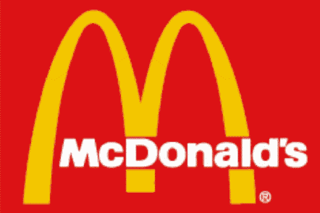
Industry Analysis Chris Athens, Ben Baker, Josh Carver, Chris Bolinger, Jordan Guenther, Justin Turner, Jeff Ward

Slide 2
Background & Purpose
Founded by 2 brothers
Franchising “McDonald’s
Phoenix, Arizona
Neil Fox- National Perspective
Ray Croc- Agent for growth
120 Countries, 31,000 Restaurants
Growing Franchises- 60% of Sales

Slide 3
Problems, Challenges, Issues
Growing Revenues
Dropping Profit Margins
GRAPH

Slide 5
Issues In Customer Service
100 point scale
Increasing Rating, but still behind average
11 points below avg.
2008- Rated 69 out of 100
High Turnover Rates

Slide 6
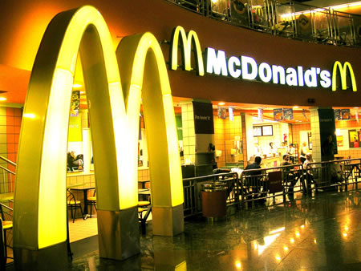
Contrasting Viewpoints
Expansion, Growth
-While maintaining innovation
Plans- Increase sales and income

Slide 7
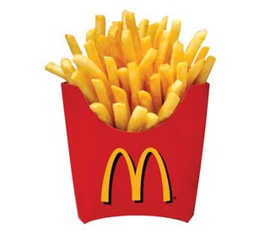
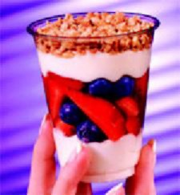
Health Issues
Shift in Demand
High Calories to Healthier Foods
Example: Salads, Sandwich’s, Fruit & Yogurt

Slide 8
Competitors
Wendy’s- 10,000 Restaurants System Wide
-Frosty’s, Spicy Chicken, Baked Potato
Jack in the Box
-Adult Consumer, Chicken Bowls, Pitas
Hardee’s
-Quality, Higher Price, Breakfast Menu
Sonic
-3,500 Drive-ins in 2008, Accessible Atmosphere

Slide 9
Economy Hurts the Industry
“The root cause of the recession is the $4 trillion decline in the value of US homes, which may well total $8 trilion before prices hit bottom. Econometric evidence suggests that for every $1 decline in housing prices, homeowners cut back spending by about 6 cents. Using this formula, a $6 trillion drop in prices translates into a $360 billion annual decline in consumption-just under 3% points of GDP.” (Schmitt)
Notes:
Using simple math, this shows that a $10,000 drop in the value of a home equates to $600 drop in consumer spending.

Slide 10
Economy Hurts the Industry

Slide 11
Economy Hurts the Industry

Slide 12
Economy Hurts the Industry

Slide 13
Economy Hurts the Industry
Finished consumer prices rose 8.3%
Menu prices rise 6%
2.3% absorbed by the industry

Slide 14
Market Size
2008 - Industry sales totaled $548 billion
2.49% increase from 2007
Notes:
Of that 49%, McDonald’s holds 19% of it.

Slide 15
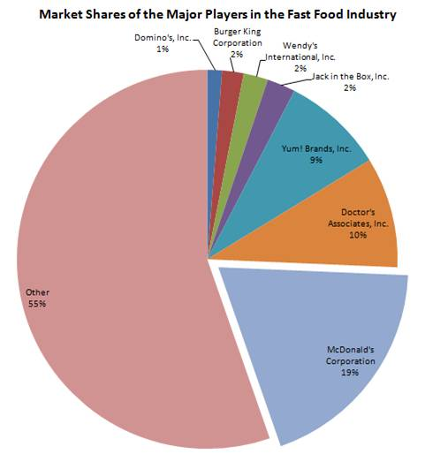
Market Size
Notes:
Of that 49%, McDonald’s holds 19% of it.

Slide 16
Porter’s 5 Forces
Threat of substitute products
Threat of entry of new competitors
Competitive rivalry
Customer bargaining power
Supplier bargaining power

Slide 17
Porter’s 5 Forces - 1. Threat of substitute products
Frozen take-home meals have become a major threat to the fast food industry. Companies are able to produce high-quality tasty frozen dinners that satisfy most consumer tastes (healthy, ethnic, or dietary.)
Notes:
The fast food industry has the advantage of being able to provide an experience with the meal. Frozen dinner companies can only provide a cardboard box.

Slide 18
Porter’s 5 Forces - 2. Threat of entry of new competitors
There are new competitors opening daily. The industry must battle one another as well as the family-owned entities. Many small businesses are able to capture small segments of the market by catering to certain tastes.
Notes:
Example – Angela’s on 26th & Boston. Small town feel, low prices, nutritious and healthy, but maintains a home-cooked taste.

Slide 19
Porter’s 5 Forces - 2. Threat of entry of new competitors (continued)
FAST FOOD CHAIN MOM & POPs
Economies of scale Cater to specific market
Automatic brand recognition Buy and support locally
Large startup capital Vested interest
Not as easy to adjust to local Limited resources
market Slow startup process
Stigmas of “fast food”
Advantages
Disadvantages

Slide 20
Porter’s 5 Forces - 3. Competitive Rivalry
Since the top 7 hold most of the market share, they are constantly trying to win over one another's customers. The average American spends $492 per year at fast food establishments.
Based on that estimate, Lubbock spends….
$98,400,000 on fast food each year.
Now the top 7 are trying new ways to be innovative and help offset the rising costs:
Value meals
Off-peak deals
Reduced pricing

Slide 21
Porter’s 5 Forces - 4. Customer Bargaining Power
Customer do not have bargaining power once they are in the line to order. It all begins when they choose to go to a particular eating establishment. Customers as a group have a tremendous amount of bargaining power. Subway has recognized this and has introduced 2 new ideas in their mix.
5 sandwiches with 5grams of fat or less
Adding these sandwiches to the $5 footlong menu
After the documentary “Super Size Me” came out, the bargaining power shifted to the customers. They demanded healthier selections and McDonald’s had no choice but to conform to the customers’ demands.

Slide 22
Porter’s 5 Forces - 5. Supplier Bargaining Power
The supplier side of the industry is divided into two groups:
Commodities
Beverages
The commodities side has very little bargaining power since most of the prices are determined by the market. The only aspect in which commodity suppliers have bargaining power is transportation costs. This is something that they can manipulate to win new customers or satisfy existing ones.
The beverage market has two basic competitors: Pepsi and Coca-Cola. The fast food industry has formed alliances with these to ensure the best price. This is one area in which the supplier has the most power.

Slide 23
SWOT Analysis
Strengths
Weaknesses
Opportunities
Threats
Global Brand
Diversified Geographic Presence
Strong Supply Chain Capabilities
Large Scale of Operation
Fluctuating Operating and Net Profits
Growth of Franchisee Operated Restaurants
New Products
Beverage Market
Change in Commodity Prices
Food Safety and Food Borne Illness Concerns
Fresh Threat of Bird Flu

Slide 24
McDonald’s Strengths: Global Brand
McDonald’s has a well established brand that appeals to customers of all age groups and nationalities
McDonald’s strong brand helps to draw customers to the restaurants and provides it acceptability in new markets

Slide 25
McDonald’s Strengths: Diversified Geographic Presence
In 2007, the company operated 31,370 fast food restaurants in over 180 countries
United States
Europe
Asia
Middle East and Africa
Latin America
Canada

Slide 26
McDonald’s Strengths: Strong Supply Chain
The company and its partners purchase food and related items from an approved group of suppliers
McDonald’s has specified quality standards to be met by all of its suppliers

Slide 27
McDonald’s Strengths: Large Scale of Operation
McDonald’s had a revenue in excess of $22.7 billion in 2007
The company is the world’s largest food service retailing chain
McDonald’s has bigger scale, in terms of revenues, to compete with other players in the market

Slide 28
McDonald’s Weaknesses: Fluctuating Operating and Net Profits
The company’s operating and net profit has registered decline in every alternate year
Fluctuating operating profits and declining net profits would negatively impact the investor confidence

Slide 29
McDonald’s Opportunities: Growth of Franchisee Operated Restaurants
McDonald’s is planning to significantly increase its count of franchisee operated restaurants
The transition of company-operated restaurants to franchisee and developmental license structure is likely to increase the overall profitability of McDonald’s

Slide 30
McDonald’s Opportunities: New Products
McDonald’s launched many new products in 2008:
Southwest salad
Cinnamon melts
McSkillet Burrito
In 2009, the company’s key areas of focus will be breakfast, chicken, beverages and convenience

Slide 31
McDonald’s Opportunities: Beverages Market
The global hot drinks market was valued at $63.4 billion in 2007
In 2011, the market is forecast to have a value of $71.4 billion
The expected growth in the beverages category will offer the company opportunities for expanding its revenue base

Slide 32
McDonald’s Threats: Changes in Commodity Prices
McDonald’s may get affected by the price fluctuations in beef, chicken and cheese
Also, the company remains susceptible to increases in food costs as a result of our current economic conditions
Any increase in these commodity prices will have an impact on the operating costs of the company

Slide 33
McDonald’s Threats: Food Safety and Food-Borne Illness
The company must ensure that food and quality are of the highest standards
The occurrence of food-borne illnesses or food safety issues could adversely affect the price and availability of affected ingredients

Slide 34
McDonald’s Threats: Fresh Threat of Bird Flu
The threat of bird flu is once again on the rise throughout the world
The outbreak of diseases such as bird flu and mad cow disease exerts a downward pressure on the consumption of poultry and meat products all over the world

Slide 35
Industry Forces
In the United States alone, about one-quarter of the adult population visits a fast food restaurant daily
In a short time period, the fast food industry has transformed the American diet as well as our landscape, economy, workforce, and popular culture.

Slide 36
Industry Forces
The fast food industry has grown at an extraordinary rate which has been driven by fundamental changes in American society.
Americans spent about $6 billion on fast food in 1970 while spending more than $110 billion in 2000.
In 1975, less than one-third of American mothers with young children had jobs outside the house. Today, that number had increased to almost two-thirds.

Slide 37
Competitive Position
As the growth of McDonald's, Burger King and other large fast food chains continues to be generally positive, the performance for most casual chains is weak
McDonald's and Burger King each achieved "meaningful" same-store sales increases last year, reflecting their leveraging of breakfast, snack and late-night opportunities according to the S&P analysts.

Slide 38
Competitive Position
The report also stated that casual- and family-dining chains saw same-store sales that generally ranged from mid-single-digit declines to modest increases, with performance worsening as the year progressed.
This lack of progress is a direct effect from the weakening global economy.
Most that saw gains did so as a result of price increases that offset traffic declines

Slide 39
Competitive Position
McDonalds posted a 7.1 percent worldwide increase for the month of January of this year
KFC it creating up to 9,000 jobs in Great Britian

Slide 40
Competitive Position
The most recent data shows that Taco Bell is close to the bottom after an 11 percent same-store sales decline.
Most of the blame for Taco Bell’s most recent downfall can be placed on their own shoulders following a recent e-coli outbreak and a widely publicized rodent infestation at a New York restaurant.

Slide 41
Competitive Moves
The next competitive moves that will be made in the fast food industry will be:
the growth of the value menu
the expansion into developing countries

Slide 42
Competitive Moves- Value Menu
Wendy’s for years has been the home of the value menu. Their value menu started in 1989 and years later McDonald’s would create their dollar menu in 2002.
With the recent economic crisis, many people have turned to the value menu to help keep money in their pockets
The value menu is going to become the next move made by many companies in the fast food industry
Sonic has already implemented their own version of a dollar menu which offers their smallest items for only a buck.

Slide 43
Competitive Moves- Expansion
The major fast food companies such as Burger King, McDonalds and KFC and been entering markets around the world for many years
As developing countries continue to grow, it is believed that fast food companies will grow right with them
The latest reports show that the economic development has fueled urban growth while it is also driving per capita incomes higher in these countries
As a result, the proportion of people living in extreme poverty and hunger is slowly shrinking.

Slide 44
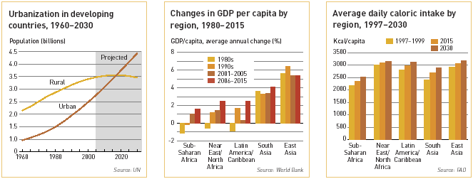
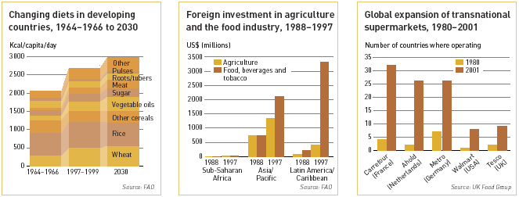
Competitive Moves- Expansion
The latest projections by the World Bank show income per person in the developing countries growing at an annual rate of 3.4 percent for the period 2006-2015, twice the 1.7 percent registered during the 1990s.

Slide 45
Strategic Groups
Fast food industry started when McDonald’s opened in 1955.
Includes McDonald’s, Wendy’s/Arby’s, Burger King, Jack in the Box, and Hardee’s.
Restaurants in many geographical locations across the world.
Offer low quality food at a low price, in a short amount of time.

Slide 46
Strategic Moves
Fast food restaurants initially began acquiring other fast food restaurants.
McDonald’s acquired Boston Market, Chipotle Mexican Grill, and Donato’s Pizza.
Wendy’s acquired Tim Horton’s and Baja Fresh.
Restaurants now are attacking industry by themselves.
Some still own other restaurants, but majority are on their own.
McDonald’s owns Pret A Manger and Piles Café
Triarc Company owns Wendy’s and Arby’s

Slide 47
Strategic Moves
Global expansion have dramatically increased.
McDonald’s operated 30,000 local stores as well as stores in over 100 countries.
Serves 52 million customers a day.
Wendy’s/Arby’s runs over 10,000 restaurants in over 20 countries worldwide.
Burger King has 11,100 stores in 71 countries.

Slide 48
Strategic Changes
The introduction of nutritious items.
Many of these restaurants offer salads, wraps, chicken sandwiches, fruit and yogurt parfait’s, and other side options.
In order to attract the parents and adults, these restaurants had to make the menu change.
Can eat a meal under 600 calories.

Slide 49
Competitive Advantages
Fast food restaurants offer meals at a cheap price in a short time span.
The cheap price allows people to eat even in bad economic times.
The invention of the dollar/value menu
The quickness allows people to eat in 30 minutes or less, which enables them to get back to work or whatever is on their schedule.

Slide 50
The Economic Crisis
McDonald’s in America is recording record numbers and sales are through the roof.
(People want to save money at the dollar menu).
In China McDonald’s is losing money, but still looking for new opportunities.

Slide 51
Employment Opportunities
McDonald’s Europe, 240 new locations, 12,000 new jobs in Poland, Italy, France, Spain and Russia.
McDonald’s China, 175 new restaurants, with 10,000 new job opportunities.

Slide 52
Preparation for competition
McDonald’s vs. Starbucks
McDonald’s improves the quality of coffee and still competes on price.
Starbucks adds food to their menu while still serving a variety of high end coffee.

Slide 53
Economy meets Obesity
Everyone wants to save a dollar.
This leads to more fast food/dollar menus.
The rate of obesity increases at an alarming rate, but the public is more concerned with saving their money.
Government wants to implement a plan of health.

Slide 54
Chef’s move to Fast Food
Chef Paul Bocuse (the pope of French cuisine) along with many others in France have made the move to the fast food industry.
Complaints of high priced food coupled with the financial crisis have lead to
“the historical turning point in cuisine”
This is good to some and bad to others, depending on the perspective.

Slide 55
Any Questions?

