Slide 1
Hayley Rush
Alex Beverly
Everett Gibson
Andrew Keeling
Charity Moore
Kolt Pederson
Emily Dale
Carli Slingerland

Slide 2
Historical Analysis

Slide 3
Acquisitions & Mergers
(‘48-’72)- 1,016 mergers amounting to $13.0 billion.
National Commission on Food Marketing Report.
Mid-1960’s- Federal Trade Commission

Slide 4
Current Market Share

Slide 5
Historical Forces of Change
Self-Service
Impulse Buying
In-store Branding
The Super-Store

Slide 6
History
Safeway began in 1915 when M.B. Scaggs purchased a grocery store from his father.
By 1926 Safeway had doubled in size.
Scaggs’ philosophy was to give his customers value and expand by keeping a narrow profit margin
Examples

Slide 7
Current
Owns 1,775 stores
Operates on the NYSE as SWY
Also owns the following stores: Von’s, Pavillions, Randall’s, Tom Thumb, Genuardi’s, Dominick’s and Carr’s
Owns 49% of the 137 Casa Ley stores
Private-label success

Slide 8
SWOT
Strengths:
Private-labels
Financial ratios: Net profit margin and days supply of receivables
Ingredients for Life
Community Caring
Environmental Campaign
Weaknesses:
One stop shopping
Downgraded stock
Consistency in stores
Opportunities:
Prepared food niche
Threat of new entrants is low
Threats:
Commodity prices have increased
Altered shopping style

Slide 9
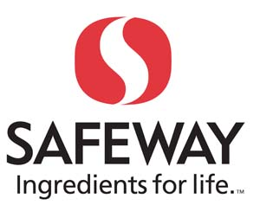
Marketing Overview
“Ingredients for Life Campaign”
Store remodeling
Increased emphasis on health & wellness
Repositioning proprietary corporate brands
Transition from private label brands to consumer brands
Brand-Enhancing marketing campaign
New emphasis on packaging design

Slide 10
Environmental Scan Social Factors
Food Trends
Eco-Friendly Foods
Local, Natural, and Fresh Foods
Food safety concerns
Rising food costs
Probiotics and prebiotics
Whole grains
Simple ingredients and clear labels
Lower salt
Artificial sweeteners
Bottled water backlash
Going environmentally Friendly
Green processing
Green distribution
Green retailing
Green consumer

Slide 11
Environmental Scan: Economic Factors
Inflation in food prices
Consumers going to cheaper versions of products as well as store brand versions
“How do you expect private-label penetration to change in 2009, in terms of dollar sales?”
Economic recession is causing consumers to change their buying habits:
Looking for more meaningful discounts
The “smart shopper” is back
Shoppers stock up on items only when on sale
Using more coupons than before
Reading more circulars to find the better deals
These changes are expected to be more permanent than temporary
26% of people have left supermarkets for smaller more discounted venues
11% have left the smaller venues to go to supermarkets
Decreased | 3.1%
Not at all | 4.1%
Up less than 2% | 29.9%
Up more than 2% | 61.9%
No answer | 1.0%

Slide 12
Government Factors
FDA regulation- the FDA regulates five areas of the food retail industry:
Management
Human Element-Staff
Human Element-Public
Operations
Facility

Slide 13
Environmental Scan: Technological Factors
Small Format Stores
RFID
ECR motors

Slide 14
Competitive Factors
Difficult to Gain Competitive Advantage
Similar products/services among competitors
Difficult to achieve Differentiation
Strategic Changes in the grocery industry
Main Competition over Price (differentiation is low)

Slide 15
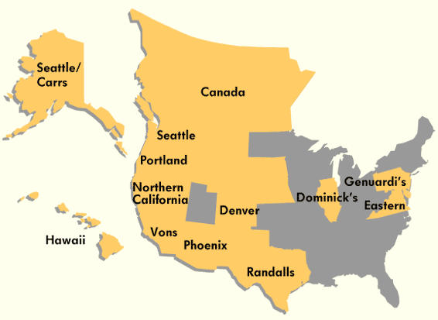
Geographic Factors
Owns close to 1,800 stores between the United States and Canada
Also owns stores in Mid-Atlantic region, and Eastern Seaboard
Corporate Headquarters is located in Pleasanton, California
1,521 in the U.S., and 222 in Canada. 80% in western provinces
Most Safeway stores: California 521, Washington 168, and Colorado 122
Sixteen Distribution Centers, thirteen of which are in the U.S. and the other three in Canada

Slide 16
Management Overview “Leadership”
CEO -Steven Burd
Leader since 1993
Helped expand the company
Level 5 Leader

Slide 17
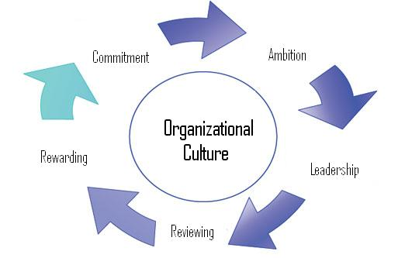
Management Overview “Cultural Elements”
Safeway culture developed over time
5 Step Process
Ambition
Leadership
Reviewing Rewarding
Commitment

Slide 18
Management Overview “Organizational Chart”
CEO
CFO
SVP – HR, Strategies, Planning, Supply
SVP- Finance
Regional Director of Retail Operations
MGT- Financial Operations
Manager of Retail Operations
Mgt of Tech Support
Retail Manager
Mgt Schematics
Mgt of Client Services
Retail Coordinator
Retail Coordinator
Vendor Program Coord
Vender Program Asst
Retail Coord
Retail Coord
Tech Analyst
Tech Analyst
Senior Analyst
Senior Analyst Store
Grocery Analyst
GM Analyst

Slide 19
Organization Life Cycle
Large
Phase 1
Initiation
(Entrepreneurial Structure)
Phase 2
Formalization
(Bureaucratic structure)
Phase 3a
Expansion
(Divisional structure)
Phase 3b
Coordination
(Production group structure)
Phase 4
Participation
(Matrix structure)
Safeway stage 3
1940’s-1980
Need to adapt and cope
Safeway Stage1
1912-1922
Safeway Stage 2
1926- 1930’s
Lack of control
Safeway
Stage 5
2000-Present
Safeway Stage 4 1990’s
Lack of autonomy
Small
Need for direction
Age of Company
Phase 1- Sam Seelig
Phase 2- Charles Merrill
Phase 3- 80’s Bust
Phase 4- Steven Burd
Phase 5- Present Day

Slide 20
Supply Chain
Farmer
Manufacturing Plant
Suppliers
Distribution / Warehouse Centers
Stores
Stores
Stores
Developed Over Time
New Technological Advances
Simple, But Efficient

Slide 21
Strategic Technological Position
Strong Position
New Technological Advances
Coding, Distribution
Efficient Supply Chain
Keep everything simple but efficient
Keeps From Complication
Runs Smoother

Slide 22
Current Events
Safeway
Corporate Social Responsibility
Kroger
Free Online Samples
Aldi
New Product Lines

Slide 23
Safeway’s Liquidity

Slide 28
Safeway’s Profitability

Slide 32
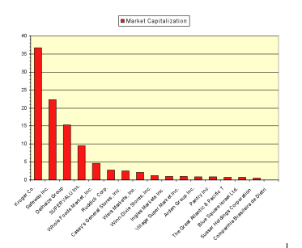
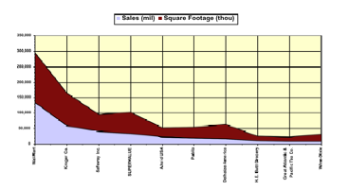
Competitive Advantage: Market Share
When compared to traditional retail stores, Safeway has a good share of the food retail industry
Safeway could set a goal to gradually close the gap between itself and Kroger Co.
Safeway makes greater use of its space than its competitors
Utilizing its capital to the fullest extent

Slide 33
Competitive Advantage: High Barriers to Entry
Consumers ate an average of 861 meals at home in 2007, from 817 meals in 2002.
Inflation in food prices
Consumers are trading down
Creates higher margins for food retailers

Slide 34
Competitive Advantage: Product Quality & Strength
Safeway’s private-label brand has a reputation for quality and freshness
The Quality Assurance Division of the company strives to uphold this reputation with its consumers.
Kroger also offers more than 14,000 private-label items
Account for 26 percent of its sales dollars.

Slide 35
Competitive Advantage: Product Life Cycle
DemandTec, Inc.’s software
Assist Safeway in understanding their product life cycle
Support sales & marketing objectives
Method of pricing & promotions
Kroger Co. has a skilled logistics technician
Day-to-day freight shipment activity
Trained to make sure that the right products are going to the right places and that they are getting there on time and in quality condition.

Slide 36
Competitive Advantage: Product Replacement Cycle
Manager is responsible for removing out-dated products
Food compost
Safeway generally keeps more products in its stores to avoid stock outs
Wal-Mart’s product replacement
Bar code information

Slide 37
Competitive Advantage: Customer Loyalty & Satisfaction
Club card – “The Smart Way to Shop”
Save money on weekly specials
Receive additional savings
Save money on Safeway gas
GroceryWorks.com
Tom Thumb
Tom Thumb card

Slide 38
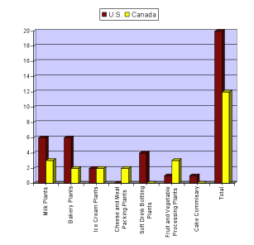
Competitive Advantage: Manufacturing Capability
Revolves around its private-label merchandise
22% of Safeway’s private-label merchandise if manufactured in company-owned plants.

Slide 39
Competitive Advantage: Supplier Strength & Material Availability
Safeway has suppliers for all different categories of perishables and non-perishables
Safeway Quality Assurance Auditor
Safeway’s Quality Assurance Supplier Expectations Manual, “A Bridge to Quality”
Safeway has more of a hold on the suppliers than its suppliers have on Safeway
Boldly pronounce the quality of its products

Slide 40
Competitive Advantage: Financial Strength
According to the numbers, Safeway seems to be financially sound in the food retail industry
Industry is extremely competitive
Safeway has worked hard for its position and will have to continue to maintain superior performance

Slide 41
Competitive Advantage: Relative Cost Position
Safeway is changing its cost position to match the current state of the economy
Consumers want to reduce their spending
Safeway is where they get more for their money

Slide 42
Competitive Advantage: Investment in R&D
Safeway created new concept stores
The Market
15,000 square feet
15% of the stock
Trademark & Patent ownership
Over 400
Kroger
Remodeling stores all over the country

