Slide 1
Blue Ocean Strategy
An Overview
Team 4
Rachel Rose
Michael Dickerson
Chris Carruthers
Yao Hai
Adam Kogler
Michael Ostrowsky
Matt Porter
Ryan Martin

Slide 2
Red Oceans
Red Oceans
Compete in existing market space
Beat the competition
Exploit existing demand
Make the value/cost trade off
Align the whole system of a company’s activities with its strategic choice of differentiation or low cost

Slide 3
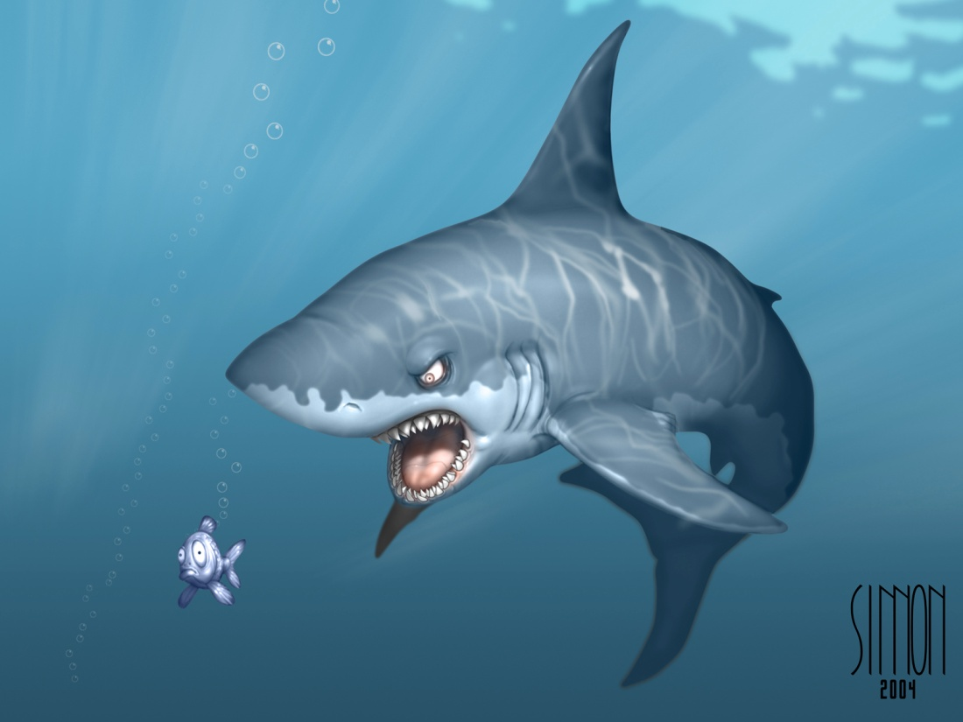
Blue Oceans
Blue Oceans
Create uncontested market space
Make the competition irrelevant
Create and capture new demand
Break the value/cost trade-off
Align the whole system of a company’s activities in pursuit of differentiation and low cost

Slide 4
FOSSIL ENGADGET
Fossil and Sony Ericsson Join together to create a blue ocean… a Bluetooth watch
a straight-up analog watch face, with a small OLED display that helps you manage the Bluetooth functions, the watch displays incoming calls and notifies you of new SMS messages.

Slide 5
Four Actions Framework
•Elimination •Reduction •Raising •Creating
Creating a new value curve for your company

Slide 6
Elimination- Eliminate Factors those competitors in your business have competed on.
Reduction- What products or services have been overdesigned, to over serve customers for little to no gain.
Raising- How to eliminate the compromises your industry forces customers to make.
Creation: Discover new sources of value to customers and to create new demand and pricing for the industry EX: In the early 90’s the “Cute” packaging for new fossil watches really helped increase the value of the watch itself and made it popular.

Slide 7
Reconstruct Market Boundaries
The 6 fundamental assumptions underlying many companies’ strategies:
Define their industry similarly and try to be the best within.
Adhere to generally accepted strategic groups
Focus on the same buyer group
Define the scope of their products similarly
Accept their industry’s functional or emotional orientation.
Focus on the same point in time in strategic planning.

Slide 8
The 6 Paths Framework to Reconstruct Market Boundaries
Path 1: Look across alternative industries
Path 2: Look across strategic groups within industries
Path 3: Look across the chain of buyers
Path 4: Look across complementary products and service offerings
Path 5: Look across functional or emotional appeal to buyers
Path 6: Look across time

Slide 9
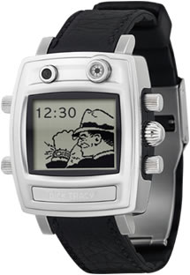
Fossil Uses the Paths to Create New Markets
Fossil teams up with MSN/Dick Tracy for Wrist Net Smart Watch
Customizable data channels and watch faces
Syncs up with your Outlook calendar
Sports, news, instant messages, and more--delivered wirelessly to your watch face
Looks across alternative industries and functional/emotional appeal

Slide 10
Visualize Strategy
1. Visual Awakening
2. Visual Exploration
3.Visual Strategy Fair
4. Visual Communication

Slide 11
3 Tiers of Non-Customers

Slide 12
3 Tiers of Non-Customers
Reach beyond existing demand and go for Non-Customers.
Fossil Inc.
1st Tier Non Customers – Consumers wearing retro-styled products, but attain them from competitors, such as Guess
2nd Tier Non Customers – Consumers that decide Fossil is too cheap or pricey (e.g. Rolex customers)
3rd Tier Non Customers – Consumers that have no need for watches

Slide 13
Sequence of Blue Ocean Strategy
How can we decide if we have a BOS idea?
1) Business Utility- Are we offering something that can provide exceptional utility to potential buyers?
2) Price- Is it priced to draw in a large share of potential buyers?
3) Cost- Can it be produced cheaply enough to make a sufficient profit given its price?
4)Adoption- Will retailers and partners be receptive to the new product offering?
If you answered YES to all of these questions, you may have found a BOS idea!

Slide 14
Sequence of Blue Ocean Strategy
Fossil followed the correct BOS sequence:
Watches with a vintage look and feel were not being produced, but vintage styling was popular.
Priced to allow a large number of consumers to afford to wear Fossil watches and accessories.
Less use of high-tech and precious metals, allows Fossil to earn a profit on reasonably priced items.
Idea was not offensive of controversial. Retailers and advertisers embrace the Fossil brand

Slide 15
Organizational Hurdles
Cognitive Hurdle:
Organization content with status quo
Resource Hurdle:
Limited resources
Motivational Hurdle:
Unmotivated Staff
Political Hurdle:
Opposition from powerful vested interests

Slide 16
Hurdles
A cognitive hurdle
Waking employees up to the need for a strategic shift. Red oceans may not be the paths to future profitable growth, but they feel comfortable to people and may have even served an organization well until now, so why rock the boat?
Limited resources
The greater the shift in strategy, the greater it is assumed are the resources needed to execute it. But many companies find resources in notoriously short supply
Motivation
How do you motivate key players to move fast and tenaciously to carry out a break from the status quo?
Politics
As one manager put it, “In our organization you get shot down before you stand up.”

Slide 17
Tipping Point
Conventional wisdom asserts that the greater the change, the greater the resources and time you will need to bring about results
By single-mindedly focusing on points of disproportionate influence, tipping point leaders can topple the four hurdles that limit execution of blue ocean strategy. They can do this fast and at low cost.
The key questions answered by tipping point leaders are as follows:
What factors or acts exercise a disproportionately positive influence on breaking the status quo?
On getting the maximum bang out of each buck of resources?
On motivating key players to aggressively move forward with change?
And on knocking down political roadblocks that often trip up even the best strategies?

Slide 18
Executing Strategy
Getting all employees to buy in to a system
Three E’s
Engagement
Involving all individuals affected by the decision
Explanation
All employees should know not just what the decision is, but how and why it was made
Expectation Clarity
The rules and penalties should be clearly stated to all of the employees

Slide 19
Executing Strategy
Fossil three focus model
Engagement
Fossil has all of management take part in the decision making process to ensure that they not only address the correct issues but that the management buys into the problems
Explanation
Management then brings the issues back to their teams with an understanding of how the decision was made and why they should concentrate on it
Expectation Clarity
Fossil employees are graded on their ability to reach certain goals throughout the current year. The goals are weighted to focus more on the three problems they wish to focus on

