Slide 1
Strategic Management in Action Ch 6 – Competitive Strategies
Brock Breedlove
Christina Higgins
Chris Nelson
Shelby Bentley
Emily Applebaum
Matt Lohr
Jimmie Minshew
Holt Martin

Slide 2
Competitive Strategies
What competitive advantage is and what it implies
Description of the different competitive strategies
How competitive strategies are implemented and evaluated

Slide 3
Competitive Advantage Defined
It is what sets an organization apart from the competition
Ex: Coke formula, Dell custom computers
Distinct capability
Unique resource

Slide 4
Understanding Competitive Environment
To understand the competitive environment, we first have to understand what competition is and then look at who our competitors are.
Competition: when organizations battle or vie for some desired object or outcome
For business organizations, that’s typically customers market share, survey ranking, or needed resources
FIN 3321 project
What competition might an organization face? We can answer this by looking at who the competitors are

Slide 5
Understanding Competitive Environment
Competitors
Chapter 3: competitors are part of the specific environment
3 approaches to defining an organization’s competition—industry, market share, strategic groups

Slide 6
Understanding Competitive Environment
3 approaches to defining an organization’s competition
Industry: identifies competitors as organizations that are making and selling the same or very similar goods or services
Ex. Supermarket industry, automobile industry
Can be described according to number of sellers and degree of differentiation, both of which affect the intensity of competition
Market: says competitors are organizations that satisfy the same customer needs.
Ex. Entertainment- video games, movie theaters, Six Flags
Intensity depends on how well customer’s needs are understood and how well different organizations are able to meet those needs

Slide 7
Understanding Competitive Environment
3. Strategic Groups: based on the idea that there are groups of firms competing within an industry that have similar strategies, resources, and customers
In a single industry, may have few or several strategic groups, depending on what is important to customers (ex. Price, quality)
Good way to define who competitors are because your most relevant competitors are those in your strategic groups
Competition intensity depends on how effectively each competitor has developed its competitive advantage and on the competitive strategies each uses

Slide 8
Understanding Competitive Environment
Some Home Depot Competitors
Lowe’s Company
Menards
CCA Global

Slide 9
Resources and Distinctive Capabilities in Gaining Competitive Advantage
What is it that makes some organizations more successful than others?
Why do some professional basketball teams consistently win championships or draw larges crowds?
Why do some colleges, universities, or majors experience continually increasing enrollments?

Slide 10
Competitive Advantage
Every organization most likely has the resources or capabilities it needs to be successful so why do some succeed over others?
All organizations in a certain industry want to be on top and strive to be better than competition. They do this based on the their competitive strategy.
As an organization refines and sharpens its competitive advantage, the basis for competitive strategy is established.

Slide 11
Competitive Strategy & Advantage
A company that displays a successful competitive strategy is Netflix.
Competitive strategy is based on competitive advantage:
Unique DVD rental and distribution service.

Slide 12
Download the Corporate Fact Sheet
Our competitive advantages position Netflix for long-term success in Internet delivery
Netflix is uniquely positioned to offer a hybrid service – Internet streaming and DVDs by mail, for one low price – giving our subscribers access to a broad content selection and offering a compelling value proposition. We have built an iconic and widely admired brand that consumers have come to associate with an outstanding home entertainment experience. We have a large and loyal subscriber base that loves us for our selection, recommendations, convenience and an excellent customer experience.
(http://www.netflix.com/?mqso=80025836)

Slide 13
Top Music and Video Stores Companies by Market Cap

Slide 14
Traditional Approaches to Defining Competitive Strategy
Miles and Snow’s Adaptive Strategies
Porter’s Generic Competitive Strategies

Slide 15
Miles and Snow
Based on the strategies organizations use to adapt to their uncertain competitive environments
Prospector
Defender
Analyzer
Reactor

Slide 16
Prospector Strategy
Continually innovates by finding and exploiting new product and market opportunities
Blue Ocean Strategy

Slide 17
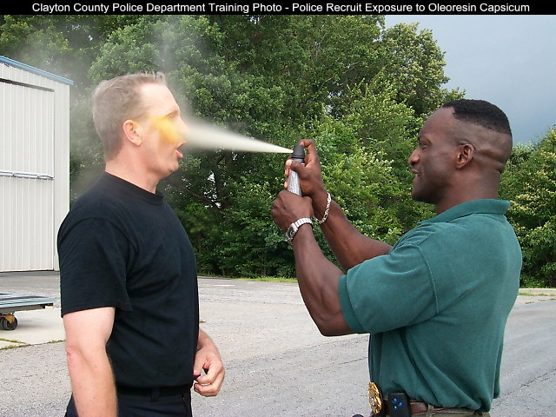
Defender Strategy
Used to protect current market share by emphasizing existing products
Red Ocean Strategy

Slide 18
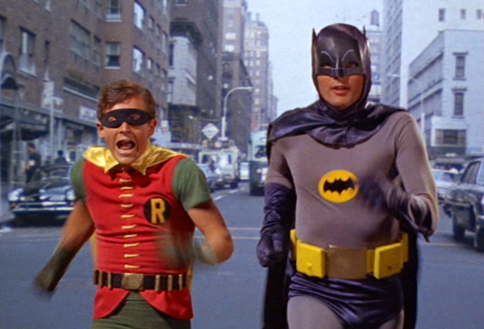
Analyzer Strategy
Watch and copy the successful ideas of prospectors
Compete by following the direction that prospectors pioneer

Slide 19
Reactor Strategy
Lack coherent strategy, simple react to changes in the environment
Lag behind competitors
Weak competitive position

Slide 20
Porter’s Generic Competitive Strategies
Cost Leadership
Differentiation
Focus

Slide 21
Cost Leadership Strategy (Low-Cost Strategy)
Tries to achieve lowest costs in its industry
Produce products for broad customer base
With lowest costs, it can charge lower prices

Slide 22
Cost Leadership Strategy How to keep costs low:
Detailed attention to efficiency at all levels
Little product line variations
Aim marketing at the “average” customer
Strict adherence to budgeting
Emphasize productivity
Lack lavish corporate headquarters
Disadvantages:
Competitors can develop ways to leverage costs better
Easy to lose sight of changing customer needs by solely focusing on low-costs

Slide 23
Home Depot as a Cost Leadership Strategist
World’s largest home improvement chain
Offer wide range of products
2nd largest retailer in the US behind Wal-Mart
In-Store Low Price Guarantee
Match any other retailers lowest price on an item in stock, and guarantee to beat it by up to 10%

Slide 24
Differentiation Strategy
Compete by providing unique products
Usually higher prices
Customers view product as different
Broad differentiator
Customers willing to pay a premium
Costs are high, but prices are too

Slide 25
Differentiation Strategy Successful differentiation:
Aim all operations at understanding a specific market
Develop diverse product lines
Establish brand loyalty
Develop skilled R&D capabilities
Disadvantages:
Without uniqueness, customers won’t pay premiums
Poor economic climate causing frugality

Slide 26
Focus Strategy
Pursue cost or differentiation advantage through consumer limitations
Close relations with a limited market
Operate on small scale = higher costs (Disadvantage.)
Separate from broad differentiator & cost leader
Focus on a narrow customer segment
3 ways to segment consumer base:
Geographical
Customer Type
Product Line

Slide 27
Cost Focuser vs. Differentiation Focuser
Lowest costs in an overall industry in specific niches
Produce custom built products
Product features, innovations, and quality are all specialized into one market segment.
“Buy High, Sell High” mentality to create culture of quality

Slide 28
Contemporary Views on Competitive Strategy
Contemporary Views: provide an expanded and more realistic description of the competitive strategies organizations are using.
Two Kinds:
Integrated Low Cost-Differentiated Strategy
Mintzberg’s Generic Competitive Strategies

Slide 29
Integrated Low Cost-Differentiation Strategy
A strategy that involves simultaneously achieving low costs and high levels of differentiation.
Porter argued that a company could not simultaneously pursue a low cost and a differentiation strategy. He believed the result of pursuing both would lead to a company not fully developing either.
However, research has showed it is possible to have a low cost and differentiation strategy (but it’s difficult)

Slide 30
Example of successful Low Cost- Differentiation Strategy: McDonalds
Succeeded in competitive market by innovating new products and keeping costs low.
$1 breakfast menu

Slide 31
How do companies compete successfully?
Technology
Widespread technology has made it easier for organizations to pursue product and service differentiation while still keeping costs low.
just in time inventory systems, flexible manufacturing systems, integrated information systems

Slide 32
Mintzberg’s Generic Competitive Strategies:
Harry Mintzberg proposed six possible competitive strategies
Research shows his ideas has merit , but will probably never replace the popularity of Porter’s competitive strategies

Slide 33
Mintzberg’s Model
By Price
By Marketing Image
Differentiation
By Product Design
By Product Quality
Undifferentiated
By Product Support

Slide 34
Differentiated:
By Price: Argued in opposition to Porter that having the lowest costs didn’t provide a competitive advantage in itself, but the advantage came from the fact that it allowed the organization to charge below-average prices.
By Marketing Image: organization attempts to create image in customers’ minds

Slide 35
Differentiated:
By Product Design: organizations use desirable product features and design configurations
By Product Quality: organizations deliver higher reliability and performance at a comparable price
By Product Support: emphasized customer support services provided by the organization

Slide 36
Undifferentiated
Organization has no basis for differentiation or follows a copycat strategy

Slide 37
How Competitive Strategy is Implemented and Evaluated
The competitive strategy can be seen by what’s actually being done or implemented.
Strategy Implementation is crucial.
If the strategy is not implemented, it is nothing more than an idea.
Once a strategy is implemented, it must be assessed and modified as need.

Slide 38
Implementing Competitive Strategy
Having effective resources, capabilities, and core competencies in place.
These include employees, facilities and equipment, work activities and work systems
Having these effectively in place is the key successful implementation
An organization’s functional strategies play a significant role in implementing competitive strategy.

Slide 39
The Role of Functional Strategies
Create and exploit a sustainable competitive advantage.
Use resources and develop capabilities that may become distinctive.
Functional Strategy plays a dual role
First, choose a competitive strategy based on a company’s resources and capabilities currently available
Second, the resources, capabilities, and competencies are how the strategy is implemented
Overall, the functional strategies being used should support whatever competitive advantage, and competitive strategy is being pursued.

Slide 40
Competitive Actions
Using certain tactics to acquire or keep whatever object or outcome they are after
Offensive Moves - An organizations attempt to exploit and strengthen its competitive position through attacks on a competitor’s position
Defensive Movies - An organizations attempt to protect its competitive advantage and turf

Slide 41
Evaluating & Changing Competitive Strategy
Monitoring & Evaluating
Results?
What Happened and Why?
Changing vs. Modifying

Slide 42
Take-Aways
Competitive Strategy, Advantage, & Environment
Different Strategies
Implementing Strategies
Evaluation of Strategy

