Slide 1
Chapter 2: Analytical Tools and Frameworks for developing a “Blue Ocean Strategy”
Team 6
Emily Applebaum
Shelby Bently
Brock Breedlove
Christina Higgins
Matt Lohr
Holt Martin
Jimmie Minchew
Chris Nelson

Slide 2
Introduction
Blue Oceans VS Red Oceans
Tools for success, or lack thereof
Applying Analytics
Analytics for a successful strategy
Wine Industry
Competitive Market
The Strategy Canvas
Analytical framework to create a Blue Ocean

Slide 3
The Strategy Canvas
Diagnostic and action framework
Captures current state of play
Captures factors they compete on

Slide 4
U.S. Wine Industry

Slide 5
No a Little More for a Little Less
Benchmarking against competitor is obsolete
War strategy – Ch. 1 Blue Ocean/ Good to Great
Will not create Blue Oceans
Customer insight

Slide 6
Shifting the Strategy Canvas
From competitors to alternatives
From customers to noncustomers
Redefine the problem
Casella Wines

Slide 7
Hybrid Cars
Idea had been around
Technology evolved
Toyota and Honda took advantage

Slide 8
Four Actions Framework
This framework lays out four simple questions for a company to use as evaluation points. In order for a company to differentiate its buyer value elements while creating a new value curve, there are four factors that can be used as a valuable tool. These factors can aid companies in competing on differentiation and low costs.

Slide 9
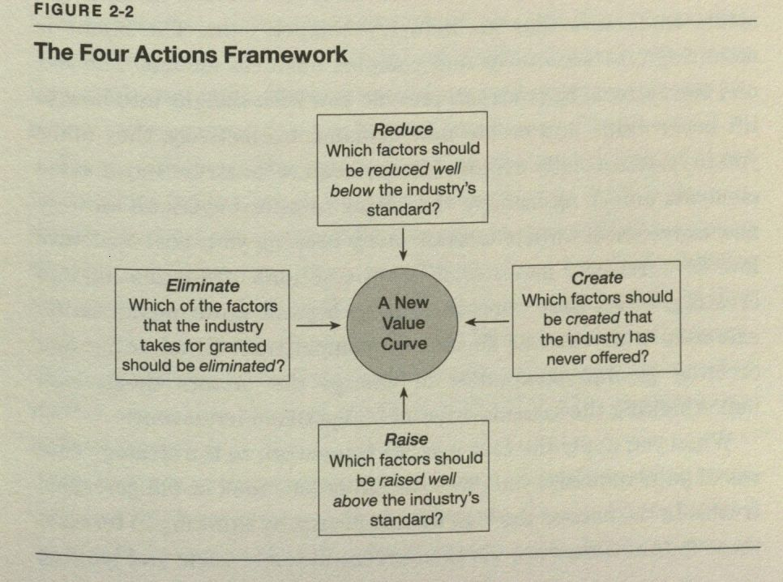

Slide 10
Four Actions Framework
Which of the factors that the industry takes for granted should be eliminated?
Can you eliminate key factors companies in your industry have always competed on but maybe aren’t even necessarily valuable to customers.
Which factors should be reduced well below the industry’s standard?
Are products OVER designed for what they should be? Are they producing high costs and no gain for the company because of this?
Which factors should be raised well above the industry’s standard?
Does your industry force customers to make compromises when buying your product?
Which factors should be created that the industry has never offered?
Discover new sources of value for buyers in order to create new demand. (Attempt to create a BLUE OCEAN)

Slide 11
Casella Wines
Here’s a company that was able to create a blue ocean in the wine industry. This company created what we know as [yellowtail] wine. Casella Wines worked off of three core competitive factors based off the four actions framework just discussed.

Slide 12
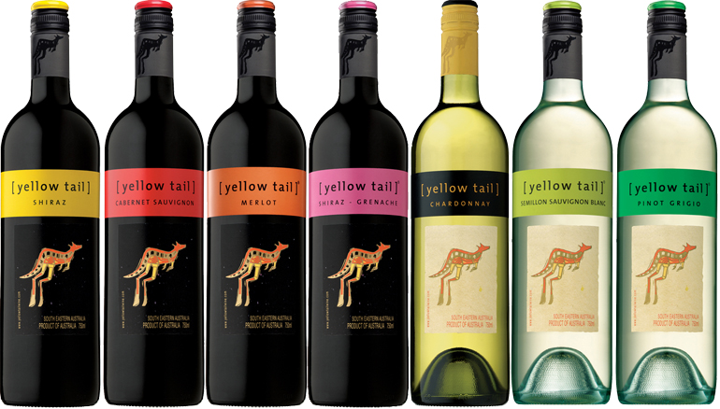
[yellowtail]
1. Easy drinking
Created a sweet, fruity wine anyone can enjoy
2. Easy select
Vibrant bottle with no sophisticated jargon
3. Fun & adventure
Australian roots give this wine the extra kick it needs to gain customers

Slide 13
[yellowtail]
In only 2 short years, Casella was able to double the price of its wine over the market price and still be the fastest growing wine company in the history of the industry. Casella did this without any mass media, advertising, or promotions. This company’s achievements are attributed to the creation of a blue ocean.

Slide 14
The Eliminate-Reduce-Raise-Create Grid
Supplements the four actions framework
Pushes companies not only to ask all four questions in the four actions framework but also to act on all four to create a new value curve
The grid works to create four immediate benefits:
simultaneously pursue differentiation and low costs to break the value-cost trade off
It immediately flags companies that are focused only on raising and creating, which can raise cost structure – common plight among companies
It is easily understood by managers at any level, creating a high level of engagement in its application
Completing the grid is challenging – it drives companies to scrutinize every factor they compete on, making them discover the range of implicit assumptions they make unconsciously in competing

Slide 15
What decisions need to be made?
Eliminate. Which of the factors that the industry takes for granted should be eliminated?
Reduce. Which factors should be reduced well below the industry's standard?
Raise. Which factors should be raised well above the industry's standard?
Create. Which factors should be created that the industry has never offered?

Slide 16
The Case of Cirque du Soleil
Eliminate Star Performers Animal Shows Aisle concession sales Multiple show arenas | Raise Unique venue
Reduce Fun and humor Thrill and danger | Create Theme Refined environment Multiple productions Artistic music and dance

Slide 17
What does the grid reveal?
Many companies discover the range of factors that an industry has long competed on, and that many of them can be eliminated and reduced
Cirque du Soleil eliminated several acts that were not cost effective
Use of animals was growing concern
Three ring venues became too expensive as more performers were needed to satisfy the audience

Slide 18
Why we drink Yellowtail today
Eliminate Enological terminology Aging qualities Above-the-line marketing | Raise Price vs. Budget wines Retail store investment
Reduce Wine complexity Wine range Vineyard prestige | Create Easy drinking Ease of selection Fun and adventure

Slide 19
Three Characteristics of a Good Strategy
Focus
Divergence
Compelling Tagline

Slide 20
Focus
What you focus on is key
Pick out the best attributes you want to focus on
Don’t Focus on things unrelated to your core competencies

Slide 21
Southwest Airline’s Focus
Friendly Service
Speed
Frequent point-to-point departures
Focusing on these aspects, Southwest permits the competition to direct its competitive path.

Slide 22
Southwest Airline’s Non-Focus
Meals
Lounges
Seating Choices
All other competitors focus on these, which makes it difficult to match Southwest’s low prices.

Slide 23
Flights from Austin to Lubbock February 20th, 2010
Southwest
Offers a non-stop 1 hour and 10 minute flight along with three other flights
More seating available on larger aircraft
Cheapest Fare-$90.00
American Eagle
No direct flights to Lubbock
All flights change planes and terminals DFW
Smaller planes create longer travel time and less seating
Cheapest Fare-$117.40

Slide 24
Divergence
When company’s strategy is to keep up with competition, it loses its uniqueness
Value curves of blue ocean strategists always stand apart
Eliminating, reducing, raising, and creating

Slide 25
Divergence
Value curve of competitors are identical; value curve of blue ocean strategists stand apart
Ex. Southwest- point to point travel between midsize cities compared to hub-and-spoke system

Slide 26
Has new and non-circus factors such as theme, multiple productions, refined watching entertainment, and artistic music and dance
Cirque de Soleil’s departure from the conventional logic of the circus– value curve stands apart

Slide 27
Compelling Tagline
A good strategy has a clear cut and compelling tagline
Tagline must not only deliver a clear message but also advertise an offering truthfully
Best way to test effectiveness and strength of strategy
Ex. Southwest, Apple

Slide 28
A Blue Ocean Strategy
Does a Business Deserve to be a Winner?
First, the company must meet the three criteria for having a Blue Ocean Strategy (focus, divergence, compelling tagline)
1) Without Focus- cost structure high and business model complex
2)Without Divergence- strategy has no reason to stand apart in marketplace
3)Without Compelling Tagline- usually has no commercial potential

Slide 29
A Company Caught in the Red Ocean
What if a company’s value curves converge with a competitor?
The company is likely caught within the red ocean of bloody competition
This signals slow growth UNLESS (because of luck) the company benefits from a growing industry and not the product itself

Slide 30
Company caught in the Red Ocean:

Slide 31
Over-delivery Without Payback
How can a company deliver high levels across all factors on a value curve?
Value Innovate
Company must decide which factors to eliminate or reduce as well as which factors to raise and create
Company must strike a balance between giving customers what they want and offering too many elements that increase cost without adding value
Ex: Southwest Airlines reducing costs by eliminating meals, and seat assignments. Still gives the customer what they want by getting them to their destination.

Slide 32
Over-delivery without payback:

Slide 33
An Incoherent Strategy
What if a company’s value curve looks like spaghetti- with curves that seem to zigzag?
This signals the company does not have a coherent strategy or cohesive vision.
Often seen in organizations with divisional or functional silos

Slide 34
An incoherent Strategy:

Slide 35
Strategic Contradictions
Areas where a company is offering a high level on one competing factor while ignoring others that support that factor.
Ex: heavily investing in a company’s website but failing to correct the slow speed of the site.
Strategic Inconsistencies can often be seen in the organization’s offering and its price
-Ex: a petroleum station offering “less is more” by having fewer services than its competitor at a higher price would signal a trend of losing market share and profits quickly.

Slide 36
An Internally Driven Company
How does the company label the industry’s competing factors?
Ex: does the company use the words thermal water temperature instead of hot water?
Thermal water temperature is industry jargon that consumers won’t understand.
This kind of language gives us an idea whether a company’s vision is built on the inside or outside.
By analyzing the language, we can understand how a company creates industry demand.

