Slide 1
Chapter 5 Good to Great The Hedgehog Concept
Yao Hai
Adam Kogler
Matt Porter
Ryan Martin
Rachel Rose
Michael Ostrowsky
Michael Dickerson
Chris Carruthers

Slide 2
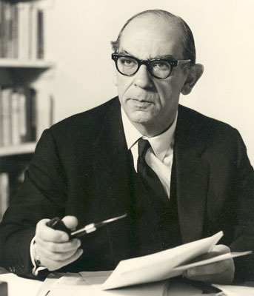
Intro to The Hedgehog Concept
“The Hedgehog and the Fox” by Isaiah Berlin

Slide 3
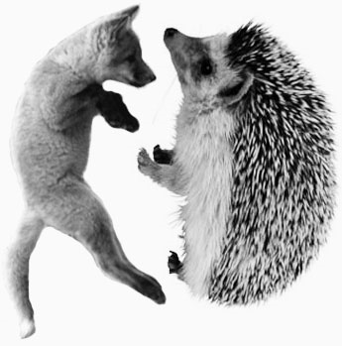
Intro to The Hedgehog Concept
Keep
It
Simple
Stupid
“The fox knows many things, but the hedgehog knows one big thing” -Archilochus

Slide 4
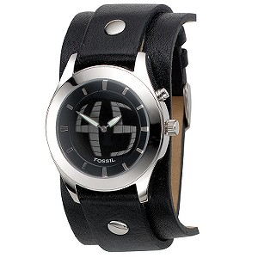
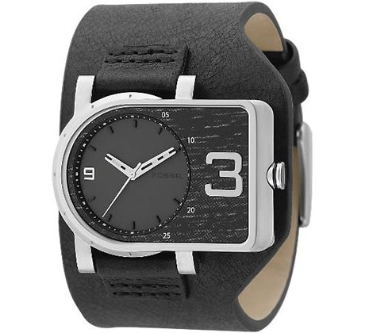
Fossil – “accessible cool”
“Founded in 1984, Fossil was the first American brand to bring value and style to the watch category transforming the concept of timekeeping from the merely functional to chic and stylish must-haves for the wrist.”
http://www.fossil.com/webapp/wcs/stores/servlet/InvestorRelationsView?storeId=12052&page=company_profile&catalogId=10052&langId=-1

Slide 5
Hedgehog V. Fox
“The fox know many things, but the hedgehog knows one big thing.”
Despite the greater cunning of the fox the hedgehog always wins.
FOX:
Pursue many ends at the same time and see the world in all its complexity
Scattered of diffused, moving on many levels

Slide 6
Hedgehog V. Fox (Con’t)
HEDGEHOGS:
Simplify a complex world into a single organized idea, a basic principal, or concept that unifies and guides everything
Reduce all challenges and dilemmas to simplistic hedgehog ideas
Understand profound insight in simplicity

Slide 7
Walgreen’s as a Hedgehog
“Look it just wasn’t that complicated! Once we understood the concept, we just moved straight ahead.” – Cork Walgreen
A very simple strategy (Convenience):
Easy entrance/ Corner lots
Drive-through Pharmacies
Close by stores
Eckerd Fails

Slide 8
Simplicity
Keep it Simple Stupid
Easy to understand and implement
Difference in good-to-great companies and others based on two key distinctions
Understanding of the three circles
Translation into a simple concept that influenced every effort made

Slide 9
Three Circles
What can you be the best in the world at?
What can you not be the best at?
Core Competence does not matter
What can provide continued cash flow?
Profit per x
What are you passionate about?
Can’t learn to be passionate about it but find something that fits your existing passion

Slide 10
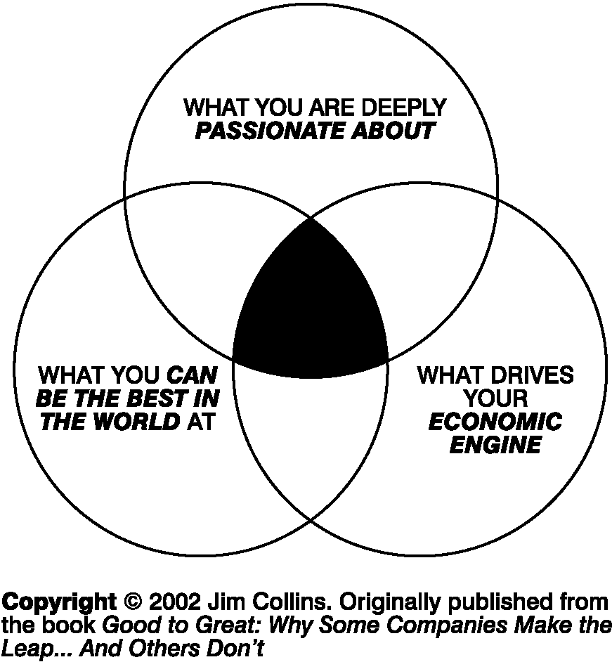
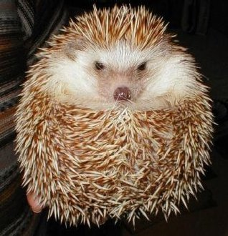
Three Circles Concept

Slide 11
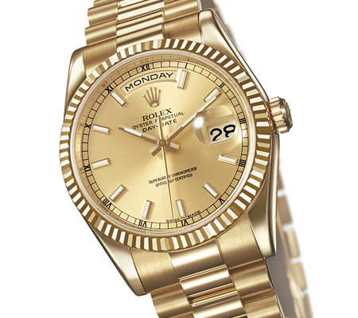
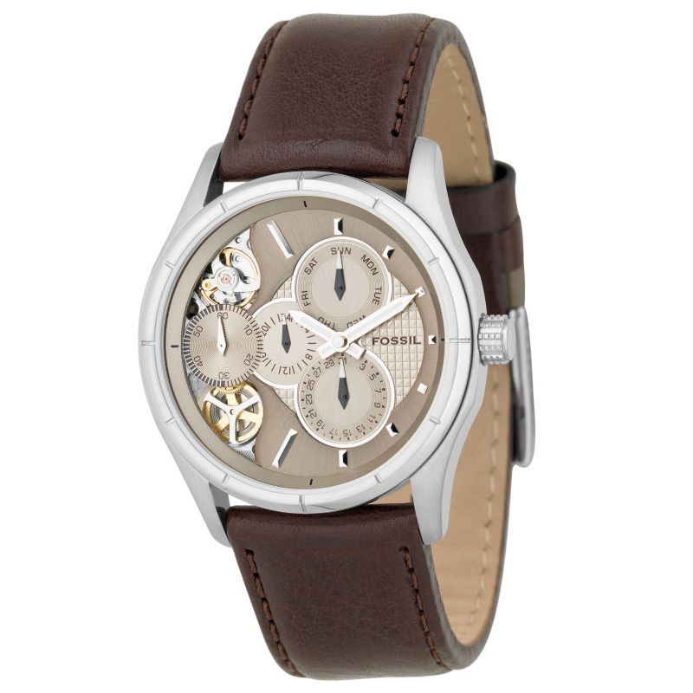
Fossil, Inc.

Slide 12
Be the Best
Focus on what you could be the best at and what you cannot be the best at
When dealing with the Hedgehog concept, it is not a goal to be the best or a plan to be the best, it is an understanding of what you can be the best at
Just because your “good” at something doesn’t mean you can be the best, and when using the hedgehog concept want to stay away from things that you can be just good at.
Be critical on what you want to be the best at.

Slide 13
Example Companies
Circuit City- could be the best and the 4 “S’s” service, selection, savings, and satisfaction
Gillette- Could become the best at building toiletries for everyone with sophisticated manufacturing technology
Wells Fargo- could become the best at running a bank like a business in the western U.S. instead of global banking

Slide 14
Insight Into Your Economic Engine -What is your denominator?
Each good-to-great company built a fabulous economic engine, regardless of how great the industry was
Ability to do this because they attained profound insights into their economic drivers and built a system in accordance with this understanding
Consider that your economics at their very best have underlying laws of physics about them

Slide 15
Find “Economic Denominator”
The key is to find which single denominator (of a ratio) will maximize your economic engine
Walgreens
Switched focus from profit per store to Profit per customer visit
Walgreens was able to increase convenience (9 stores in a mile!) and simultaneously increase profitability across its entire system
The denominator can be quite subtle, sometimes even unobvious. The key is to use the question of the denominator to gain understanding and insight into your economic model

Slide 16
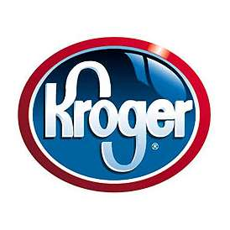
Economic Denominator
Kroger: per local population
Key Insight: Shift from profit per store to profit per local population reflected the insight that local market share drove grocery economics. If you can’t attain number one or number two in local share, you should not play
Wells Fargo: per employee
Key Insight: Shift from profit per loan to profit per employee reflected understanding of the brutal fact of deregulation: Baking is a commodity

Slide 17
Applying the Economic Denominator
All the good-to-great companies discovered a key economic denominator , while the comparison companies usually did not.
Hasbro (Comparison Company)
Became best in the world at acquiring and renewing tried-and-true toys, reintroducing and recycling them at just the right time to increase profit per classic brand (Hasbro’s economic denominator)
Formed all three circles of the Hedgehog Concept and was the best performing comparison company in the study.

Slide 18
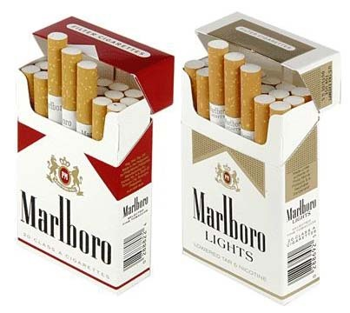
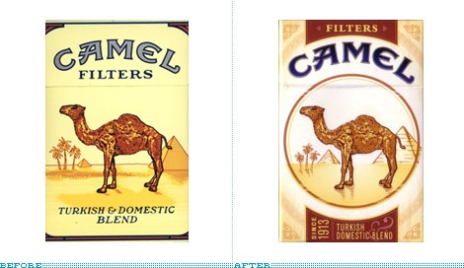
Understanding your passion
Good to great companies only did the things that they are truly passionate about Ex. Philip Morris Ross Millhiser – Vice Chairman of Philip Morris in 1979 “I love cigarettes. It’s one of the things that make life really worth living.” Ex. R.J. Reynolds Focused on acquisitions rather than passion or being the best cigarette company. Saw tobacco as just of way to make money.

Slide 19
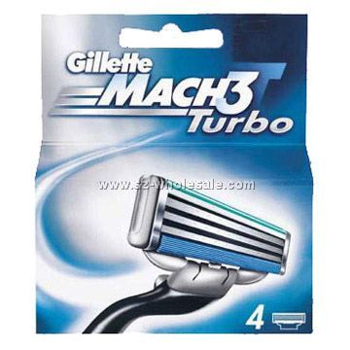
Passion (Con’t)
You can’t manufacture passion or “motivate” people to be passionate.
You can only discover what ignites your passion and the passions of those around you.
Ex. Gillette -Sophisticated, relatively expensive shaving system rather than cheap disposable razors. - “People who aren’t passionate about Gillette need not apply”
You don’t have to be passionate about the mechanics of the business per se, but the passion circle can be focused equally on what the company stands for.

Slide 20
The Triumph of Understanding Over Bravado
Pre hedgehog state:
You’re making progress on a long march, but you can’t see all that well. At each juncture in the trail, you can only see a little bit ahead and must move at a deliberate slow crawl. Then with the Hedgehog Concept, you break into a clearing.
Post hedgehog state:
Miles of trail move swiftly beneath your feet, forks in the road fly past as you quickly make decisions that you could not have seen so clearly in the fog.
For the comparison companies, why does a world so simple and clear remain to be complex and shrouded in mist? -Comparison companies never ask the right questions in the three circles - They set goals and strategies more from bravado than from understanding.

Slide 21
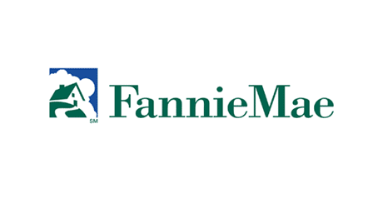
Triumph (Con’t)
Not one of the good to great companies focused obsessively on growth
Ex. Great Western -Found itself in Finance, Leasing, Insurance, Manufactured houses….. - “Wants to grow in everyway it can” Wall Street Transcript
Ex. Fannie Mae -Could be the best capital markets player in anything related to mortgages. -But framed its business model on risk management, rather than selling mortgage. -Created passion in what they were doing.
If you have the right Hedgehog Concept and make decisions relentlessly consistent with it, you will create such momentum that your main problem will not be how to grow, but how not to grow too fast.

Slide 22
The Role of The Council
Two main objectives:
Develop a Hedgehog Concept
Ask the right questions, Allow for dialogue and debate, The executive implements the decisions, Analyze the results.
Accelerate the process of realizing the Hedgehog Concept
Increase the number of times you go around that full cycle in a given period of time.

Slide 23
Getting the Hedgehog Concept: An Iterative Process
The Council
Ask Questions
Dialogue and Debate
Executive Decisions
Autopsies and Analysis
All Guided by the Three Circles

Slide 24
The Council
The Council exists as a device to gain understanding about important issues facing the organization.
The Council is assembled and used by the leading executive and usually consists of five to twelve people.
Each Council member has the ability to argue and debate in search of understanding, not from the egoistic need to win a point or protect their own interest.
Each Council member retains the respect of every other Council member, without exception.
Council members come from a range of perspectives, but each member has deep knowledge about some aspect of the organization and/or the environment in which it operates.

Slide 25
The Council (Con’t)
The Council includes key members of the management team but is not limited to members of the management team, nor is every executive automatically a member.
The Council is a standing body, not an ad hoc committee assembled for a specific project.
The Council meets periodically, as much as once a week or as infrequently as once per quarter.
The Council does not seek consensus, recognizing that consensus decisions are often at odds with intelligent decisions. The responsibility for the final decision remains with the leading executive.
The Council is an informal body, not listed on any formal organization chart or in any formal documents.
The Council can have a range of possible names, usually quite innocuous. In the Good-to-Great companies, they had benign names like Long-Range Profit Improvement Committee, Corporate Products Committee, Strategic Thinking Group, and Executive Council.

Slide 26
All Good-to-Great Companies have a Hedgehog Concept
Some found it hard to develop, but no matter how awful they were at the start of the process, they all prevailed in the search for a Hedgehog Concept.
When you figure it out it just seems right, it is not some startling revelation.
Apple
Passion- Personal Computing (let IBM, etc. deal with boring corporations and mainframes, we love ‘cool gadgets’).
Ability To Be The Best- Software and interface design (already had some of the smartest software engineers in the world).
Economic Engine- Return on R&D (profit per dollar invested in new research, become more efficient with the money spent on R&D).

Slide 27
Conclusion
Are you a hedgehog or a fox?
Foxes: Scattered and confused
Hedgehog: Simple and unified
Focus on the big picture, not the numbers

Slide 28
Three Circles
Questions to consider:
What you can be the best in the world at?
What drives your economic engine?
What you are deeply passionate about?

Slide 29
The Triumph of Understanding Over Bravado
Pre Hedgehog State: Confused and lost
Post Hedgehog State: Making decisions quickly and swiftly
Reason Companies remain in Pre Hedgehog Stage:
First, the comparison companies never asked the right questions, the questions prompted by the three circles.
Second, they set their goals and strategies more from bravado than from understanding

Slide 30
Getting The Hedgehog Concept At Iterative Process
It took about four years on average for the good to great companies to clarify their Hedgehog Concepts.
Recognize that getting a Hedgehog Concept is an inherently iterative process, not an event.
How should we go about getting our Hedgehog Concept?
Build the Council, and use that as a model.
Ask the right questions
Engage in vigorous debate
Make decisions
Autopsy the results and learn
All of this is guided within the context of the three circles.

Slide 31
Can All Companies Find a Hedgehog Concept?
Every good to great company, no matter how awful the at the start of the process, prevailed in its search for a Hedgehog Concept.
Stockdale Paradox:
There must be something we can become the best at, and we will find it!

