Slide 1



ANALYSIS CONDUCTED BY:
RACHEL ROSE
CHRIS CARRUTHERS
ADAM KOGLER
YAO HAI
MICHAEL DICKERSON
MICHAEL OSTROWSKY
MATT PORTER
RYAN MARTIN

Slide 2
History of Fossil Inc.
Delaware Corporation formed in 1991.
Went Public in 1993
They Conduct Business Both Domestically and Internationally
They have an extensive line of watches under its proprietary Fossil, Relic, MW, MW Michele, and Zodiac brands
They offer an extensive line of watches, jewelry, handbags, small leather goods, belts, sunglasses, footwear, cold weather accessories and apparel for both men and women.

Slide 3
Industry Overview
The Four Segments of the Market
  One segment or strategic group in the market consists of fine watches
    Audemars Piguet, Cartier, Omega, Patek Philippe, Piaget and Rolex.
    Watches offered in this segment are usually made of precious metals or stainless steel and may be set with precious gems.
    prices ranging from $1,500 to in excess of $20,000.
  The second segment of the market or strategic group consists of fine premium branded and designer watches produced in Switzerland and the Far East such as Gucci, Movado, Raymond Weil, Seiko, Tag Heuer and Tissot.
    These watches are sold at retail prices generally ranging from $300 to $3,000.
    Fossil’s lines that compete in this segment include BURBERRY, EMPORIO ARMANI, MARC BY MARC JACOBS, MICHELE and ZODIAC lines.
  The third segment or strategic group consists of watches sold by mass marketers, which typically consist of digital and analog watches manufactured in the Far East.
    Well known brands in this segment include Armitron, Casio and Timex.
    Retail prices in this segment range from $7 to $74.
    Fossil competes in this segment through its ALLUDE, CHRISTIAN BENET, CALLAWAY and TROPHY lines as well as through the design and production of private label watch products for Wal-Mart and Target.
  The fourth segment or strategic group consists of moderately priced watches characterized by contemporary fashion and well known fashion brand names.
    prices ranging from $45 to $495.
    Including Fossil, DKNY, DIESEL, MARC BY MARC JACOBS and MICHAEL Michael Kors

Slide 4
Industry Overview
Type of Competition within Industry
  In the top pricing point differentiation is the main form of competition. Firms within this segment position their products to be the most cutting edge and fashionable.
  As you move down to the lower pricing points, differentiation becomes less important and costs because more important.

Slide 5
Industry Overview
Competitors:
  Fossil’s watches compete against Armitron, Citizen, Gucci, Guess?, Kenneth Cole, LVMH Group, Movado, Raymond Weil, Seiko, Swatch, Swiss Army, TAG Heuer and Timex.
Barriers to Entry
  The difficulty for firms entering into the watch or jewelry market is gaining access to the supply and distribution channels and responding to customer demand.
  New businesses to the markets will find it difficult to establish a brand name and gain access to distribution channels to sell their product.

Slide 6
Industry Overview
“While we have experienced a slight recovery in our North American market during the fourth quarter of 2009, if economic conditions do not improve in certain international markets, or if the North American markets slip back into a recession, our revenues and earnings for fiscal year 2010 could be negatively impacted.” (2010 10K)

Slide 7
Industry Overview
Critical Success Factors
  Overall the keys for success in Fossil industry comes down to establishing a brand name and being the next fashion.
  It is important also to understand the pricing segments with the industries. Each pricing segment has to be marketed differently.
    Lower pricing segments more worried about functionality
    Top pricing segments more worried about emotional (new fashion trends)

Slide 8


Communication
Communication by the Audit Committee is set by the rule that they must meet no less than once per quarter as a committee and meet at least once a quarter with independent auditors and management to review the Company’s financial statements. The Audit Committee is also responsible for making sure public announcements of the Company’s receipt of an audit opinion are made promptly.

Slide 9
Communication cont.
Communication within the company is encouraged. One of main criteria for a new management hire is the ability to build relationships. Fossil promotes ethical behavior and employees are encouraged to talk about any doubts they have about particular situations. Open channels for communication are published and made available to all employees.

Slide 10
Corporate Image and social responsibility
Fossil, Inc. is a corporate sponsor of UT Dallas and also gives back to the community in a variety of fundraisers such as the Greyhound Adoption League.
“Our Company’s reputation for honesty and integrity is the sum of the personal reputations of our directors, officers and employees. To protect this reputation and to promote compliance with laws, rules and regulations, this Code of Business Conduct and Ethics has been adopted by our Board of Directors. “

Slide 11
Management flexibility
April 14, 2010, the following directors from the board of Fossil, Inc., tendered their resignations; Michael W. Barnes, Jeffrey N. Boyer, Kosta N. Kartsotis, Elysia Holt Ragusa, James E. Skinner, Michael Steinberg and James M. Zimmerman.
5th of January the founder and chairman of the Board of Directors, Mr. Tom Kartsotis, announced that he would not be seeking re-election to the Board.
This could be good or bad for the company because of the flexibility of the company

Slide 12
Strategy Canvas

Slide 13

Technical Factors
China
  Owns majority of factories
    Allows them complete control of
    all aspects of the production process
    Most materials come from third party vendors
      Include movement, leather, face, dials
      Can lead to problems due to lack of control over these aspects of the production process
  Takes a skilled laborer around ten minutes to put together a watch

Slide 14
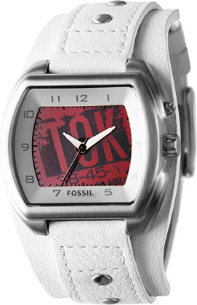
Kaleido Watch
Watches that change color
  Huge level of technology involved
  Still keep their Vintage style, using the technology to enhance their products

Slide 15
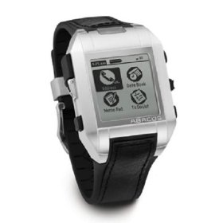

PDA Watch
Fossil had the technology to make watches but not PDAs
  Joint Venture with Microsoft to ensure they had the best technology available for each aspect of the product

Slide 16

Fossil Financial Analysis
Fossil’s financial performance has been stellar
over the last few years.
Fossil operates with a relatively conservative capital
structure, utilizing low leverage and maintaining high
levels of liquidity.
Fossil’s most pressing concern is future growth.
We recommend altering Fossil’s operational strategy
in its Direct to Consumer distribution lines, allocating
funds away from its “Cash Cow” Wholesale operation
to facilitate the expansion of its high growth
Direct-to-Consumer unit.

Slide 17
Capital Stucture
Leverage: 1.3
  Much lower than industry average of 4.7, shows that Fossil is being very conservative
Long Term Debt: $4.54 million
  Decrease from 2008 levels, very small percentage of Total Assets
Total Assets: $1.28 billion
  Up from $1.08 billion in 2008, mainly due to large increase in Cash

Slide 18
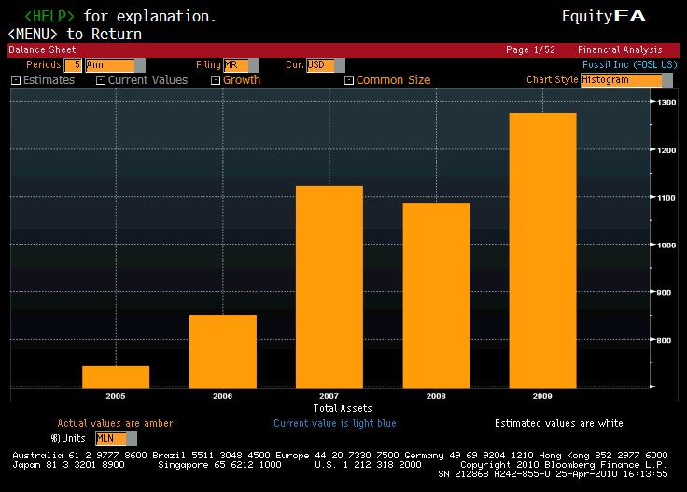

Slide 19
Liquidity
Current Ratio: 3.86
  Very high compared to industry
Short term debt: $3.62 million
  Decreased from $5.27 million in 2008, over the same period Cash increased 135%
Working Capital: $700 million
  Increase of 26% from 2008 levels, Fossil shows no need to increase Current Assets relative to Current Liabilities

Slide 20
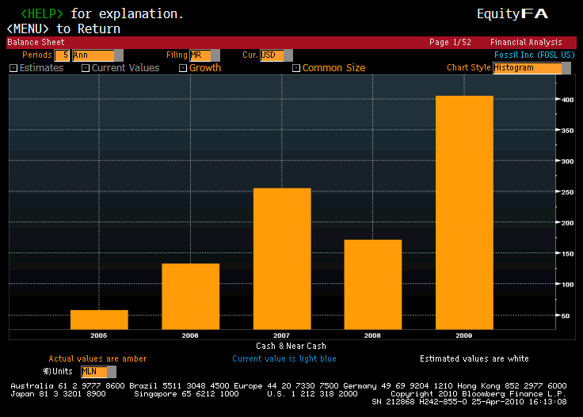

Slide 21
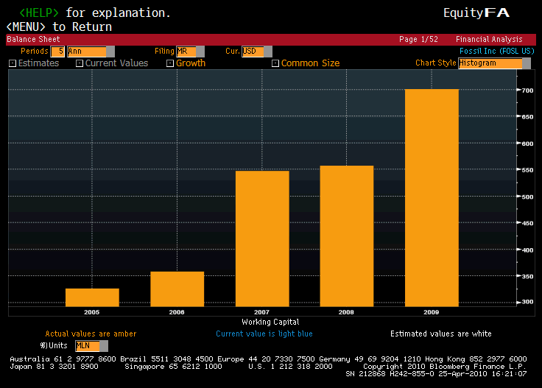

Slide 22
Performance
ROA: 11.8%
  Has decreased slightly over the last few years, but still much higher than industry average of 5.6%
ROE: 15.8%
  Lower than main competitor Guess (27%), but higher than industry average of 13.9%
Net Income: $139.19 million
  NI has increased each of the last 4 years, fueled by record high margins (9% Net)

Slide 23
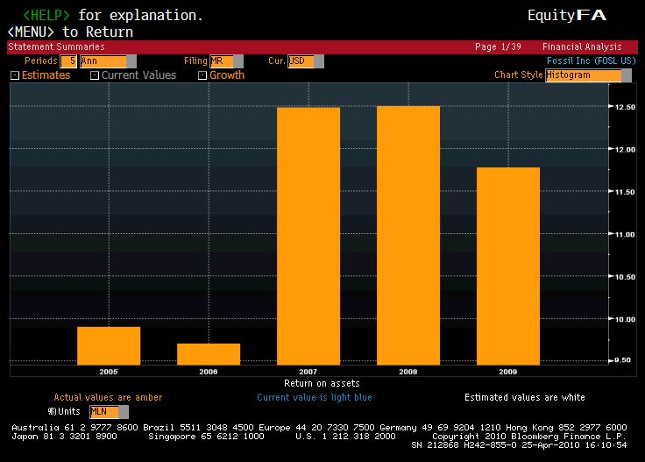

Slide 24
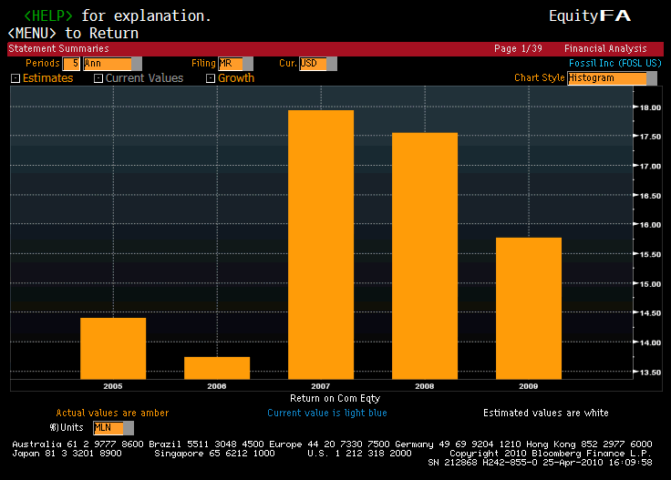

Slide 25
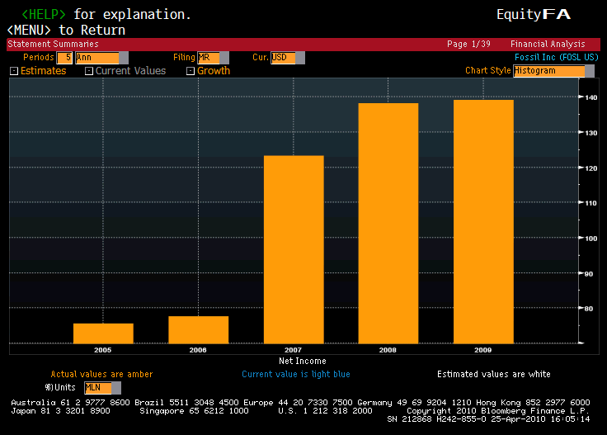

Slide 26
Cash Flow
Cash Flow from Operations: $266 million
  Up from $109 million in 2008, 5 year high
Free Cash Flow: $228 million
  Amazing 970% increase from 2008, Fossil is producing cash at an unprecedented rate.
FCF as a % of Net Income: 1.64%
  5 year high, the difference between CFO and FCF is very low due to the huge decrease in capital expenditure, this could be a concern

Slide 27
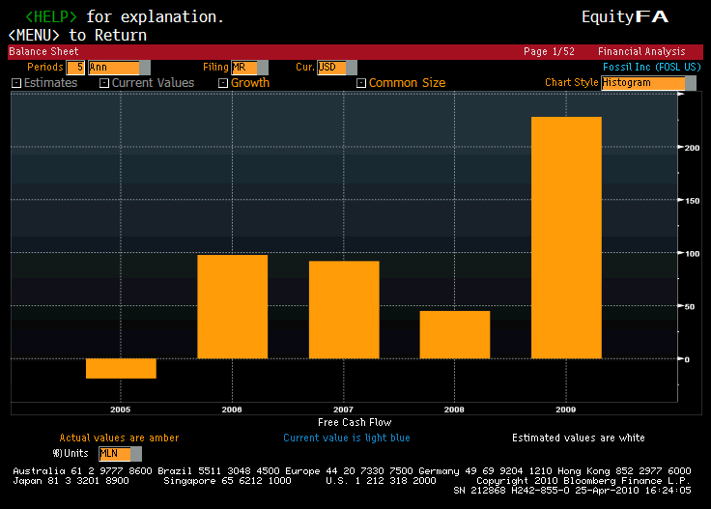

Slide 28
Growth Outlook
Revenue: $1.55 billion
  Slight decrease ( 2.2%) from 2008 levels. Still, higher margins resulted in NI growth
Capital Expenditures: $37.69 million
  Decreased from $87.6 million in 2008, CapEx as a % of Sales less than half of 2008’s rate. Could signal that management is having trouble finding new positive NPV projects
Morningstar 5yr future growth rate: 16%
  Much lower than industry rate (20.75%)

Slide 29
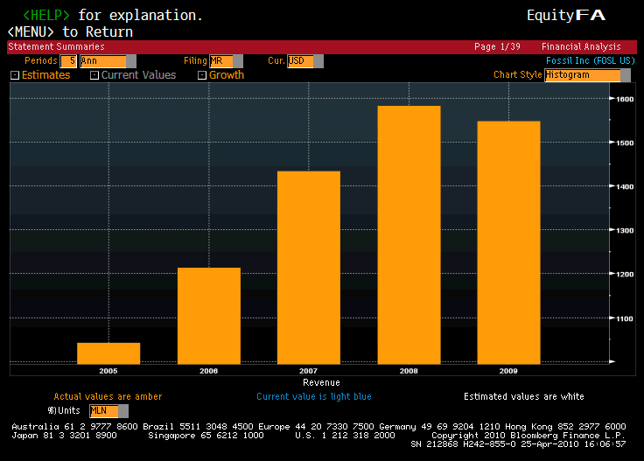

Slide 30
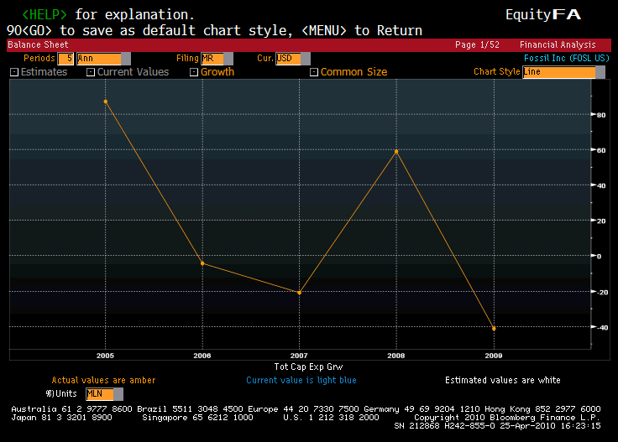

Slide 31
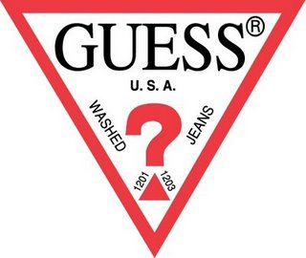


Guess
-One of Fossil’s top competitors
-Started out as a clothing store in
Los Angeles in 1981, specializing
in innovative jeans
-Known for quality, marketing
creativity, and popularizing new
trends and styles, Guess
became a billion dollar branded
empire in less than 15 years.

Slide 32
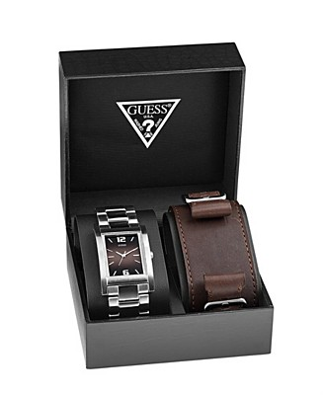

-To compete against Fossil, Guess
emphasized on what other
competitors could not offer
customers, the complete Guess
lifestyle of jeans, accessories,
and image
-Although Fossil is successful in
retailing clothing and
accessories as well, the majority
of their sales come from watches

Slide 33
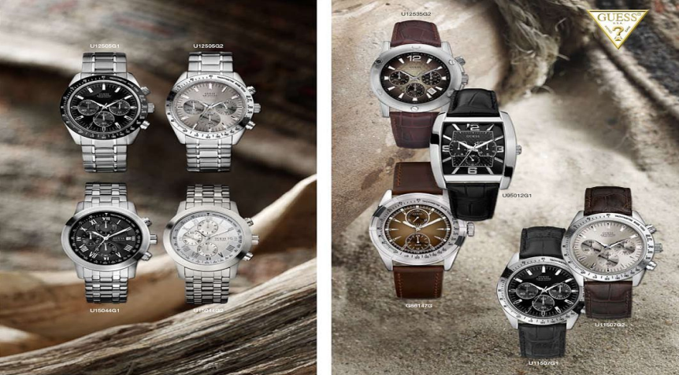
-Because of Fossil’s specialization in watches,
an exclusive licensing agreement was under
construction in 2005 between the two in
which Fossil will design, market, and
distribute watches for Guess.
-However, Guess ultimately signed the deal
with Callanen Inc. and created an ongoing
dispute and competitive tension between
Fossil and Guess

Slide 34

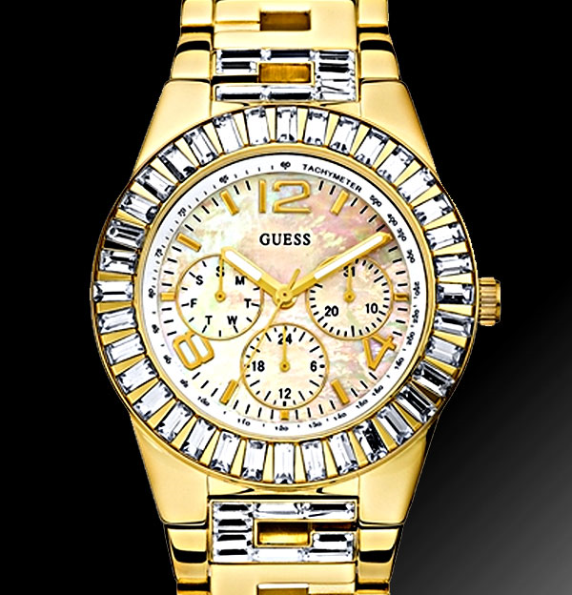
New Market Approach by Guess
-In 2007, Guess introduced a brand new collection of watches called the GC collection
-Watches were introduced with gold, silver, and diamond designs
-Priced at between $200 and $1200
-Guess entered the market of entry level high-end watches, alongside high competitions such as Tag Heuer, D&G, and Fendi

Slide 35

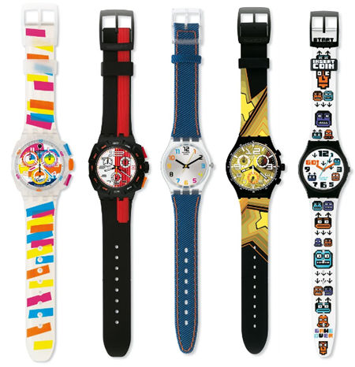

Slide 36
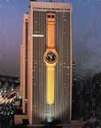
Swatch is largely credited with pioneering the “fashion watch” industry in the United States.
The first Swatch Watches were sold in 1983 in department stores in New York and Dallas
  One of these department stores was Sanger-Harris, where Kosta Kartsotis worked as a merchandising executive
  The following ad, from 1983, appeals to both functional quality and fashion

Slide 37
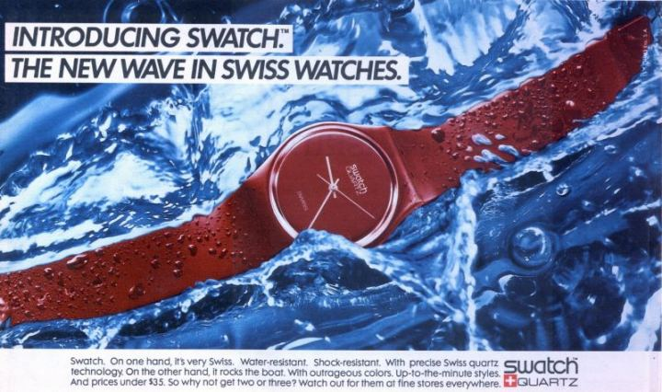

Slide 38
The Swatch Brand owes its tremendous success to two men:
Nicolas G. Hayek
  Outlined his plan to save the Swiss watch industry in the now famous “Hayek Study,” including merging two manufacturers ASUAG & SSIH into one company, SMH, and producing a low cost “second watch” the Swatch.
Max Imgruth
  The President of Swatch USA in the 1980s, Imgruth’s greatest contribution to the Swatch brand was his idea of marketing the watches as fashion items.

Slide 39
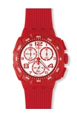
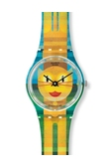

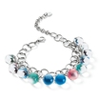


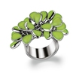
Swatch dominated the industry in the early to mid 80’s, only falling from the number one position in 1986 as Fossil and Guess competed to take the lead.
Documents from the 80s and early 90s show that Swatch had similar aspirations to Fossil (expanding into other fashion products and even classically styled watches), but today Swatch remains firmly rooted in the watch industry.

Slide 40

&
In the mid 80s through early 90s, Swatch and Fossil were direct competitors in the newly created “fashion watch” industry in the US. Both companies planned to expand their fashion line.
The plastic Swiss timepieces turned out to be a timeless fad, and the brand continues to sell Swatch Watches in the same style as the original products. Swatches in auctions have gone for over $20,000
Fossil has been successful expanding their product offering to include clothing and accessories, as well as growing their overseas operations.
Swatch, on the other hand, did not end up expanding their product line beyond watches and jewelry, but has grown to become the largest watch manufacturer in the world, making movements for many Swiss brands. The Swatch Group, managed by Hayek, has become a respected consulting group in high-tech manufacturing processes.

Slide 41

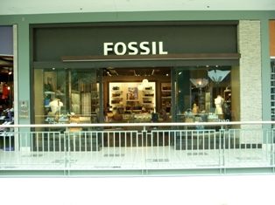
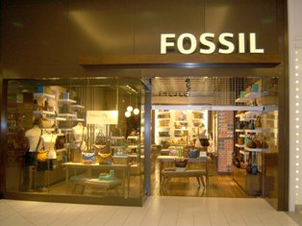
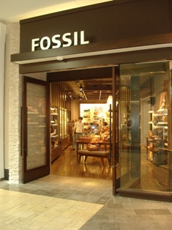
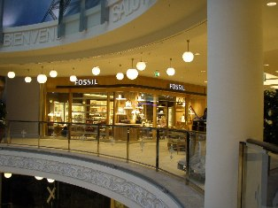
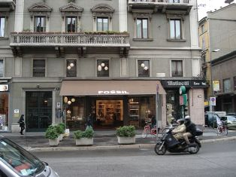
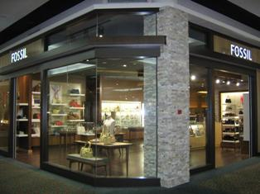
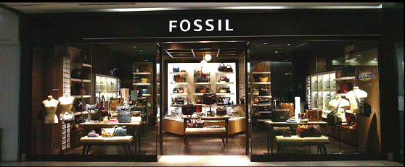
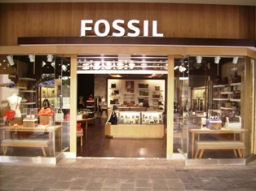
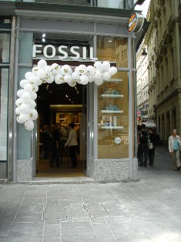
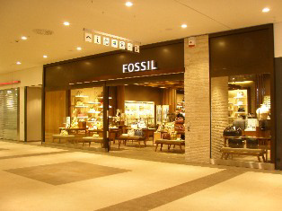


Screen saver page with store shots

