Slide 1
Amazon
John Beddingfield
Scott Bearden
Lauren Frick
Patrick Lewis
Trevor McDonald

Slide 2
E-commerce
Transaction of products and services performed over electronic systems
The Internet
The “dot-com” boom
Inception of the World Wide Web
Increase of personal computers in many American homes
Virtual marketplace was established

Slide 3
E-commerce
Rush to finance led to failures and bankruptcy
Many businesses struggled to maintain profitability
Known as the “dot.com fallout”
By 2010, B2C e-commerce primary aspect of mainstream consumerism
Brick and mortar companies’ websites
Wal-Mart, Best Buy, Target, Lowes, and JCPenney

Slide 4
Economic Factors
Cost of setting up website ~ $1 Million
Less costly than setting up a traditional business
Fluctuating business cycle
Large influx of virtual companies during “dot-com” boom
By 2000’s, many investors neglected investing in the low profit virtual businesses
By the end of the decade, online retail surged
Will most likely continue to surge for years to come

Slide 5
Political Factors
Taxation of E-commerce sales
Ongoing today
1998: just before the surge, Congress passed the Internet Tax Freedom Act
This prevented “discriminatory” taxes imposed by traditional businesses to discourage E-commerce
This battle for taxation continues today

Slide 6
Drivers for Change
Six factors that impeded electronic commerce during the 1990’s
Download delays
Interface issues
Search problems
Inadequate measures of e-commerce success
Security issues
Malware, viruses
Lack of standards
No industry standard
Made it difficult for users and developers

Slide 7
Drivers for Change
Technology has accelerated rapidly over the past two decades
Download delays
No longer an irritant
High Speed Internet
Website Interfaces
More “user friendly”
Customizable

Slide 8
Drivers for Change
Search capabilities
Users can connect to multiple databases
Better planning and evaluation of products
Better measures of success
Information systems
Better security measures in place
Defend against spyware, malware
Industry standards in place
Less confusion for the customer
More fluid experience

Slide 9
Competitive Forces
July 1995: Amazon first founded as online bookstore
June 1998: Began to sell music online
Early online competitors
Barnes and Noble
CDNOW
N2K

Slide 10
Barnes and Noble
Didn’t have as much of a head start
June 1997: tapped into online bookselling
Wanted to build easy-to-use, friendly interface
At the time, more readily able to serve customers
Amazon stocked “limited bestsellers” mostly
B&N operated as wholesaler and retailer
Able to cut out many resellers along the supply chain
Could give dedicated readers books they wanted at an affordable price
Amazon Kindle vs Barnes and Noble Nook

Slide 11
eBay
Becoming more of an online retailer, Amazon found new competition
Connects buyers and sellers in online marketplaces
Core E-commerce platform eBay.com
Vertical shopping sites
StubHub
Fashion Motors
Half.com

Slide 12
eBay
Strong position in market
High brand value
Maintains zero inventories
Costs related to inventory management are negligible
New and scarce good markets
End-of-life products
Used or vintage items
Internationally accessible in over 25 countries
Increase in customer base contributed to company’s growth
Struggled with sale of counterfeit products

Slide 13
Overstock.com
Leader in e-commerce by end of 2009
Sells brand name goods at discounts of 40-80%
9 major categories
Supplements partnerships with suppliers to attain products at low prices
Inventory reduction
Overproduction
Cancelled retail orders
Downsizing
Pass savings onto customers
Overproduced manufacturers sell to Overstock
Lower price, older models, unpopular products

Slide 14
Overstock.com
Bissell, HP, Movado, Steve Madden
Also functions as online auction site
Provides car and real estate listings
“Club O” loyal customer program

Slide 15
Wal-Mart.com
Supplements traditional shopping methods with website
Provides value-added benefits to customers by:
Items ordered at store shipped directly to customer’s home
Customer can pick up item from store
Customer can view which store carries an item
Virtually, lag behind Amazon
Pioneers the fight for taxing online retail

Slide 16
Other Competitors
GSI Commerce
Buy.com
Apple.com
Bestbuy.com
Sears.com
Costco
JCPenney

Slide 17
What’s Next?
Grant and Jordan said “many innovations may involve little or no new technology: eBooks have brought together a number of existing technologies such as e-ink, fingerprint resistant coatings and lithium polymer batteries” (261).
Amazon introduced the Kindle in 2007
Barnes and Noble introduced the Nook in 2009. -The Kindle and Nook were both eBooks that were designed for reading books, magazines, or newspapers. It was only a matter of time before other competitors starting creating their own version of an eBook.

Slide 18
What’s Next Cont.
“ Once introduced, innovation diffuses: on the demand side, through customers purchasing the good or service; on the supply side, through imitation by competitors” (Grant and Jordan 261).
In 2010 Apple introduced the iPad

Slide 19
What’s Next Cont.
Today Amazon offers the Kindle Fire tablet, Barnes and Noble offers a nook tablet, and Apple offers newer versions of the iPad
We do know customers want high quality products and services all the time
Preferably a small device that can operate the fastest, stay charged the longest, and have the most features
No one knows what the future holds, but history has proved companies will deliver products that meet customer’s demands

Slide 20
Success Factors
Thinking Innovatively
One Click Ordering
Click to Look Inside
Prime Membership Program -free two day shipping, unlimited instant streaming of thousands of movies and TV episodes with Prime Instant Video, and thousands of books to borrow for free as frequently as once a month with no due dates through the Kindle Owners’ Lending Library

Slide 21
Success Factors Cont.
Development of Commerce Strength
Marketplace: Third Party Sellers -Two million third party sellers and growing
High Inventory Turnover -Products on shelves avg. 25 days
Cash Conversion Cycle -How long cash is tied up in working capital -Measure of management capability and overall efficiency
International Growth -Ships to more than 200 countries -International sales are 45% of total sales

Slide 22
Success Factors Cont.
Productive Paranoia
“…staying highly attuned to threats and changes in their environment, even when – especially when – all’s going well. They assume conditions will turn against them, at perhaps the worst possible moment. They channel their fear and worry into action, preparing, developing contingency plans, building buffers, and maintaining large margins of safety” (Collins and Hansen)
Jeff Bezos

Slide 23
Amazon
American multinational electronic commerce company with their headquarters located in Seattle, Washington, United States
Amazon is the world’s largest online retailer
They started as an online bookstore, but soon diversified, selling dvds, cds, mp3 downloads, software, video games, electronics, apparel, furniture, food, toys, and jewelry
Amazon has a separate retail website for the U.S, Canada, United Kingdom, France, Germany, Italy, Spain, Japan, and China

Slide 24
Jeff Bezos incorporated Amazon in July 1994, and the site was officially online as amazon.com in 1995
The company was named after the Amazon River which is one of the largest rivers in the world
Amazon has over 65,000 employees as of 2012
Last year Amazon brought in 48 billion dollars in revenues and 630 million dollars in income

Slide 25
Amazon’s strategy
Amazon did not rise to power by inventing a new product or service like Google or Apple creating a new market; it came to power by systematically taking down an entire existing industry
Bezos understood before most people that the ability of the Web to connect almost anyone with any product meant that he could do things that couldn’t be done in the physical world such as sell 3 million books in a single store
The book industry for example, Amazon took on every part of the supply chain, not just retail

Slide 26
Perks and Benefits for shopping at Amazon
one-click shopping
24 hour shipping available
free shipping over $25
Purchasing off the Kindle

Slide 27
SWOT Analysis for Amazon
Strengths
Customer friendly website
Call center globally
Wide variety of products
Low prices
Weaknesses
Financial stability
Increased receivables
Decline in operational efficiently

Slide 28
SWOT Analysis continued
Opportunities
More and more customers prefer shopping online
top ten countries with highest users of internet include China, the US, India, Japan, Brazil, Germany, Russia, Indonesia, the UK and France
Between 2000 and 2012, the internet usage grew by 2,988.4% in Africa, 789.6% in Asia, 376.4% in Europe, 2,244.8% in Middle East, 152.6% in North America, 1,205.1% in Latin America and 214 % in Oceania and Australia
Threats
Factors including high energy, fuel and food costs; the weakened job market; the credit crisis; sluggish growth in the US housing market affects the disposable income for most consumers

Slide 29
Relative Cost Position
What is RCP?
A way of comparing the cost of a companies product to another company.
Ex. Ford produces a F-150 for $20,000, Chevrolet produces a 1500 at $22,000, Ford has a better RCP.

Slide 30
RCP
Comparing Wal-Mart’s RCP to Amazon’s
Wal-Mart:
Hundreds of brick and mortar stores
Large number of employees
Amazon:
No physical stores

Slide 31
RCP
Amazon has a cost advantage over Wal-Mart due to its low overhead on physical sites

Slide 32
Strategic issues and Problems
Amazon’s potential to over stretch themselves.
Multiple products and more in the pipeline

Slide 33
Competitive Advantages
Easiest way to create competitive advantage is to gain a cost advantage.
Purchases from home or mobile devices
Lack of physical overhead
Rising gas prices

Slide 34
Competitive Advantage
Competitive advantage over Netflix
Cheaper product
Instant streaming
Free two day shipping
Borrow a Kindle as long as you are paying for the product.

Slide 35
Competitive Advantage
Pre-Order Price Protection
Guarantee that you get the lowest price from time of purchase to time of release.
Automated Systems
Detect poor video quality and refund the customer.

Slide 36
What business are we in?
On-line retail
Product Range
Books
Electronics
Sporting Goods
Clothing
Product Scope

Slide 37
The Kindle
First introduced in November 2007
Six different generations of Kindle since release
Appealing to growing demand and changing dynamics of customers
Created two additional revenue streams for Amazon
Sales of actual electronic device
Sales of electronic books for reader

Slide 38
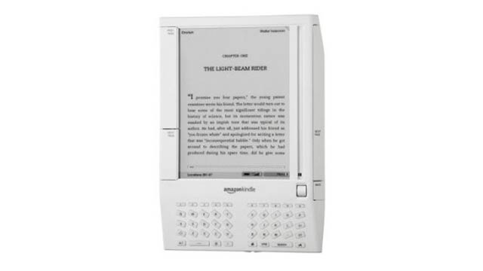
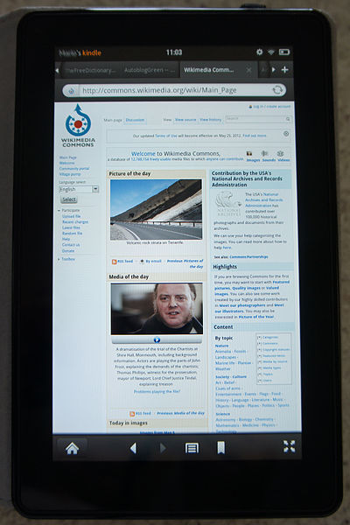

Slide 39
Competitive Advantage Gained by Kindle
Speed to market vs. Market share
Beat other companies to market and gained large share of market
Closest competitor
Nook by Barnes and Noble, released in 2009
Price comparison of books
Electronic books are much cheaper for both Amazon and customer

Slide 40
