Slide 1
Best Buy Industry and Business Analysis
Team 4

Slide 2
Industry and Competitive Situation Analysis
Why we chose Best Buy
Electronics and Appliance Stores industry, NAICS 443
Major chains use superstore format
Sell wide variety of electronic devices
Knowledgeable employees
As opposed to employees of say American Eagle

Slide 3
Direct Competitors
Amazon.com Inc.
Apple Inc.
Wal-Mart Stores Inc.
Others such as Radio Shack and Target
Circuit City-out of business in 2009

Slide 4
Change needed
Growing technology
Then and Now
Going to a store to purchase an album vs. buying online today
“Showrooming” issue-driving change

Slide 5
Best buy’s struggles vs. competitors
Best Buy only sells electronics
Competitors have many other types of products to offer

Slide 6
Opportunities best buy needs to emphasize
Online shopping
Great insurance policy that needs to be marketed/promoted more

Slide 7
Key Success Factors of the industry
Ability to give customers hands-on experience with products
Customer service

Slide 8
History
Founded in 1966
Richard Schulze
Gary Smoliak
Audio Specialty Store
Rebranded in 1983

Slide 9
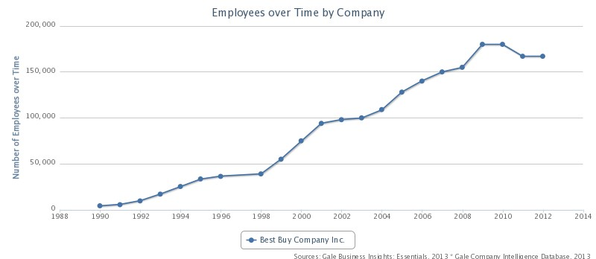
Today
More than 1500 Retail stores
Restructuring Cooperate Strategy
2012-2013 had negative 11% sales growth
Online Retailer
Above160,000 employees

Slide 10
Current position
Struggling
On the right path, but a long road ahead
Market Position
SWOT

Slide 11
SWOT
Strengths Stable Revenue Growth Strong Brand Recognition Wide Product Portfolio | Weaknesses Declining Liquidity High Dependence on Vendors
Opportunities Growing Opportunities in e-Retailing Strategic Key Initiatives Acquisition of mindSHIFT Technologies | Threats Increase in Labor Wages Counterfeit Products Fierce Competition

Slide 12
Best Buys’ Core Capabilities
Wide Range of Products
Strong Brand Recognition
Customer-centric Strategy

Slide 13
Financial Analysis (ROA)

Slide 14
Other financial anaylsis
ROE of -11.54%
Sales of $31.56 billion
Profit Margin of -0.98%
Current Ratio of 1.11

Slide 15
Working on the weaknesses
Dependence on Vendors
Innovation
Learn how to better compete with online powerhouse companies.
May need to read the book, “Blue Ocean Strategy.”

Slide 16
Competitive Advantage
Best Buy’s competitive advantage throughout the years has always been about customer service.
The implementation of the geek squad has put Best Buy at the top of electronic retail stores throughout the nation.
Were determined to fix problems in house and take responsibility of the products sold in there store.

Slide 17
Best Buy is competing with a perfect storm of disruptive technologies that have made buying, servicing, and using consumer electronics that are using old technology.
Not doing a good job with keeping up with the newest technology.

Slide 18
What Went Wrong?
Bad Management
New executives to change Best Buy’s strategy
Reluctant to change
Were not ready for competition

Slide 19
Virtual Retailers
The new wave of virtual retailers is by far the biggest reason Best Buy is in decline.
These online services the same or even better products than Best Buy at a cheaper price.

Slide 20
Advice For Best Buy
Hire motivated management with a will to change the company so it can thrive like it once did.
Establish healthy relationships with suppliers
Improve bestbuy.com

Slide 21
IDENTIFY/EVALUATE THE COMPANY’S OPTIONS
Best Buy’s ability to attain customer relationships
Employees training
Specialized in learning what the customer wants and needs
Expertise help
Inform customers more directly of what the product offers
Website re-design
Redesigning of the store layout

Slide 22
Target market
Local business owners
Small businesses
Small institutions who purchase small
No selling in bulk

Slide 23
Implementing the idea
Becoming more convenient to the consumer
More accessible products
Going business to business
Reaching out to the consumer base
Building customer relationships
Becoming more convenient then just online ordering
Ability to see the product without going to the store

Slide 24
New idea of customer service
Allows buyers to see the benefit of purchasing at Best Buy rather than ordering online
Direct communication between sales representatives and the customer
Fewer technological issues of ordering
Assuring the product is received and not lost in delivery
Delivery is from the closet Best Buy store
Instead of being shipped across country

Slide 25
Customer satisfaction
Upholding a substantial competitive advantage
Personal relationship with customer
Satisfaction will allow word of mouth to put the name of Best Buy back at a top as an electronic store
The knowledge and expertise shown of the company and its products to the customer will back the guarantee and reliability of each purchase

Slide 26
characteristics of the industry
Online convenience
Convergence
Competitive low price

Slide 27
Changes in the industry
Customer service
Shipping and easy return
No more loyalty

Slide 28
Competitive Forces
Customer database
No sales tax
Showrooming

Slide 29
Strongest & weakest competitive positions
Strongest – Amazon, Apple
Weakest – Circuit City, Radio Shack, Best Buy

Slide 30
Keys to competitive success
Perception of customer service

Slide 31
Prospects for above average profitability
Not about what you sell, but they way you sell it

Slide 32
The end!

